Slide 1
Muhammad Osama FA16-BSE-088 Rana Waqar Tufail FA16-BSE-117 Haris Mehmood FA16-BSE-154
Comfort Zone
Supervisor Name: Mr. Muzaffar Iqbal
Department of Computer Science,
COMSATS University Islamabad.

Slide 2
Topics
Introduction
Modules
Current Status
Conclusion

Slide 3
Introduction
In this digital world many affairs of airport housing society operates manually. The members of society receive their bills at their door steps manually. Many times the bill lost from their garages. This procedure of delivering bill is risky required manpower and money. Keeping in mind the current security situation the members are unable to contact the concern security officials, if they face any security hazard. The garbage spreads on the open area cause smells and pollutes the atmosphere. So there is no defining procedure of complaining the authority to dispose this garbage. The members also face the problem of how to contact and monitor the garbage truck which collects the garbage. The society faces shortage of budget for the development of new tube wells so they need fundraising from the members. The manual system of fundraising is not trustworthy. The manual tender and its auction system involve the allotment of tender to favorite contractor and it involves corruption, which should be sorted out.

Slide 4
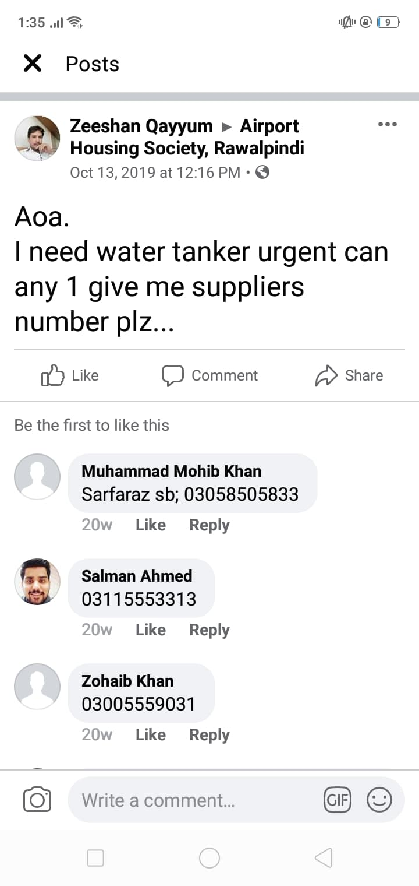
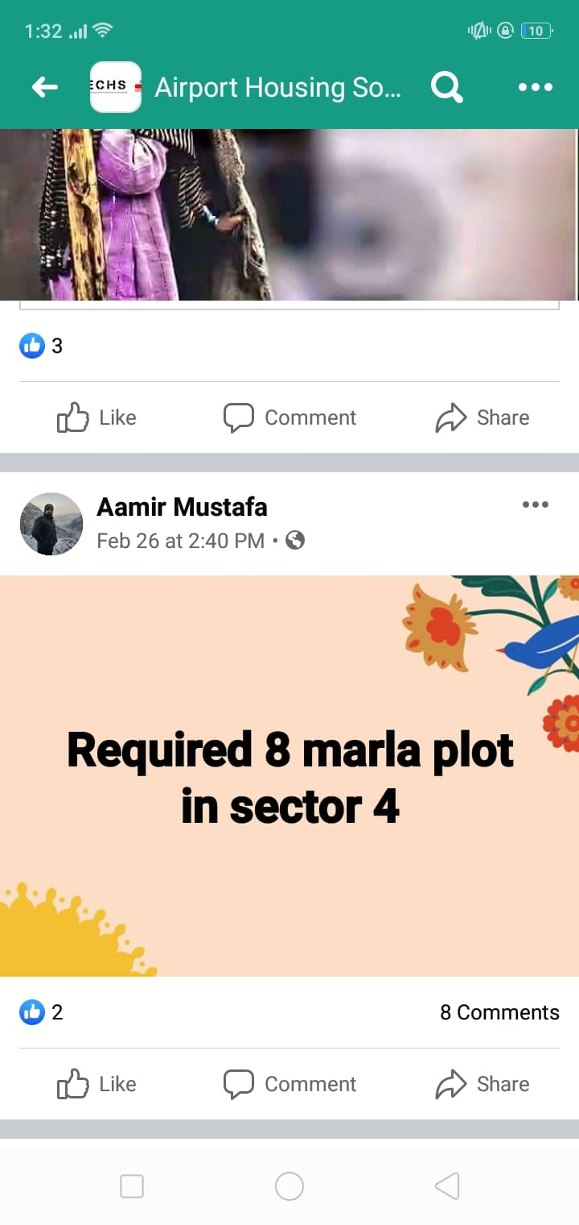
Introduction

Slide 5
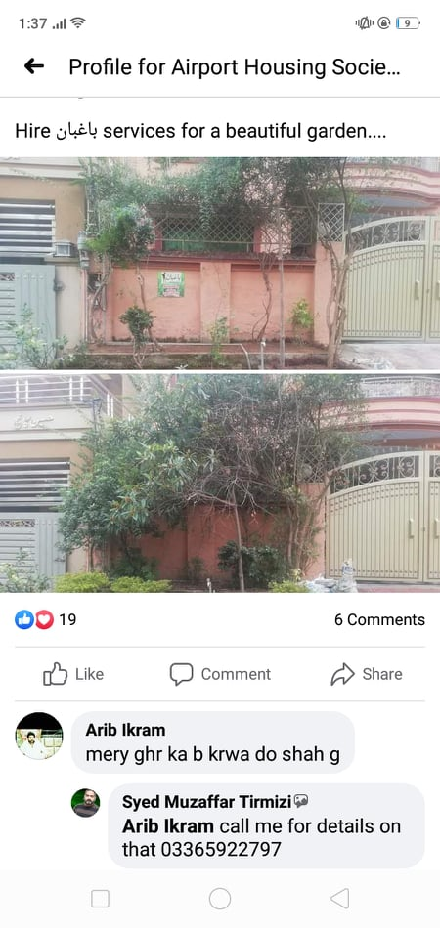
Introduction

Slide 6
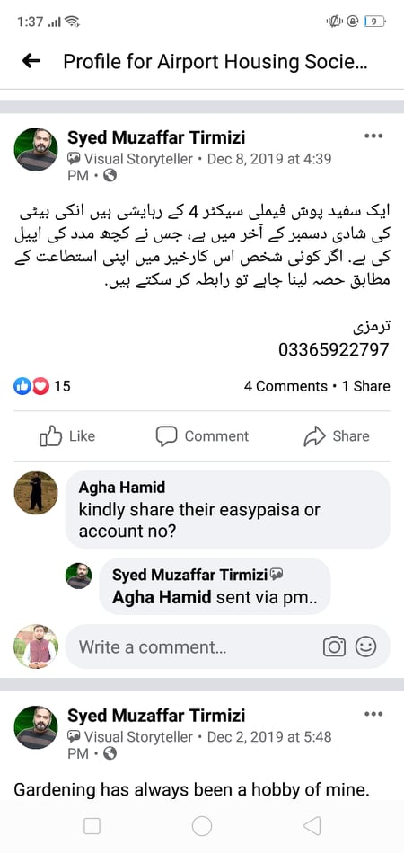
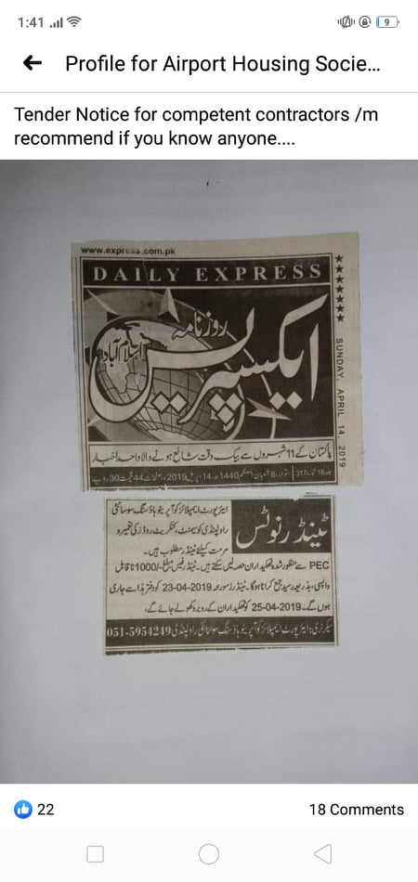
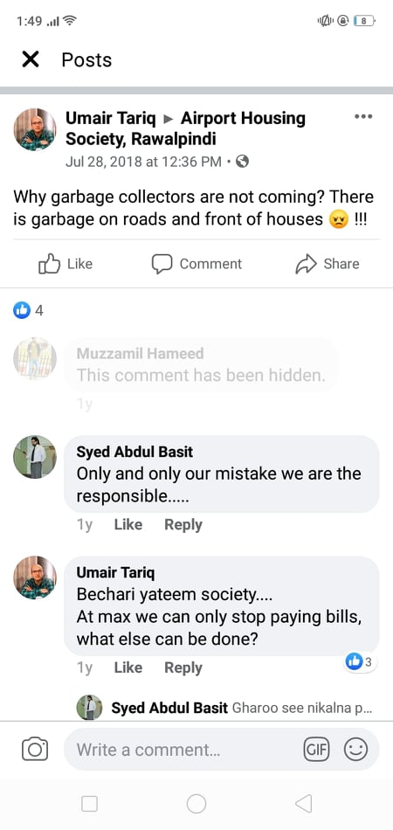
Introduction

Slide 7
Modules
Module 1: Billing
In the Billing section the admin will able to create a bill for the members by adding the fields like water, street lights, sanitary bill etc. and the members will able to get the bill and see his previous record of the bill.
Module 2:Tracking
The members will able to track the garbage track at the time of it collecting garbage from different street so the members will able to submit their house trash to the truck easily.
Module 3:Compliant
In the complaint section the members will able to upload the image of the garbage which they found on the open area or the image of the damage street light, then they send the image with the description (what is the location) or any other few lines explaining the complaint.
Module 4:Facility corner
The workers can able to create their profile by mentioning their skills like the electricians, plumbers so the members can get their services by contacting them when required.
Module 5:Advertisement corner
In this section the member can able to advertise their products which they want to sell or if they want to grow their business they will post the ad, for example if someone wants to sell his furniture he can post the ad of the furniture or if some has to open a new shop in civic center he will advertise his shop in the advertisement corner.

Slide 8
Modules
Module 6: Security
This module includes the security staff profile management, the attendance of the staff and this feature enables the members to generate security alert, when they face any security risk while their stay in the society. When the alert generated a message or phone call will ring on the nearest security staff mobile no.
Module 7: Tender and Auction
The admin can place the tender through tender management features, then the interested candidate can apply for the tender and the bidding for the tender can take place online. The buyer have specific time period to bid online after which the auction closes. Then the highest bid will awarded tender.
Module 8: Chat forum
The members will able to post the issue for the discussion. The other members in the forum will able to give feedback on the post in the form of comment.
Module 9: Fund Raising
In the fund raising, the member will able to pay online using integrated payment systems and he will be able to monitor his/her funds.

Slide 9
Current Status
We implement total 6 modules in 70 % implementation out of 9 modules most of the functionality our system was complete.
The frontend and backend was completely setup and flow of data or action perform frontend call our API’s and date update in our mongo database.
Now you will more understand to use or review our system.

Slide 10
Conclusion
After 70 % we implement last 3 modules and some of our suggestion some functionality we will add if manage our time .
After complete our system with testing then deploy our system of comfort zone hosting and domain.
If any thing in your mind pleas feel free to ask inshallah we will try our best to complete any suggestion or things to be needed.

Slide 11
References
https://jwt.io/
https://developer.mozilla.org/en-US/
https://www.npmjs.com/products
https://alligator.io/react/axios-react/
Different tutorials and communication and collaboration.

