Slide 1
FAKE NEWS DETECTION
Natural Language Processing Challenge
Classifying real vs. fake news headlines
using classical NLP and machine learning
36,429
99.6%
3
Training articles
Best model accuracy
Models compared

Slide 2
Agenda
01
Problem Statement
05
Model Training
What we set out to solve
Naive Bayes · Logistic Reg. · Random Forest
02
Exploratory Data Analysis
06
Results & Evaluation
Understanding the dataset
Accuracy, F1, confusion matrix
03
Text Preprocessing
07
Predictions
Cleaning & normalising text
Applying the model to new data
04
Feature Engineering
Embeddings + stylistic signals

Slide 3
Problem Statement
The Challenge
Our Approach
Given a dataset of news headlines, build a classifier to distinguish fake (0) from real (1) news.
🔍 EDA
Understand the data patterns
🧹 Preprocessing
Clean & normalise text
Dataset columns:
📐 Features
TF-IDF + stylistic signals
`label` — 0 (fake) or 1 (real)
`title` — headline text
🤖 Model
NB · LR · Random Forest
`text` — full article body
📊 Evaluate
Pick best on test split
`subject`— news category
`date` — publication date
📁 Predict
Label validation data

Slide 4
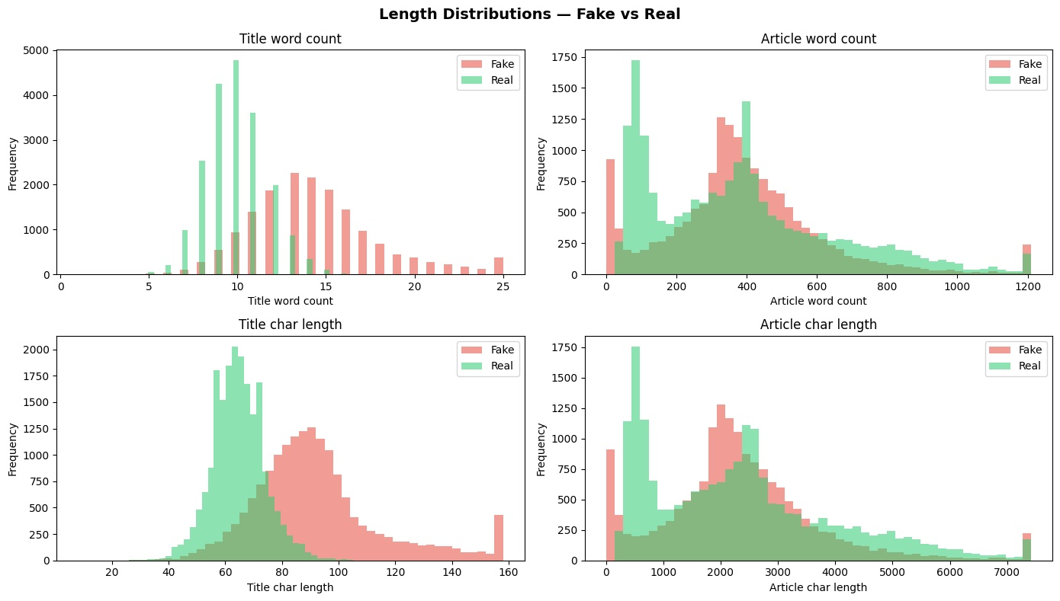
Exploratory Data Analysis: Dataset Overview
36,429
~50/50
10
0
Total articles
Class balance
(Fake vs Real)
News subjects
(categories)
Remaining
duplicates
Key EDA Findings
Dataset is balanced → no resampling needed
Fake titles are ~50% longer than real ones
Fake news uses ~200× more exclamation marks
Fake titles have ~5× higher CAPS ratio
Subjects are perfectly separated by class

Slide 5
EDA: Stylistic Signals in Fake vs Real Titles

Slide 6
Text Preprocessing Pipeline
01
02
03
04
05
Tokenisation
Lowercase +
Punctuation
Stop Word
Removal
Lemmatisation
vs Stemming
Rejoin to
Plain String
Split title into individual word tokens
using NLTK word_tokenize()
Lowercase all tokens, drop
non-alphabetic characters (.isalpha())
Remove common words with no
discriminative value (NLTK list)
Reduce to base form. Both tested
and compared in modelling stage.
Required for TF-IDF/BoW vectorizers
which expect string input
"Trump wins" → ["Trump", "wins"]
["Trump", "wins!"] → ["trump", "wins"]
["trump", "the", "wins"] → ["trump", "wins"]
"running" → "run" | "troubl" (stem)
["trump", "win"] → "trump win"

Slide 7
Pre-Training Data Preparation
Feature Engineering
Bag of Words
TF-IDF
Length & Style Signals (9 features)
Baseline
Primary Embedding
Title length (chars & words)
Top 1,000 most frequent words
Top 5,000 terms
Article length (chars & words)
Raw word counts per title
Unigrams + bigrams (1,2)
Exclamation marks in title (Fake avg: 0.21 vs Real: 0.001)
Sparse matrix representation
Log normalisation (sublinear_tf)
Question marks in title
No weighting — simple baseline
Down-weights common words
CAPS ratio in title (Fake avg: 0.18 vs Real: 0.04)
Contains quote marks
First word in ALL CAPS

Slide 8
Model Training: Three Classifiers with Six Experiments Each
Benay
Each model was evaluated on: BoW (lem) · BoW (stem) · TF-IDF (lem) · TF-IDF (stem) · TF-IDF+Numeric (lem) · TF-IDF+Numeric (stem)
Naive Bayes
Logistic
Regression
Random
Forest
MultinomialNB
max_iter=1000
n_estimators=100
Probabilistic classifier. Assumes word independence. Naturally suited to sparse text data. Fast and interpretable.
Linear model learning a weight per feature. Strong baseline for TF-IDF. StandardScaler applied to numeric features.
Ensemble of 100 decision trees. Robust to overfitting. No scaling needed. Provides feature importance scores.
Very fast to train
Interpretable weights
No scaling needed
Handles sparse matrices well
Strong with TF-IDF
Handles mixed features
No scaling needed (MinMax for numeric)
Scalable
Feature importance

Slide 9
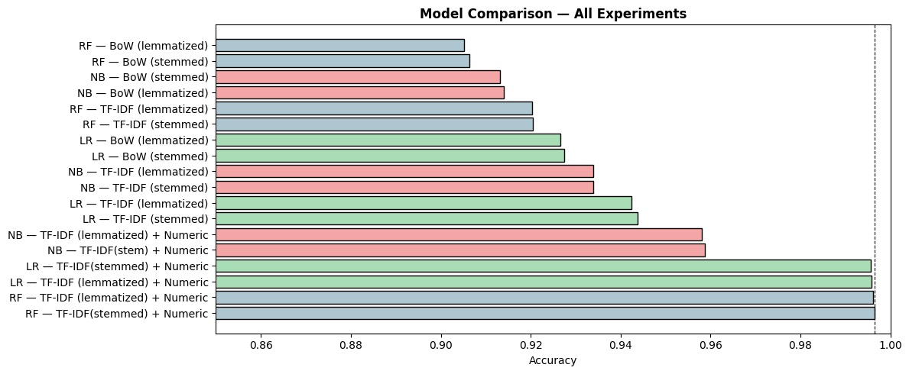
Results: Ranked by Accuracy
Selected Model

Slide 10
Confusion Matrix: Best Model: RF TF-IDF + Numeric (stemmed)
Predicted: FAKE
Predicted: REAL
Actual: FAKE
3,284
13
True Negative
False Positive
Actual: REAL
12
3,976
False Negative
True Positive
Test Accuracy: 99.64% | Only 25 misclassified out of 7,286 articles

Slide 11
Key Results: What the Numbers Tell Us
🥇
99.6%
Best Model: RF + TF-IDF + Numeric
All three models converge near 99.6% with TF-IDF + Numeric features. RF leads (99.64%), LR second (99.57%). The feature set, not the classifier, is the key.
🔤
<0.1%
Stemming ≈ Lemmatisation
Difference across all experiments. Either approach works for this task — confirming that word root normalisation method is not a critical choice here.
📈
+2%
TF-IDF > Bag of Words
Consistent improvement across all three models. Down-weighting common words gives cleaner signal for fake news detection.
⚠️
90-92%
RF Weak on Text Alone, Leads with Features
RF scores only 90-92% on sparse TF-IDF alone but jumps to 99.64% with numeric features — best overall. Tree models excel at dense numeric signals.

Slide 12
Section 5: Predicting on Validation Data
The exact same preprocessing pipeline applied to training data was applied to validation_data.csv — no re-fitting.
1
2
3
4
5
6
7
8
Tokenise +
Clean
Remove
Stop Words
Lemmatise
Rejoin
TF-IDF
Transform
Scale
Numeric
Combine
& Predict
Save
CSV
word_tokenize()
.lower() .isalpha()
NLTK stopwords
filter
WordNetLemmatizer()
.lemmatize()
' '.join(tokens)
→ string
.transform()
NOT fit_transform
minmax.transform()
NOT fit_transform
hstack()
.predict()
Replace 2 → 0/1
export predictions

Slide 13
Accuracy Estimation & Model Confidence
Why we trust this estimate:
99.6%
Proper train/test split (80/20): test data never seen during training
Vectorizers & scalers fitted on train only, transform applied to test
Balanced dataset → accuracy and F1 are equally reliable
Test Set Accuracy
25 misclassifications out of 7,286 articles
7,286 unseen articles
random_state=42 split
⚠️ Potential caveat:
The `subject` column perfectly separates classes in training data. Performance on out-of-distribution data (new topics) may be lower.

Slide 14
Thank You
99.6%
36K+
5,009
18
Test Accuracy
Articles processed
Features used
Experiments run
NLP Challenge · Fake News Classifier · 2026

Slide 15
Conclusions
✅
Stylistic features are the key signal
Adding 9 simple features about how a title is written pushed accuracy from 93.4% → 99.6%. Fake news is as much about style as vocabulary.
✅
Features matter more than classifier choice
All three models reach ~99.6% with TF-IDF + Numeric features. RF leads, LR is close behind, NB plateaus at 95.8%. Investing in features beats switching classifiers.
✅
TF-IDF consistently beats Bag of Words
The ~2% improvement across all models confirms that weighting rare but distinctive words adds real discriminative power.
✅
Lemmatisation vs Stemming is a non-issue
Less than 0.1% difference in all comparisons. Either approach is valid — focus resources on features, not normalisation method.

