Slide 1
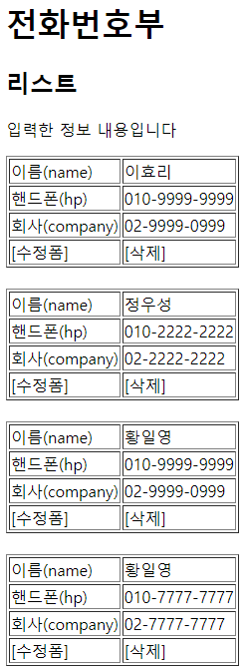
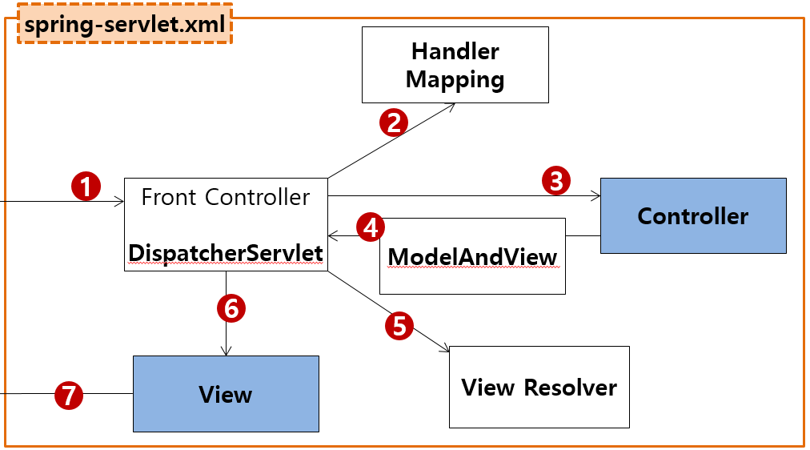
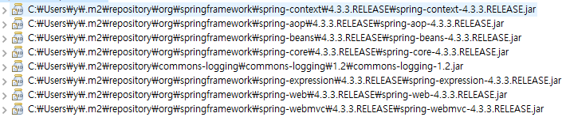
phonebook4>list
Rqeust(요청)
웹서버
Controller
Service
Dao=Repository
sqlSession.insert(“person.insert", vo);
sqlSession.update("person.update", vo);
sqlSession.delete("person.delete", no);
sqlSession.selectOne("person.getbyno", no);
sqlSession.selectList("person.getlist");
Request header
(파라미터)
Request body
web.xml
http://localhost:8088/phonebook4/list
Tomcat
applicationContext.xml
phonebook3
request
*파라미터
*어트리뷰트
"personList" personList:0x789
com.javaex.controller
@Service
@Repository
MyBatis
@Controller
/test
test()
phoneService 객체
phoneDao 객체
Response(응답)
@controller
count=1
getPersonList()
count=1
getPersonList()
count=1
SqlSession (sqlSessionTemplate)
Response header
Response body (html)
response
SqlSessionFactioryBean
Oracle
DataSource
configuration.xml
Pool
Connection
mapper.xml
Connection
mapper.xml
Connection
…
Connection
(라이브러리관리)
다운로드관리
maven
pom.xml
JDBC Driver

Slide 2
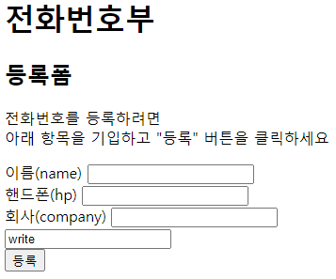
phonebook4>writeForm
Rqeust(요청)
웹서버
Controller
Service
Dao=Repository
Request header
(파라미터)
Request body
web.xml
http://localhost:8088/phonebook4/writeForm
Tomcat
applicationContext.xml
phonebook3
request
*파라미터
*어트리뷰트
"personList" personList:0x789
com.javaex.controller
@Controller
/test
test()
Response(응답)
@controller
Response header
Response body (html)
response
(라이브러리관리)
다운로드관리
maven
pom.xml

Slide 3
phonebook4>write
Rqeust(요청)
웹서버
Controller
Service
Dao=Repository
sqlSession.insert(“person.insert", vo);
sqlSession.update("person.update", vo);
sqlSession.delete("person.delete", no);
sqlSession.selectOne("person.getbyno", no);
sqlSession.selectList("person.getlist");
Request header
(파라미터)
name=황일영
hp=010-2222-2222
company=02-2222-2222
Request body
web.xml
http://localhost:8088/phonebook3/write?
name=황일영
&hp=010-2222-2222
&company=02-2222-2222
Tomcat
applicationContext.xml
phonebook3
request
*파라미터
name=황일영
&hp=010-2222-2222
&company=02-2222-2222
*어트리뷰트
com.javaex.controller
@Service
@Repository
MyBatis
@Controller
/test
test()
:0x456
pervonVo
phoneService 객체
:0x456
pervonVo
phoneDao 객체
:0x456
pervonVo
Response(응답)
@controller
count=1
PersonInsert()
count=1
PersonInsert()
count=1
SqlSession (sqlSessionTemplate)
리다이렉트
Response header
Response body (html)
response
SqlSessionFactioryBean
Oracle
http://localhost:8088/phonebook4/list
DataSource
configuration.xml
Pool
Connection
mapper.xml
Connection
mapper.xml
Connection
…
Connection
maven
pom.xml
JDBC Driver

Slide 4
phonebook4>delete
Rqeust(요청)
웹서버
Controller
Service
Dao=Repository
sqlSession.insert(“person.insert", vo);
sqlSession.update("person.update", vo);
sqlSession.delete("person.delete", no);
sqlSession.selectOne("person.getbyno", no);
sqlSession.selectList("person.getlist");
Request header
(파라미터)
no=3
Request body
web.xml
http://localhost:8088/phonebook3/delete?no=3
Tomcat
applicationContext.xml
phonebook3
request
*파라미터
no=3
*어트리뷰트
com.javaex.controller
@Service
@Repository
MyBatis
@Controller
/test
test()
phoneService 객체
phoneDao 객체
Response(응답)
@controller
no=3
PersonDelete()
no=3
PersonDelete()
no=3
SqlSession (sqlSessionTemplate)
리다이렉트
Response header
Response body (html)
response
count=1
count=1
count=1
SqlSessionFactioryBean
Oracle
http://localhost:8088/phonebook4/list
DataSource
configuration.xml
Pool
Connection
mapper.xml
Connection
mapper.xml
Connection
…
Connection
maven
pom.xml
JDBC Driver

Slide 5
phonebook4>updateForm
웹서버
Controller
Service
Dao=Repository
sqlSession.insert(“person.insert", vo);
sqlSession.update("person.update", vo);
sqlSession.delete("person.delete", no);
sqlSession.selectOne("person.getbyno", no);
sqlSession.selectList("person.getlist");
Rqeust(요청)
Request header
(파라미터)
no=3
Request body
web.xml
http://localhost:8088/phonebook3/updateForm?no=3
Tomcat
applicationContext.xml
phonebook3
request
*파라미터
no=3
*어트리뷰트
"personVo" personVo:0x222
com.javaex.controller
phoneService 객체
@Repository
MyBatis
phoneDao 객체
SqlSession (sqlSessionTemplate)
@Controller
/test
test()
no=3
getPerson(no)
no=3
getPerson(no)
no=3
Response(응답)
@controller
personVo
:0x222
personVo
:0x222
personVo
:0x222
Response header
Response body (html)
response
SqlSessionFactioryBean
Oracle
수정폼
3번 전화정보 출력
DataSource
configuration.xml
Pool
Connection
no=3
mapper.xml
Connection
mapper.xml
Connection
…
Connection
maven
pom.xml
JDBC Driver

Slide 6
phonebook4>update
웹서버
Controller
Service
Dao=Repository
sqlSession.insert(“person.insert", vo);
sqlSession.update("person.update", vo);
sqlSession.delete("person.delete", no);
sqlSession.selectOne("person.getbyno", no);
sqlSession.selectList("person.getlist");
Rqeust(요청)
Request header
(파라미터)
name=유
hp=010
company=02
personId=121
Request body
web.xml
http://localhost:8088/phonebook3/update
?name=유
&hp=010
&company=02
&personId=121
Tomcat
applicationContext.xml
수정폼
3번 전화정보 출력
phonebook3
request
*파라미터
name=유
&hp=010
&company=02
&personId=121
*어트리뷰트
"personVo" personVo:0x222
com.javaex.controller
phoneService 객체
@Repository
MyBatis
phoneDao 객체
SqlSession (sqlSessionTemplate)
@Controller
/test
test()
PersonVo
peronUpdate(vo)
PersonVo
peronUpdate(vo)
PersonVo
Response(응답)
@controller
count=1
count=1
count=1
리다이렉트
Response header
Response body (html)
response
SqlSessionFactioryBean
Oracle
http://localhost:8088/phonebook4/list
DataSource
configuration.xml
Pool
Connection
@ModelAttribue
PersonVo
mapper.xml
Connection
PersonVo
Connection
mapper.xml
Connection
maven
pom.xml
…
JDBC Driver

