Slide 1
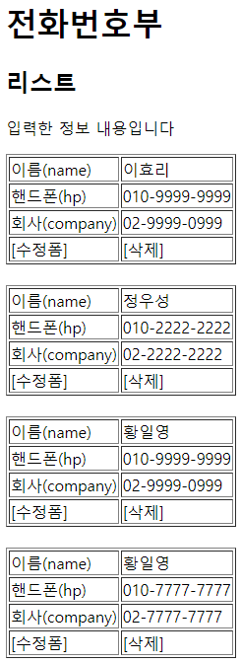
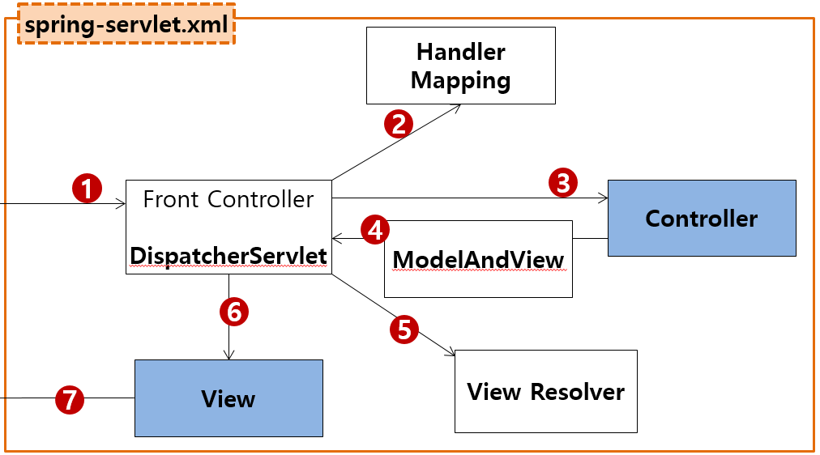
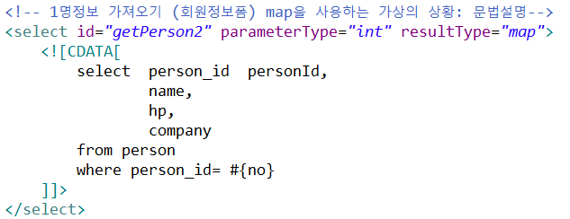
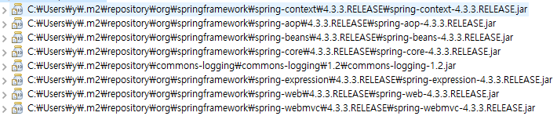

phonebook4>updateForm2
/updateForm2 get post → phoneController.updateForm2()
sqlSession.insert(“person.insert", vo);
sqlSession.update("person.update", vo);
sqlSession.delete("person.delete", no);
sqlSession.selectOne("person.getbyno", no);
sqlSession.selectList("person.getlist");
Rqeust(요청)
웹서버
Controller
Service
Dao=Repository
Request header
(파라미터)
no=3
Request body
web.xml
http://localhost:8088/phonebook3/updateForm2?no=3
Tomcat
applicationContext.xml
[수정폼2]
phonebook3
request
*파라미터
no=3
*어트리뷰트
"pMap" pMap:0x222
com.javaex.controller
phoneService 객체
@Repository
MyBatis
phoneDao 객체
SqlSession (sqlSessionTemplate)
@Controller
/test
test()
no=3
getPerson2(no)
no=3
getPerson2(no)
no=3
Response(응답)
@controller
Map<String, Object> pMap
:0x222
Map<String, Object> pMap
:0x222
Map<String, Object> pMap
:0x222
Response header
Response body (html)
response
Map을출력 해본다
SqlSessionFactioryBean
Oracle
수정폼
3번 전화정보 출력
DataSource
configuration.xml
Pool
Connection
no=3
mapper.xml
Connection
PersonVo
mapper.xml
Connection
…
Connection
maven
pom.xml
JDBC Driver
0x222
Map<String, Object>
String
Object
"PERSONID" 1
"NAME" "이효리"
"HP" "010-2222-2222"
"COMPANY" "02-2222-2222"
-----
get("NAME")

