Slide 1
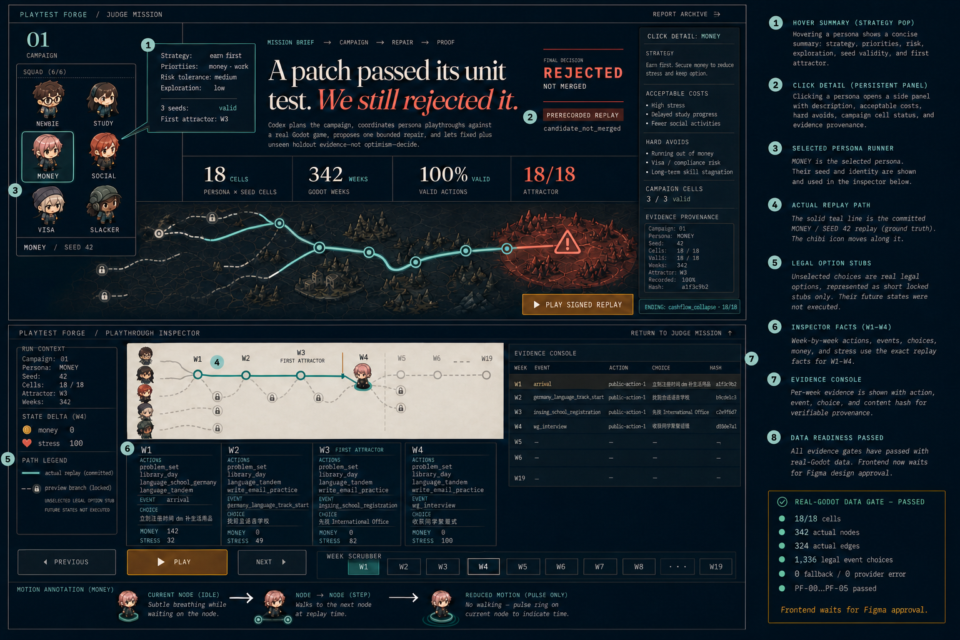
The patch passed. The evidence still said no.
Judge Mission + Playthrough Inspector — competition review board backed by one signed replay bundle.
JUDGE TAKEAWAY
Reproducible
does not mean
acceptable.
Money was configured to prioritize income and career. The observed career-tag rate was only 0.4386% — then every seed collapsed.
18 / 18
cells complete
342
week nodes
324
actual edges
1,336
evidence refs
PRERECORDED · REAL GODOT REPLAY
Truth boundary: replay proves reproducibility — not a fresh OpenAI call.
REVIEW GATE · approve the story and interaction states before frontend implementation

Slide 2
One signed replay answers six review states.
Every number, node and transition below is traceable to the committed playthrough-v1 evidence bundle.
S1
Judge default
S2
Money hover
S3
Persona detail
Campaign proof before spectacle
Strategy contract vs observed behavior
Evidence, not invented ability scores
18/18 cells · 342 weeks · 324 actual edges
1.0 valid · zero fallback · 18 target members
Decision: reproducible campaign, rejected outcome.
Goal: income + career + survival
Observed career tag: 0.4386%
First attractor: W3 / W3 / W6
All 3 seeds: cashflow_collapse.
Show contract, priorities, risk tolerance, action-tag rates, seeds and ending distribution.
Click opens a traceable detail drawer; no subjective intelligence rating.
S4
Inspector · W1
S5
Inspector · W3
S6
Inspector · W19
The route begins with a real decision
First cashflow-stress attractor
The ending is unavoidable and auditable
Arrival → ‘go buy essentials now’
Money 500→142 · Energy 100→48
Stress 20→32
Source line 1 · hash 4d66dd4714fe…
Missing school registration → International Office
Stress 49→82 · Hunger 39→73
Arrears 373→628 · shortfall 2→3
Source line 3 · hash 4041083497b4…
After-exam void → safe handling
Money 0 · Hunger 100 · Stress 96
Arrears 3,862 · shortfall 16
Ending: cashflow_collapse · e0458a9d636e…
PATH SEMANTICS
solid edge = recorded transition · avatar position = current week · amber = attractor · coral = terminal failure · logs = signed source excerpt
Controls: Previous / Next / Play · keyboard ← → Space · reduced-motion mode must preserve state clarity

Slide 3
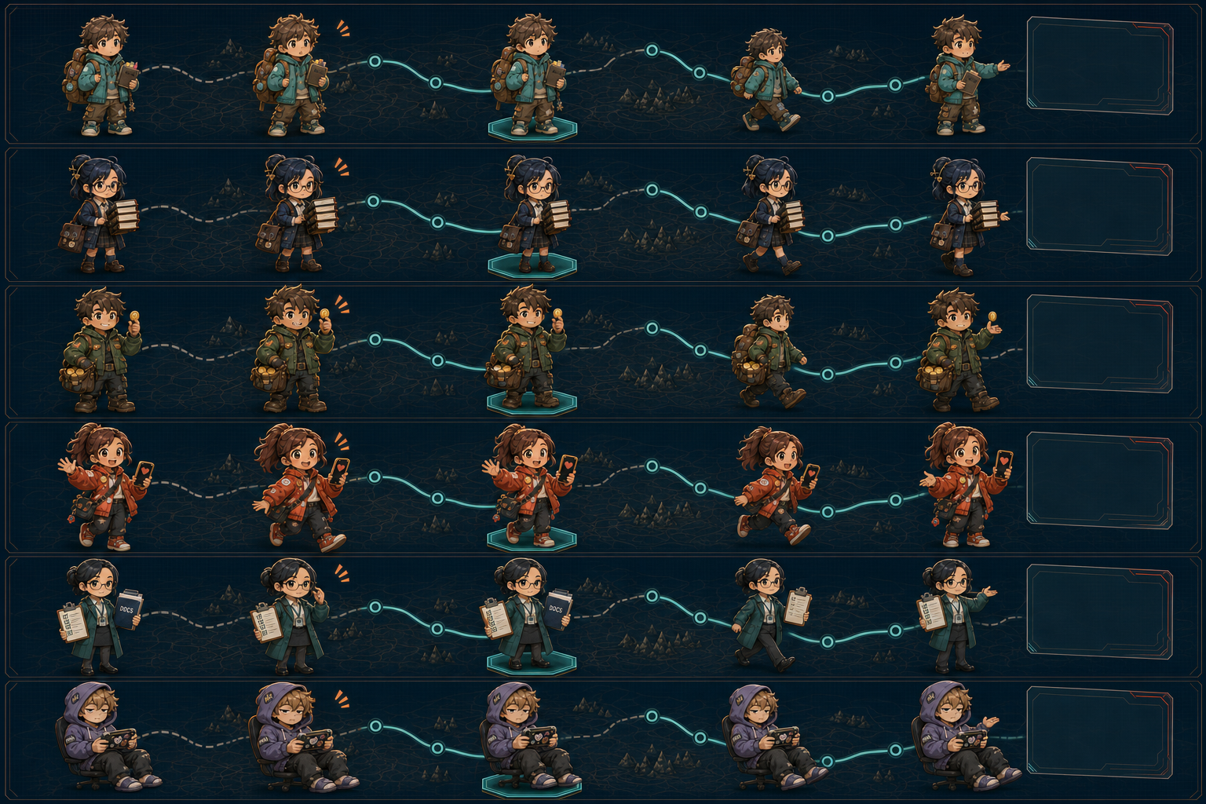
Six strategies become one readable playback language.
Chibi people carry strategy identity; evidence panels carry the facts. No Codex mascot and no decorative path presented as data.
MOTION CONTRACT
Idle
subtle breathing; no metric claim
Hover
amber outline + observed summary
Select
teal pedestal locks active persona
Move
advance only across recorded edges
Detail
drawer opens exact evidence fields
PERSONA-SPECIFIC NOTES
Money is the default demo persona because its contract/behavior mismatch is clearest.
Slacker stays seated: use chair glide/roll instead of a generic walk cycle.
Coral is reserved for terminal risk; hover remains amber.
DECORATIVE ROUTES ≠ TEST EVIDENCE
Approval required: story · interaction states · persona language · path semantics

