Slide 1
Sociology 601 Class 7: September 22, 2009
6.4: Type I and type II errors
6.5: Small-sample inference for a mean
6.6: Small-sample inference for a proportion
6.7: Evaluating p of a type II error.
1

Slide 2
6.5: A catastrophe of small samples:
Historical example: W.S. Gossett, a chemist at Guinness, testing beer quality in 1908.
  assumptions: random sample, normal distribution, &c.
  H_{o}: a given batch of beer has the same characteristics as an overall standard (pH, alcohol content, clarity, &c.)
  test statistics: mean scores from small samples of measurements from a single batch of beer.
  p-values: often quite low!
  a frequent conclusion: the batch of beer has nonstandard characteristics, so we must discard it even if it tastes fine.

Slide 3
6.5: Why the problem with small samples?
  Within a distribution of samples, the estimated variance and standard deviation will vary, even for samples with the same sample mean.
  s² will sometimes be larger than σ² and sometimes smaller.
  when s is smaller than σ, a moderate difference between Y_{bar} and μ₀ might be statistically significant.
  when s is larger than σ, a large difference between Y_{bar} and μ₀ might not be statistically significant.

Slide 4
What causes this problem?
The problem is that an imprecise estimator of sigma can distort p-values.
This problem arises even though the population has a normal distribution, and even though the (imprecise) estimator is unbiased.

Slide 5
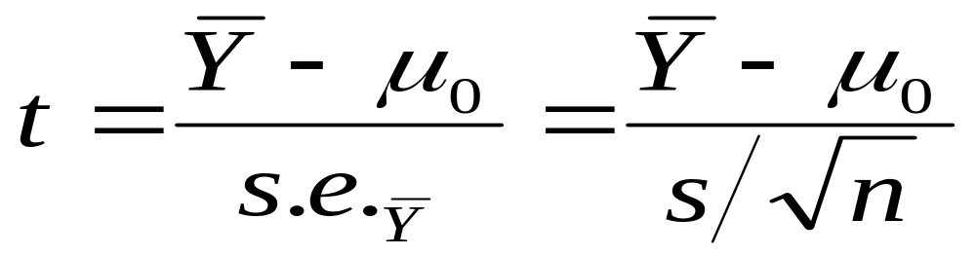
Correcting the problem: the t-test.
SOLUTION: calculate test statistics as before, but recalculate the table we use to find p-values.
the t-score for small samples is calculated in the same way as the z-score for large samples.
look up the test statistic in Table B, page 669
degrees of freedom = n-1
conduct hypothesis tests or estimate confidence intervals as with a larger sample.

Slide 6
Properties of the t-distribution:
the t-distribution is bell-shaped and symmetric about 0.
Compared to a z-distribution, the t-distribution has extra area in the extreme tails.
as n-1 increases, the t-distribution becomes indistinguishable from the normal distribution.

Slide 7
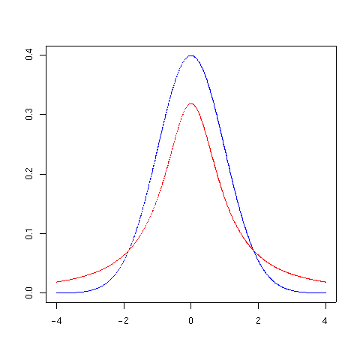
Student’s t-distribution
t-distribution (df=1) and normal distribution:

Slide 8
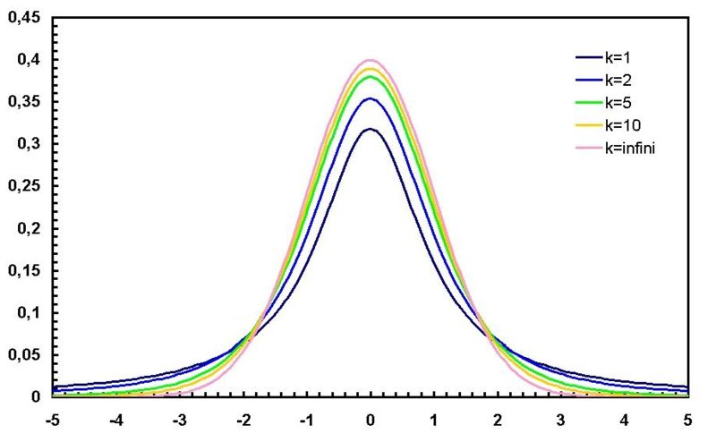
Student’s t-distribution

Slide 9
Using table B on page 669:
You have a t-score: what is the p-value?
t | n | Lower t in Table B | Lower p in Table B | Higher t in Table B | Higher p in Table B | P (1-sided) | P (2-sided)
2.130 | 5
2.130 | 16
2.130 | 601

Slide 10
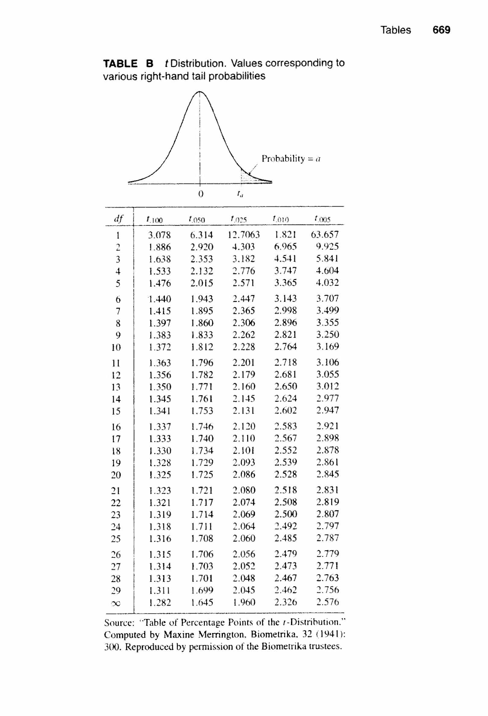

Slide 11
Using table B on page 669:
You have a t-score: what is the p-value?
t | N | Lower t in Table B | Lower p in Table B | Higher t in Table B | Higher p in Table B | P (1-sided) | P (2-sided)
2.130 | 5 | 1.533 | .100 | 2.132 | .050 | p<.10 | n.s.
2.130 | 16 | 1.753 | .050 | 2.131 | .025 | p<.05 | p<.10
2.130 | 601 | 1.960 | .025 | 2.326 | .010 | p<.025 | p<.05

Slide 12
Using STATA to find t-scores and p-values
t-statistics and p-values using DISPLAY INVTTAIL and DISPLAY TPROB:
  You provide the df and either the 1-tailed p or the 2-tailed t
  compare to table B, page 669
  examples given for sample sizes 10000 and 5 (df = n – 1)
  Compare also to invnorm and normprob
. display invttail(9999,.025)
1.9602012
. display invttail(4,.025)
2.7764451
. display tprob(9999,1.96)
.05002352
. display tprob(4,1.96)
.12155464

Slide 13
STATA commands for section 6.5 or 6.2
immediate test for sample mean using TTESTI:
(note use of t-score, not z-score)
. * for example, in A&F problem 6.8, n=100 Ybar=508 sd=100 and mu0=500
. ttesti 100 508 100 500, level(95)
One-sample t test
------------------------------------------------------------------------------
| Obs Mean Std. Err. Std. Dev. [95% Conf. Interval]
---------+--------------------------------------------------------------------
x | 100 508 10 100 488.1578 527.8422
------------------------------------------------------------------------------
Degrees of freedom: 99
Ho: mean(x) = 500
Ha: mean < 500 Ha: mean != 500 Ha: mean > 500
t = 0.8000 t = 0.8000 t = 0.8000
P < t = 0.7872 P > |t| = 0.4256 P > t = 0.2128

Slide 14
T-test example: small-sample study of Anorexia
A study compared various treatments for young girls suffering from anorexia. The variable of interest was the change in weight from the beginning to the end of the study.
For a sample of 29 girls receiving a cognitive behavioral treatment, the changes in weight are summarized by Y_{bar} = 3.01 and s = 7.31 pounds
“Does the cognitive behavioral treatment work?”

Slide 15
T-test example: small-sample study of Anorexia
Assumptions:
  We are working with a random sample of some sort.
  Observations are independent of each other.
  Change in weight is an interval scale variable.
  Change in weight is distributed normally in the population.
Hypothesis:
  H₀: µ = 0. The mean change in weight is zero for the conceptual population of young girls undergoing the anorexia treatment.

Slide 16
T-test example: small-sample study of Anorexia
Test statistic: if Y_{bar} =3.01, s = 7.31, and n=29, then
  Standard error = 7.31/sqrt(29) = 1.357
  t = 3.01 / 1.357 = 2.217
P-value:
  df = 29 – 1 = 28
  T(.025, 28df) = 2.048, T(.010, 28df) = 2.467
  2.467 > 2.217 > 2.048
  .01 < p < .025
  P < .025 (one-sided), so
  P < .05 (two-sided)

Slide 17
T-test example: small-sample study of Anorexia
conclusion: reject H₀: girls who undergo the cognitive behavioral treatment do not stay the same weight.
By this analysis, the results of the study are statistically significant. To conclude that the results are substantively significant, we need to address more questions.
Q: Is 3.1 pounds a meaningful increase in weight?
  Note: s = 7.31. This number has substantive as well as statistical importance.
Q: Would we really expect girls to have no change in weight if there was no effect of the program?

Slide 18
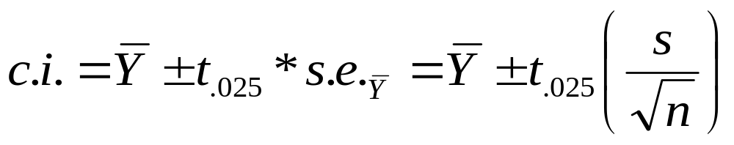
confidence interval using a t-test
This is a formula for a 95% confidence interval for a two-sided t-test.
Anorexia example again:
  Y_{bar} = 3.01, s=7.31, n=29, df=29-1=28, t_{(.025,28)} = 2.048
c.i. = 3.01 ± 2.048(7.31/SQRT(29)) = 3.01 ± 2.780
c.i. = (0.23, 5.79)

Slide 19
6.6: Small-sample inference for a population proportion: the Binomial Distribution
With large samples, we have been treating population proportions as a special case of a population mean, but with slightly different equations.
  z = ( - π_{o} ) /s.e.
  = ( - π_{o} ) / (σ₀ / SQRT(N) )
  = ( - π_{o} ) / ( [ SQRT(π_{o}(1- π_{o})) ] / SQRT(N) )
With small samples, however, tests for population means require the specific assumption that the variable has a normal distribution within the population.
We need a statistic from which we can draw inferences when np < 10 or n(1-p) < 10.

Slide 20
Definitions for the Binomial Distribution
Often, a single ‘random trial’ will have two possible outcomes, “yes” (=1) and “no (=0).
Let B be a random variable generated by a yes/no process. Then B has a probability distribution:
  P(B=1) = p ; P(B=0) = 1-p.
  a heads on a coin flip: p =.5;
  a 6 on a die role p: = .167;
  for left-handed p: = ~.10;
For a fixed number of observations N, each observation falls into one of the two categories.
A key assumption is that the outcomes of successive observations are independent.
  coin flips? left-handedness?

Slide 21
Probabilities for the Binomial Distribution
If we know the population proportion π and the sample size N, we can calculate the probability of exactly X outcomes for any value of X from 0 to N:
where N! = 1*2*…*N
example: What is the probability of getting 3 heads (and 1 tail) when flipping a coin four times?
example: What is the probability of rolling a die 6 times and getting exactly 1 six? Exactly 2 sixes?

Slide 22
Small sample example for population proportion.
Gender and selection of manager trainees:
If there is no gender bias in trainee selection and the pool of potential trainees is 50% male and 50% female, what is the possibility of getting only two women in a sample of 10 trainees?
Alternately, is there evidence of gender bias in trainee selection?

Slide 23
Hypothesis test for a population proportion.
Assumptions: we are estimating a population proportion, and the observations are dichotomous, identical, and independent.
Hypothesis: H_{o}: π = .5, where π is the population proportion of trainees who are women.
Test statistics: none: we calculate p-values by hand using an exact application of the binomial distribution.
  P(0 women) = (10!/0!*10!)*(.5)⁰*(1-.5)¹⁰ = .000977
  P(1 woman) = (10!/1!*9!)*(.5)¹*(1-.5)⁹ = .000977
  Binomial distribution for n= 10, π =.5:
  x 0 1 2 3 4 5 6 7 8 9 10
  P(x) .001 .010 .044 .117 .205 .246 .205 .117 .044 .010 .001

Slide 24
Hypothesis test for a population proportion.
p-value: the p-value is the sum of p(x) for every X at least as unlikely as the x we measure.
  with 2 women and 8 men, we get …
  p = .001+.010+.044+.044+.010+.001 = .110
Conclusion: Do not reject H_{o}: from this sample, we cannot conclude with certainty that women and men do not have an equal chance of being selected into the training program.

Slide 25
STATA command for binomial distributions
immediate test for small sample proportion using BITESTI:
In a jury of 12 persons, only two are women, even though women constitute 53% of the jury-age population. Is this evidence for systematic selection of men in the jury?
bitesti 12 2 .53
N Observed k Expected k Assumed p Observed p
------------------------------------------------------------
12 2 6.36 0.53000 0.16667
Pr(k >= 2) = 0.998312 (one-sided test)
Pr(k <= 2) = 0.011440 (one-sided test)
Pr(k <= 2 or k >= 11) = 0.017159 (two-sided test)

Slide 26
Alternative STATA command for testing probabilities: useful for large n
immediate test for sample proportion using PRTESTI:
. * for proportion: in A&F problem 6.12, n=832 p=.53 and p0=.5
. prtesti 832 .53 .50, level(95)
One-sample test of proportion x: Number of obs = 832
------------------------------------------------------------------------------
Variable | Mean Std. Err. [95% Conf. Interval]
-------------+----------------------------------------------------------------
x | .53 .0173032 .4960864 .5639136
------------------------------------------------------------------------------
Ho: proportion(x) = .5
Ha: x < .5 Ha: x != .5 Ha: x > .5
z = 1.731 z = 1.731 z = 1.731
P < z = 0.9582 P > |z| = 0.0835 P > z = 0.0418

Slide 27
Comparison of a binomial distribution and a normal distribution
with a large enough N, a binomial distribution will look like a normal distribution.
With small samples, and with very low or high sample proportions, the binomial distribution is not normal enough to allow us to extrapolate from a t-score to a p-value.
With the binomial, we do not calculate means and standard deviations: we calculate p directly.

Slide 28
6.7: Common questions related to type II error
We seldom ask: “What is the power of this test?”
A much more common question: “How big an effect would be needed for this study to reject the null hypothesis?”
  Rule of thumb answer: If alpha = .05 and desired power = .5, then ybar – mu must be at least 2 standard errors.
Another common question: “How big a sample size is needed to achieve a desired level of power?”
  use the SAMPSI command in STATA

Slide 29
Evaluating the probability of type II error
The probability of a β (type II) error is the probability of failing to reject the null hypothesis, if the null is false and should be rejected.
A related concept is the power of a test: the probability of correctly rejecting the null hypothesis, if the null is false and should be rejected.
If the null is false, then β = 1 – (power)
If the null is true, then β and power do not apply.

Slide 30
STATA commands for section 6.7:
Sample size estimation for a population mean
sampsi 12 13, sd(2.5) power(.5) onesample a(.01)
  where…
  12 is the population mean under the null hypothesis
  13 is the sample mean you think you might get
  sd(2.5) specifies the assumed population standard deviation
  power(.5) specifies a proposed power of 1 – β = .5
  onesample indicates we are trying to find the value for one group, not comparing two groups.
  a(.01) means alpha = .01, or a .99 confidence interval

Slide 31
STATA commands for section 6.7:
Sample size estimation for a population proportion
sampsi .5 .53, alpha(.05) power(.5) onesample
  where…
  sampsi is the command
  .5 is the assumed population proportion
  .53 is the upper bound you would want, based on .5
  alpha is the proposed alpha level
  power is the proposed power, or 1 - β
  onesample indicates we are trying to find the value for one group, not comparing two groups.

Slide 32
STATA commands for section 6.7:
Using the SAMPSI command to estimate power
sampsi .5 .53, alpha(.05) n(100) onesample
  where…
  sampsi is the command
  .5 is the assumed population proportion
  .53 is the upper bound you would want, based on .5
  alpha is the proposed alpha level
  n is the proposed sample size
  onesample indicates we are trying to find the value for one group, not comparing two groups.

