Slide 1
Evaluation of Circulating Tumor Cell Count in Non-small Cell Lung Cancer Patients
Xu ZhiZhi, Shi Jun-Li and Tan Min-Han
Exit Presentation
December 15, 2017

Slide 2
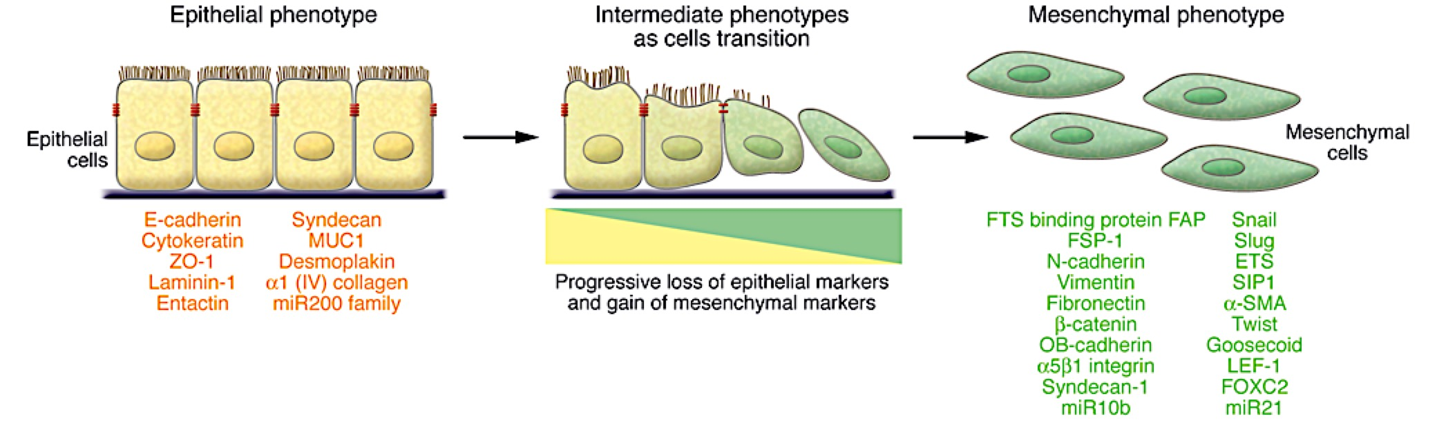
Introduction
Circulating Tumor Cells (CTCs)
Shed from primary tumor into bloodstream
Present in trace amount in peripheral blood
Cell size of 30-35 µm
Research Questions
Can CTC count provide meaningful prognostic information for NSCLC?

Slide 3



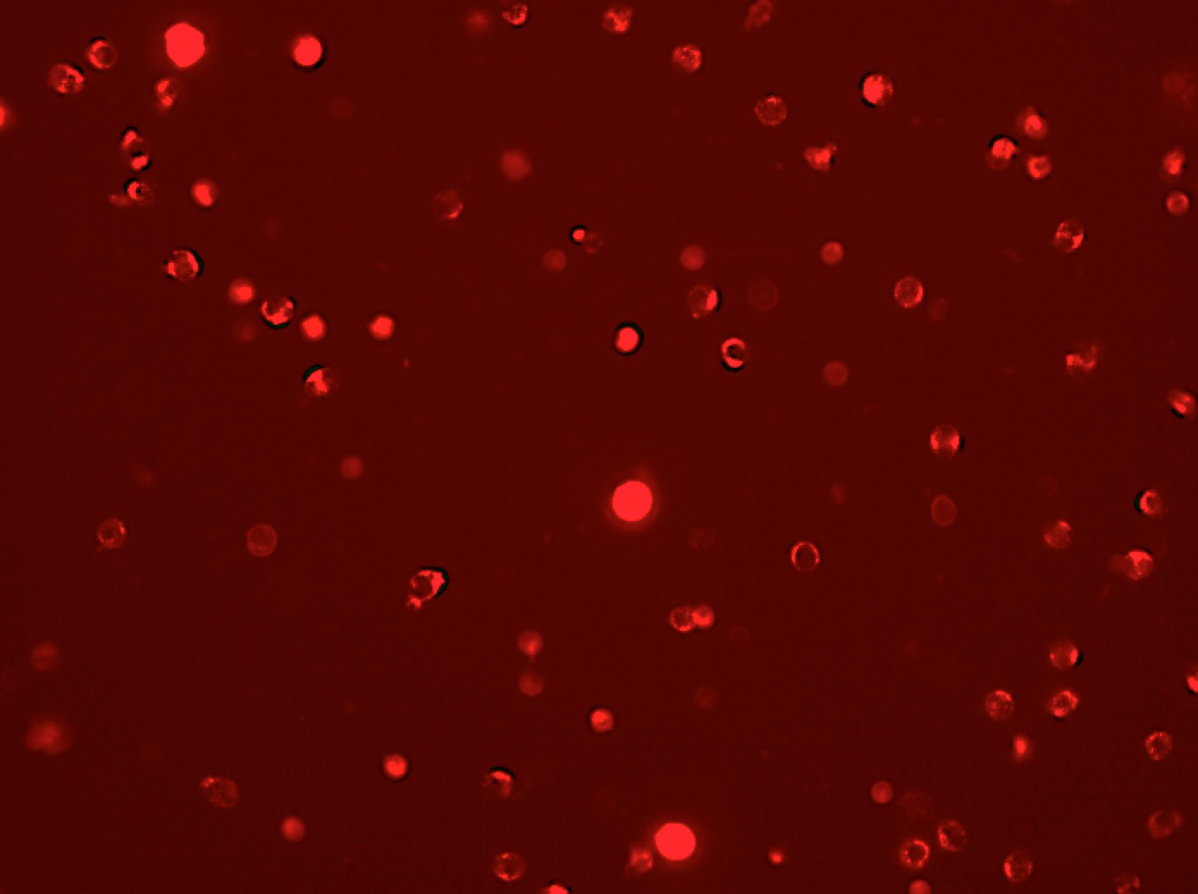
Introduction
Methods
Cells on microsieve were stained for nucleus, cytokeratin (CK), vimentin (VIM) and CD45 (white blood cell marker)
Images were processed with an algorithm built using Metamorph
Cells with nucleus and are CK⁺ and CD45⁻ were identified as CTCs
DAPI
(nucleus stain)
Anti-CK stain
Anti-VIM stain
Anti-CD45 stain

Slide 4
Results – Healthy controls vs patient samples
1. Total Cells
Patient samples show higher total cell count than healthy controls (Mean: 6339 vs 5297)
p< 2.2e-16
(n= 114)
(n= 13)
2. CTCs
A maximum of 6 CTCs was found in healthy controls (Mean: 3)
Patient samples has a range of 0-29 CTCs (Mean: 8)
p< 2.2e-16
(n= 114)
(n= 13)

Slide 5
Results – Healthy controls vs patient samples
3. %CTCs with only epithelial marker
Patient samples show higher total cell count than healthy controls (Mean: 6339 vs 5297)
p< 2.2e-16
(n= 99)
(n= 13)

Slide 6
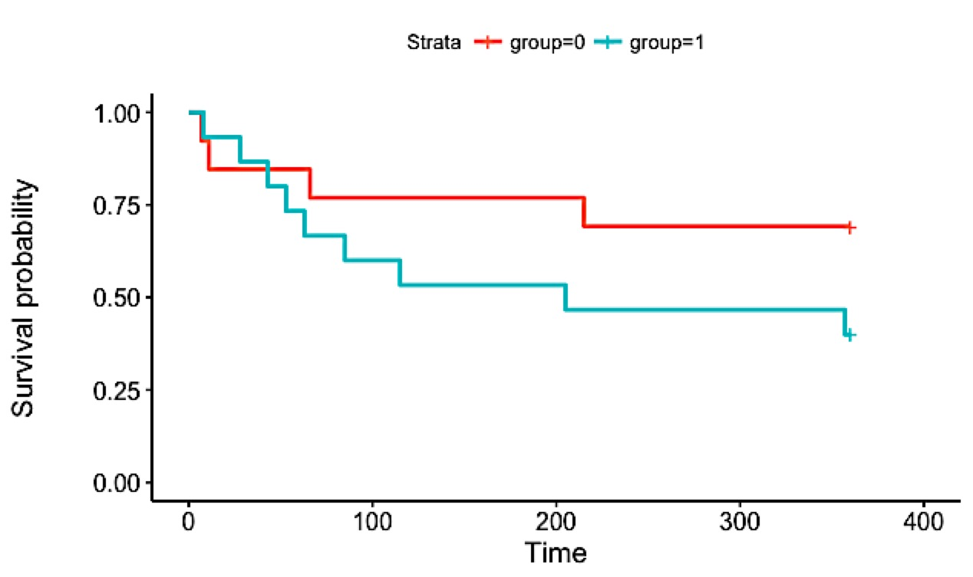
Results – Survival Analysis
CTC count ≤ 6 blood confers favourable prognosis
Group 0: CTC ≤ 6
Group 1: CTC > 6
Median survival (days): Infinite vs 205
Null hypothesis not rejected
n= 28, number of events = 13
Chi Square = 1.9 on 1 degree of freedom
p=0.163

Slide 7
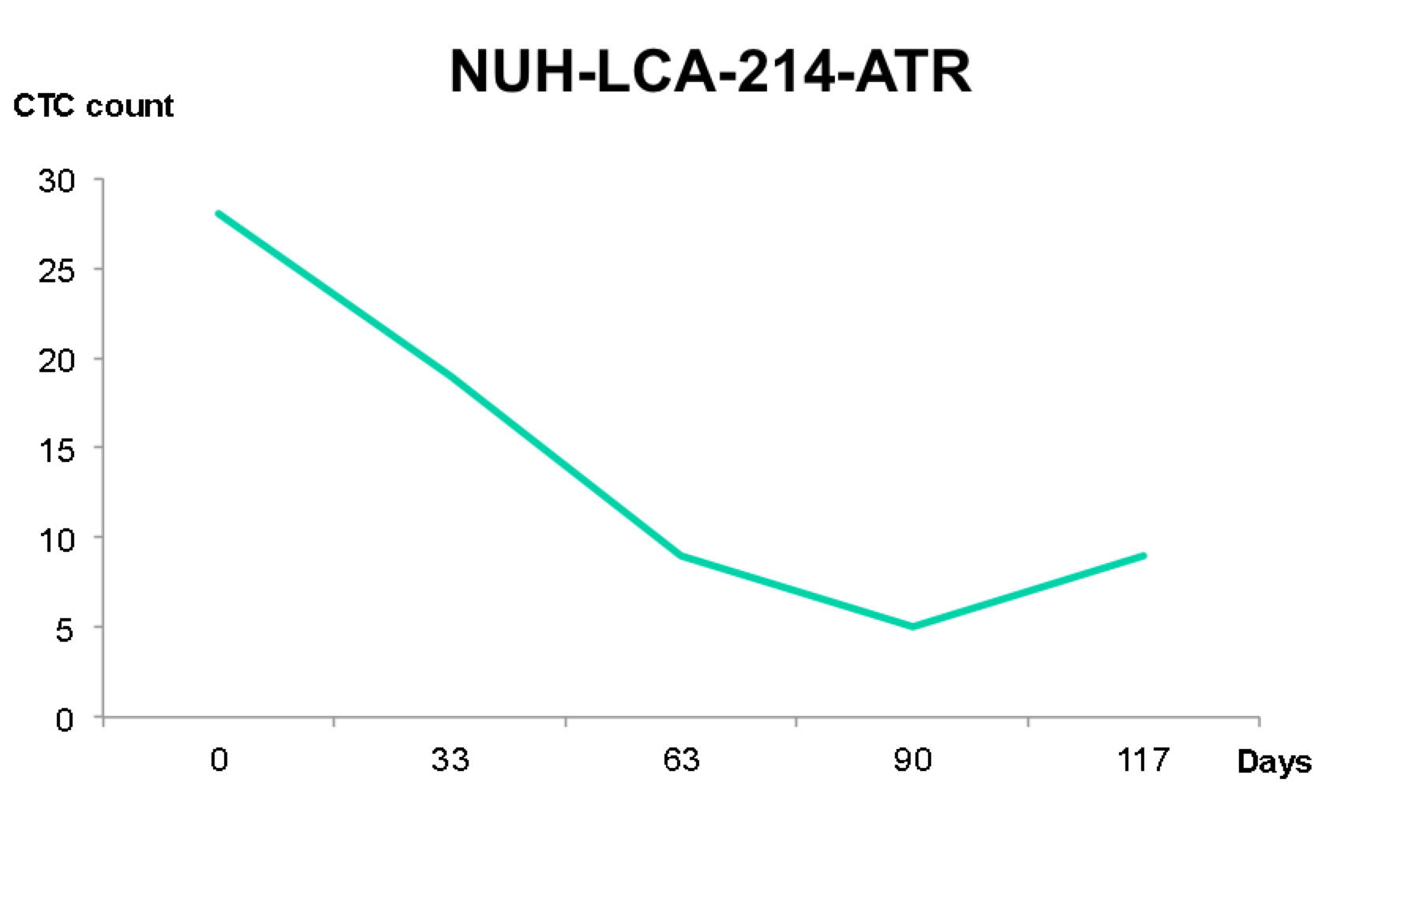
Results – Correlation to other clinical information
Treatment Response
67% of partial response (PR) reported corresponds to a decrease in CTC count
25% of stable disease (SD) reported corresponds to unchanged CTC count
53% of progressive disease (PD) reported corresponds to an increase in CTC count
No obvious trend
PR
PR
PD

Slide 8
Conclusion
NSCLC patients have higher total cell count, CTC count and percentage CTC expressing only epithelial marker
CTC count can have prognostic significance in predicting the outcome of NSCLC patients
- the threshold should be further optimized
The change in CTC count has no clear association with patient’s treatment response
Future expansion
Recruit more patients and healthy controls
Investigate:
- if CTC count predicts progress-free survival
- if post treatment change in CTC count in baseline patients predicts overall survival

Slide 9
Acknowledgments
Name of Mentor
Name of Group/Team Leader or Other Group Members
Other Collaborators/Staff/Students
Youth Research Program
IBN, BMRC and A*STAR

