Slide 1
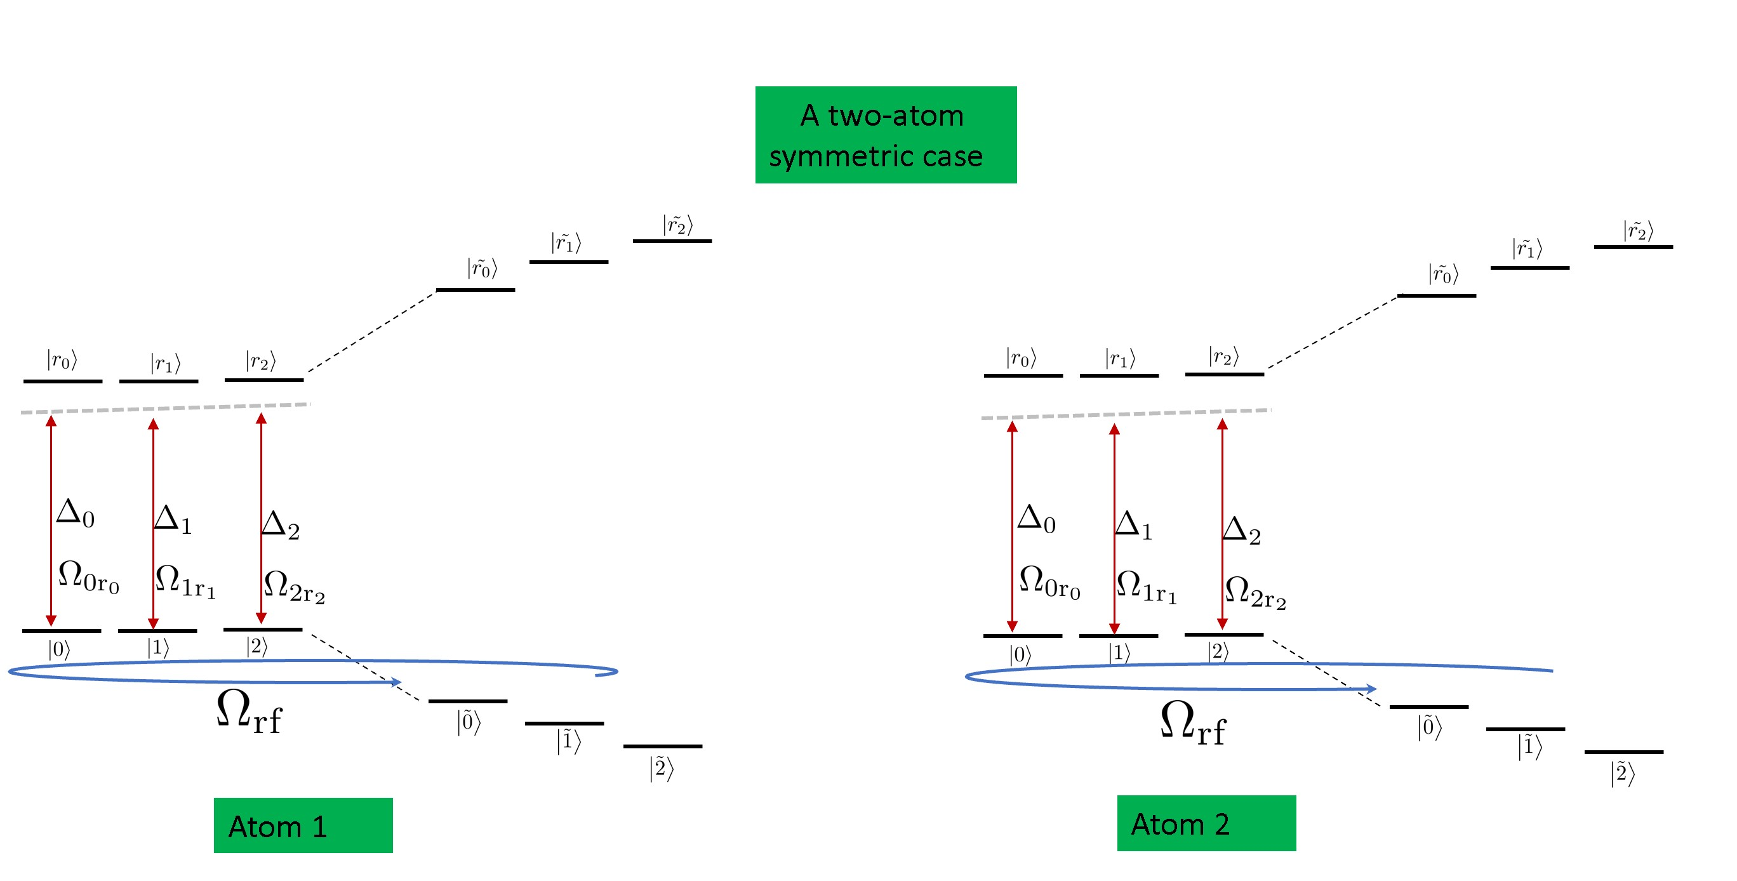




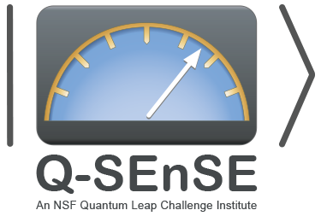
Qudit entanglers using quantum optimal control and Rydberg interaction
on nuclear-spin
Sivaprasad Omanakuttan(UNM), Anupam Mitra(UNM),
Michael J. Martin (LANL), Ivan Deutsch (UNM)
DAMOP 2022 (May 30-June 3)

Slide 2
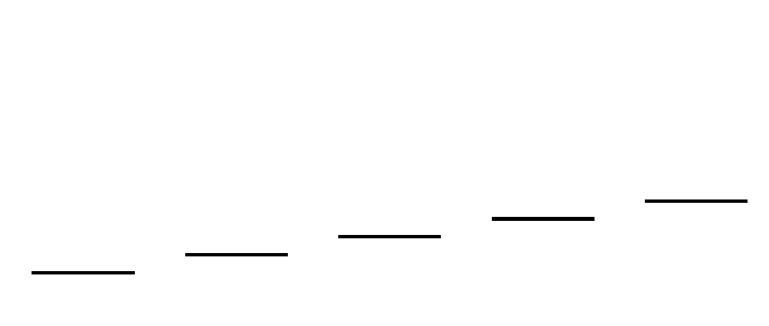
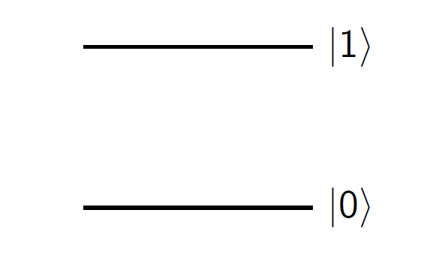
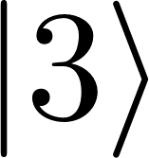
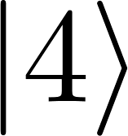

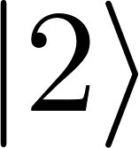
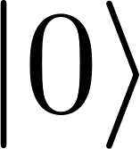
Quantum computing beyond qubits
Qudits
(d>2) (d=5):
Qubits(d=2):
Universal gate set for quantum computing
Qubits : SU(2) + one entangling gate such as CNOT
Qudits : SU(d) + one entangling gate

Slide 3
Quantum computing beyond qubits
Qudits
(d>2) (d=5):
Qubits(d=2):
Universal gate set for qudits:
Gates are harder to implement for qudits
Constructive analytical approach ^{[1][2]}
[1] M. Ringbauer, M. Meth, L. Postler, R. Stricker, R. Blatt, P. Schindler, and T. Monz, arXiv:2109.06903 (2021)
[2] M. S. Blok, V. V. Ramasesh, T. Schuster, K. O’Brien, J. M. Kreikebaum, D. Dahlen, A. Morvan, B. Yoshida, N. Y. Yao, and I. Siddiqi, Phys. Rev. X 11, 021010 (2021)

Slide 4
Quantum computing beyond qubits
Qudits
(d>2) (d=5):
Qubits(d=2):
Universal gate set for qudits:
Gates are harder to implement for qudits
Constructive analytical approach:
Numerical approach: Quantum control
High fidelity entangling qudit gates using quantum control
[1] M. Ringbauer, M. Meth, L. Postler, R. Stricker, R. Blatt, P. Schindler, and T. Monz, arXiv:2109.06903 (2021)
[2] M. S. Blok, V. V. Ramasesh, T. Schuster, K. O’Brien, J. M. Kreikebaum, D. Dahlen, A. Morvan, B. Yoshida, N. Y. Yao, and I. Siddiqi, Phys. Rev. X 11, 021010 (2021)
[3] SO, A. Mitra, M. J. Martin, and I. H. Deutsch, Phys. Rev. A 104, L060401 (2021).

Slide 5
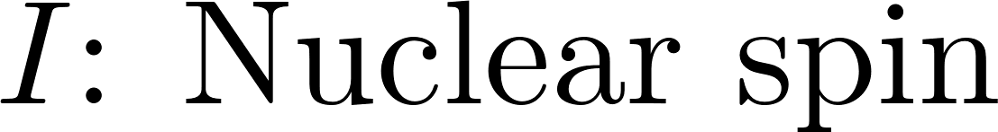
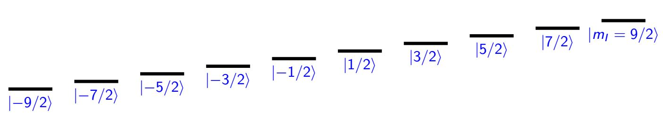
Nuclear Spin Qudit: Group-II Atoms
Strontium: ⁸⁷Sr^{[1][2]}
The ground space of ⁸⁷Sr, J=0 and F=I+J=I
I=9/2 gives d=10 (qudecimal) [d=2F+1]
[1] Boyd, M. M. (2007). High precision spectroscopy of strontium in an optical lattice: Towards a new standard for frequency and time, JILA Ph. D Thesis.
[2] Martin, M. J. (2013). "Quantum metrology and many-body physics: pushing the frontier of the optical lattice clock." JILA Ph. D Thesis.

Slide 6
Control Hamiltonian for quantum control
We use the quantum control technique of GRAPE to generate qudit entanglers
We have a controllable two qudit Hamiltonian,
The single atom Hamiltonian is given as,
Larmor Precession
Notes:
Consider a pair of atoms. When both atoms are excited to Rydberg states, there is electric dipole-dipole interaction between them. If the dipole-dipole interaction is much larger than the Rabi frequency and detuning for the ground to Rydberg transition, Rydberg blockade occurs, which suppress the simultaneous excitation of both atoms to their Rydberg states. Instead, the atoms are excited to a bright state which is a super-position of one atom in the ground state and one atom in the Rydberg state.
Looking at the dressed states of the atom, the two-atom ground state is primarily dressed with an admixture of the bright state and a negligible admixture of the two-atom Rydberg state. Here, I have the light shift experience by the two-atom ground state and the bright state as a function of detuning from the ground to Rydberg transition. There is an adiabatic path from the two-atom ground state to the bright state. This path is used for adiabatic Rydberg dressing.
In the dressed states, the difference in light shifts experienced by interaction atoms and the light shifts experience by non-interaction atoms is the entangling energy kappa. This energy facilitates entangling gates, interacting spin models and spin squeezing.

Slide 7
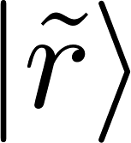

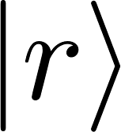
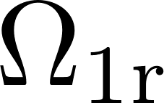
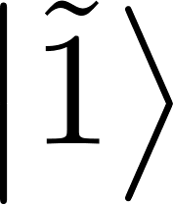
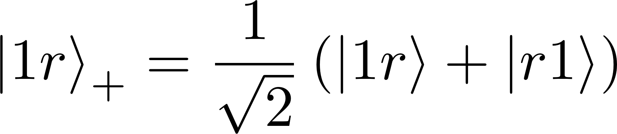
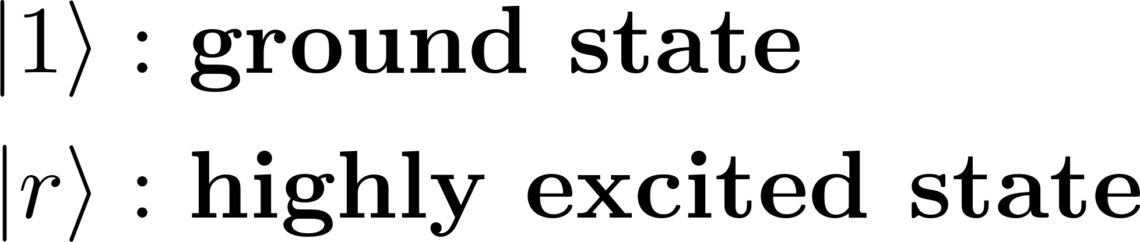
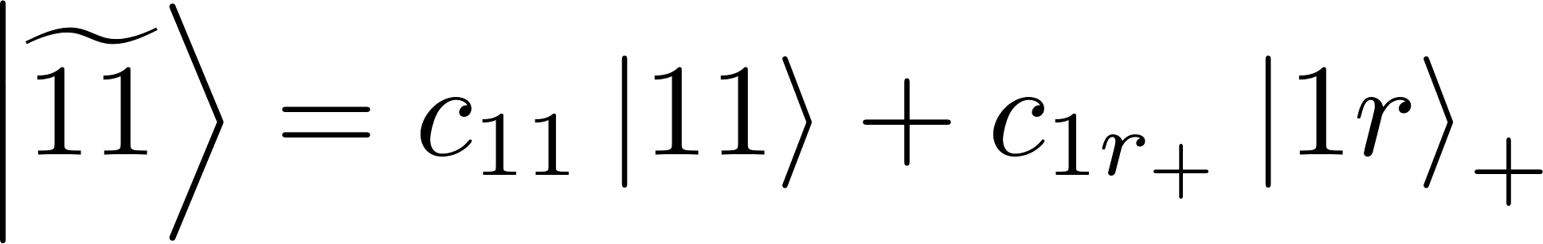

Rydberg blockade and Rydberg dressing^{[1][2]}
Both atoms in Rydberg state
Electric dipole-dipole interaction
Atom 1
Atom 2
Rydberg blockade occurs when
Rydberg blockade
[1] A. Mitra, M. J. Martin, G. W. Biedermann, A. M. Marino, P. M. Poggi, and I. H. Deutsch, Phys. Rev. A 101, 030301 (R) (2020).
[2] J. E. Johnson and S. L. Rolston, Phys. Rev. A 82, 033412 (2010).
Notes:
Consider a pair of atoms. When both atoms are excited to Rydberg states, there is electric dipole-dipole interaction between them. If the dipole-dipole interaction is much larger than the Rabi frequency and detuning for the ground to Rydberg transition, Rydberg blockade occurs, which suppress the simultaneous excitation of both atoms to their Rydberg states. Instead, the atoms are excited to a bright state which is a super-position of one atom in the ground state and one atom in the Rydberg state.
Looking at the dressed states of the atom, the two-atom ground state is primarily dressed with an admixture of the bright state and a negligible admixture of the two-atom Rydberg state. Here, I have the light shift experience by the two-atom ground state and the bright state as a function of detuning from the ground to Rydberg transition. There is an adiabatic path from the two-atom ground state to the bright state. This path is used for adiabatic Rydberg dressing.
In the dressed states, the difference in light shifts experienced by interaction atoms and the light shifts experience by non-interaction atoms is the entangling energy kappa. This energy facilitates entangling gates, interacting spin models and spin squeezing.

Slide 8
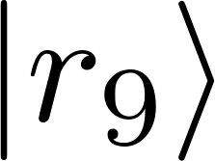
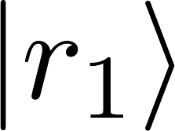
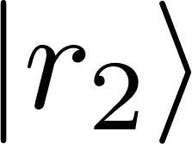
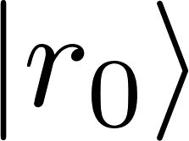

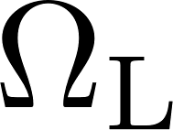
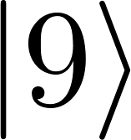
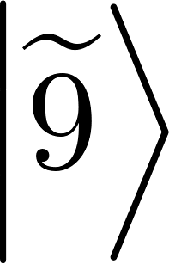
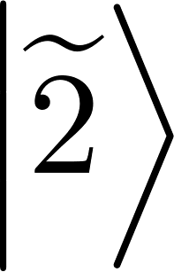
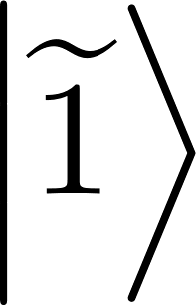
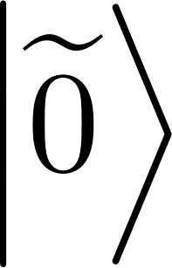
Control Hamiltonian for quantum control
Metastable (³P₂)
Metastable (³P₂)
Atom 1
Atom 2
Notes:
Consider a pair of atoms. When both atoms are excited to Rydberg states, there is electric dipole-dipole interaction between them. If the dipole-dipole interaction is much larger than the Rabi frequency and detuning for the ground to Rydberg transition, Rydberg blockade occurs, which suppress the simultaneous excitation of both atoms to their Rydberg states. Instead, the atoms are excited to a bright state which is a super-position of one atom in the ground state and one atom in the Rydberg state.
Looking at the dressed states of the atom, the two-atom ground state is primarily dressed with an admixture of the bright state and a negligible admixture of the two-atom Rydberg state. Here, I have the light shift experience by the two-atom ground state and the bright state as a function of detuning from the ground to Rydberg transition. There is an adiabatic path from the two-atom ground state to the bright state. This path is used for adiabatic Rydberg dressing.
In the dressed states, the difference in light shifts experienced by interaction atoms and the light shifts experience by non-interaction atoms is the entangling energy kappa. This energy facilitates entangling gates, interacting spin models and spin squeezing.

Slide 9
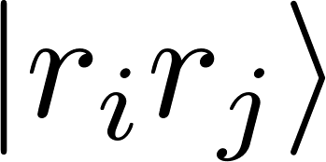
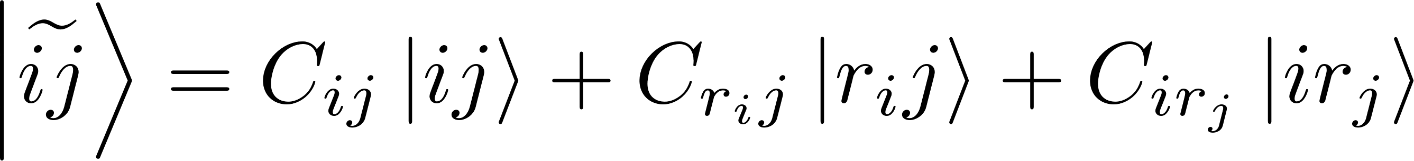
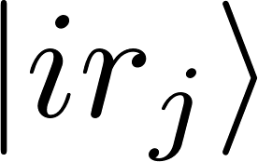
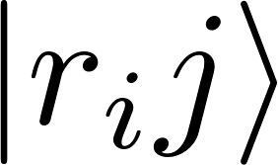
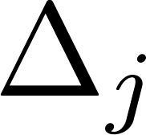
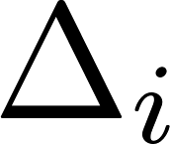
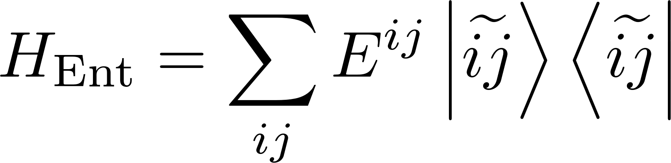
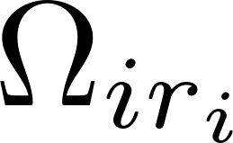
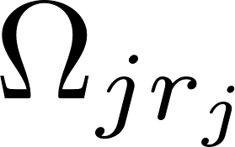
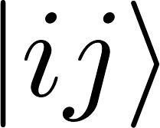
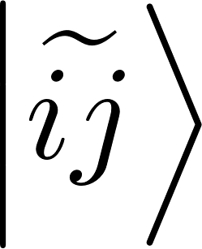
Control Hamiltonian for quantum control
Notes:
Consider a pair of atoms. When both atoms are excited to Rydberg states, there is electric dipole-dipole interaction between them. If the dipole-dipole interaction is much larger than the Rabi frequency and detuning for the ground to Rydberg transition, Rydberg blockade occurs, which suppress the simultaneous excitation of both atoms to their Rydberg states. Instead, the atoms are excited to a bright state which is a super-position of one atom in the ground state and one atom in the Rydberg state.
Looking at the dressed states of the atom, the two-atom ground state is primarily dressed with an admixture of the bright state and a negligible admixture of the two-atom Rydberg state. Here, I have the light shift experience by the two-atom ground state and the bright state as a function of detuning from the ground to Rydberg transition. There is an adiabatic path from the two-atom ground state to the bright state. This path is used for adiabatic Rydberg dressing.
In the dressed states, the difference in light shifts experienced by interaction atoms and the light shifts experience by non-interaction atoms is the entangling energy kappa. This energy facilitates entangling gates, interacting spin models and spin squeezing.

Slide 10
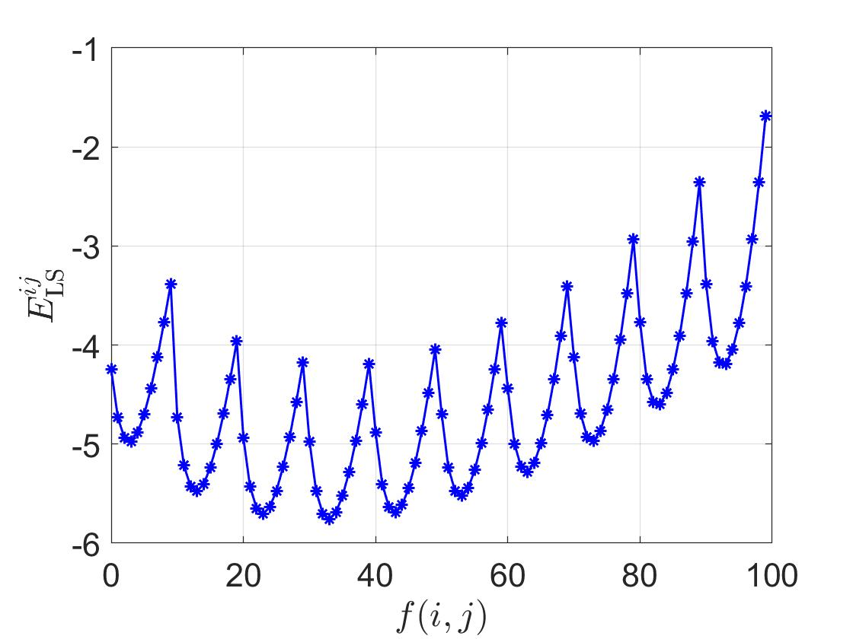
Understanding the entangling Hamiltonian
Tensor light shift kind of effect

Slide 11
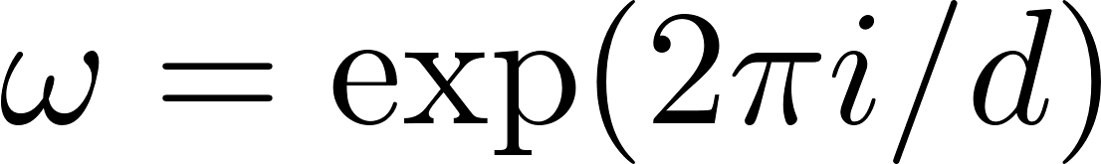
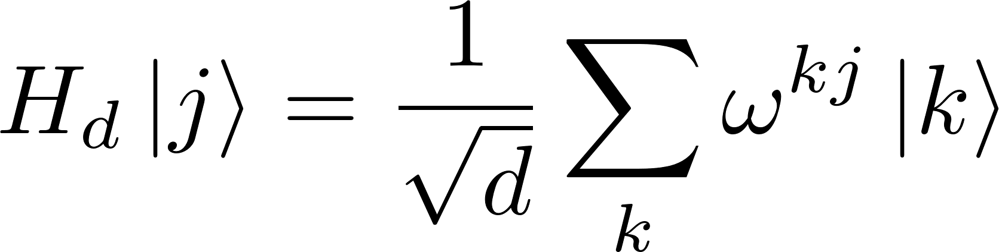
Entangling qudit gate
The SUM_{d} gate serves as a natural generalization of the CNOT gate
However, we are interested in the CPhase which generalizes CZ gate;
These gates are connected using the generalized Hadamard transformation;

Slide 12
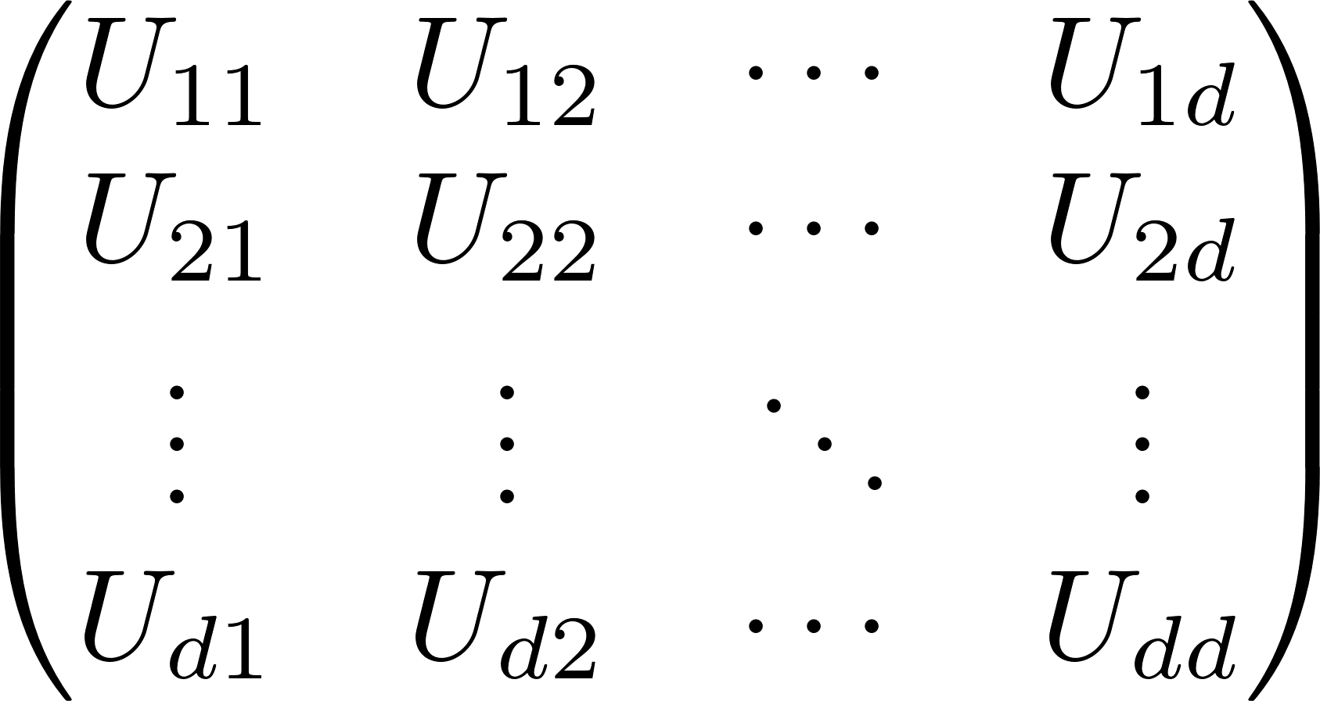
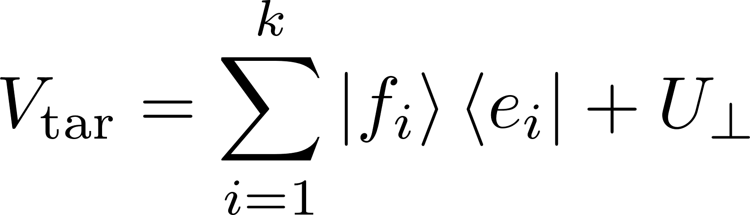

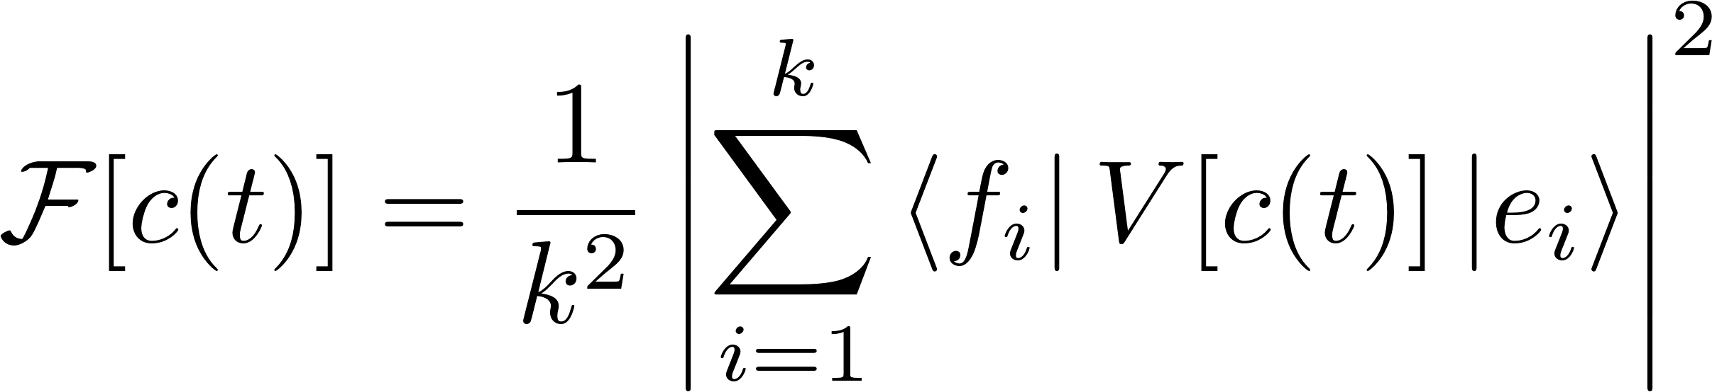
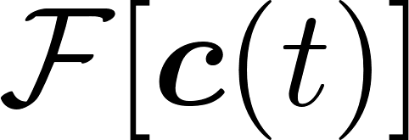
Quantum optimal control
Partial isometry
Cost function:
Divide the total time T into N equal timesteps each of width Δt
Finding the optimal control waveforms involves maximizing

Slide 13
Quantum optimal control
Partial isometry
Cost function:
Divide the total time T into N equal timesteps each of width Δt
Number of free parameter:

Slide 14
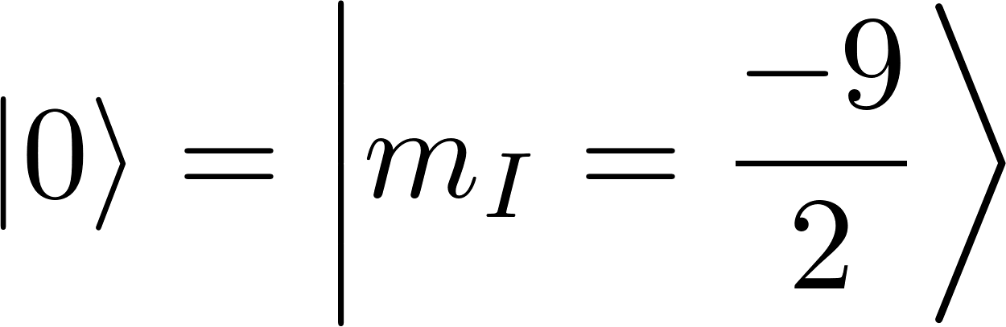
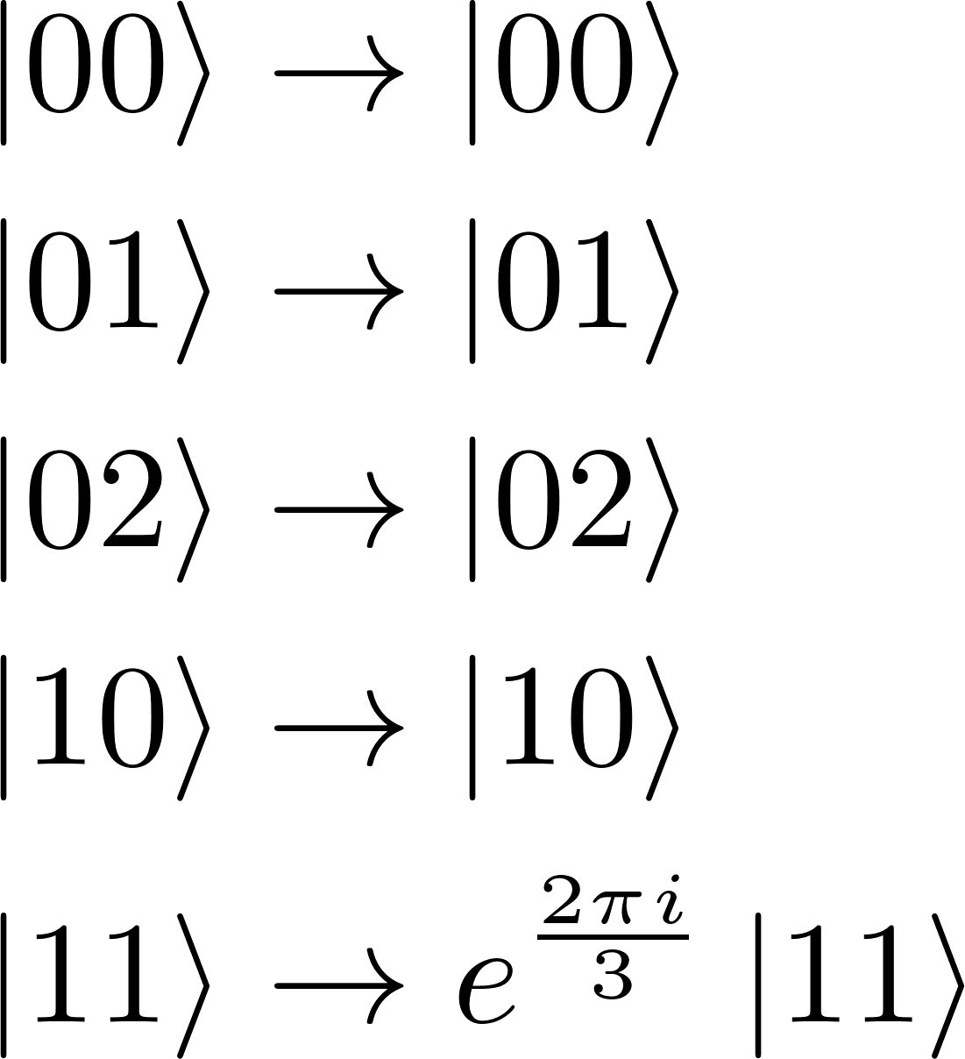
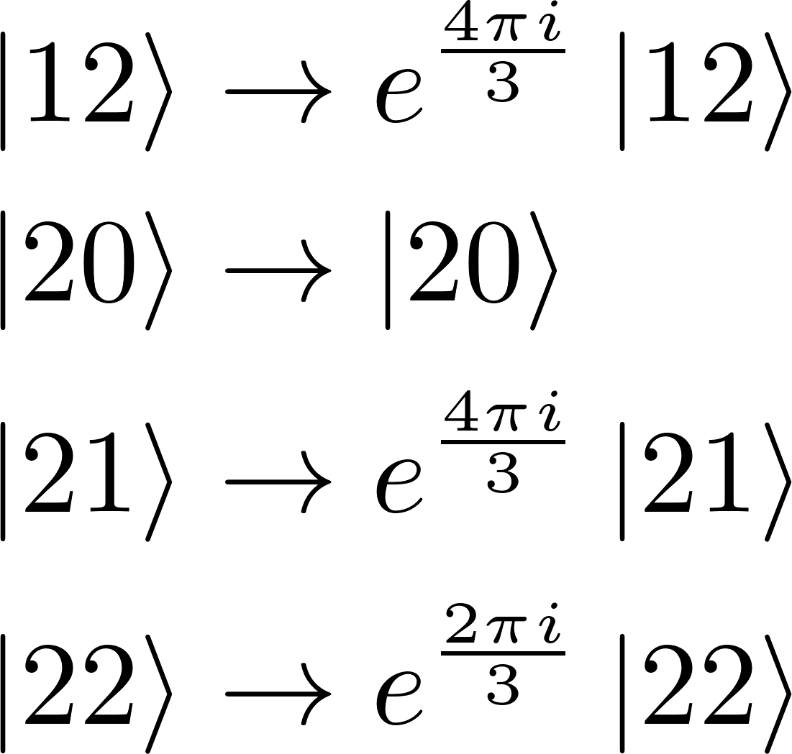
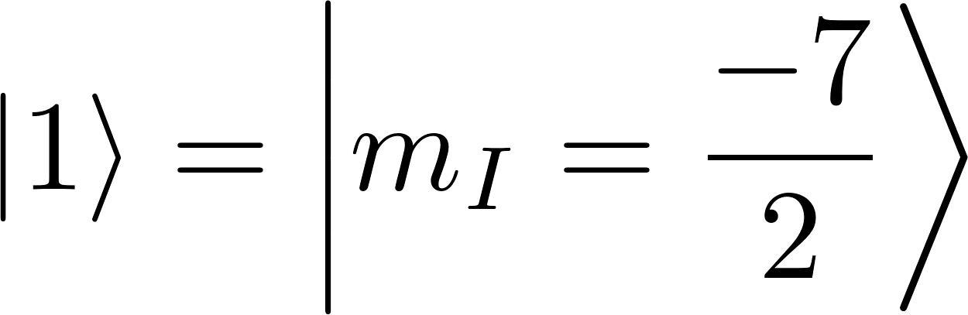
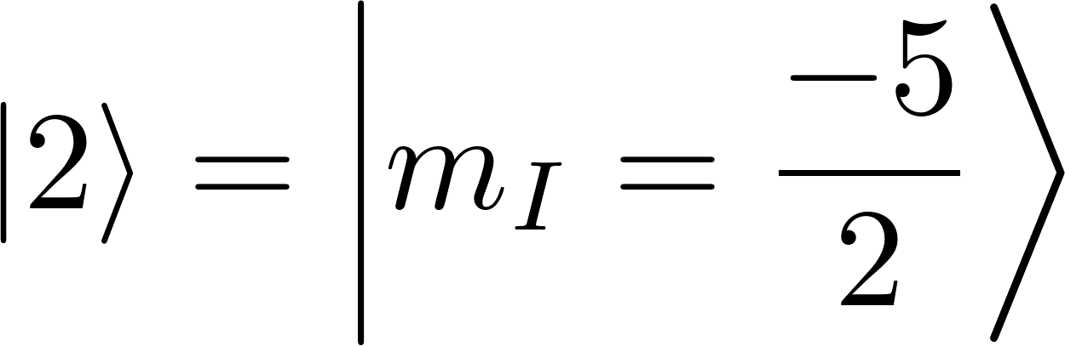
Encoding a Qutrit entangler in Qudit
We control the system by changing the phase in a piecewise constant way
with the cost function

Slide 15



Encoding a Qutrit entangler in Qudit
N_{min}= 643 (minimum number of parameters)
N: Total Number of controls
N=1500
T: Total time for the Simulation
Ω_{rf}T=70π
Fidelity=0.999

Slide 16


Decoherence: Effective Hamiltonian for qudits
Atom 1
Atom 2

Slide 17



Qutrit Cphase gate

Slide 18

Fidelity: Cphase gate
This values can be further optimized
A larger qudit stores much more information than a qubit system

Slide 19




d=7, Cphase gate
Summary:
A quantum control approach for creating CPhase gate for qudits with few
Decoherence induced by finite lifetime of the Rydberg states is studied in detail.
The preprint to appear in arXiv soon.
Anupam Mitra (UNM) Michael J. Martin (LANL) Ivan Deutsch(UNM)
Research presented in this presentation was supported by the Laboratory Directed Research and Development program of Los Alamos National Laboratory under project numbers 20200015ER.
Thanks for the attention
somanakuttan@unm.edu

