Slide 1
Non CIE Component Single-Qubit Quantum Gates Quantum Computing - MCS22
Department of Computer Science and Engineering
Name Nandini K H
USN: 1MS21SCS14

Slide 2
Quantum Circuits
A quantum circuit is a computational routine consisting of coherent quantum operations on quantum data, such as qubits. It is an ordered sequence of quantum gates, measurements and resets which may be conditioned on real time classical computation.

Slide 3
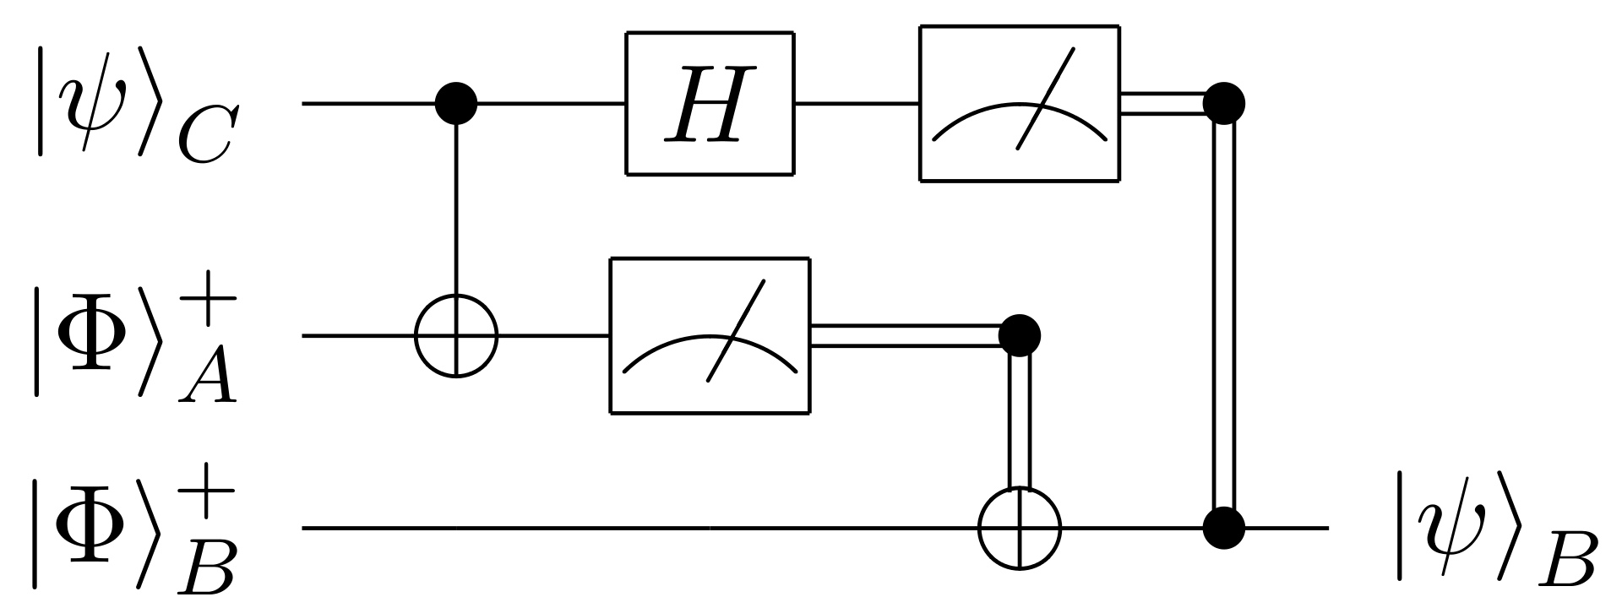

Slide 4
Quantum Gates
Quantum Gates are the building blocks of quantum circuits.
Quantum logic Gates are basic quantum circuits operating on a small number of qubits.
Quantum logic gates are reversible.
Quantum logic gates are represented by unitary matrices.

Slide 5
Categories of Quantum Gates
Quantum gates are categorized into two,
Single qubits Quantum gates.
Multiple qubits Quantum gates.

Slide 6


Single Qubit Quantum State
A single qubit quantum state can be written as
where α and β are complex numbers. In a measurement the probability of the bit being in |0⟩ is |α|² and |1⟩ is |β|². As a vector this is

Slide 7

Single Qubit Quantum State
Note: due to the conservation of probability |α|²+|β|²=1 and The qubit could be represented by 2D vectors, and their states are limited to the form:

Slide 8
Single Qubits Quantum Gates
Hadamard Gate
Pauli Gates
P Gate
I Gate
S Gate
T Gate
U Gate

Slide 9

Hadamard Gate
The Hadamard gate (H-gate) is a fundamental quantum gate. It allows us to move away from the poles of the Bloch sphere and create a superposition of |0⟩|0⟩ and |1⟩|1⟩. It has the matrix:

Slide 10
Pauli Gate
The three most basic single qubit gates are,
Pauli- X gate
Pauli- Y gate
Pauli- Z gate

Slide 11

Pauli- X Gate
The X gate is directly analogous to the classical NOT gate.
It transforms |0> to |1> and |1> to |0>
In terms of the bloch sphere, this is equivalent to rotating around the X axis by radians of (180 degree)

Slide 12
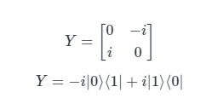
Pauli- Y Gate
Similarly to Pauli-X gate, The Y gate represents a rotation of around the Y axis by radians of (180 degree)
It transforms |0> to i|1> and |1> to -i|0>

Slide 13
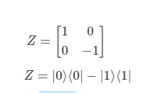
Pauli- Z Gate
It represents a rotation of around the Z axis by the radians of (180 degree)
It has no effect on |0> but transforms |1> to -|1>

Slide 14


P-Gate
The P-gate (phase gate) is parameterised, that is, it needs a number ($∅$) to tell it exactly what to do. The P-gate performs a rotation of around the Z-axis direction. It has the matrix form.
Where ($∅)$ is a real number.

Slide 15

I-Gate
This is simply a gate that does nothing. Its matrix is the identity matrix:
Applying the identity gate anywhere in circuit should have no effect on the qubit state.

Slide 16


S-Gate
The next gate to mention is the S-gate
It includes a $\frac{π}{2}phase, and is sometimes called the P−gate$
Equivalent to a $\frac{π}{2}$radian rotation about the Z axis.

Slide 17

T-Gate
The T-gate is a very commonly used gate, it is an P-gate with :

Slide 18

U-Gates
As we saw , The I, Z, S & T-gates were all special cases of the more general P-gate. In the same way, the U-gate is the most general of all single-qubit quantum gates.
It is a parameterized gate of the form:

Slide 19
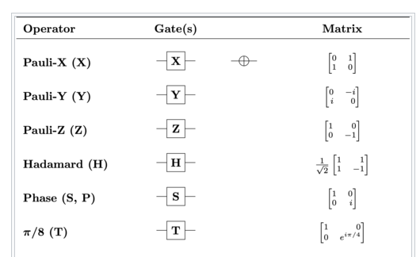
Gates

Slide 20
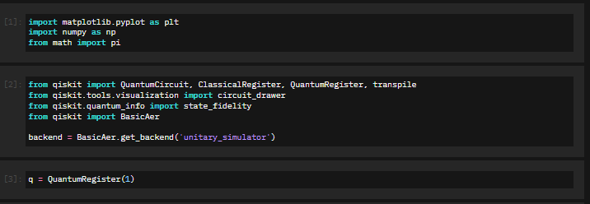

Slide 21
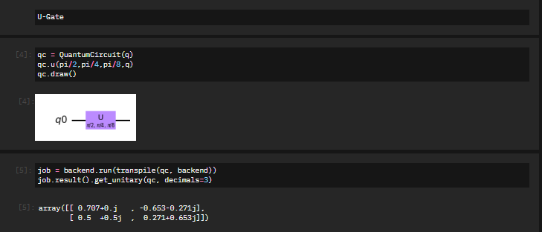

Slide 22
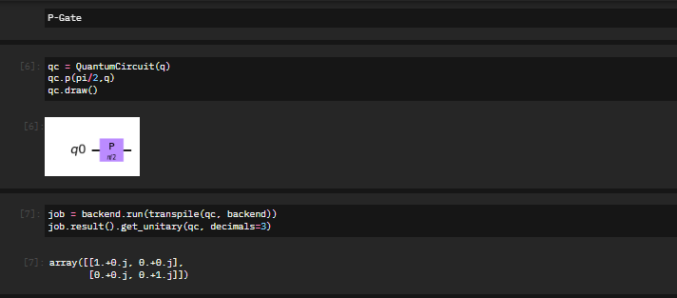

Slide 23
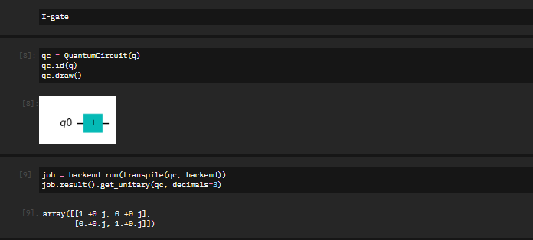

Slide 24
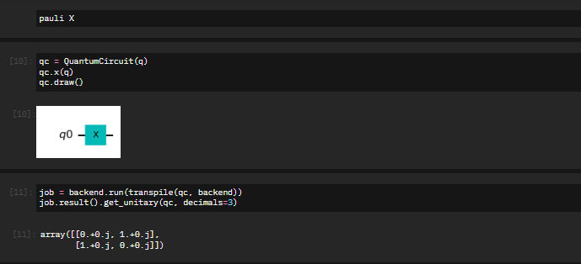

Slide 25
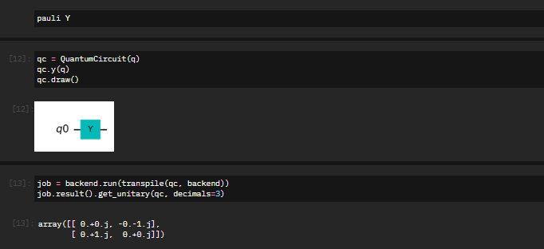

Slide 26
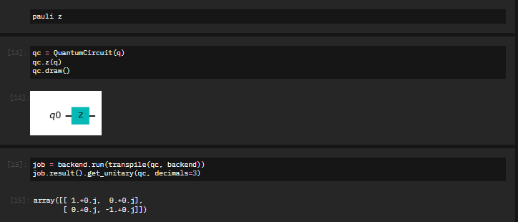

Slide 27
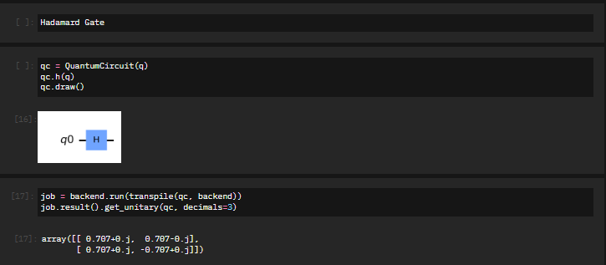

Slide 28
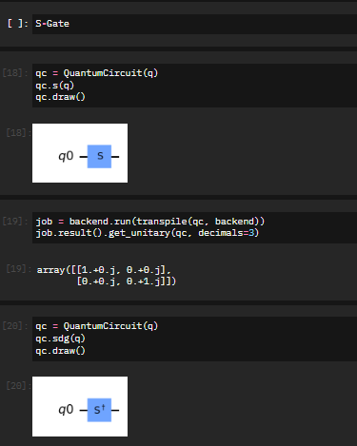

Slide 29
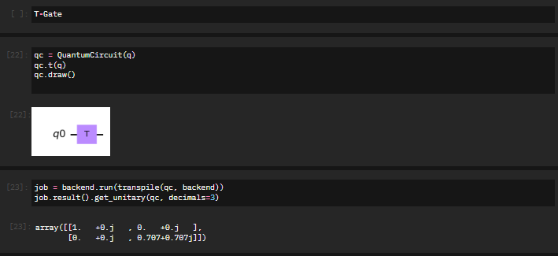

Slide 30
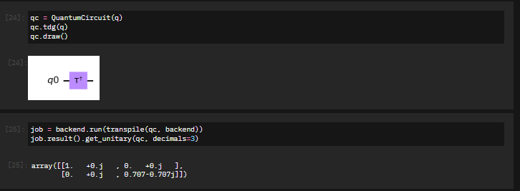

Slide 31
Thank You

