Slide 1
BB84 Protocol in Quantum Key Distribution Non CIE Component Quantum Computing MCS22
Department of Computer Science and Engineering
Presented By:
Bhagyashree Hosmani
1MS21SCS08

Slide 2
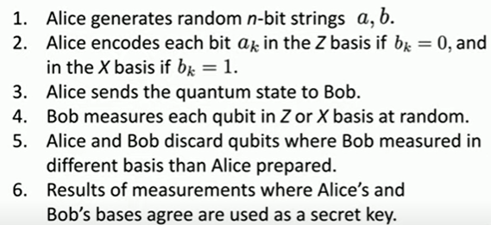
^{Steps in BB84 Protocol}

Slide 3
^{BB84 Protocol}
Alice and Bob communicate through a public quantum channel.
Alice public quantum Bob
channel
Alice generates two n-bit strings:
a = a1, a2,….,an
b = b1, b2,….,bn
Alice creates a quantum state according to these bit strings

Slide 4
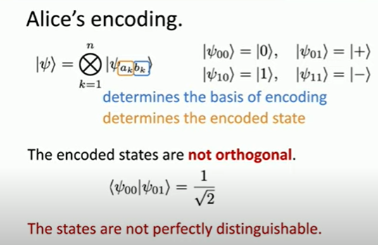

Slide 5
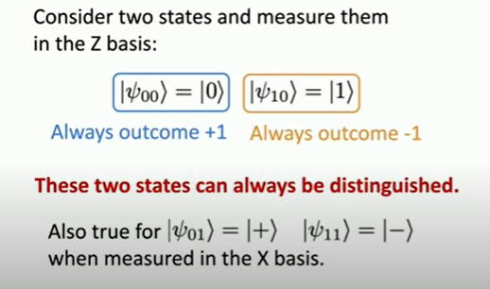
What does it mean to be distinguishable?

Slide 6
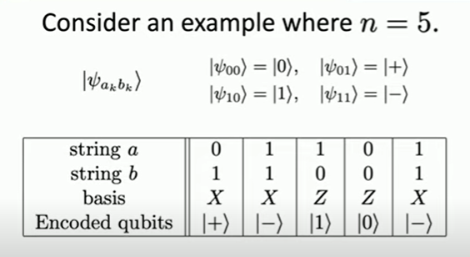
Encoding Example:

Slide 7
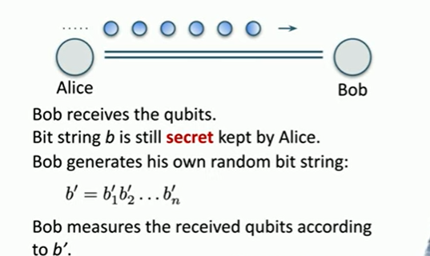
Alice sends encoded qubit to Bob

Slide 8
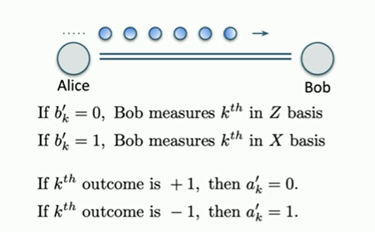
Bob measures the qubits to produce bit string a’

Slide 9
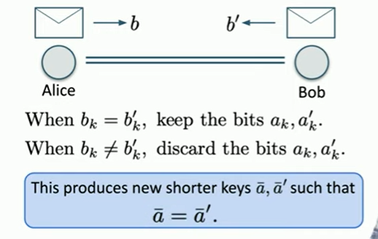
Alice and Bob announce the string b and b’

Slide 10
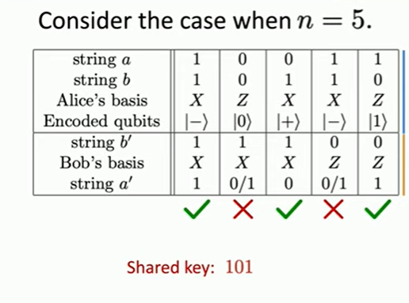
Example:

Slide 11
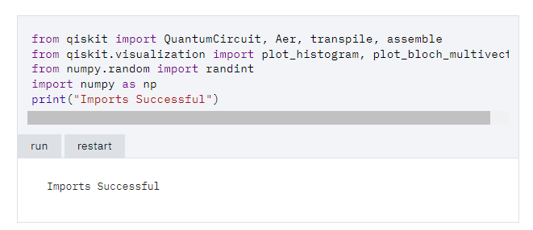
Implementation

Slide 12
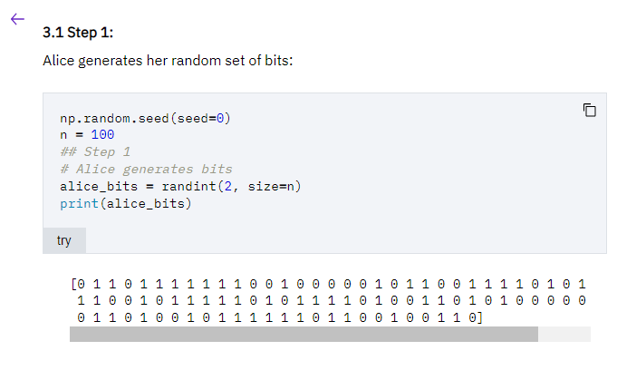

Slide 13
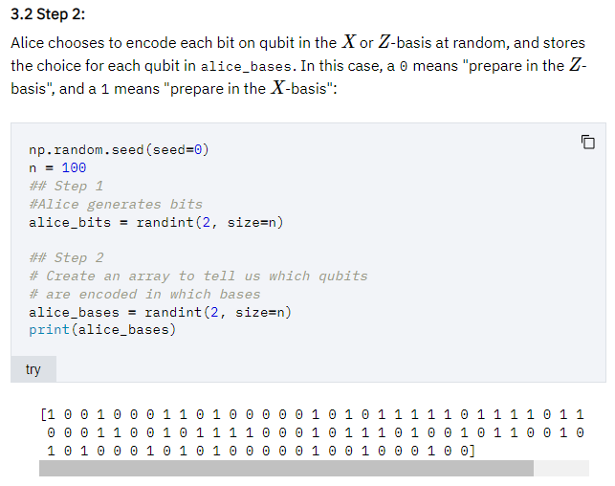

Slide 14
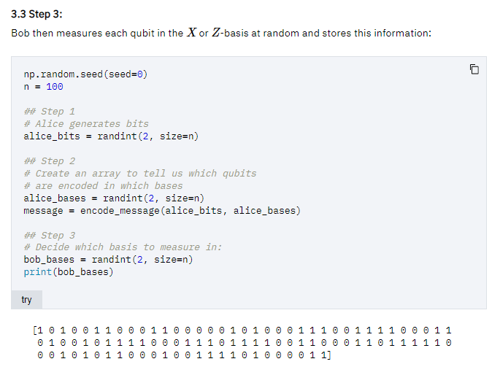

Slide 15
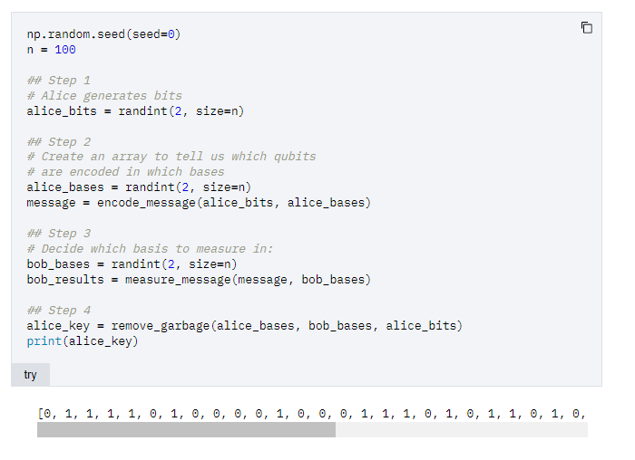

Slide 16
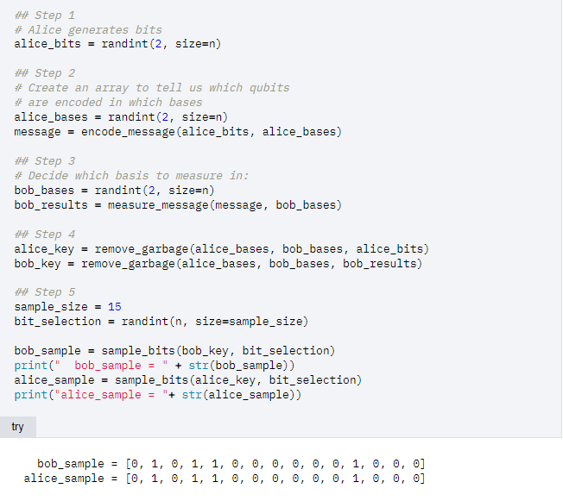

Slide 17
THANK YOU

