Slide 1
QUANTUM COMPUTING(MCS251) Non-CIE Component Presentation on GROVER’S ALGORITHM FOR SEARCHING
Department of Computer Science and Engineering
M. Tech (CSE) – Second Semester (Term: June-October 2022)
Presented By:
Mohammed Jawaad Shariff
1MS21SCS13

Slide 2
Introduction
You have likely heard that one of the many advantages a quantum computer has over a classical computer is its superior speed searching databases. Grover’s algorithm demonstrates this capability.
This algorithm can speed up an unstructured search problem quadratically, but its uses extend beyond that.
It can serve as a general trick or subroutine to obtain quadratic run time improvements for a variety of other algorithms. This is called the amplitude amplification trick.

Slide 3
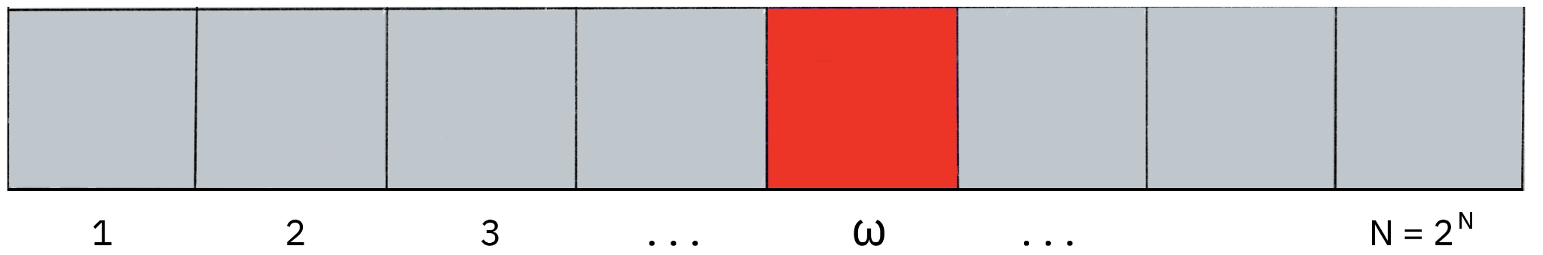
The Unstructured Search
Consider a large list of N items. Among these items is one item with a unique property that we wish to locate. We will call this one the winner, w. Say all items in the list are gray except the winner w, which is red.
To find the red box – the marked item – using classical computation, one would have to check on average N/2 of these boxes, and in the worst case, all N of them.

Slide 4
On a quantum computer, however, we can find the marked item in roughly sqrt(N) steps with Grover’s amplitude amplification trick. It was proven (even before Grover’s algorithm was discovered) that this speedup is in fact the most we can hope for.
A quadratic speedup is indeed a substantial time-saver for finding marked items in long lists.
Additionally, the algorithm does not use the list’s internal structure, which makes it generic.
This is why it immediately provides a quadratic quantum speed-up for many classical problems.

Slide 5

The Oracle
How will the list items be provided to the quantum computer? For the examples in this topic, our ‘database’ is comprised of all the possible computational basis states our qubits can be in. For example, if we have 3 qubits, our list is the states |000>, |001>....|111> (i.e, the states |0> → |7>.
Grover’s algorithm solves oracles that add a negative phase to the solution states. That is, for any state |x> in the computational basis:

Slide 6
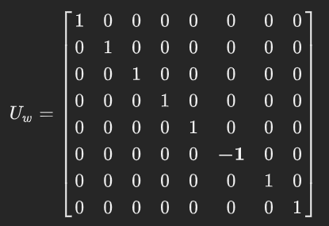
This oracle will be a diagonal matrix, where the entry that correspond to the marked item will have a negative phase. For example, if we have three qubits and w=101, our oracle will have the matrix:
What makes Grover’s algorithm so powerful is how easy it is to convert a problem to an oracle of this form. There are many computational problems in which it’s difficult to find a solution, but relatively easy to verify a solution.

Slide 7

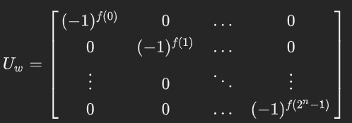
For example, we can easily verify a solution to a sudoku by checking all the rules are satisfied. For these problems, we can create a function f that takes a proposed solution x and returns f(x)=0 if x is not a solution (x!=w), and f(x)=1 for a valid solution (x=w). Our oracle can then be described as:
and the oracle’s matrix will be a diagonal matrix of the form:

Slide 8

Amplitude Amplification
So how does the algorithm work? Before looking at the list of items, we have no idea where the marked item is. Therefore, any guess of its location is as good as any other, which can be expressed in terms of a quantum state called a uniform superposition:
If at this point we were to measure in the standard basis {|x>}, this superposition would collapse, according to the fifth quantum law, to any one of the basis states with the same probability of 1/N = 1/2^{n}. Our chances of guessing the right value w is therefore 1 in 2^{n}, as could be expected. Hence, on average we would need to try about N = 2^{n} times to guess the correct item.

Slide 9
The amplitude amplification procedure signifies how a quantum computer significantly enhances this probability. This procedure stretches out (amplifies) the amplitude of the marked item, which shrinks the other items’ amplitudes, so that measuring the final state will return the right item with near certainty.
The only two special states we need to consider are the winner |w> and the uniform superposition |s>. These two vectors span a two-dimensional plane in the vector space C^{N}. They are not quite perpendicular because |w> occurs in the superposition with amplitude N^{-1/2} as well.
We can, however, introduce an additional state |s’> that is in the span of these two vectors, is perpendicular to |w>, and is obtained from |s> by removing |w> and rescaling.

Slide 10
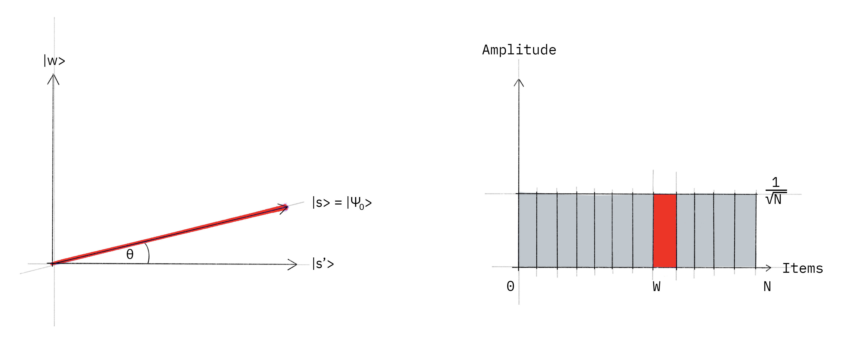
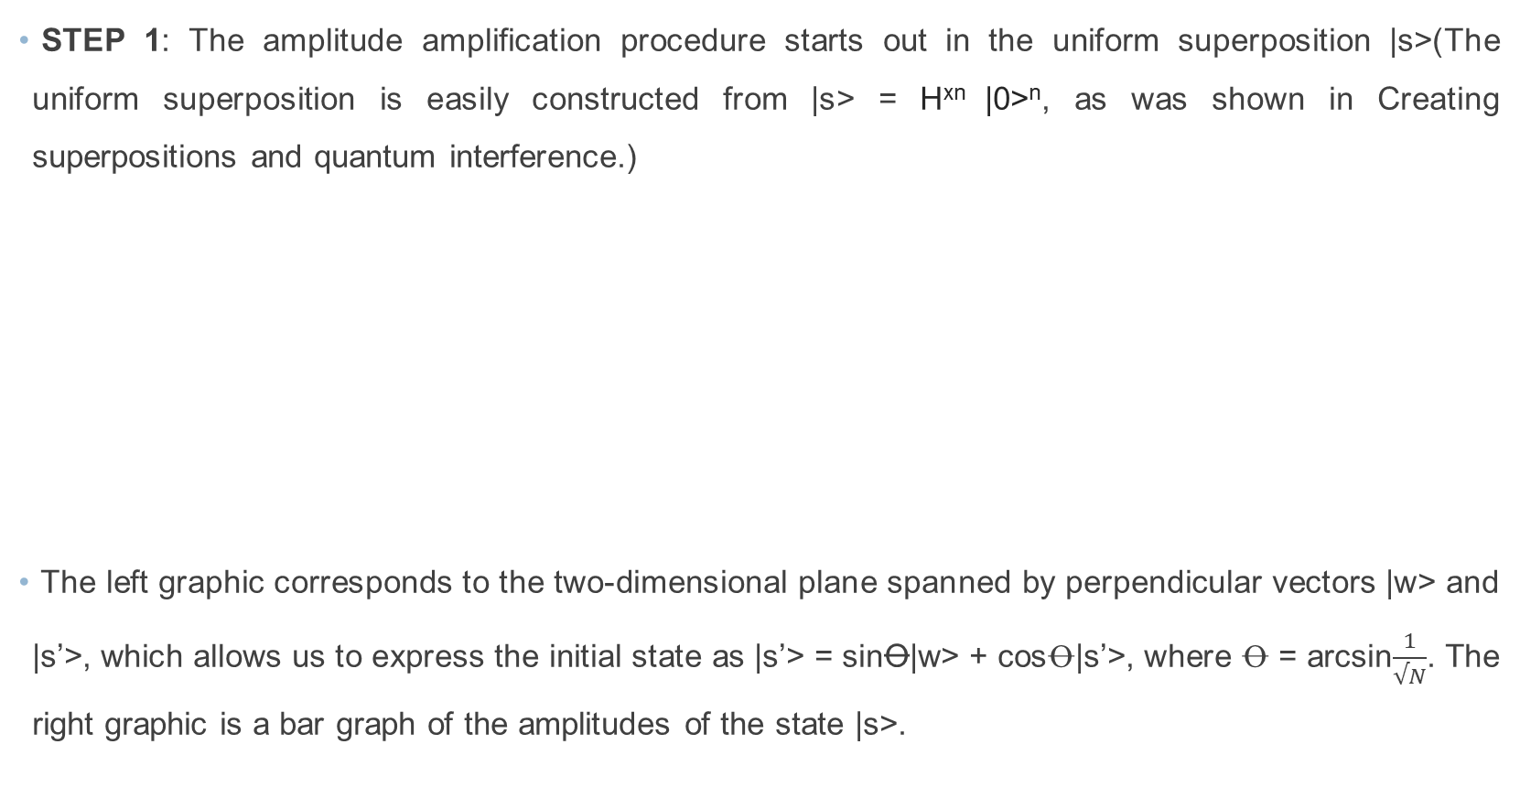
STEP 1: The amplitude amplification procedure starts out in the uniform superposition |s>(The uniform superposition is easily constructed from |s> = H^{xn} |0>^{n}, as was shown in Creating superpositions and quantum interference.)
The left graphic corresponds to the two-dimensional plane spanned by perpendicular vectors |w> and |s’>, which allows us to express the initial state as |s’> = sin$Ꝋ$|w> + cos$Ꝋ$|s’>, where $Ꝋ$ = arcsin$\frac{1}{√N}$. The right graphic is a bar graph of the amplitudes of the state |s>.

Slide 11
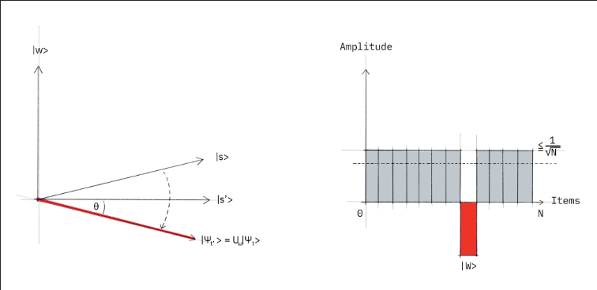
STEP 2: We apply the oracle reflection U_{f} to the state |s>.
Geometrically this corresponds to a reflection of the state |s> about |s’>. This transformation means that the amplitude in front of the |w> state becomes negative, which in turn means that the average amplitude (indicated by a dashed line) has been lowered.

Slide 12
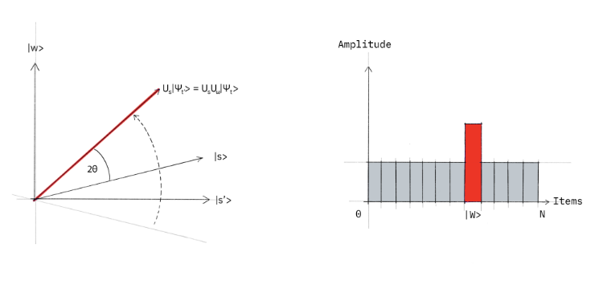
STEP 3: We now apply an additional reflection U_{s} about the state |s>: U_{s} = 2|s><s| - I. This transformation maps the state to U_{s}U_{f}|s> and completes the transformation.
Two reflections always correspond to a rotation. The transformation U_{s}U_{f} rotates the initial state |s> closer toward the winner |w>. The action of the reflection U_{s} in the amplitude bar diagram can be understood as a reflection about the average amplitude. Since the average amplitude has been lowered by the first reflection, this transformation boosts the negative amplitude of |w> to roughly three times its original value, while it decreases the other amplitudes.

Slide 13
We then go to Step 2 to repeat the application. This procedure will be repeated several times to focus in on the winner.
After t steps, the state will have transformed to |Ψ>, where = (U_{s}U_{f})^{t}|s> How many times do we need to apply the rotation? It turns out that roughly √𝑁 rotations suffice. This becomes clear when looking at the amplitudes of the state |Ψ>. We can see that the amplitude of |w> grows linearly with the number of ~tN^{-1/2} applications . However, since we are dealing with amplitudes and not probabilities, the vector space’s dimension enters as a square root. Therefore it is the amplitude, and not just the probability, that is being amplified in this procedure.

Slide 14
The algorithm is divided in to the following steps:
Put all Qubits in to superposition using a Hadamard gate.
Implement an oracle that will mark the state you wish to find. This oracle works by performing a phase flip inverts the states amplitude.
Implement an amplification circuit that further increases the marked states amplitude while decreasing the amplitude of all other states.
Measure all qubits.

Slide 15
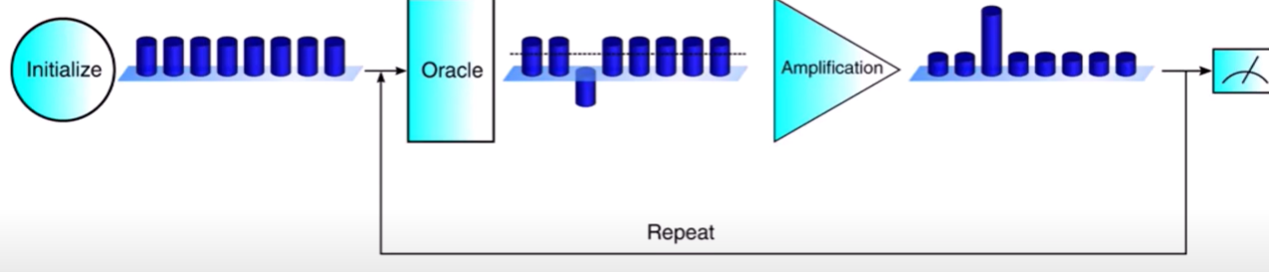

Slide 16
Classical vs Quantum
It is not that Quantum Computers can do more steps at once, it is that they use more complex steps than conventional computers.
In traditional computers, there are only 2 existing states that a bit (binary-digit 0/1) can be in, but this is different in Quantum mechanics.
A Grover algorithm outperform classical unordered database search algorithms quadratically. So, it can serve as an example of higher performance of quantum computers.
However, when complexity of Grover search is assessed, generally a complexity of an oracle is ignored. In some cases the oracle complexity is so high that it cancels out advantage of faster search.

Slide 17
A Quantum Computer can do all the same calculations as a binary computer, but is exceptionally good at a few, precise, tasks — such as breaking encryption.
Since the state of a Qubit doesn't have to be distinctively a 0 or a 1, you can run a single calculation with a superpositioned Qubit and get an answer with multiple attributes - you can run multiple tasks at once - with one bit of information.
Through this process and other similar processes, which would take a traditional computer millions of years, could take a Quantum Computer a matter of seconds.

Slide 18
References
[1] Quantum Computing, A Gentle Introduction Eleanor G. Rieffel, and Wolfgang H. Polak MIT press (2014)
[2] IBM Quantum. https://quantum-computing.ibm.com/, 2021
[3] Ahmed, Tanvir. “Grover's Algorithm | Simplified | Quantum Computing”. Youtube. Uploaded by Tanvir Ahmed 14 Nov 2020. https://www.youtube.com/watch?v=EoH3JeqA55A
[4] org, Qiskit. “Grover’s Algorithm and Amplitude Amplification &mdash; Qiskit 0.37.2 Documentation.” Grover’s Algorithm and Amplitude Amplification &mdash; Qiskit 0.37.2 Documentation, 2022, qiskit.org/documentation/tutorials/algorithms/06_grover.html?highlight=grovers.

Slide 19
THANK YOU

