Slide 1
Quantum Cryptography Non CIE Component Quantum Computing MCS22
Department of Computer Science and Engineering
Presented By:
Ashritha N K
1MS21SCS04

Slide 2
What is Quantum Cryptography?
Cryptography : Process of encrypting and decrypting the data for a secure transmission.
Quantum Cryptography : It is the extension of cryptography which simply uses the principles of ‘Quantum mechanics’ to encrypt data and transmit it in a way that cannot be hacked.
2 types:
Private Key Cryptography
Quantum Key Distribution [QKD]

Slide 3
Private Key Cryptography
How it works?
If Alice wishes to send messages to Bob then Alice must have an encoding key, which allows her to encrypt her message, and Bob must have a matching decoding key, which allows Bob to decrypt the encrypted message.
Vernam cipher [One Time Pad]: A simple, yet highly effective private key cryptosystem.

Slide 4
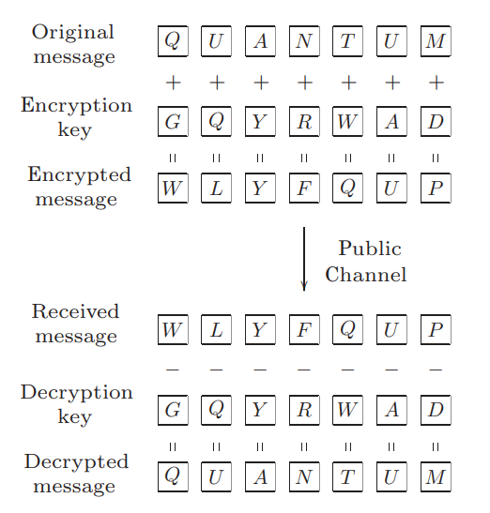
Private Key Cryptography
Feature: As long as the key strings are truly secret, it is provably secure.
Difficulty: Secure distribution of key bits.
Vernam cipher is secure only as long as the number of key bits is at least as large as the size of the message being encoded, and key bits cannot be reused! Thus, the large amount of key bits needed makes such schemes impractical for general use.

Slide 5
Privacy Amplification & Information Reconciliation
Information reconciliation: It is more than error-correction conducted over a public channel, which reconciles errors between X and Y to obtain a shared bit string W while divulging as little as possible to Eve.
After this procedure, suppose Eve has obtained a random variable Z which is partially correlated with W.
Privacy amplification is then used by Alice and Bob to distill from W a smaller set of bits S whose correlation with Z is below a desired threshold.

Slide 6
Quantum Key Distribution
Quantum key distribution (QKD) is a protocol which is provably secure, by which private key bits can be created between two parties over a public channel.
The key bits can then be used to implement a classical private key cryptosystem, to enable the parties to communicate securely.
Requirement: Qubits can be communicated over the public channel with an error rate lower than a certain threshold.

Slide 7
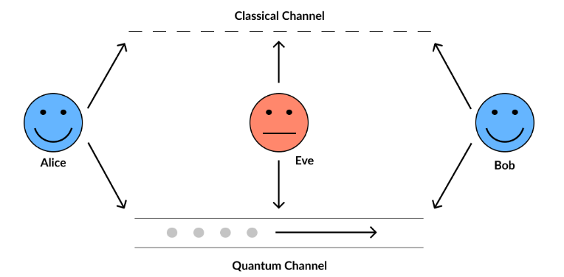
Quantum Key Distribution
General Representation of QKD setup

Slide 8
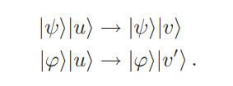
Quantum Key Distribution
Proof: Let |ψ> and |ϕ> be the non-orthogonal quantum states Eve is trying to obtain information about.
Assume without loss of generality that the process she uses to obtain information is to unitarily interact the state (|ψ> or |ϕ>) a standard state |u>.

Slide 9

Quantum Key Distribution
Eve would like |v> and |v’> to be different so that she can acquire information about the identity of the state.
Since inner products are preserved under unitary transformations, it must be that :
Thus, distinguishing between |ψ> and |ϕ> must inevitably disturb at least one of these states.

Slide 10
Quantum Key Distribution
The threshold for the maximum tolerable error rate is thus determined by the efficacy of the best information reconciliation and privacy amplification protocols. Three different QKD protocols are :
BB84 Protocol
B92 Protocol
EPR Protocol

Slide 11
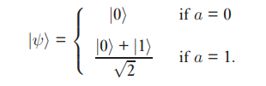
B92 Protocol
BB84 protocol can be generalized to use other states and bases, and similar conclusions hold.
Particularly simple protocol exists in which only two states are used.
Suppose Alice prepares one random classical bit a, and, depending on the result, sends Bob.

Slide 12
B92 Protocol
Bob’s Side:
Generates a random classical bit a’.
If a’ = 0, measures the qubit in Z basis [ |0>, |1> ]
If a’ = 1, measures the qubit in X basis [ (|0>+|1>)/√2, (|0>-|1>)/√2 ]
From his measurement, he obtains the result b, which is 0 or 1, corresponding to the −1 and +1 eigenstates of X and Z.

Slide 13
B92 Protocol
Then Bob publicly announces b, Alice and Bob conduct a public discussion keeping only those pairs {a, a’} for which b = 1.
Note: If a = a’, then b = 0 always
Only if a’ = 1 – a, then b = 1 [ Occurs with probability 0.5]
Final key is : a for Alice and 1-a for Bob.

Slide 14
B92 Protocol
This protocol highlights how the impossibility of perfect distinction between non-orthogonal states lies at the heart of quantum cryptography.
B92 protocol allows Alice and Bob to created shared key bits while also placing an upper bound on the noise and eavesdropping during their communication. They can then apply information reconciliation and privacy amplification to extract secret bits from their resulting correlated random bit strings.

Slide 15

EPR Protocol
In EPR protocol, it turns out that the key can be seen to arise from a fundamentally random process involving the properties of entanglement.
Suppose Alice and Bob share a set of n entangled pairs of qubits in the state
These states are known as EPR states.

Slide 16
EPR Protocol
Obtaining these states can happen in different ways:
Alice could prepare the pairs and then send half of each to Bob, or vice versa.
Third party could prepare the pairs and send halves to Alice and Bob.
They could have met a long time ago and shared them, storing them until the present.

Slide 17
EPR Protocol
Alice and Bob then select a random subset of the EPR pairs, and test to see if they violate Bell’s inequality or some other appropriate test of fidelity.
Passing the test certifies that they continue to hold sufficiently pure, entangled quantum states, placing a lower bound on the fidelity of the remaining EPR pairs.

Slide 18
EPR Protocol
Where do the key bits come from in this EPR protocol?
Since it is symmetric – Alice and Bob perform identical tasks on their qubits, even possibly simultaneously – it cannot be said that either Alice or Bob generates the key. Rather, the key is truly random.
1. Suppose that Alice prepares a random classical bit b, and according to it, measures her half of the EPR pair in either the |0>, |1> basis, or in the basis |± >= (|0>±|1>)/ √ 2, obtaining a.

Slide 19
EPR Protocol
2. Let Bob do identically, measuring in (his randomly chosen) basis b’ and obtaining a’
3. Now they communicate b and b over a public classical channel, and keep as their key only those {a, a’} for which b = b’
Note : This key is ‘undetermined’ until Alice or Bob performs a measurement on their EPR pair half.

Slide 20
Quantum Cryptography
Quantum cryptography is sometimes thought of not as secret key exchange or transfer, but rather as secret key generation, since fundamentally neither Alice nor Bob can pre-determine the key they will ultimately end up with upon completion of the protocol.

Slide 21
THANK YOU

