Slide 1
Quantum Circuit That Makes a Three Qubit GHZ State Non CIE Component Quantum Computing MCS22
Department of Computer Science and Engineering
Presented By:
Somanath R Goudar
1MS21SCS20

Slide 2
Quantum Entanglement
Quantum entanglement is the state where two systems are so strongly correlated that gaining information about one system will give immediate
information about the other no matter how far apart these systems are.
How it is used in Quantum Computing?
In quantum computers, changing the state of an entangled qubit will change the state of the paired qubit immediately.

Slide 3
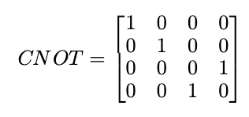

Bell State Circuit
Bell state circuit is used to generate two maximally entangled quantum states. This circuit is used in quantum mechanics to test Bell inequalities. It consists of a Hadamard gate and a CNOT gate.
Mathematical representation of these gates is given by:

Slide 4
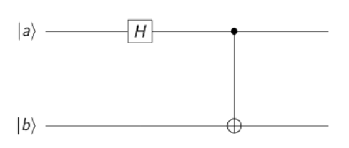
Algorithm:
1: start
2: input |a>
3: input |b>
4: apply H on |a>
5: calculate tensor product of |a> and |b>
6: apply CNOT on the product
7: end

Slide 5
Q/A: Create a quantum circuit that makes a three-qubit GHZ state Show the steps of the building, visualizing and simulating the circuit.

Slide 6
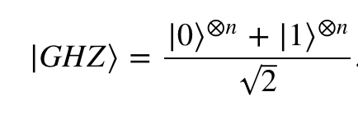
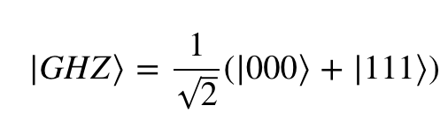
GHZ State Circuit
A GHZ circuit (named after its founders Greenberger, Horne and Zeilinger) is used to generate three or more maximally entangled quantum states. It also uses Hadamard and CNOT gates.
For the system of n qubits
the GHZ state can be written as,
For 3 Qubit GHZ State,

Slide 7
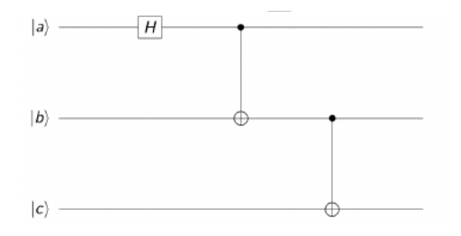
GHZ Procedure Algorithm:
1: start
2: input |a>
3: input |b>
4: input |c>
5: apply H on |a>
6: calculate tensor product of |a> and |b>
7: apply CNOT on the product
8: calculate tensor product of the result and |c>
9: apply CNOT on |b> and |c>
10: end

Slide 8
Observations
In experiments with two entangled particles, where Bell’s inequalities are tested, one comes to the conclusion that statistical predictions of quantum mechanics are in conflict with local realism. According to an observation of Greenberger, Horne and Zeilinger, made back in 1989, the entanglement of more than two particles will show that not only statistical but also nonstatistical predictions of quantum mechanics are in conflict with local realism.

Slide 9
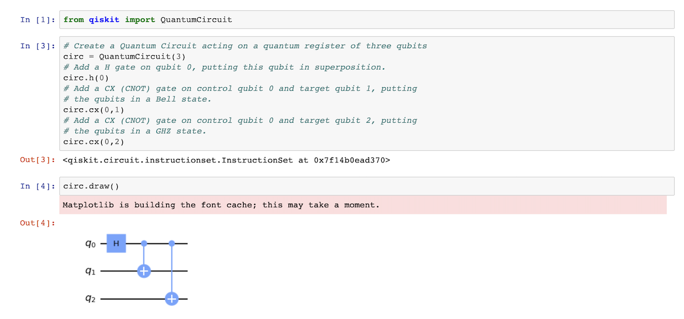
Implementation

Slide 10
Simulating Circuits using Qiskit Aer
Qiskit Aer is a package for simulating quantum circuits. It provides many different backends for doing a simulation.
Statevector Backend
The most common backend in Qiskit Aer is the statevector. This simulator returns the quantum state, which is a complex vector of dimensions 2^{n}, where n is the number of qubits.

Slide 11
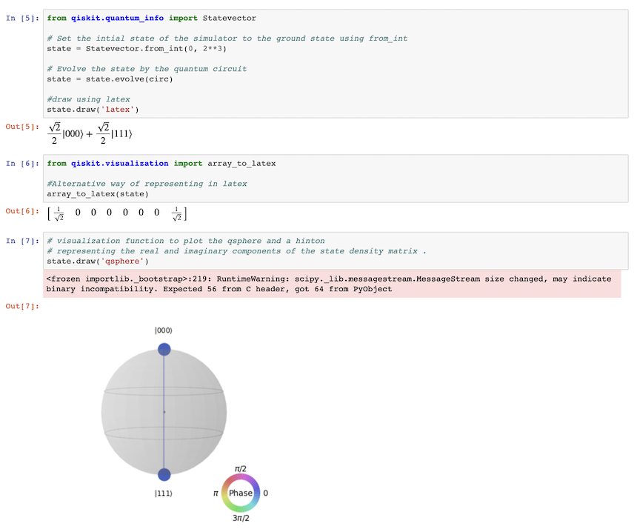

Slide 12
References
[1] M. Senekane, L. Mohapi and F. Petruccione, "Simulating quantum circuits with GNU Octave and Python," 2013 Africon, 2013, pp. 1-4, doi: 10.1109/AFRCON.2013.6757857.
[2] Quantiki, “GHZ” 2015, (online) https://www.quantiki.org/wiki/ghz
[3] Quantum Computing, A Gentle Introduction Eleanor G. Rieffel, and Wolfgang H. Polak MIT press (2014)
[4] Quantum Computation and Quantum Information, M. A. Nielsen & I.Chuang, Cambridge University Press (2013).

Slide 13
THANK YOU

