Slide 1
M.Tech (CSE) – Second Semester (Term: June - September 2022) Title – Superdense Coding Non-CIE Component Quantum Computing – (MCS22)
Department of Computer Science and Engineering
Presented By:
Manasa M
1MS21SCS11

Slide 2
Superdense coding
In quantum computing, superdense coding (also referred to as dense coding) is a quantum communication protocol used to communicate a number of classical bits of information by only transmitting a smaller number of qubits.
Superdense coding is defined as, the ability to transmit two bits of classical information by transmitting one qubit of quantum information.

Slide 3

Superdense coding involves two parties, conventionally known as ‘Alice’ and ‘Bob’, who are far away from one another.
Their goal is to transmit some classical information from Alice to Bob.
Suppose Alice and Bob initially share a pair of qubits in the entangled state.

Slide 4
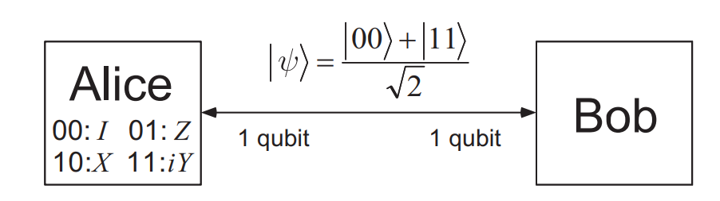
Alice is initially in possession of the first qubit, while Bob has possession of the second qubit. |ψ> is a fixed state; there is no need for Alice to have sent Bob any qubits in order to prepare this state. Instead, some third party may prepare the entangled state ahead of time, sending one of the qubits to Alice, and the other to Bob.
Figure1:The initial setup for superdense coding, with Alice and Bob each in possession of one half of an entangled pair of qubits.

Slide 5
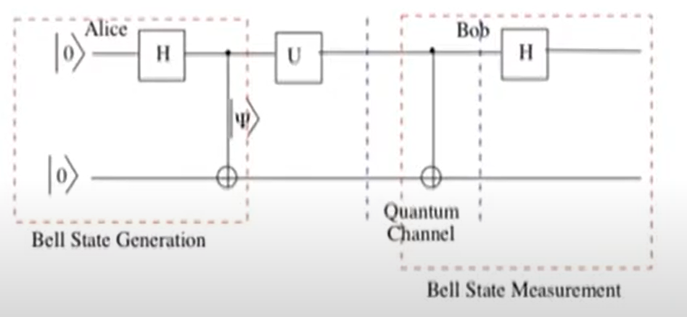
Figure 2: Schematic diagram of generation of Bell states

Slide 6
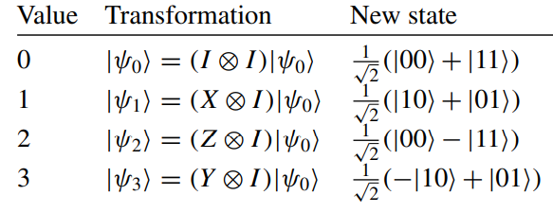
If she wishes to send the bit string ‘00’ to Bob then she does nothing at all to her qubit.
If she wishes to send ‘01’ then she applies the quantum gate, X, to her qubit.
If she wishes to send ‘10’ then she applies the phase flip Z to her qubit.
If she wishes to send ‘11’ then she applies the iY gate to her qubit.

Slide 7
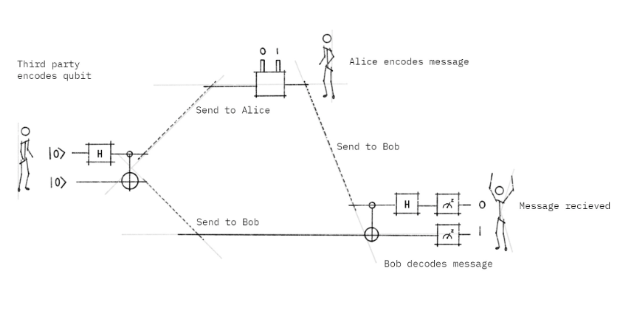
How to send two bits using one qubit ?

Slide 8

STEP 1
The process starts with a third party, who we'll call Charlie. Two qubits are prepared by Charlie in an entangled state. He initially starts the 2 qubits in the basis state |0>.He applies Hadamard gate (H) to the first qubit to create superposition. He then applies CNOT gate (CX) using the first qubit as a control and the second as the target. This is the entangled state (Bell pair) we mentioned earlier.
Outcome States
We start in the state:
where the qubit to be sent to Alice is labeled with A and the qubit to be sent to Bob is labeled B.

Slide 9


Charlie first applies a Hadamard gate to the first qubit, which creates superposition and we get the state:
Then Charlie applies the CNOT gate. The CNOT gate entangles both qubits, i.e. it flips the target if the control is |1> . Note that the control qubit is our leftmost qubit.

Slide 10
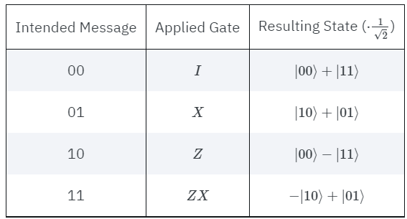
STEP 2
Charlie sends the first qubit to Alice and the second qubit to Bob. The goal of the protocol is for Alice to send 2 classical bits of information to Bob using her qubit. But before she does, she needs to apply a set of quantum gates to her qubit depending on the 2 bits of information she wants to send:
Encoding Rules for Superdense Coding (Alice protocol):

Slide 11
Thus if she wants to send a 00, she does nothing to her qubit (apply the identity (I) gate). If she wants to send a 01, then she applies the (X) gate. Depending on what she wants to send, she applies the appropriate gate, then sends her qubit to Bob for the final step in the process.

Slide 12
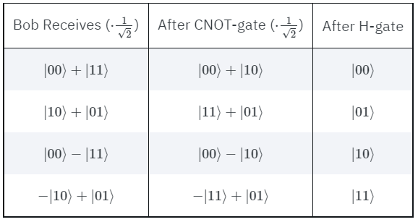
STEP 3
Bob receives Alice's qubit (leftmost qubit) and uses his qubit to decode Alice's message. Notice that he does not need to have knowledge of the state in order to decode it — he simply uses the restoration operation.
Bob applies a CNOT gate using the leftmost qubit as control and the rightmost as target. Then he applies a Hadamard gate and finally performs a measurement on both qubits to extract Alice's message.

Slide 13

Qiskit
Simulating the Superdense Coding Protocol

Slide 14
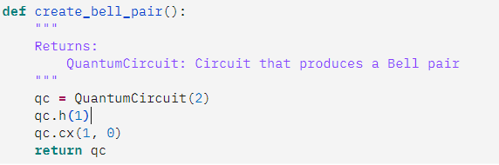
We saw that to create an entangled pair, we needed to do a H-gate followed by a CNOT. Let's create a function that takes a Quantum-Circuit and entangles the qubits with indices a and b:

Slide 15
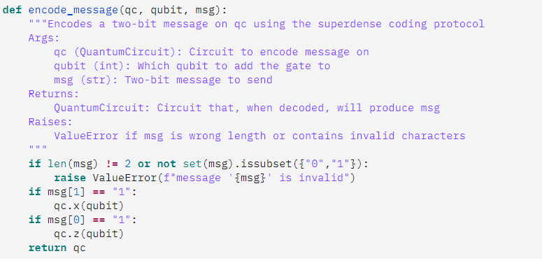
Next we need to encode our message. We saw that there were four possible messages we could send: 00, 10, 01 or 11. Let's create a function that takes this message and applies the appropriate gates for us:

Slide 16

Finally, we need to decode our message, we saw we could do this using a CNOT followed by a H-gate. Let's create a function that does this for us too:
Finally, we can put this together to complete our protocol.

Slide 17
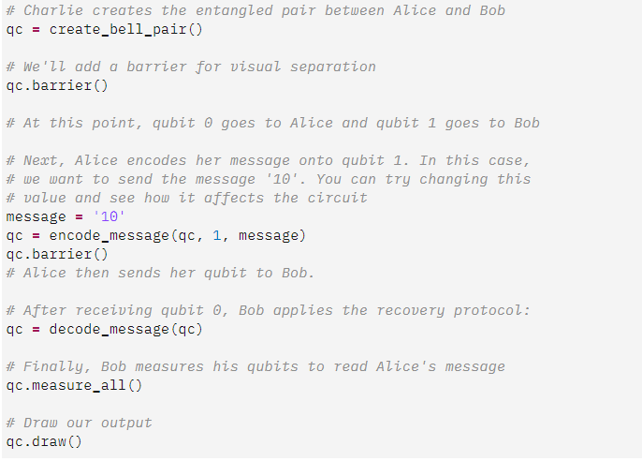

Slide 18
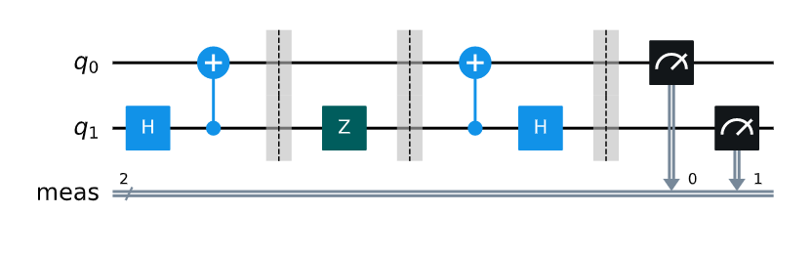
OUTPUT:

Slide 19
Summary :
Alice wants to transmit two bits of classical information by transmitting one qubit of quantum information.
Alice and Bob share an EPR pair.
Goal is to send 2 classical bits through one qubit.
There is a presence of quantum channel.
Alice sends a single encoded qubit, Bob will decode the qubit and obtains Alice’s 2 classical bits.

Slide 20
THANK YOU !

