Slide 1
FAULT IDENTIFICATION IN WIND-TURBINES USING NEURAL NETWORK
BY MAYANK SOMANI (22MCA1065)
VIT,CHENNAI
GUIDE NAME- Dr. Amrit Pal

Slide 2
ABSTRACT
Condition monitoring and early fault diagnosis for wind turbines have become essential industry practice as they help improve wind farm reliability, overall performance and productivity.
In the last five years, a lot of research has been done on neural networks as a typical representation of intelligent diagnostic models.
A lot of this research has been published in academic journals and conference proceedings. However, all of this research is dispersed across the internet and not present in one location. Therefore, in an effort to close this gap, a review and summary of the major literature surveys linked to fault diagnosis are provided .

Slide 3
INTRODUCTION
Neural networks are a powerful machine learning technique that can be used to analyze sensor data from wind turbines and identify faults. They are inspired by the structure and function of the human brain and consist of a large number of interconnected processing units, called neurons. In the context of wind turbine fault identification, neural networks can be trained on a large dataset of normal and fault conditions to learn the patterns that correspond to different types of faults. Once trained, the neural network can analyze sensor data in real-time and provide an output indicating the presence and type of fault. The use of neural networks in wind turbine fault identification is becoming increasingly common in the wind energy industry due to their accuracy and efficiency.

Slide 4
MOTIVATION
Neural networks are a powerful machine learning technique that can be used to analyze sensor data from wind turbines and identify faults. They are inspired by the structure and function of the human brain and consist of a large number of interconnected processing units, called neurons. In the context of wind turbine fault identification, neural networks can be trained on a large dataset of normal and fault conditions to learn the patterns that correspond to different types of faults. Once trained, the neural network can analyze sensor data in real-time and provide an output indicating the presence and type of fault. The use of neural networks in wind turbine fault identification is becoming increasingly common in the wind energy industry due to their accuracy and efficiency.

Slide 5
LITREATURE SURVEY
Paper No. | Attributes of data set | Algorithms | Accuracy
Paper 1: Wind turbine condition monitoring by the approach of SCADA data analysis . | Generator speed, Rotor speed, Blade pitch angle, Nacelle position, Active power output, Reactive power output, Wind speed, Wind direction, Ambient temperature, Gearbox oil temperature, Generator bearing temperature, Blade root vibration and Tower acceleration | ANN ,Random Forest ,SVM (support vector machine), PCA(principal component analysis ) | Reported that the overall accuracy of their approach was over 90%.
PAPER 2: Detection and classification of faults in pitch-regulated wind turbine generators using normal behaviour models based on performance curves. | Generator speed, Rotor speed, Blade pitch angle, Power output, Wind speed, Ambient temperature, Hydraulic pressure, Pitch system status. | ANN ,Random Forest ,SVM (support vector machine) | The authors reported an overall accuracy of 93% for fault detection, and an overall accuracy of 86% for fault classification.

Slide 6
Paper No. | Attributes of data set | Algorithms | Accuracy
PAPER 3: Diagnosing wind turbine faults using machine learning techniques applied to operational data. | The attributes used in the analysis may include data related to the operation of wind turbines, such as wind speed, power output, temperature, vibration, and other sensor data. | ANN,RNN(Recurrent neural network),SVM(support vector machine), PCA(principal component analysis ) | As this paper do not provide specific results or accuracy levels
PAPER 4: A generalized model for wind turbine anomaly identification based on SCADA data. | Data from the Supervisory Control and Data Acquisition (SCADA) system, wind turbine speed, wind direction, generator speed, generator power, rotor speed, blade pitch angle, nacelle position, ambient temperature, oil temperature, vibration signals, electrical signals. | ANN ,Random Forest ,SVM (support vector machine), ELM(Extreme learning machine) | The proposed model achieved an overall detection rate of 92.4% for different types of wind turbine anomalies, with a false alarm rate of 1.9%.

Slide 7
Paper No | Attributes of data set | Algorithms | Accuracy
PAPER 5: A combined mono-and multi-turbine approach for fault indicator synthesis and wind turbine monitoring using SCADA data. | Generator speed, Generator power, Rotor speed, Blade pitch angle, Nacelle position, Ambient temperature, Oil temperature, Reactive power, Active power, Wind speed, Wind direction, Pitch system status, Brake status. | ANN, Principal Component Analysis (PCA), Multivariate State Estimation Technique (MSET), Support Vector Machine (SVM), Decision Tree (DT) | The authors report a fault detection rate of 95% and a fault diagnosis rate of 91% using the proposed approach, which is based on the combination of PCA, MSET, SVM, and DT algorithms.
PAPER 6: Real-time condition monitoring and fault detection of components based on machine-learning reconstruction model | Torque, Temperature, Vibration, Current, Voltage, Power, Speed, and Oil pressure. | Random Forest (RF), Back Propagation Neural Network (BPNN), Local Projection-based Feature Extraction (LPFE), Empirical Mode Decomposition (EMD) | The algorithms yielded satisfactory results on the experimental data set but need to make the data set more efficient.

Slide 8
Paper No | Dataset | Algorithms | Accuracy
PAPER 7: Anomaly detection and fault analysis of wind turbine components based on deep learning network. | Wind speed, Generator speed, Rotor speed, Pitch angle, Power output, Vibration signals. | ANN, Convolutional neural network (CNN), Recurrent neural network (RNN) | The authors reported that their proposed method achieved an accuracy of 98.0% for anomaly detection, which was higher than traditional machine learning methods.
PAPER 8: Detection and classification of faults in pitch-regulated wind turbine generators using normal behaviour models based on performance curves. | Wind speed, Rotor speed, Generator speed, Pitch angle, Electrical power output, Blade pitch angle, Generator torque, Nacelle direction. | Support Vector Machines (SVM), Artificial Neural Networks (ANN) , K-means clustering, Principal Component Analysis (PCA) | The results showed that the proposed method using SVM and ANN achieved a fault detection rate of 99.5% and an accuracy of 98.1%, which outperformed other methods such as PCA and k-means clustering.

Slide 9
Paper | Attributes of data set | Algorithms | Accuracy
PAPER 9:An imbalance fault detection algorithm for variable-speed wind turbines | Generator speed, Pitch angle of the blades, Reactive power, Active power, Wind speed, Rotor speed, Voltage and current signals from the generator, Temperature of the generator and other components. | Convolutional Neural Network (CNN), Short-time Fourier transform (STFT), Principal component analysis (PCA), Recursive feature elimination (RFE), Support vector machine (SVM) | The authors report a detection accuracy of 97.8% for their proposed algorithm.
PAPER 10: Application of spectral kurtosis and improved extreme learning machine for bearing fault classification. | Sampling frequency, Number of data points, Number of bearings, Bearing types, Number of fault levels, Number of repetitions, Data format, Data acquisition method, Operating conditions. Vibration signals were collected under these conditions for each fault type and severity level, resulting in a total of 360 vibration signals | Spectral Kurtosis (SK), Improved Extreme Learning Machine (ELM), K-Means clustering, Principal Component Analysis (PCA) and Support Vector Machine (SVM) | The author reports an overall classification accuracy of 99.63% for the proposed method.

Slide 10
Paper | Attributes of data set | Algorithms | Accuracy
PAPER 11:Enhanced random forest with concurrent analysis of static and dynamic nodes for industrial fault classification | Mean, standard deviation, root mean square, kurtosis of vibration signals in the time domain,Power spectral density, mean frequency, and spectral entropy of vibration signals in the frequency domain Energy and entropy of vibration signals in the wavelet domain The authors also mentioned that they used a total of 19 features, consisting of 7 static and 12 dynamic features, to classify the industrial faults. | ANN, Random Forest, Static node analysis, Dynamic node analysis, Concurrent analysis and ELM | NA
PAPER 12:Research on fault detection for three types of wind turbine subsystems using machine learning. | Gearbox system: Gearbox oil temperature, Gearbox oil level, Gearbox bearing temperature, Gearbox vibration Generator system: Generator winding temperature, Generator bearing temperature, Generator vibration Pitch system: Pitch bearing temperature, Pitch motor temperature, Pitch angle, Pitch vibration | Artificial neural networks (ANNs) Decision trees (DTs) Support vector machines (SVMs) | Gearbox system: 99.86%. Generator system: 99.33%. Pitch system: 98.89

Slide 11
Paper | Attributes of data set | Algorithms | Accuracy
PAPER13:Bearing fault classification of induction motors using discrete wavelet transform and ensemble machine learning algorithms | Statistical features, Time-domain features, Frequency-domain features, Higher-order spectral analysis features, Power spectral density (PSD) features, Kurtogram features. | Decision tree, Random forest, Adaboost, Gradient boosting machine (GBM) and Extreme gradient boosting (XGBoost) | The average accuracy of the five machine learning algorithms used in the paper is approximately 96.34%. However, it's important to note that this is not an exact calculation, and the actual average accuracy may vary depending on the specific weights given to each algorithm's accuracy level.
PAPER 14:Real-world application of machine-learning-based fault detection trained with experimental data. | Current, Voltage, Power, Frequency, Harmonics, Phasors, Phase angle. | SVM, k-NN, decision tree, random forest, and GBM. | The accuracy of the SVM algorithm for fault detection was reported to be 99.2%. The k-NN algorithm achieved an accuracy of 98.1%, while the decision tree algorithm achieved an accuracy of 96.8%. The random forest algorithm achieved an accuracy of 97.3%, and the GBM algorithm achieved an accuracy of 98.4%.

Slide 12
Paper | Attributes of data set | Algorithms | Accuracy
PAPER15: Wind turbine fault diagnosis and predictive maintenance through statistical process control and machine learning. | Wind speed, generator speed, rotor speed, pitch angle, active power, reactive power, temperature, vibration, oil debris, pressure, humidity, voltage. | CNN, random forest, SVM, ANN and logistic regression. | NA
PAPER16: Evaluation of three potential machine learning algorithms for predicting the velocity and turbulence intensity of a wind turbine wake | Wind speed at the turbine rotor plane, Wind direction at the turbine rotor plane, Ambient turbulence intensity, Thrust coefficient, Tip-speed ratio, Blade pitch angle, Hub height, Distance between wind turbines, Time of day, Atmospheric stability, Ambient wind shear exponent, Temperature, Air pressure. | Artificial neural network (ANN), Random forest (RF), Support vector regression (SVR) | The study found that all three algorithms were able to accurately predict the wake characteristics of a wind turbine, with the ANN algorithm performing slightly better than the other two algorithms in terms of the evaluation metrics used

Slide 13
Paper | Attributes of data set | Algorithms | Accuracy
PAPER17:A comprehensive study on Structural Health Monitoring (SHM) of wind turbine blades by instrumenting tower using machine learning methods. | Structural Health Monitoring (SHM), Wind turbine blades, Tower instrumentation, Machine learning, Renewable energy, Condition monitoring, Vibration analysis, Acoustic emissions, Strain gauges, Accelerometers, Temperature sensors, Data acquisition, Data preprocessing etc | Linear Regression,Support Vector Regression (SVR), Decision Tree Regression, Random Forest Regression, Gradient Boosting Regression And Artificial Neural Network (ANN) | NA
PAPER 18:SCADA system dataset exploration and machine learning based forecast for wind turbines. | SCADA system, Dataset exploration, Machine learning, Wind turbines, Power output, Weather conditions, Hub height, Rotor diameter, Nacelle direction, Wind speed, Wind direction, Ambient temperature, Generator speed, Pitch angle, Vibration sensors, Anemometers, Wind vanes, etc | Linear Regression, Decision Tree, Random Forest, Support Vector Regression (SVR), Artificial Neural Network (ANN) | Effectively achieved the target but the accuracy level vary depending in the given input values.

Slide 14
RESEARCH GAP IDENTIFIED
Limited data: Most of the studies have used data from a single or few wind turbines. This limitation reduces the diversity of data and limits the generalization of results to other wind turbines with different specifications.
Lack of comparative studies: There is a lack of comparative studies that evaluate the performance of different neural network models or machine learning algorithms for fault identification in wind turbines.
Limited use of deep learning: Although some studies have used deep learning techniques such as convolutional neural networks (CNN) and recurrent neural networks (RNN), their use is still limited in fault identification in wind turbines.
Limited real-world application: Most studies have been conducted in a controlled laboratory or simulated environment. There is a need for studies that validate the performance of neural networks in real-world conditions, where the data is noisy and there are uncertainties in the operational environment

Slide 15
Limited consideration of external factors: Most studies have focused on identifying faults based on operational data from the wind turbine. However, external factors such as weather conditions and grid disturbances can also impact the performance of the wind turbine. There is a need for studies that consider these external factors in fault identification.

Slide 16

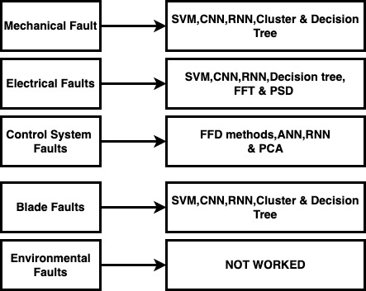
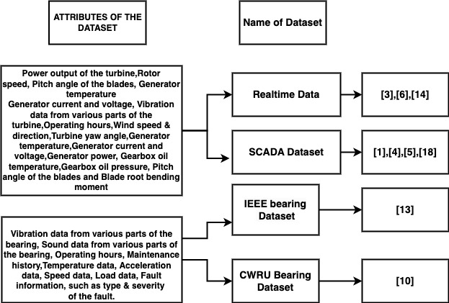
COMPARATIVE ANALYSIS

Slide 17
IMPLEMENTATION & DATASET USED
IMPLEMENTATION:
Data pre-processing: The labeled wind turbine data was loaded and the "Fault" column was added to it using a custom labeling function. Then, the dataset was split into training and testing sets using the train_test_split function from sklearn.
Random Forest Classifier: A Random Forest Classifier was trained on the training set using the RandomForestClassifier function from sklearn. The model was then used to make predictions on the testing set and its accuracy was evaluated using the accuracy_score function from sklearn.
Convolutional Neural Network: The data was scaled using the StandardScaler function from sklearn and then reshaped for input to the CNN model. The CNN model was built using the Sequential model from Keras with a Conv1D layer, MaxPooling1D layer, Flatten layer, and Dense layer. The model was then compiled using the binary_crossentropy loss function, the Adam optimizer, and the accuracy metric. The model was trained on the training set and validated on the testing set using the fit function from Keras.
Model Evaluation: The accuracy of the Random Forest Classifier and the CNN model were compared to determine which model performed better in fault identification.

Slide 18
DATASET:
The SCADA Dataset used in this implementation is a wind turbine dataset that contains measurements of the following variables:
LV ActivePower (kW): the power output of the wind turbine in kW
Wind Speed (m/s): the speed of the wind in m/s
Theoretical_Power_Curve (KWh): the theoretical power output of the wind turbine in KWh
Wind Direction (°): the direction of the wind in degrees
After data pre-processing dataset will also includes a "Fault" column that indicates whether or not a fault occurred in the wind turbine. A fault is indicated by a value of 1 in the "Fault" column, and a value of 0 indicates that no fault occurred. The dataset was used to train and test the Random Forest Classifier and the CNN model to identify faults in wind turbines based on the measurements of the variables in the dataset.

Slide 19
INPUTS FOR RANDOM FOREST
X_train: This variable represents the input features for the training set. It is a DataFrame that contains the following columns: 'LV ActivePower (kW)', 'Wind Speed (m/s)', 'Theoretical_Power_Curve (KWh)', 'Wind Direction (°)'. These columns correspond to the features used to train the Random Forest classifier.
y_train: This variable represents the target variable (labels) for the training set. It is a Series or array-like object that contains the corresponding labels or classes for the training samples.
X_test: This variable represents the input features for the test set. It is a DataFrame with the same columns as X_train and contains the test samples' features.
y_test: This variable represents the target variable (labels) for the test set. It is a Series or array-like object that contains the corresponding labels or classes for the test samples.
The Random Forest classifier uses the input features (X_train, X_test) and their corresponding labels (y_train, y_test) to learn patterns and relationships in the data during the training phase. It then uses this learned information to make predictions on unseen data (test set) during the prediction phase.

Slide 20
INPUTS FOR CNN
In the CNN, the input began from convolutional layer which expects a three-dimensional input tensor with the shape (num_samples, num_features, num_channels).
To break it down further:
num_samples: This represents the number of samples or instances in your dataset. It corresponds to the number of rows or data points you have.
num_features: This refers to the number of features or input variables in your dataset. It corresponds to the number of columns or input dimensions.
num_channels: In the case of a 1D convolutional layer (Conv1D), the num_channels is set to 1. It represents the number of channels in the input data and is required for convolutional layers to operate.

Slide 21
WORKING OF CNN MODEL
Data Preprocessing: The input data is first preprocessed. The features are scaled using StandardScaler to normalize their values and ensure they are on a similar scale. Then, the scaled data is reshaped to match the input shape required by the CNN model.
Building the CNN Model: The CNN model is defined using the Keras Sequential API. It consists of several layers:
Convolutional Layer: This layer applies filters to the input data to extract features. Each filter represents a pattern or feature to be detected. The number of filters and their size is specified (e.g., 32 filters with a kernel size of 3).
Max Pooling Layer: This layer reduces the spatial dimensions of the data by selecting the maximum value within small windows. It helps retain important features while reducing the computational complexity.
Flatten Layer: This layer converts the 2D output from the previous layers into a 1D vector, preparing it for the fully connected layers.
Fully Connected Layer: This layer connects every neuron from the previous layer to the subsequent layer. It learns complex patterns and makes final predictions. In this case, there is a single neuron with a sigmoid activation function, which outputs a value between 0 and 1 representing the probability of a binary classification (fault or no fault).

Slide 22
Compiling the Model: The model is compiled by specifying the loss function (binary cross-entropy) and optimizer (Adam). The loss function measures the difference between predicted and actual values, while the optimizer adjusts the model's weights to minimize the loss.
Training the Model: The model is trained using the training data. It goes through multiple epochs (complete passes through the data) and adjusts the weights based on the loss function and optimizer. The batch size determines how many samples are processed before updating the weights.
Predicting and Evaluating: The trained model is used to predict the fault status for the test data. A threshold of 0.5 is applied to convert the output probabilities to binary predictions (fault or no fault). The accuracy of the predictions is then evaluated using the accuracy score.
Fault Identification: Based on the predictions from the Random Forest Classifier and the CNN model, the code determines whether a fault has been identified or not. If either model predicts a fault, it prints "Fault identified." Otherwise, it prints "No fault identified."

Slide 23
WHY RANDOM FOREST AND CNN??
Random Forest is a popular machine learning algorithm for classification tasks. It works by constructing multiple decision trees at training time and outputting the class that is the mode of the classes (classification) or mean prediction (regression) of the individual trees. In this project, it is used as a baseline model to classify the wind turbine data as either normal or faulty while
On the other hand, CNNs are deep learning models that can learn to recognize patterns and features in input data through multiple layers of convolutional filters. They have been successfully used in many computer vision tasks, including image classification.
In this case, both Random Forest and CNN are used to predict the fault in wind turbine data. Random Forest is used as a traditional machine learning approach. CNN is used as a deep learning approach. Both models are compared to determine which one performs better in this specific task.

Slide 24
GLIMPSE OF WORKING MODEL

Slide 25
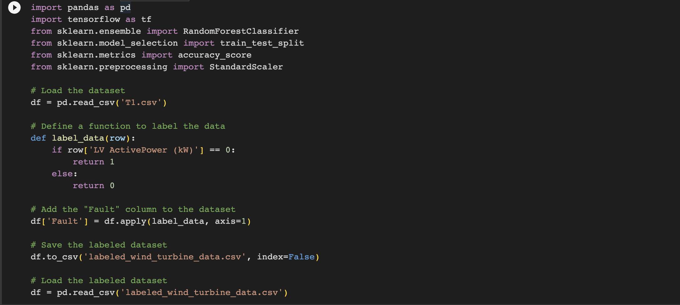

Slide 26
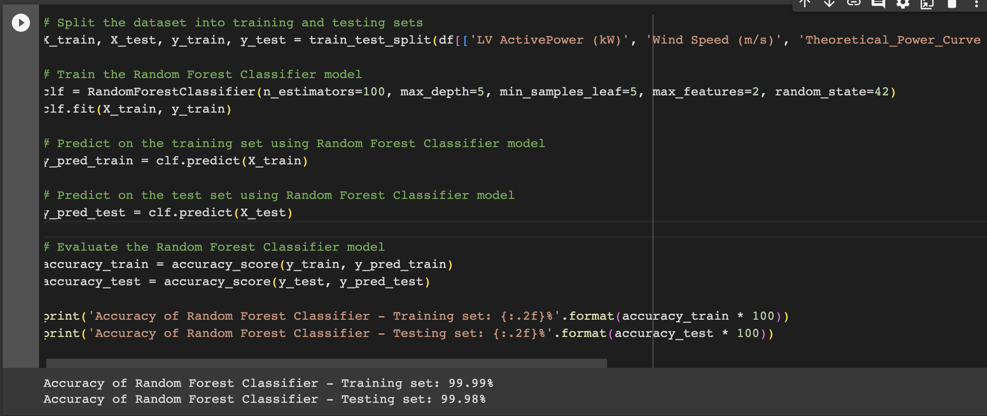
RANDOM FOREST

Slide 27
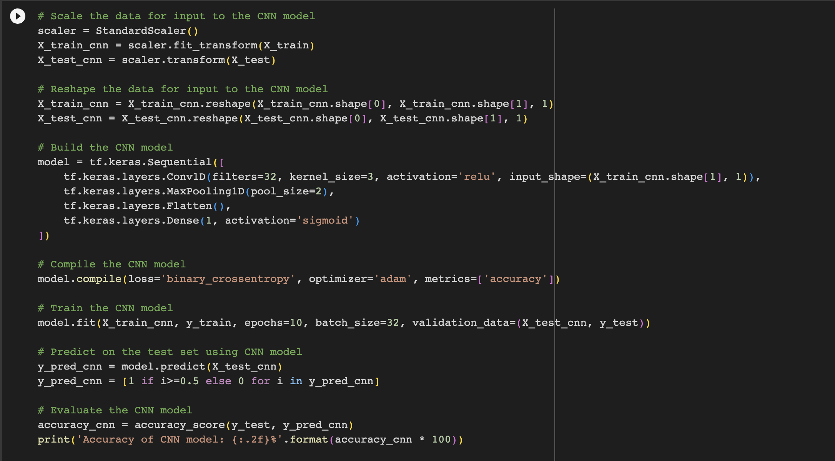
CNN(Convolutional neural network)

Slide 28
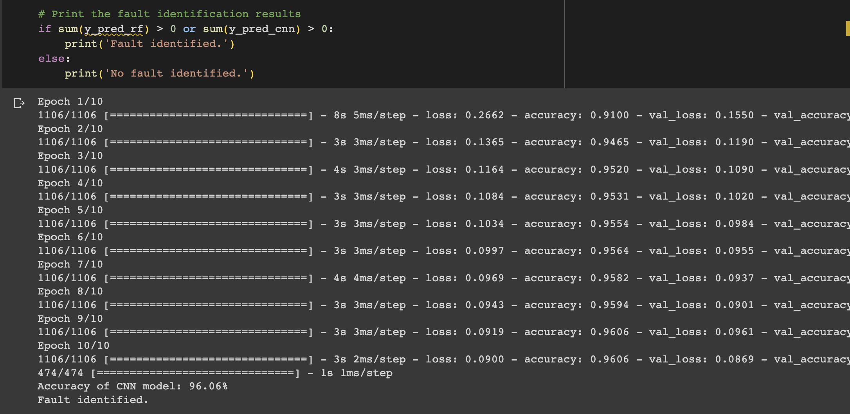

Slide 29

GUIDE’S APPROVAL MAIL

Slide 30
REFERENCES
[1] Yang, W., Court, R., & Jiang, J. (2013). Wind turbine condition monitoring by the approach of SCADA data analysis. Renewable energy, 53, 365-376.
[2] Bi, R., Zhou, C., \& Hepburn, D. M. (2017). Detection and classification of faults in pitch-regulated wind turbine generators using normal behaviour models based on performance curves. Renewable Energy, 105, 674-688
[3] Leahy, K., Hu, R. L., Konstantakopoulos, I. C., Spanos, C. J., & Agogino, A. M. (2016, June). Diagnosing wind turbine faults using machine learning techniques applied to operational data. In 2016 ieee international conference on prognostics and health management (icphm) (pp. 1-8). IEEE.
[4] Sun, P., Li, J., Wang, C., & Lei, X. (2016). A generalized model for wind turbine anomaly identification based on SCADA data. Applied Energy, 168, 550-567.

Slide 31
[5] Lebranchu, A., Charbonnier, S., Bérenguer, C., & Prevost, F. (2019). A combined mono-and multi-turbine approach for fault indicator synthesis and wind turbine monitoring using SCADA data. ISA transactions, 87, 272-281.
[6] Yang, C., Liu, J., Zeng, Y., & Xie, G. (2019). Real-time condition monitoring and fault detection of components based on machine-learning reconstruction model. Renewable Energy, 133, 433-441.
[7] Zhao, H., Liu, H., Hu, W., & Yan, X. (2018). Anomaly detection and fault analysis of wind turbine components based on deep learning network. Renewable energy, 127, 825-834.
[8] Bi, R., Zhou, C., & Hepburn, D. M. (2017). Detection and classification of faults in pitch-regulated wind turbine generators using normal behaviour models based on performance curves. Renewable Energy, 105, 674-688.
[9] Chen, J., Hu, W., Cao, D., Zhang, B., Huang, Q., Chen, Z., & Blaabjerg, F. (2019). An imbalance fault detection algorithm for variable-speed wind turbines: A deep learning approach. Energies, 12(14), 2764.

Slide 32
[10] Udmale, S. S., & Singh, S. K. (2019). Application of spectral kurtosis and improved extreme learning machine for bearing fault classification. IEEE Transactions on Instrumentation and Measurement, 68(11), 4222-4233.
[11] Chai, Z., & Zhao, C. (2019). Enhanced random forest with concurrent analysis of static and dynamic nodes for industrial fault classification. IEEE Transactions on Industrial Informatics, 16(1), 54-66.
[12] Liu, Z., Xiao, C., Zhang, T., & Zhang, X. (2020). Research on fault detection for three types of wind turbine subsystems using machine learning. Energies, 13(2), 460.
[13] Nishat Toma, R., & Kim, J. M. (2020). Bearing fault classification of induction motors using discrete wavelet transform and ensemble machine learning algorithms. Applied Sciences, 10(15), 5251.
[14] Bode, G., Thul, S., Baranski, M., & Müller, D. (2020). Real-world application of machine-learning-based fault detection trained with experimental data. Energy, 198, 117323.
[15] Hsu, J. Y., Wang, Y. F., Lin, K. C., Chen, M. Y., \& Hsu, J. H. Y. (2020). Wind turbine fault diagnosis and predictive maintenance through statistical process control and machine learning. Ieee Access, 8, 23427-23439.

Slide 33
[16] Purohit, S., Ng, E. Y. K., & Kabir, I. F. S. A. (2022). Evaluation of three potential machine learning algorithms for predicting the velocity and turbulence intensity of a wind turbine wake. Renewable Energy, 184, 405-420.
[17] Khazaee, M., Derian, P., & Mouraud, A. (2022). A comprehensive study on Structural Health Monitoring (SHM) of wind turbine blades by instrumenting tower using machine learning methods. Renewable Energy, 199, 1568-1579.
[18] Singh, U., & Rizwan, M. (2022). SCADA system dataset exploration and machine learning based forecast for wind turbines. Results in Engineering, 16, 100640.
[19] Wind Turbine SCADA Dataset : www.kaggle.com/datasets/berkerisen/wind-turbine-scada-dataset
[20] https://www.kaggle.com/code/franciscotenorio/wind-turbine-energy-model-prediction

Slide 34
THANK YOU

