Slide 1
ECE 551
Digital Design And Synthesis
Fall ‘21
Lecture 2
  Commenting & Meta-stability
  Verilog Syntax (literals, 4-value, strength vectors)
  Dataflow Verilog
  Handy Miscellaneous

Slide 2
Administrative Matters
Tutorial sessions
    Tuesday 6:30 – 8:00 for those in Dis. 302 only in B555 Linux lab.
    Wednesday 6:30 – 8:00 on General channel of MS Teams
    Wednesday 8:00 – 9:30 on General channel of MS Teams
    Can also do on your own
If you are a windows user install ModelSim locally
OR…look at video on how to remote to Unix
Watch Videos on mid & final sections of Lecture02
  Quiz on these lectures next Monday in class.
Homework #1
  Due Next week by beginning of class

Slide 3
Comments in Verilog
Commenting is important
  In industry many other poor schmucks are going to read your code
  Some poor schmuck (perhaps you 4 years later) are going to have to reference your code when a customer discovers a bug.
The best comments document why you are doing what you are doing, not what you are doing.
  Any moron who knows verilog can tell what the code is doing.
  Comment why (motivation/thought process) you are doing that thing.

Slide 4
Commenting in Verilog
always @(posedge clk)
begin
Sig_FF1 <= Sig // Capture value of Sig Line in FF
Sig_FF2 <= Sig_FF1; // Flop Sig_FF1 to form Sig_FF2
Sig_FF3 <= Sig_FF2; // Flop Sig_FF2 to form Sig_FF3
end
// start_bit is ~Sig_FF2 & Sig_FF3
assign start_bit = (~Sig_FF2 && Sig_FF3) ? 1’b1 : 1’b0;
(Read with sarcasm)
“Thanks for the commenting the code pal. It tells me so much more than the verilog itself”.

Slide 5
Consequence of Bad Commenting
Sig_FF1
Sig_FF2
Sig
start_bit
Sig_FF3
clk
clk
clk
The code synthesizes as shown above
Being the next arrogant engineer reading the code and the comments I realize there is an optimization to be made.
There is no need for the two flops up front. So, I delete them.

Slide 6
Commenting in Verilog
always @(posedge clk)
/********************************************
* Sig is asynchronous and has to be double flopped *
* for meta-stability reasons prior to use ************
*********************************/
begin
Sig_FF1 <= Sig;
Sig_FF2 <= Sig_FF1; // double flopped meta-stability free
Sig_FF3 <= Sig_FF2; // flop again for use in edge detection
end
/**********************************************
* Start bit in protocol initiated by falling edge of Sig line *
**********************************************/
assign start_bit = (~Sig_FF2 && Sig_FF3) ? 1’b1 : 1’b0;
Can see 2 types
of comments.
Comment to end of line is //
Multi line comment starts with /* and ends with */
This is better commenting. It tells you why stuff was done

Slide 7
Aside: what is meta-stability
Back to back inverters
Form a “memory loop” that is central to latch
1
0
0
1
D
Q
D
Q
E
E
=0
0
0
0
1
1
Q
D
E
weak
=1

Slide 8
Aside: what is meta-stability
V_{out}
V_{out} vs V_{in} (inverter)
VDD
2
1.2V
VDD
2
D
1→0
Q
0.6V
E
V_{in}
1→0
0.6V
1.2V
Sig_FF1
Sig_FF2
Yes…the first flop can go meta-stable, but can is stay in that state for a whole clock period?
Yes, and a meteor could crash through the roof and kill us all.
Take away: Always double flop asynch signals before “using” them
asynchSig
clk
clk
clk

Slide 9
Numbers in Verilog
General format is: <size>’<base><number>
Examples:
  4’b1101 // this is a 4-bit binary number equal to 13
  10’h2e7 // this is a 10-bit wide number specified in hex
Available bases:
  d = decimal (please only use in test benches)
  h = hex (use this frequently)
  b = binary (use this frequently for smaller #’s)
  o = octal (who thinks in octal?, please avoid)

Slide 10
Numbers in Verilog
Numbers can have x or z characters as values
  x = unknown, z = High Impedance
  12’h13x // 12-bit number with lower 4-bits unknown
If size is not specified then it depends on simulator/machine.
  Always size the number for the DUT verilog
    Why create 32-bit register if you only need 5 bits?
    May cause compilation errors on some compilers
Supports negative numbers as well
  -16’h3A // this would be -3A in hex (i.e. FFC6 in 2’s complement)
  I rarely if ever use this. I prefer to work 2’s complement directly

Slide 11
Identifiers (Signal Names)
Identifiers are the names you choose for your signals
In a programming language you should choose descriptive variable names. In a HDL you should choose descriptive signal names.
  Use mixed case and/or _ to delimit descriptive names.
    assign parityErr = ^serial_reg;
    nxtState = returnRegister;
  Have a convention for signals that are active low
    Many errors occur on the interface between blocks written by 2 different people. One assumed a signal was active low, and the other assumed it was active high
    I use _n at the end of a signal to indicate active low
    rst_n = 1’b0 // assert reset

Slide 12
Signal Values & Strength in Verilog
Signals can have 1 of 4 values
Value: | Meaning:
0 | Logic zero, false condition
1 | Logic one, true condition
x | Unknown, either uninitialized or in contention
z | High impedance. Not driven, or not connected
Need high impedance for modeling of tri-state
busses
rd_eep
What value
does q have prior to any positive clock edge?
EEPROM
q
16
16
d
CPU
dbus[15:0]
clk
rd_ram
RAM
It is unknown: x
(uninitialized)
16
16

Slide 13
Resolving 4-Value Logic
S
A
OUT
A
OUT
A
T
OUT
B
B
B
A B OUT
A B OUT
S A T B OUT
0 0 0
0 1 1
1 1 1
0 x
0 z
1 x
1 z
0 0 0
0 1 0
1 1 1
0 x
0 z
1 x
1 z
0 0 z z
0 1 z x
0 x z 1
0 z z 0
1 0 0 1
1 0 0 z
1 1 1 z
1 x x z
1 z x 0
z
x
1
X
0
0
X
0
x
1
x
0
1
x
1
x
x
OUT
A
OUT
0 1 x z
1 0 x
A
X

Slide 14
Signal Values & Strength in Verilog
Strength Level | Meaning:
supply | Strongest (like a supply VDD or VSS)
strong | Strong (default if not specified)
pull | Medium strength (like a pullup device)
weak | Weak, like a keeper (sustainer, leaker)
highz | High impedance
Concept of drive strength supported to model certain CMOS circuits that utilize contention.
D
inv1
Q
not inv1 (Q,n1)
not (weak0,weak1) inv2 (n1,Q)
E
inv2

Slide 15
reg (or logic) in Verilog
reg (or logic) are storage nodes
  They retain their value till a new value is assigned
  Unlike a net (wire) they do not need a driver
  Can be changed in simulation by assigning a new value
Signals of type reg are not necessarily FlipFlops
  Anything assigned in an always or initial block must be assigned to a signal of type reg (or logic)
  This inconsistency along with people’s inability to keep it straight was part of the motivation for creation of the superset type logic.
  Just make you life easier by using type logic

Slide 16
Vectors in Verilog
Vectors are a collection of bits (i.e. 16-bit wide bus)
////////////////////////////////////////////////////////////////////
// Define the 16-bit busses going in and out of the ALU //
//////////////////////////////////////////////////////////////////
logic [15:0] src1_bus,src2_bus,dst_bus;
///////////////////////////////////////////////////////////////
// State machine has 8 states, need a 3-bit encoding //
/////////////////////////////////////////////////////////////
reg [2:0] state,nxt_state;
Bus ≠ Vector (how are they different?)

Slide 17
Vectors in Verilog
Can select parts of a vector (single bit or a range)
module lft_shift(src,shft_in,result,shft_out);
input [15:0] src;
input shft_in;
output [15:0] result;
output shft_out;
/////////////////////////////////////////////////////////////////////////
// Can access 15 LSB’s of src with [14:0] selector //
// { , } is a process of concatenating two vectors to form one //
//////////////////////////////////////////////////////////////////////
assign result = {src[14:0],shft_in};
assign shft_out = src[15]; // can access a single bit MSB with [15]
endmodule
src
16
shft_out
left shift
shft_in
16
result

Slide 18
Concatenation { }
module off_corr(
input [15:0] raw_sensor, // raw signed 16-bit sensor reading
input [7:0] offset, // +/- offset to correct sensor reading
output [15:0] corr_sensor // corrected sensor reading
);
assign corr_sensor = raw_sensor + offset;
endmodule
What is wrong with this implementation?
This is effectively the same as:
assign corr_sensor = raw_sensor + {8’h00,offset};

Slide 19
Concatenation { } (fixing it by sign extension)
module off_corr(
input [15:0] raw_sensor, // raw signed 16-bit sensor reading
input [7:0] offset, // +/- offset to correct sensor reading
output [15:0] corr_sensor // corrected sensor reading
);
assign corr_sensor = raw_sensor + {offset[7],offset[7],offset[7],offset[7],
offset[7],offset[7],offset[7],offset[7],offset};
endmodule
Sign extension is a replication of the MSB’s right?
There must be a better way!

Slide 20
Replication {N{sig}} (sign extension)
A digit (N) can be a placed in front of a set of { } to replicate whatever scalar or vector quantity is inside the curly braces.
{2’b00,{3{2’b10}},2’b11} = 10’b0010101011
module off_corr(
input [15:0] raw_sensor, // raw signed 16-bit sensor reading
input [7:0] offset, // +/- offset to correct sensor reading
output [15:0] corr_sensor // corrected sensor reading
);
assign corr_sensor = raw_sensor + {{8{offset[7]}}, offset};
endmodule
sign extension
(NOTE: the curly braces around the replicated quantity)

Slide 21
Other Handy Uses of { }
assign signedDiv8 = {{3{value[15]}},value[15:3]}; // ASR 3-bits
assign signedDiv8 = (value>>>3); // watch it!
assign rotated = {value[0],value[15:1]}; // RR 1-bit
Can also do concatenation on left hand side.
module add(
input [15:0] A_op, B_op , // operands to be summed
input Cin, // carry in bit
output [15:0] sum, // 16-bit sum
output Cout // carry out
);
assign {Cout,sum} = A_op + B_op + Cin; // could be 17-bit result
endmodule

Slide 22
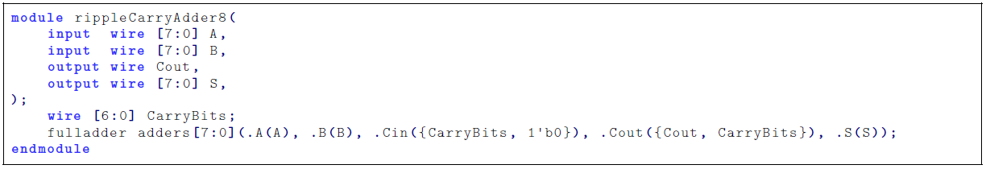
Concatenation in port list
module add_concatenate(out, a, b, c, d);
input [7:0] a;
input [4:0] b;
input [1:0] c;
input d;
output [7:0] out;
add8bit(.sum(out), .cout(), .a(a), .b({b,c,d}), .cin(Cin));
endmodule
Vector concatenation is not limited to assign statements. In these examples it is done in a port connection of a module instantiation.
Example from Aaron Cohen’s Verilog Guide

Slide 23
End of part I of Lecture02

Slide 24
Dataflow Verilog
The continuous assign statement
  It is the main construct of Dataflow Verilog
  It is deceptively powerful & useful
Generic form:
assign [drive_strength] [delay] list_of_net_assignments;
Where:
list_of_net_assignment ::= net_assignment [{,net_assignment}]
& Where:
Net_assignment ::= net_lvalue = expression
OK…that means just about nothing to me…how about some examples?

Slide 25
Continuous Assign Examples
Simplest form:
  // out is a net, a & b are also nets
  assign out = a & b; // and gate functionality
Using vectors
  logic [15:0] result, src1, src2; // 3 16-bit wide vectors
  assign result = src1 ^ src2; // 16-bit wide XOR
Can you implement a 32-bit adder in a single line?
  wire [31:0] sum, src1, src2; // 3 32-bit wide vectors
  assign {c_out, sum} = src1 + src2 + c_in; // wow!

Slide 26
Continuous Assign (continued)
If RHS result changes, LHS is updated with new value
  Constantly operating (“continuous”)
  It’s hardware!
  What makes it powerful?
    RHS can use operators: ( +, - ,&, |, ^, ~, >>, <<, >>>, …)
src1[31:0]
src2[31:0]
c_in
➔
assign {c_out,sum} = src1 + src2 + c_in;
c_out
sum[31:0]

Slide 27
Lets Kick up the Horse Power
You thought a 32-bit adder in one line was powerful. Lets try a 32-bit MAC…
Design a multiply-accumulate (MAC) unit that computes
Z[31:0] = A[15:0]*B[15:0] + C[31:0]
It sets overflow to one, if the result cannot be represented using 32 bits.
module mac(output Z [31:0], output overflow,
input [15:0] A, B, input [31:0] C);

Slide 28

Lets Kick up the Horse Power
module mac(output Z [31:0], output overflow,
input [15:0] A, B, input [31:0] C);
assign {overflow, Z} = A*B + C;
endmodule
I am a brilliant genius. I am a HDL coder extraordinaire. I created a 32-bit MAC, and I did it in a single line.
assign {overflow, Z} = A*B + C;
Oh my god, I’ve created a behemoth
Synopsys

Slide 29
Conditional Operator
This is a favorite!
  The functionality of a 2:1 Mux
  assign out = conditional_expr ? true_expr : false_expr;
Examples:
// a 2:1 mux
assign out = select ? in1 : in0;
// tri-state bus
assign src1 = rf2src1 ? mem[addr1] : 16’hzzzz;
// Either true_expr or false_expr can also be a conditional operator
// lets use this to build a 4:1 mux
assign out = sel[1] ? (sel[0] ? in3 : in2) : (sel[0] ? in1 : in0);
false_expr
0
out
true_expr
1
cond_expr

Slide 30
Conditional assign (continued)
Examples: (nesting of conditionals)
localparam add = 3'b000
localparam and = 3'b001
localparam xor = 3'b010
localparam shft_l = 3'b011
localparam shft_r = 3'b100
// an ALU capable of arithmetic,logical, shift, and zero
assign {cout,dst} = (op==add) ? src1+src2+cin :
(op==and) ? {1’b0,src1 & src2} :
(op==xor) ? {1’b0,src1 ^ src2} :
(op==shft_l) ? {src1,cin} :
(op==shft_r) ? {src1[0],src1[15],src1[15:1]} :
17’h00000;
This can be very confusing to read if not coded with proper formating

Slide 31
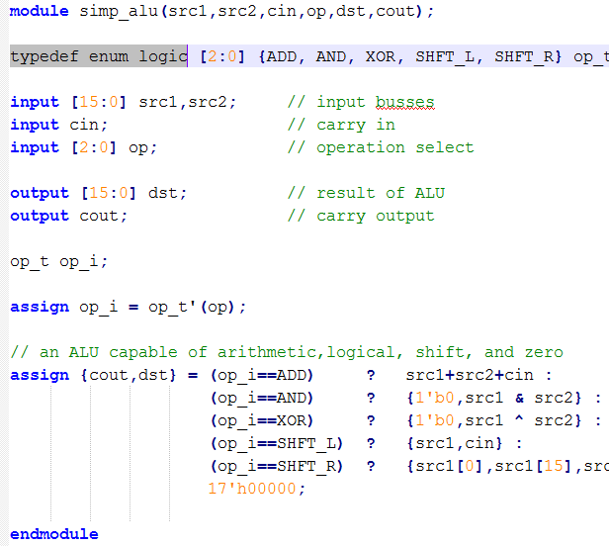

Aside: enum type for readability/debugability
System verilog allows for the use of enumerated types.
Does not make the code more readable, but does enhance debug because of waveform view.

Slide 32
Operators: Arithmetic
Much easier (and better) than structural!
* multiply ** exponent
/ divide % modulus
+ add - subtract
Some of these don’t synthesize
Also have unary operators +/- (pos/neg)
Understand bitsize!
  Can affect sign of result
  Is affected by bitwidth of BOTH sides
  assign prod[7:0] = a[3:0] * b[3:0]

Slide 33
Operators
Operator Category: | Operators: | Notes:
Shift | >>, <<, >>> | >>> only works of operand and dest signal declared as signed
Relational | <,>,<=,>= | Will default to unsigned comparison if operands are not declared as signed
Equality | ==,!=, ===, !== | === and !== compare x’s and z’s explicitly not as don’t care. Use in testbenches.
Logical | &&, ||, ! | Build clause for if or ternary check
Bitwise | &, |, ^, ~ | Applies bit by bit, ~ is unary

Slide 34
Reduction Operators (remember these…they are slick)
Reduction operators reduce all the bits of a vector to a single bit by performing an operation across all bits.
  Reduction AND
    assign all_ones = &accumulator; // are all bits set?
  Reduction OR
    assign not_zero = |accuumulator; // are any bits set?
  Reduction XOR
    assign parity = ^data_out; // even parity bit

Slide 35
Saturation Example
Assume we have a 16-bit signed sum and want to saturate it to a 12-bit signed value for use in “downstream” calculations.
assign sat12 = (!sum[15] && |sum[14:11]) ? 12’h7FF :
(sum[15] && !&sum[14:11]) ? 12’h800 :
sum[11:0];
vs
assign sat12 = (~sum[15] & |sum[14:11]) ? 12’h7FF :
(sum[15] & ~&sum[14:11]) ? 12’h800 :
sum[11:0];

Slide 36
Latches with Continuous Assign
What does the following statement imply/do?
  assign q_out = enable ? data_in : q_out;
  It acts as a latch. If enable is high new data goes to q_out. Otherwise q_out maintains its previous value.
  Ask yourself…It that what I meant when I coded this?
  It simulates fine…just like a latch

Slide 37
Latches with Continuous Assign
  assign q_out = enable ? data_in : q_out;
How does it synthesize??
0
data_in
q_out
q_out
en
data_in
1
enable
enable
Is the synthesizer smart enough to see this as a latch
and pick a latch element from the standard cell library?
Or is it what you code is what you get? A combinational feedback loop. Still acts like a latch. Do you feel comfortable with this?

Slide 38
End of part II of Lecture02

Slide 39
Arrays & Memories
Can have multi-dimentional arrays
  reg [7:0] mem[0:99][0:3]; // what is this?
addr1
RF
Flash
I²C
Often have to model memories
  RF, SRAM, ROM, Flash, Cache
  Memories can be useful in your test bench
addr2
src1
src2
input [4:0] addr1, addr2;
input rd,wrt; // read and write enables
output [15:0] src1,src2; // source busses to ALU
reg [15:0] reg_file[0:31]; // Register file of 32 16-bit words
.
.
assign src1 = (rd) ? reg_file[addr1] : // transfer addressed register
16’hzzzz // otherwise back off bus
.
ALU
result

Slide 40
Parameters
Parameters can make your code more generic/flexible.
  Defined locally to the module
  Can be overridden (passed a value in an instantiation)
  There is another method called defparam (don’t ever use it) that can override them
localparam ➔ more local than parameter
  Can’t be passed a value
  defparam does not modify

Slide 41
Parameter Example
module adder(a,b,cin,sum,cout);
parameter WIDTH = 8; // default is 8
input [WIDTH-1:0] a,b;
input cin;
output [WIDTH-1:0] sum;
output cout;
assign {cout,sum} = a + b + cin
endmodule
module alu(src1,src2,dst,cin,cout);
input [15:0] src1,src2;
…
//////////////////////////////////
// Instantiate 16-bit adder //
////////////////////////////////
adder #(16) add1(.a(src1),.b(src2),
.cin(cin),.cout(cout),
.sum(dst));
…
endmodule
Instantiation of module can override a parameter.

Slide 42
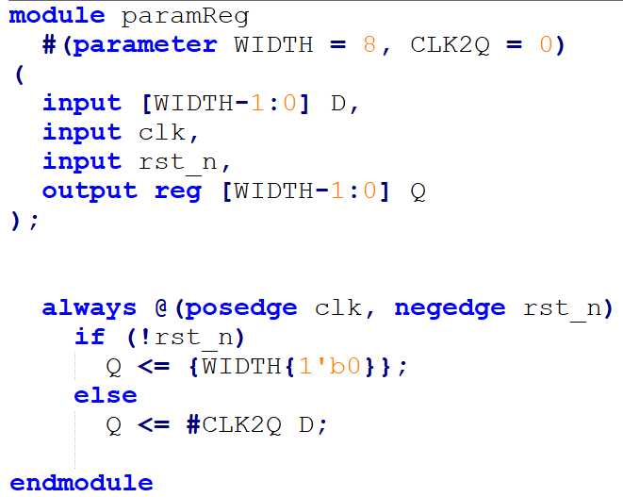
Parameter Example (ANSI header & named params)
This example uses multiple parameters
If you are using the ANSI declaration style then you declare your parameters here. NOTE: this is even before the opening paren
Much like connect by name is clearer and less error prone than by reference order, same can apply to passing of parameters.

Slide 43
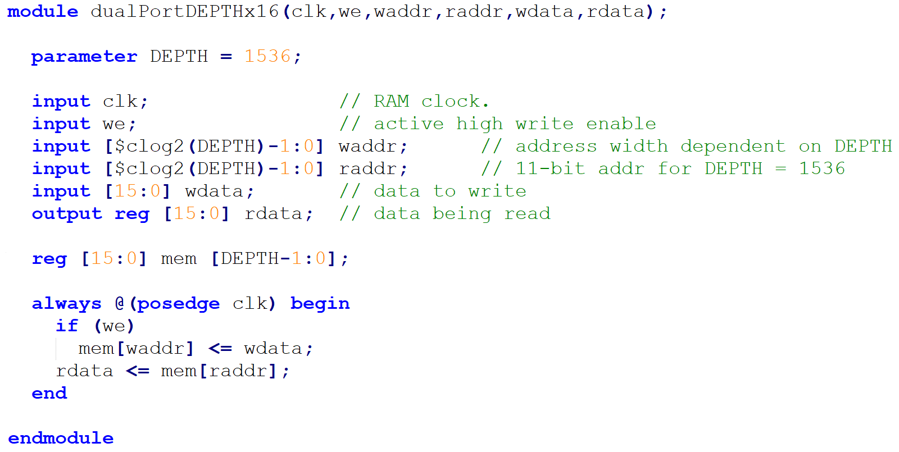
Parameter Example (use of $clog2 for address width)
$clog2(3072) will result in 12, so address width is [11:0]

Slide 44
localparam
localparam IDLE = 2’b00; // idle state of state machine
localparam CONV= 2’b01; // in this state while A2D converting
localparam ACCUM = 2’b10; // in this state while averaging samples
.
.
.
case (state)
IDLE : if (start_conv) nxt_state = CONV;
else nxt_state = IDLE;
CONV : if (gt) nxt_state = ACCUM;
else nxt_state = CONV;
.
.
.
Not really a good example!
System verilog introduced the enumerated type which is better for state encoding
Read Cumming’s paper on use of define & param. Posted on web under “reference”

Slide 45
localparam
Perhaps a better example of the use of localparam would be for defining the value of a constant used in your code that might be subject to change.
This example shows use of a localparam for a couple of coefficients used in the calculations for a PID controller.

Slide 46
System Verilog…Better Yet
System verilog adds an enumerated type.
typedef enum reg [1:0] { IDLE, CONV, ACCM } state_t;
state_t state, nxt_state; // declare state and nxt_state signals
case (state)
IDLE : if (strt_cnv) begin
clr_dac = 1;
clr_smpl = 1;
nxt_state = CONV;
end
CONV : if (!gt) begin
inc_dac = 1;
nxt_state = CONV;
  . . .
state
IDLE
CONV
ACCM
CONV
Makes debug much easier

Slide 47
Implicit Net Declarations
When wire is used but not declared, it is implied
module majority(output out, input a, b, c);
assign part1 = a & b;
assign part2 = a & c;
assign part3 = b & c;
assign out = part1 | part2 | part3;
endmodule
Defaults to single bit wire
Breaks compatibility with some tools
Disable by using `default_nettype none directive
    Helps to avoid wasting time on typos

Slide 48
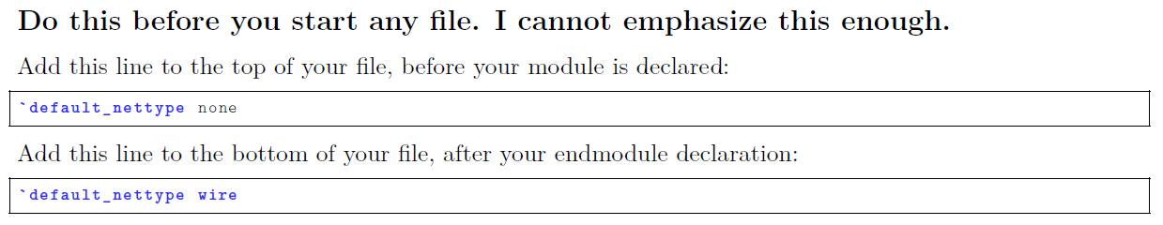
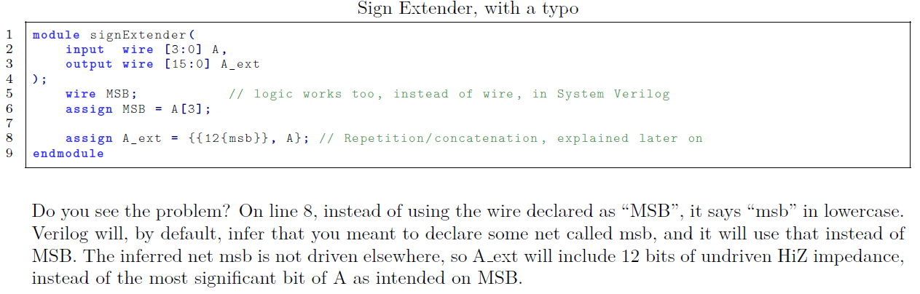
Don’t Take My Word for it (take Aaron Cohen’s)

Slide 49
Useful System Tasks
$display ➔ Like printf in C. Useful for testbenches and debug
$display(“At time %t count = %h”,$time,cnt);
$stop ➔ Stops simulation and allows you to still probe signals and debug
$finish ➔ completely stops simulation, simulator relinquishes control of thread.
Also useful is `include for including code from another file (like a header file)

Slide 50
Can Mix Styles In Hierarchy!
module Add_half_bhv(c_out, sum, a, b);
output reg sum, c_out;
input a, b;
always @(a, b) begin
sum = a ^ b;
c_out = a & b;
end
endmodule
module Add_full_mix(c_out, sum, a, b, c_in) ;
output sum, c_out;
input a, b, c_in;
wire w1, w2, w3;
Add_half_bhv AH1(.sum(w1), .c_out(w2),
.a(a), .b(b));
Add_half_bhv AH2(.sum(sum), .c_out(w3),
.a(c_in), .b(w1));
assign c_out = w2 | w3;
endmodule

Slide 51
Hierarchy And Scope
Parent cannot access “internal” signals of child
If you need a signal, must make a port!
Example:
Detecting overflow
Overflow =
cout XOR cout6
Must output
overflow or cout6!
module add8bit(cout, sum, a, b, cin);
output [7:0] sum;
output cout;
input [7:0] a, b,cin;
wire cout0, cout1,… cout6;
FA A0(cout0, sum[0], a[0], b[0], cin);
FA A1(cout1, sum[1], a[1], b[1], cout0);
…
FA A7(cout, sum[7], a[7], b[7], cout6);
endmodule

Slide 52
Hierarchy And Source Code
Can have all modules in a single file
  Module order doesn’t matter!
  Good for small designs
  Not so good for bigger ones
  Not so good for module reuse (cut & paste)
Can break up modules into multiple files
  Helps with organization
  Lets you find a specific module easily
  Good for module reuse (add file to project)

