Slide 1
Exercise 19 Gated Clocks:
32
32
32
en
clk
en
clk
Recirculating seems rather wasteful we need a 2:1 mux for each flop. Plus all the cap and gates inside the flops on the clock network will be toggling.
Wouldn’t it be better to just gate the clock? Pretty much same functionality but should save area and power? Yes, but you have to do it right.

Slide 2
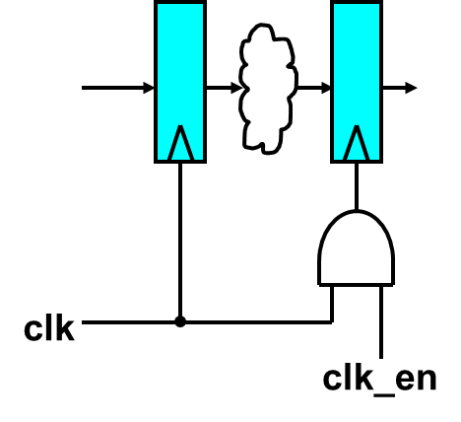
Exercise 19 Gated Clocks:
Something this simple does not work. Recall the enable function is probably coming from a SM. So it changes slightly after the rising edge of clock.
clk
clk_en
resulting gated clock
That’s pretty messed up!

Slide 3
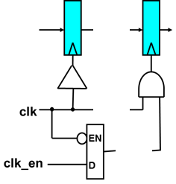
Exercise 19 Gated Clocks:
Have to use an enable low latch to latch the clock enable signal. This ensures the enable is setup and ready for the next high phase of clock
Have to balance from clock root to all leaf nodes of clock
clk_en_lat
clk
clk_en
clk_en_lat
resulting gated clock

Slide 4
Exercise 18 Gated Clocks:
Work in groups of two
On the website you will find two files:
  mult_accum.sv (design that uses recirculating flops)
  mult_accum.dc (synthesis script)
Synthesize mult_accum.sv using the provided script
  Note the area, and the power estimate
  Note whether or not it passes timing
Now modify the design to use gated clocks instead of recirculating.
Modify the synthesis script as needed (minor change to read in mult_accum_gated.sv instead of mult_accum.sv)
Again synthesize and remark on the difference in both area an timing.
Submit the area and dynamic power numbers for both designs to the dropbox for this exercise. (both people submit)

Slide 5
0
A[15:0]
0
0
+
1
1
32
prod_reg[31:0]
1
accum[63:0]
32
64’h0
B[15:0]
clk
clk
clr
en
en_stg2
clk
This is what we have to start

Slide 6
0
A[15:0]
0
0
+
1
1
32
prod_reg[31:0]
1
accum[63:0]
32
64’h0
B[15:0]
gclk1
clk
clr
clk
en
Q
D
en
en_stg2
clk

Slide 7
0
A[15:0]
0
0
+
1
1
32
prod_reg[31:0]
1
accum[63:0]
32
64’h0
B[15:0]
gclk1
clk
clr
clk
en
Q
D
en
en_stg2
clk

Slide 8
A[15:0]
0
+
1
0
32
prod_reg[31:0]
1
accum[63:0]
64’h0
B[15:0]
gclk1
clk
clr
clk
en
Q
D
en
en_stg2
clk

Slide 9
A[15:0]
0
+
1
0
32
prod_reg[31:0]
1
accum[63:0]
64’h0
B[15:0]
gclk1
clr
gclk2
clk
clk
en
en
Q
Q
D
D
en
en_stg2
clk

Slide 10
A[15:0]
0
+
1
0
32
prod_reg[31:0]
1
accum[63:0]
64’h0
B[15:0]
gclk1
clr
gclk2
clk
clk
en
en
Q
Q
D
D
en
en_stg2
clk

Slide 11
A[15:0]
+
0
32
prod_reg[31:0]
1
accum[63:0]
64’h0
B[15:0]
gclk1
clr
gclk2
clk
clk
en
en
Q
Q
D
D
en
en_stg2
clk

Slide 12
A[15:0]
+
0
32
prod_reg[31:0]
1
accum[63:0]
64’h0
B[15:0]
gclk1
clr
gclk2
clk
clk
en
en
Q
clr
Q
D
D
en
en_stg2
clk

