Slide 1


CAPSTONE PROJECT colorectal cancer prediction
Presented By
Student Name: Somanjan chakraborty
College Name: KALYANI GOVERNMENT ENGINEERING COLLEGE
Department:Electronics and Communication Engineering
Email ID: somuchk007@gmail.com
AICTE Student ID: STU67eab36e301ee1743434606

Slide 2
OUTLINE
Problem Statement
Proposed System/Solution
System Development Approach (Technology Used)
Algorithm & Deployment
Result (Output Image)
Conclusion
Future Scope
References

Slide 3
Problem Statement
Colorectal cancer is a significant global health challenge.
Predicting patient survival prospects is crucial for informed clinical decisions.
Helps in personalized treatment planning and effective patient counseling.

Slide 4
Proposed Solution
Develop a predictive model to estimate patient survival beyond 12 months post-diagnosis.
Leverage comprehensive patient data including demographics, clinical parameters, lifestyle factors, and treatment history.
Use machine learning techniques to improve prediction accuracy.

Slide 5
System Approach
Programming Language: Python
Libraries Used: Pandas, NumPy, Matplotlib, Seaborn, Scikit-learn
Development Environment: Jupyter Notebook

Slide 6
Algorithm & Deployment
Chosen Algorithm: Logistic Regression (effective for binary classification tasks)
Steps Taken:
Data pre-processing: Encoding categorical variables, handling class imbalances.
Splitting dataset into training (80%) and testing (20%) subsets.
Model trained using Scikit-learn’s Logistic Regression module.
Performance evaluation using accuracy, precision, recall, and F1-score.

Slide 7
Result
Accuracy: 75.15% on test data.
Key Findings:
High recall for "Survived" class.
Lower precision for "Deceased" class due to class imbalance.
Model performs well in predicting survival, but struggles with deceased cases.

Slide 8
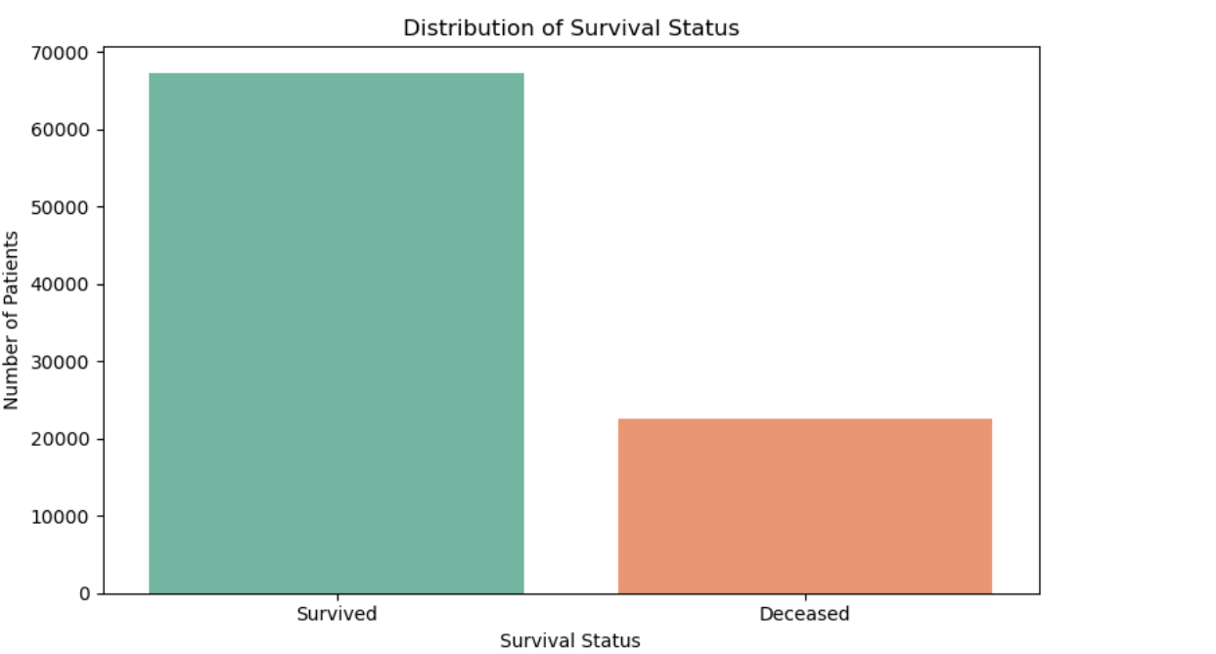
Data Visualization
Visualize survival status:

Slide 9
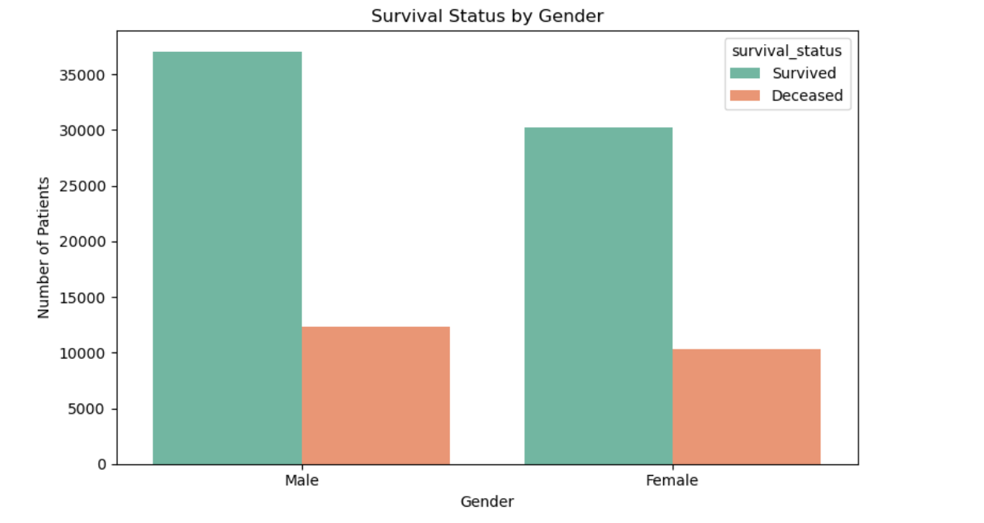
Survival Status by Gender

Slide 10
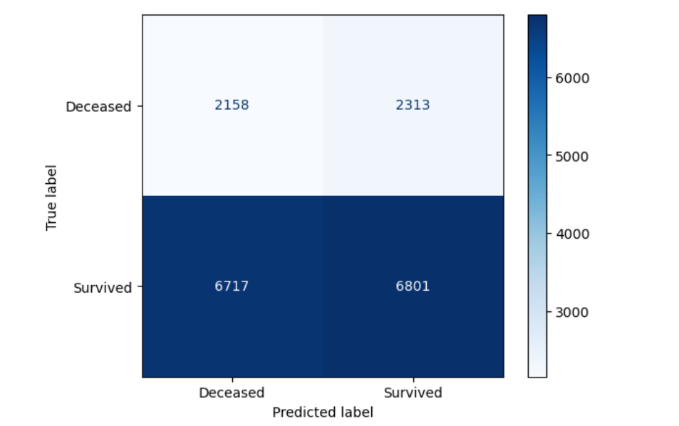
Assess model performance using accuracy and classification reports.

Slide 11
Conclusion
Logistic Regression model achieved promising accuracy (~75%).
Strength in identifying survivors but struggles with deceased predictions.
Class imbalance presents a challenge to model performance.

Slide 12
Future scope
Improvements to Consider:
Resampling techniques: Use SMOTE to balance dataset.
Advanced models: Try XGBoost, Random Forests for better performance.
Hyperparameter tuning: Optimize model parameters for greater accuracy.
Feature selection: Identify most relevant predictors for survival.
Further research: Investigate additional patient-specific factors influencing survival rates.

Slide 13
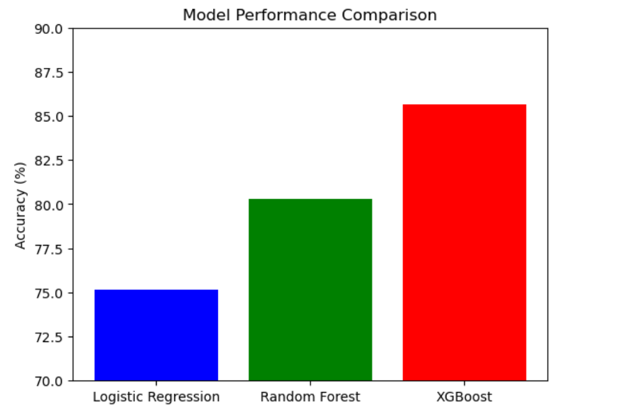
Future scope

Slide 14
References
1. Kourou, K., Exarchos, T. P., Exarchos, K. P., Karamouzis, M. V., & Fotiadis, D. I. (2015). Machine learning applications in cancer prognosis and prediction. Computational and Structural Biotechnology Journal, 13, 8–17.
https://doi.org/10.1016/j.csbj.2014.11.005
This paper provides a survey of machine learning methods in cancer prognosis, including logistic regression, decision trees, and support vector machines.
2. Weng, S. F., Reps, J., Kai, J., Garibaldi, J. M., & Qureshi, N. (2017). Can machine-learning improve cardiovascular risk prediction using routine clinical data? PLOS ONE, 12(4), e0174944.
https://doi.org/10.1371/journal.pone.0174944
While focused on cardiovascular risk, this study exemplifies how ML can enhance risk prediction using EHR-like data — similar to colorectal cancer.
3. Chen, J. H., & Asch, S. M. (2017). Machine Learning and Prediction in Medicine — Beyond the Peak of Inflated Expectations. New England Journal of Medicine, 376, 2507–2509.
https://doi.org/10.1056/NEJMp1702071
Explores practical challenges and strengths of ML in real-world medical predictions, like cancer survivability.

Slide 15
References
4. Winawer, S. J., Zauber, A. G., Fletcher, R. H., et al. (1997). Guidelines for colonoscopy surveillance after polypectomy: a consensus update by the US Multi-Society Task Force on Colorectal Cancer. Gastroenterology, 112(2), 594–642.
https://doi.org/10.1016/S0016-5085(97)70182-1
This guideline document informed factors like screening regularity and colonoscopy access.
5. Nguyen, N., Nguyen, T., Nguyen, T., & Nahavandi, S. (2020). Machine Learning in Predicting Cancer Survival Rates. Health Information Science and Systems, 8, 24.
https://doi.org/10.1007/s13755-020-00108-3
A deep dive into how algorithms like Random Forests and Logistic Regression help predict cancer survival.

Slide 16
References
📚 Colorectal Cancer-Specific Studies and Resources
American Cancer Society – Colorectal Cancer Facts & Figures
https://www.cancer.org/research/cancer-facts-statistics/colorectal-cancer-facts-figures.html
Offers updated statistics and survival trends critical for contextual understanding.
National Cancer Institute (NCI) – SEER Data
https://seer.cancer.gov/
SEER Program provides detailed data on cancer incidence, treatment, and survival across the U.S., often used in cancer prediction models.
Git Link: https://github.com/somanjan056/colorectal_cancer_prediction.git

Slide 17
Thank you

