Slide 1



Advanced ADAS Sensor Fusion Controller
State Level Hackathon
Deterministic Multi-Sensor Fusion for Real-Time Collision-Risk
Detection and Decision-Making on QNX.
FusionDrive · QNXHACK-HYD-026

Slide 2
Problem Synthesis & Scenario
Design and Execution
Decision ladder
TTC = distance ÷ closing speed
The scenario: A vehicle ahead brakes suddenly. The ADAS controller has to combine camera, distance and motion sensors into one picture of the gap, and decide to warn or brake before that gap is gone.
Criticality: At 54 km/h a car closes 30 cm every 20 ms. A late decision, or a stale reading that looks fresh, is as dangerous as no decision. Timing has to be guaranteed, not "usually fast".
Success metrics: a fusion and decision cycle every 20 ms with zero deadline misses; every sample timestamped on one clock; a failed sensor detected and isolated within one cycle while fusion keeps running.
SAFE
TTC ≥ 4 s and gap ≥ 50 cm
WARNING
TTC < 4 s or gap < 50 cm
CRITICAL
TTC < 2 s or gap < 30 cm
EMERGENCY
TTC < 1 s or gap < 15 cm
Escalates immediately; relaxes only after 200 ms (hysteresis).

Slide 3
QNX Architectural Approach
Design and Execution
Microkernel strategy: every sensor runs in its own process, isolated by the microkernel. A crash in one cannot corrupt another. All talk to a named fusion server (name_attach "adas_fusion") through kernel message passing.
IPC: IOV messages (MsgSendv / MsgReceivev: header + sample array, no repacking); pulses for timer ticks, health changes and kernel disconnect notices; shared memory with a lock-free seqlock for the dashboard, woken by MsgDeliverEvent.
Resource isolation: each device has exactly one owner process: I2C through the QNX driver (devctl), GPIO through mapped registers (root only), camera through the Sensor Framework. Threads run SCHED_FIFO on all 4 cores; CPU-set pinning (runmask) is our next step.
Priority setup: safety loop highest; priority inheritance on messages and mutexes stops a low-priority client from delaying fusion.
Thread priorities (SCHED_FIFO)
Thread | Process | Priority | Released by
fusion_tick | fusion | FIFO 30 | timer pulse, 20 ms
us_ping | ultrasonic | FIFO 29 | timer 66 ms + GPIO IRQ 145
imu_acq | imu | FIFO 28 | timer pulse, 20 ms
fusion_rx | fusion | 20, inherits sender | MsgReceivev
vf_callback | camera | libcamapi thread | each frame, 30 fps
dashboard | dashboard | 10 | pulse from fusion
Higher number runs first. The ultrasonic sleeps between echo edges (interrupt), so its high priority costs about 33 µs of CPU per ping.

Slide 4
Technical Execution (Hardware & Logic)
Design and Execution
MPU6050 IMU
I2C1 · pins 3/5 · FIFO 200 Hz
imu process
batch + timestamps + drift
fusion server
Kalman · TTC · decision
50 Hz, 20 ms deadline
dashboard
reads shared memory
HC-SR04 ultrasonic
GPIO23 trig · GPIO24 echo · IRQ 145
ultrasonic process
echo timing + tracker
Logitech C920
USB 3 · Sensor Framework unit 4
camera process
colour target + expansion TTC
IOV messages + pulses
RPi integration
I2C1 (/dev/i2c1, 400 kHz): MPU6050 hardware FIFO drained every 20 ms, so no sample is lost if the reader is late.
GPIO23/24 with a 5 V→3.3 V divider: edge detect raises IRQ 145 (InterruptAttachEvent → pulse). Echo timed with the 54 MHz ARM counter.
USB 3: C920 through the QNX Sensor Framework, 640×480 at 30 fps, frame timestamps on CLOCK_MONOTONIC.
The logic
2-state Kalman filter [distance, closing speed]; IMU ego-acceleration as input; each measurement aligned to "now" by its age.
Online cross-calibration: K = ultrasonic distance × camera size, so the camera alone gives distance if the ultrasonic fails.
Decision: TTC = distance ÷ closing speed plus distance floors, with 200 ms hysteresis.

Slide 5
Resilience & "The Hack" Response
Design and Execution
Stress applied | How it is detected | How the system stays alive | Observed
Sensor process killed (slay ultrasonic) | Kernel disconnect pulse to fusion | Sensor OFFLINE in the same cycle; camera keeps the track | disconnects 1, misses 0
Process restarted | name_open() retried every 1 s | Reconnects by name, resumes data | back online in ≤ 1 s
Sensor alive but silent | Stale-data watchdog, 500 ms | Marked DEGRADED, left out of the filter | by design
Lost / stray ultrasonic echoes | 2-echo confirmation, 4σ gate | Stray echo ignored; NO TARGET after 3 misses | stray 0.33 m echo rejected
I2C bus errors on the IMU | 5 consecutive errors | FAULT, then automatic re-init about once a second | 0 errors in 4 025 samples
Threshold chatter | Decision hysteresis | Escalate at once, relax after 200 ms | no flicker in tests
Mitigation in one line: fault isolation comes from the microkernel (one process per sensor) and fault detection from the kernel itself (disconnect pulses), so fusion never waits on a dead sensor. Next step: QNX HAM to restart failed nodes automatically.

Slide 6
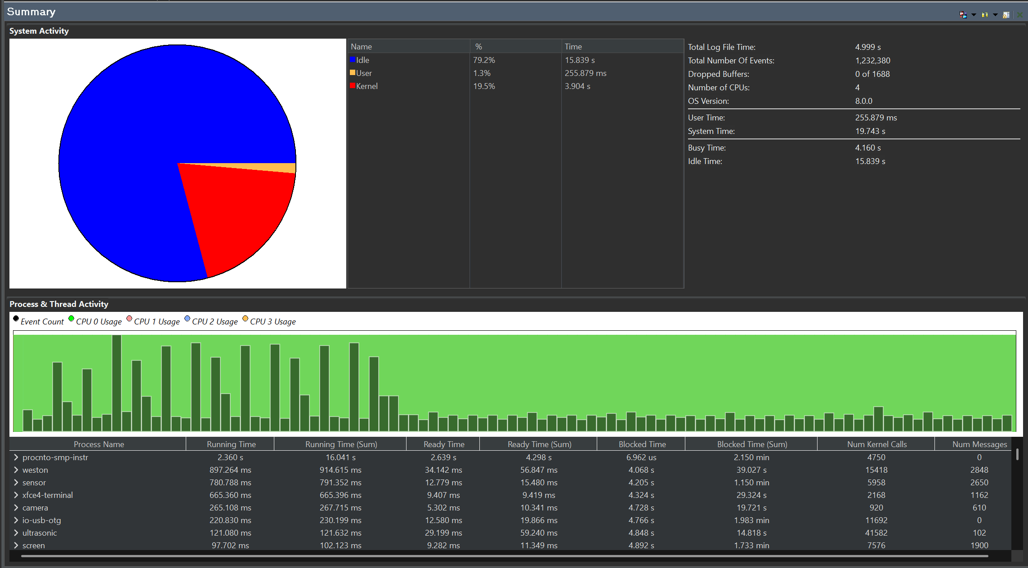
Performance Proof (The Profiler Slide)
Demonstration
0
deadline misses
14 300+ fusion cycles
501 µs
worst response
of 20 ms (traced run)
79 %
CPU idle, 4 cores
0 of 1688 buffers dropped
5.3 %
camera CPU, 1 core
ultrasonic only 2.4 %
7–20 µs
IPC latency
sensor → fusion
33–75 µs
CPU per ping
GPIO interrupt mode
Momentics System Profiler: 5 s kernel event trace on the Pi, all five processes running
Analysis: the timer, not the load, sets the decision rate. Our five processes together use a few percent of one core; most kernel time in the trace is the tracing itself plus the display (weston) and camera (sensor) services.

Slide 7
Future Scalability & Conclusion
Demonstration
Towards automotive grade
QNX HAM to restart failed sensor nodes automatically
CPU sets / runmask and adaptive partitioning to fence the safety loop
CAN-FD output from fusion to a brake ECU
Neural object detection (TensorFlow Lite) as one more camera process
Learning outcome
Getting honest timestamps: FIFO position for the IMU, echo midpoint for the ultrasonic, capture time for the camera
Three very different paths (I2C driver, raw GPIO + IRQ, Sensor Framework) sharing one clock
Designing for failure first: what fusion does when a sensor dies
A collision decision every 20 ms, guaranteed by the RTOS, that keeps deciding when a sensor dies.

