Slide 1
Fundamentals of Python: First Programs Second Edition
Chapter 3
Loops and Selection Statements

Slide 2
Objectives (1 of 2)
3.1 Write a loop to repeat a sequence of actions a fixed number of times
3.2 Write a loop to traverse the sequence of characters in a string
3.3 Write a loop that counts down and a loop that counts up
3.4 Write an entry-controlled loop that halts when a condition becomes false

Slide 3
Objectives (2 of 2)
3.5 Use selection statements to make choices in a program
3.6 Construct appropriate conditions for condition-controlled loops and selection statements
3.7 Use logical operators to construct compound Boolean expressions
3.8 Use a selection statement and a break statement to exit a loop that is not entry-controlled

Slide 4
Definitive Iteration: The for Loop
Repetition statements (or loops) repeat an action
Each repetition of action is known as pass or iteration
Two types of loops
Those that repeat action a predefined number of times (definite iteration)
Those that perform action until program determines it needs to stop (indefinite iteration)

Slide 5
Executing a Statement a Given Number of Times (1 of 2)
Python’s for loop is the control statement that most easily supports definite iteration
>>>for eachPass in range(4):
Print(“It’s alive!”, end = “ ”)
It’s alive! It’s alive! It’s alive! It’s alive!
The form of this type of loop is:
For <variable> in range(<an integer expression>):
<statement-l>
.
.
<statement-n>
First line of code is sometimes called loop header
Rest of code is loop body (must be indented and aligned in the same column)

Slide 6
Executing a Statement a Given Number of Times (2 of 2)
Example: Loop to compute an exponentiation for a non-negative exponent
>>> number = 2
>>> exponent = 3
>>> product = 1
>>> for eachPass in range(exponent)
product = product * number
print(product, end = “ ”)
2 4 8
>>>> product
8
If the exponent were 0, the loop body would not execute and value of product would remain as 1

Slide 7
Count-Controlled Loops (1 of 2)
Loops that count through a range of numbers
>>> product = 1
>>> for count in range (4):
product = product * (count + 1)
>>> product
24
To specify a explicit lower bound:
>>> product = 1
>>> for count in range (1, 5):
product = product * count
>>> product
24

Slide 8
Count-Controlled Loops (2 of 2)
Example: bound-delimited summation
>>> lower = int(input(“Enter the lower bound: ”))
Enter the lower bound: 1
>>> upper = int(input(“Enter the upper bound: ”))
Enter the upper bound: 10
>>> theSum = 0
>>> for number in range(lower, upper + 1):
theSum = theSum + number
>>> theSum
55

Slide 9
Augmented Assignment
The assignment symbol can be combined with the arithmetic and concatenation operators to provide augmented assignment operations:
a = 17
s = “hi”
a += 3 #Equivalent to a = a + 3
a −= 3 #Equivalent to a = a − 3
a *=3 #Equivalent to a = a * 3
a /= 3 #Equivalent to a = a / 3
a %= 3 #Equivalent to a = a % 3
s += “ there” #Equivalent to s = s + “ there”
Format: <variable> <operator>= <expression>
Equivalent to: <variable> = <variable> <operator> <expression>

Slide 10
Loop Errors: Off-by-One Error
Example:
# Count from 1 through 4, we think
>>>for count in range(1,4):
print(count)
1
2
3
Loop actually counts from 1 through 3
Not a syntax error, but rather a logic error

Slide 11
Traversing the Contents of a Data Sequence
range returns a list
>>> list(range(4))
[0, 1, 2, 3]
>>> list(range(1, 5))
[1, 2, 3, 4]
Strings are also sequences of characters
Values in a sequence can be visited with a for loop:
for <variable> in <sequence>:
<do something with variable>
Example:
>>> for character in “Hi there!”:
print(character, end = “ ”)
H i t h e r e !

Slide 12
Specifying the Steps in the Range
range expects a third argument that allows you specify a step value
>>> list(range(1, 6, 1)) # Same as using two arguments
[1, 2, 3, 4, 5]
>>> list(range(1, 6, 2)) # Use every other number
[1, 3, 5]
>>> list(range(1, 6, 3)) # Use every third number
[1, 4]
Example:
>>> theSum = 0
>>> for count in range(2, 11, 2):
theSum += count
>>> theSum
30

Slide 13
Loops that Count Down
Example:
>>> for count in range(10, 0, −1):
print(count, end = " ")
10 9 8 7 6 5 4 3 2 1
>>> list(range(10, 0, −1))
[10, 9, 8, 7, 6, 5, 4, 3, 2, 1]

Slide 14
Formatting Text for Output (1 of 3)
Many data-processing applications require output that has tabular format
Field width: Total number of data characters and additional spaces for a datum in a formatted string
The print function automatically begins printing an output datum in the first available column
>>> for exponent in range(7, 11):
print(exponent, 10 ** exponent)
7 10000000
8 100000000
9 1000000000
10 10000000000

Slide 15
Formatting Text for Output (2 of 3)
<format string> % <datum>
This version contains format string, format operator %, and single data value to be formatted
To format integers, letter d is used instead of s
To format sequence of data values:
<format string> % (<datum−1>, ..., <datum−n>)
>>> for exponent in range(7, 11):
print("%-3d%12d" % (exponent, 10 ** exponent))
7 10000000
8 100000000
9 1000000000
10 10000000000

Slide 16
Formatting Text for Output (3 of 3)
To format data value of type float:
%<field width>.<precision>f
where .<precision> is optional
Examples:
>>> salary = 100.00
>>> print(“Your salary is $” + str(salary))
Your salary is $100.0
>>> print(“Your salary is $%0.2f” % salary)
Your salary is $100.00

Slide 17
Selection: If and If-Else Statements
Selection statements allow a computer to make choices
Based on a condition

Slide 18
The Boolean Type, Comparisons, and Boolean Expressions
Boolean data type consists of two values: true and false (typically through standard True/False)
Example: 4 != 4 evaluates to False
Comparison Operator | Meaning
== | Equals
!= | Not equals
< | Less than
> | Greater than
<= | Less than or equal
>= | Greater than or equal

Slide 19
If-Else Statements (1 of 2)
Also called a two-way selection statement
Often used to check inputs for errors:
import math
area = float(input(“Enter the area: ”))
if area > 0:
radius = math’s(area / math.pi)
print(“The radius is”, radius)
else:
print(“Error: the area must be a positive number”)
Syntax:
if <condition>:
<sequence of statements–1>
else:
<sequence of statements-2>

Slide 20
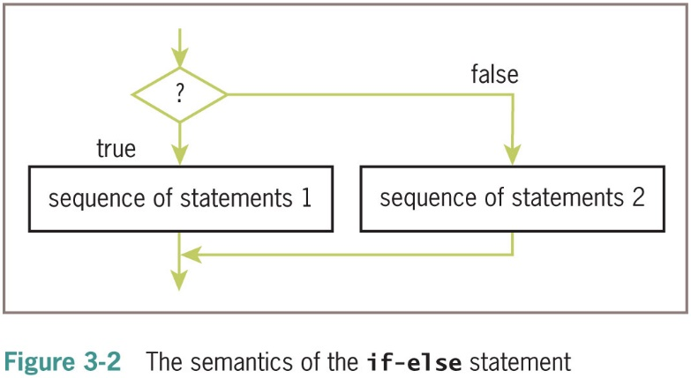
If-Else Statements (2 of 2)

Slide 21
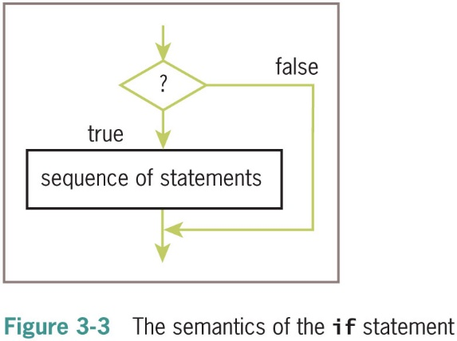
One-Way Selection Statements
Simplest form of selection is the if statement
if <condition>:
<sequence of statements>

Slide 22
Multi-Way If Statements (1 of 3)
A program may be faced with testing conditions that entail more than two alternative courses of action
Can be described in code by a multi-way selection statement
Letter Grade | Range of Numeric Grades
A | All grades above 89
B | All grades above 79 and below 90
C | All grades above 69 and below 80
F | All grades below 70

Slide 23
Multi-Way If Statements (2 of 3)
Example:
number = int(input(“Enter the numeric grade: ”))
if number > 89:
letter = ‘A’
elif number > 79:
letter = ‘B’
elif number > 69:
letter = ‘C’
else:
letter = ‘F’
print(“The letter grade is”, letter)
Syntax:
if <condition-1>:
<sequence of statements-1>
elif <condition-n>:
<sequence of statements-n>
else:
<default sequence of statements>

Slide 24
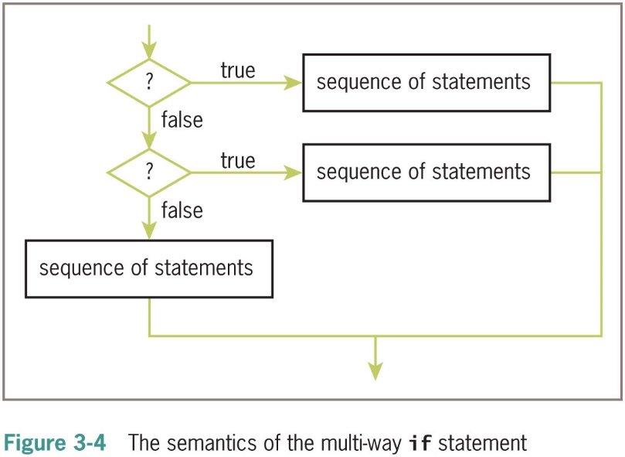
Multi-Way If Statements (3 of 3)

Slide 25
Logical Operators and Compound Boolean Expressions (1 of 4)
Often a course of action must be taken if either of two conditions is true: Below are two approaches
number = int(input(“Enter the numeric grade: ”))
if number > 100:
print(“Error: grade must be between 100 and 0”)
elif number < 0:
print(“Error: grade must be between 100 and 0”)
else:
# The code to compute and print the result goes here
Simplified Code:
number = int(input(“Enter the numeric grade: ”))
if number > 100 or number < 0:
print(“Error: grade must be between 100 and 0”)
else:
# The code to compute and print the result goes here

Slide 26
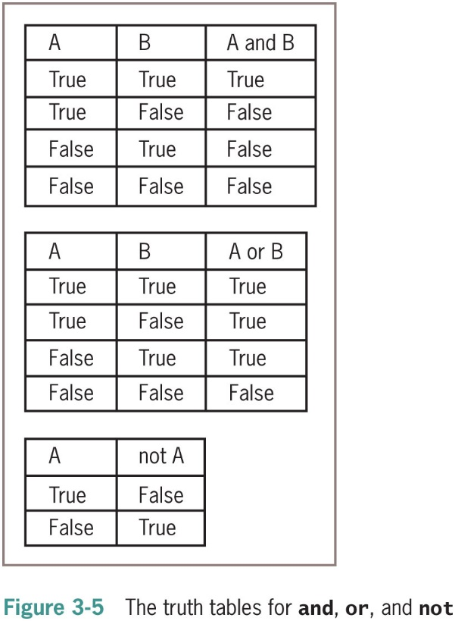
Logical Operators and Compound Boolean Expressions (2 of 4)

Slide 27
Logical Operators and Compound Boolean Expressions (3 of 4)
Next example verifies some of the claims made in the previous truth tables:
>>> A = True
>>> B = False
>>> A and B
False
>>> A or B
True
>>> not A
False
The logical operators are evaluated after comparisons but before the assignment operator
not has higher precedence than and and or

Slide 28
Logical Operators and Compound Boolean Expressions (4 of 4)
Type of Operator | Operator Symbol
Exponentiation | **
Arithmetic negation | −
Multiplication, division, remainder | *, /, %
Addition, subtraction | +, −
Comparison | ==, !=, <, >, <=, >=
Logical negation | not
Logical conjunction | and
Logical disjunction | or
Assignment | =

Slide 29
Short-Circuit Evaluation
In (A and B), if A is false, then so is the expression, and there is no need to evaluate B
In (A or B), if A is true, then so is the expression, and there is no need to evaluate B
Short-circuit evaluation: Evaluation stops as soon as possible
Example:
count = int(input(“Enter the count: ”))
theSum = int(input(“Enter the sum: ”))
if count > 0 and theSum // count > 10:
print(“average > 10”)
else:
print(“count = 0 or average <= 10”)

Slide 30
Testing Selection Statements
Tips:
Make sure that all of the possible branches or alternatives in a selection statement are exercised
After testing all of the actions, examine all of the conditions
Test conditions that contain compound Boolean expressions using data that produce all of the possible combinations of values of the operands

Slide 31
Conditional Iteration: The while Loop
The while loop can be used to describe conditional iteration
Example: A program’s input loop that accepts values until user enters a sentinel that terminates the input

Slide 32
The Structure and Behavior of a While Loop (1 of 3)
Conditional iteration requires that condition be tested within loop to determine if it should continue
Called continuation condition
Syntax:
while <condition>:
<sequence of statements>
Improper use may lead to infinite loop
while loop is also called entry-control loop
Condition is tested at top of loop
Statements within loop can execute zero or more times

Slide 33
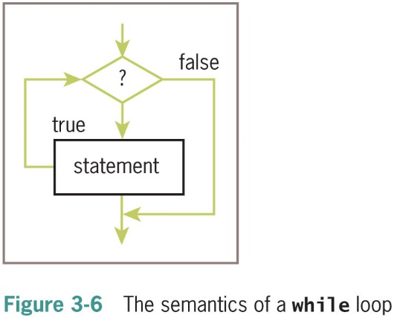
The Structure and Behavior of a While Loop (2 of 3)

Slide 34
The Structure and Behavior of a While Loop (3 of 3)
Example:
theSum = 0.0
data = input(“Enter a number or just enter to quit: ”)
while data != “”:
number = float(data)
theSum += number
data = input(“Enter a number or just enter to quit: ”)
print(“The sum is”, theSum)
Enter a number or just enter to quit: 3
Enter a number or just enter to quit: 4
Enter a number or just enter to quit: 5
Enter a number or just enter to quit:
The sum is 12.0
Data is the loop control variable
first input statement initializes a variable to a value that the loop condition can test

Slide 35
Count Control with a While Loop
Use a while loop for a count-controlled loop
# Summation with a for loop
theSum = 0
for count in range(1, 100001):
theSum += count
print(theSum)
# Summation with a while loop
theSum = 0
count = 1
while count <= 100000:
theSum += count
count += 1
print(theSum)

Slide 36
The While True Loop and the Break Statement (1 of 3)
The while loop can be complicated to write correctly
It is possible to simplify its structure and improve its readability
theSum = 0.0
while True:
data = input(“Enter a number or just enter to quit: ”)
if data == “ ”:
break
number = float(data)
theSum += number
print(“The sum is”, theSum)
Within this body, the input datum is received
It is then tested for the loop’s termination condition in a one-way selection statement
The break statement will cause an exit from the loop

Slide 37
The While True Loop and the Break Statement (2 of 3)
This example modifies the input section of the grade-conversion program to continue taking input numbers from the user until entering an acceptable value:
while True:
number = int(input(“Enter the numeric grade: ”))
if number >= 0 and number <= 100:
break
else:
print(“Error: grade must be between 100 and 0”)
print(number) # Just echo the valid input

Slide 38
The While True Loop and the Break Statement (3 of 3)
Alternative: Use a Boolean variable to control loop
done = False
while not done:
number = int(input(“Enter the numeric grade: ”))
if number >= 0 and number <= 100:
done = True
else:
print(“Error: grade must be between 100 and 0”)
print(number) # Just echo the valid input

Slide 39
Random Numbers (1 of 3)
Programming languages include resources for generating random numbers
random module supports several ways to do this
randint returns random number from among numbers between two arguments, included
>>> import random
>>> for roll in range(10):
print(random.rand int(1, 6), end = “ ”)
2 4 6 4 3 2 3 6 2 2

Slide 40
Random Numbers (2 of 3)
Example: A simple guessing game
import random
smaller = int(input(“Enter the smaller number: ”))
larger = int(input(“Enter the larger number: ”))
myNumber = random.rand int(smaller, larger)
count = 0
while True:
count += 1
userNumber = int(input(“Enter your guess: ”))
if userNumber < myNumber:
print(“Too small!”)
elif userNumber > myNumber:
print(“Too large!”)
else:
print(“Congratulations! You've got it in”, count,
“tries!”)
break

Slide 41
Random Numbers (3 of 3)
Output from run:
Enter the smaller number: 1
Enter the larger number: 100
Enter your guess: 50
Too small!
Enter your guess: 75
Too large!
Enter your guess: 63
Too small!
Enter your guess: 69
Too large!
Enter your guess: 66
Too large
Enter your guess: 65
You've got it in 6 tries!

Slide 42
Loop Logic, Errors, and Testing
Errors to rule out during testing while loop:
Incorrectly initialized loop control variable
Failure to update this variable correctly within loop
Failure to test it correctly in continuation condition
To halt loop that appears to hang during testing, type Control+c in terminal window or I D L E shell
If loop must run at least once, use a while True loop with delayed examination of termination condition
Ensure a break statement to be reached eventually

Slide 43
Chapter Summary (1 of 3)
Control statements determine order in which other statements are executed in program
Definite iteration is process of executing set of statements fixed, predictable number of times
Example: use for loop
for loop consists of header and set of statements called body
Can be used to implement a count-controlled loop
Use range to generate sequence of numbers
Can traverse and visit the values in any sequence

Slide 44
Chapter Summary (2 of 3)
A format string and its operator % allow programmer to format data using field width and precision
An off-by-one error occurs when loop does not perform intended number of iterations, there being one too many or one too few
Boolean expressions evaluate to True or False
Constructed using logical operators: and, or, not
Python uses short-circuit evaluation in compound Boolean expressions
Selection statements enable program to make choices

Slide 45
Chapter Summary (3 of 3)
if-else is a two-way selection statement
Conditional iteration is the process of executing a set of statements while a condition is true
Use while loop (which is an entry-control loop)
A break can be used to exit a loop from its body
Any for loop can be converted to an equivalent while loop
Infinite loop: Continuation condition never becomes false and no other exit points are provided
random.rand int returns a random number

