Slide 1
Fundamentals of Python: First Programs Second Edition
Chapter 10
Multithreading, Networks, and Client Server Programming

Slide 2
Objectives (1 of 2)
10.1 Describe what threads do and how they are manipulated in an application
10.2 Code an algorithm to run as a thread
10.3 Use conditions to solve a simple synchronization problem with threads

Slide 3
Objectives (2 of 2)
10.4 Use I P addresses, ports, and sockets to create a simple client/server application on a network
10.5 Decompose a server application with threads to handle client requests efficiently
10.6 Restructure existing applications for deployment as client/server applications on a network

Slide 4
Threads and Processes
Time-sharing systems (late 1950s – early 1960s)
Allowed several programs to run concurrently on a single computer
Multiprocessing systems (1980s)
A single user running several programs at once
Networked/distributed systems (1980s –1990s)
Processes began to be distributed across several C P U s linked by high-speed communication lines
Parallel systems
Run a single program on several C P U s at once

Slide 5
Threads (1 of 5)
In Python, a thread is an object like any other in that it can hold data, be run with methods, be stored in data structures, and be passed as parameters to methods
A thread can also be executed as a process
Before it can execute, a thread’s class must implement a run method
During its lifetime, a thread can be in various states

Slide 6
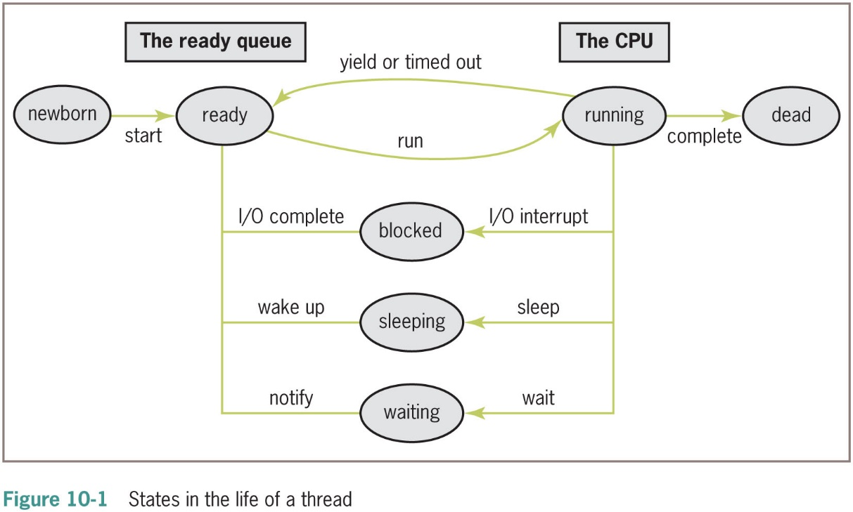
Threads (2 of 5)

Slide 7
Threads (3 of 5)
A thread remains inactive until start method runs
Thread is placed in the ready queue
Newly started thread’s run method is also activated
A thread can lose access to the C P U:
Time-out (process also known as time slicing)
Sleep
Block
Wait
Process of saving/restoring a thread’s state is called a context switch

Slide 8
Threads (4 of 5)
Most common way to create a thread is to define a class that extends the class threading.Thread
from threading import Thread
class MyThread (Thread):
“““A thread that prints its name.”””
def __init__(self, name):
Thread.__init__(self, name = name)
def run(self):
print(“Hello, my name is %s" % self.getName())
>>> process = MyThread(“Ken”)
>>> process.start()
Hello, my name is Ken

Slide 9
Threads (5 of 5)
Thread Method | What It Does
__init__(name = None) | Initializes the thread’s name
getName() | Returns the thread’s name
setName(newName) | Sets the thread’s name to newName
run() | Executes when the thread acquires the C P U
start() | Makes the new thread ready and raises an exception if run more than once
isAlive() | Returns True if the thread is alive or False otherwise

Slide 10
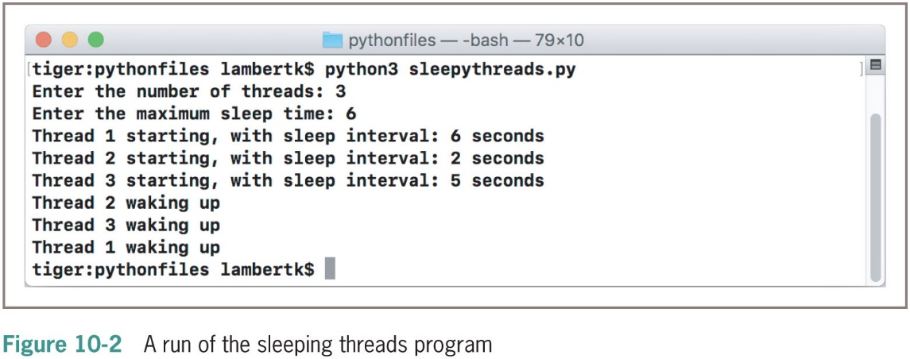
Sleeping Threads
The function time.sleep puts a thread to sleep for the specified number of seconds

Slide 11
Producer, Consumer, and Synchronization (1 of 8)
Threads that interact by sharing data are said to have a producer/consumer relationship
Example: an assembly line in a factory
A producer must produce each item before a consumer consumes it
Each item must be consumed before the producer produces the next item
A consumer must consume each item just once
We will simulate a producer/consumer relationship:
Will share a single data cell with an integer

Slide 12
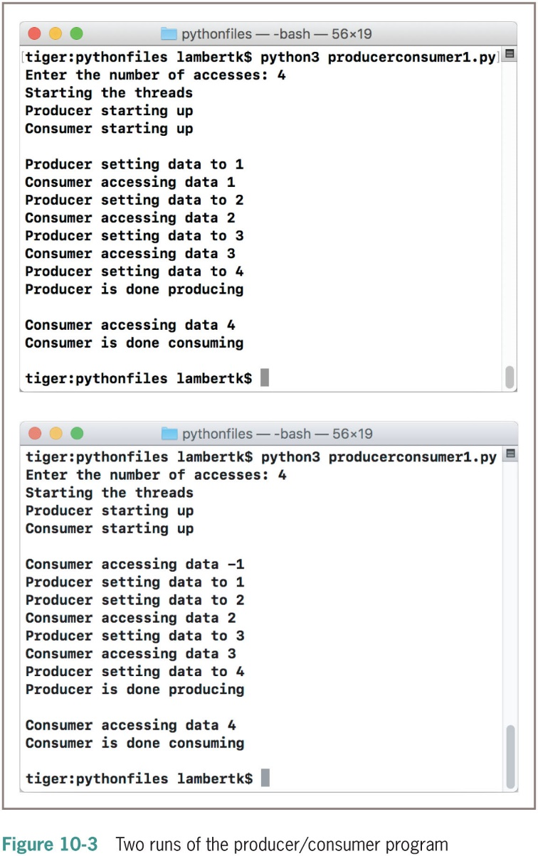
Producer, Consumer, and Synchronization (2 of 8)

Slide 13
Producer, Consumer, and Synchronization (3 of 8)
Class or Function | Role and Responsibility
main | Manages the user interface. Creates the shared cell and producer and consumer threads and starts the threads
SharedCell | Represents the shared data, which is an integer (initially -1)
Producer | Represents the producer process. Repeatedly writes an integer to the cell and increments the integer, until it reaches an upper bound.
Consumer | Represents the consumer process. Repeatedly reads an integer from the cell, until it reaches an upper bound.

Slide 14
Producer, Consumer, and Synchronization (4 of 8)
class Producer(Thread):
“““A producer of data in a shared cell.”””
def __init__(self, cell, accessCount, sleepMax):
“““Create a producer with the given shared cell,
number of accesses, and maximum sleep interval.”””
Thread.__init__(self, name = “Producer”)
self.accessCount = accessCount
self.cell = cell
self.sleepMax = sleepMax
def run(self):
“““Announce start-up, sleep and write to shared
cell the given number of times, and announce
completion.”””
print(“%s starting up” % self.getName())
for count in range(self.accessCount):
time.sleep(random.randint(1, self.sleepMax))
self.cell.setData(count + 1)
print(“%s is done producing\n” % self.getName())

Slide 15
Producer, Consumer, and Synchronization (5 of 8)
class Consumer(Thread):
“““A consumer of data in a shared cell.”””
def __init__(self, cell, accessCount, sleepMax):
“““Create a consumer with the given shared cell,
number of accesses, and maximum sleep interval.”””
Thread.__init__(self, name = “Consumer”)
self.accessCount = accessCount
self.cell = cell
self.sleepMax = sleepMax
def run(self):
“““Announce start-up, sleep, and read from shared
cell the given number of times, and announce completion.”””
print("%s starting up" % self.getName())
for count in range(self.accessCount):
time.sleep(random.randint(1, self.sleepMax))
value = self.cell.getData()
print(“%s is done consuming\n” % self.getName())

Slide 16
Producer, Consumer, and Synchronization (6 of 8)
Synchronization problems may arise:
Consumer accesses the shared cell before the producer has written its first datum
Producer then writes two consecutive data (1 and 2) before the consumer has accessed the cell again
Consumer accesses data 2 twice
Producer writes data 4 after consumer is finished
Solution: synchronize producer/consumer threads
States of shared cell: writeable or not writeable
Add two instance variables to SharedCell: a Boolean flag (_writeable) and an instance of threading.Condition

Slide 17
Producer, Consumer, and Synchronization (7 of 8)
A Condition maintains a lock on a resource
Pattern for accessing a resource with a lock:
Run acquire on the condition
While it's not OK to do the work
Run wait on the condition
Do the work with the resource
Run notify on the condition
Run release on the condition

Slide 18
Producer, Consumer, and Synchronization (8 of 8)
Condition Method | What It Does
acquire() | Attempts to acquire the lock. Blocks if the lock is already taken.
release() | Relinquishes the lock, leaving it to be acquired by others.
wait() | Releases the lock, blocks the current thread until another thread calls notify or notifyAll on the same condition, and then reacquires the lock.
notify() | Lets the next thread waiting on the lock know that it’s available
notifyAll() | Lets all threads waiting on the lock know that it’s available

Slide 19
The Readers and Writers Problem (1 of 2)
Readers access the data to observe it
Writers access the data to modify it
Only one writer can be writing at a given time, and that writer must be able to finish before other writers or readers can begin writing or reading
Multiple readers can read the shared data concurrently without waiting for each other to finish, but all active readers must finish before a writer starts writing

Slide 20
The Readers and Writers Problem (2 of 2)
A solution to the readers and writers problem:
Encase the shared data in a shared cell object, with a locking mechanism to synchronize access for multiple readers and writers
SharedCell Method | What It Does
SharedCell(data) | Constructor, creates a shared cell containing data
read(readerFunction) | Applies readerFunction to the cell’s shared data in a critical section. readerFunction must be a function of one argument, which is of the same type as the shared data
write(writerFunction) | Applies writerFunction to the cell’s shared data in a critical section. writerFunction must be a function of one argument, which is of the same type as the shared data

Slide 21
Using the SharedCell Class
We create a shared cell containing a SavingsAccount object for
multiple readers and writers, as follows:
account = SavingsAccount(name = "Ken", balance = 100.00)
cell = SharedCell(account)
Then at some point, a reader could run the code
print(“The account balance is ”,
cell.read(lambda account: account.getBalance()))
to display the account’s balance. A writer could run the code
amount = 200.00
cell.write(lambda account: account.deposit(amount))
to deposit $200.00 into the account.

Slide 22
Implementing the Interface of the SharedCell Class
class SharedCell(object):
“““Synchronizes readers and writers around shared data,
to support thread-safe reading and writing.”””
def __init__(self, data):
“““Sets up the conditions and the count of
active readers.”””
self.data = data
self.writing = False
self.readerCount = 0
self.okToRead = Condition()
self.okToWrite = Condition()

Slide 23
Implementing the Helper Methods of the SharedCell Class (1 of 2)
In beginRead, the reader thread must wait on its condition if a writer is currently writing or writers are waiting on their condition
def beginRead(self):
“““Waits until a writer is not writing or the writers
condition queue is empty. Then increments the reader
count and notifies the next waiting reader.”””
self.okToRead.acquire()
self.okToWrite.acquire()
while self.writing or len(self.okToWrite._waiters) > 0:
self.okToRead.wait()
self.readerCount += 1
self.okToRead.notify()

Slide 24
Implementing the Helper Methods of the SharedCell Class (2 of 2)
When a reader is finished in its critical section, the method endRead decrements the count of active readers
It then notifies the next waiting writer, if there are no active readers:
def endRead(self):
“““Notifies a waiting writer if there are
no active readers.”””
self.readerCount −= 1
if self.readerCount == 0:
self.okToWrite.notify()
self.okToWrite.release()
self.okToRead.release()

Slide 25
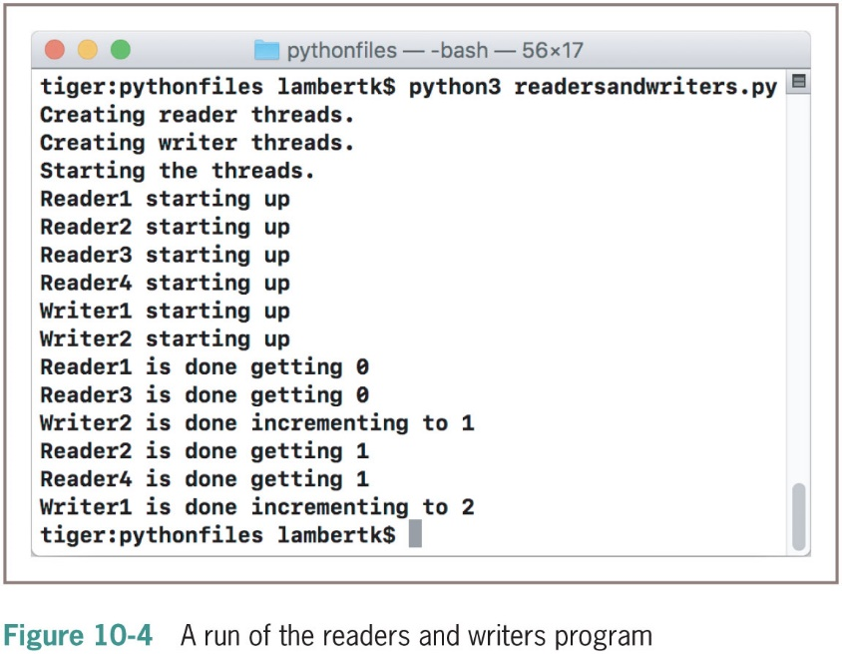
Testing the SharedCell Class with a Counter Object

Slide 26
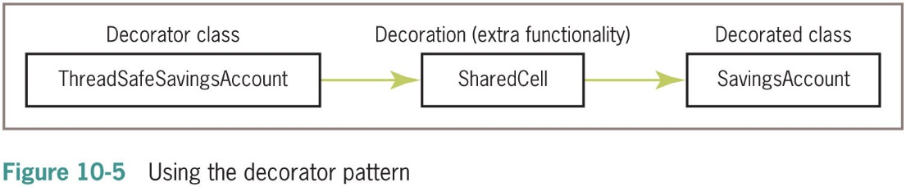
Defining a Thread-Safe Class
Decorator pattern
define a new class that has the same interface or set of methods as the class that it “decorates”
Programmers can substitute objects of this new class wherever they have used objects of the decorated class

Slide 27
Networks, Clients, and Servers
Clients and servers are applications or processes that can run locally on a single computer or remotely across a network of computers
The resources required for this type of application are:
I P addresses
Sockets
Threads

Slide 28
I P Addresses (1 of 3)
A computer on a network has a unique identifier called an I P address (I P: Internet Protocol)
Can be specified as an I P number
Format: ddd.ddd.ddd.ddd (d is a digit)
Example: 137.112.194.77
Or, as an I P name
Example: lambertk
Python’s socket module includes two functions that can look up these items of information

Slide 29
I P Addresses (2 of 3)
socket Function | What It Does
gethostname() | Returns the I P name of the host computer running the Python interpreter. Raises an exception if the computer does not have an IP address.
gethostbyname(ipName) | Returns the I P number of the computer whose I P name is ipName. Raises an exception if ipName cannot be found.

Slide 30
I P Addresses (3 of 3)
>>> from socket import *
>>> gethostname()
‘kenneth-lamberts-powerbook-g4-15.local’
>>> gethostbyname(gethostname())
‘193.169.1.209’
>>> gethostbyname(“Ken”)
Traceback (most recent call last):
File “<pyshell#7>”, line 1, in <module>
gethostbyname('Ken')
gaierror: (7, ‘No address associated with nodename’)
try:
print(gethostbyname(‘Ken’))
except Exception as exception:
print(exception)

Slide 31
Ports, Servers, and Clients
Clients connect to servers via ports
Serve as a channel through which several clients can exchange data with the same server or with different servers
Usually specified by numbers
Some are dedicated to special servers or tasks
Example: 13 for the day/time server or 80 for a Web server
Most computers also have hundreds or even thousands of free ports available for use by any network applications

Slide 32
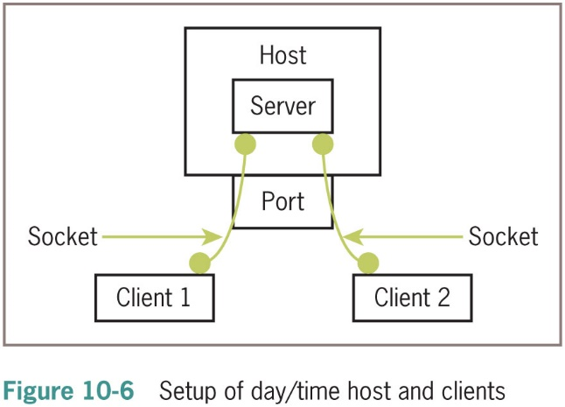
Sockets and a Day/Time Client Script (1 of 2)
We’ll write a script that is a client to a server
Socket: object that serves as a communication link between a server process and a client process
Can create/open several sockets on the same port

Slide 33
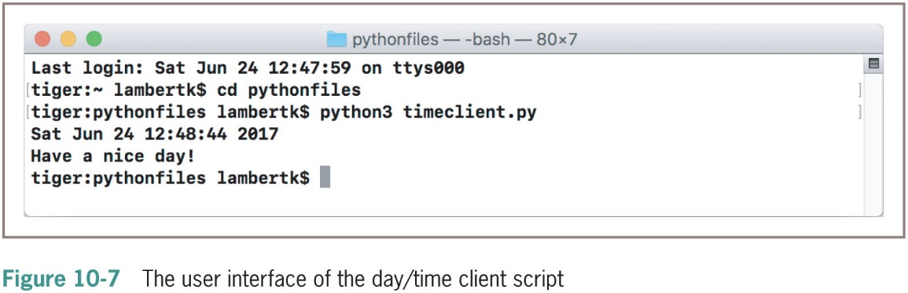
Sockets and a Day/Time Client Script (2 of 2)

Slide 34
A Day/Time Server Script (1 of 3)
You can write a day/time server script in Python to handle requests from many clients
The basic sequence of operations for a simple day/time server script is:
Create a socket and open it on port 5000 of the local host
While true:
Wait for a connection from a client
When the connection is made, send the date to the client

Slide 35
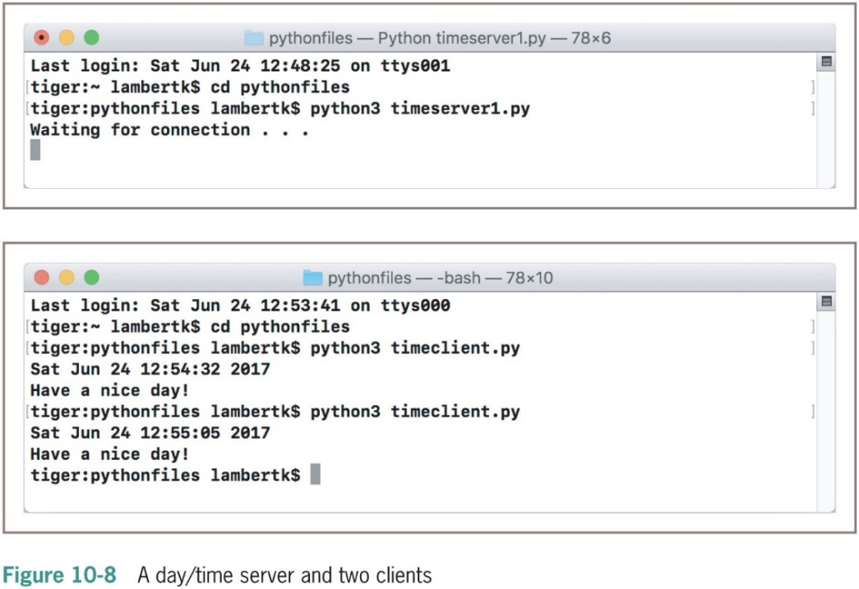
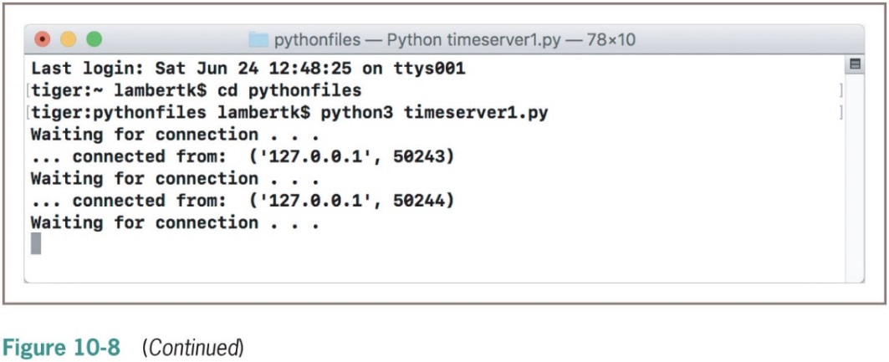
A Day/Time Server Script (2 of 3)

Slide 36
A Day/Time Server Script (3 of 3)
“““
Server for providing the day and time.
”””
from socket import *
from time import ctime
HOST = “localhost”
PORT = 5000
ADDRESS = (HOST, PORT)
server = socket(AF_INET, SOCK_STREAM)
server.bind(ADDRESS)
server.listen(5)
while True:
print(“Waiting for connection ...”)
(client, address) = server.accept()
print(“... connected from: ”, address)
client.send(bytes(ctime() + “\nHave a nice day!”,
“a s c i”))
client.close()

Slide 37
A Two-Way Chat Script (1 of 2)
Server creates a socket and enters an infinite loop to accept/handle clients; when one connects, it sends a greeting, and enters loop to chat with client
while True:
print(“Waiting for connection ...”)
client, address = server.accept()
print(“... connected from: ”, address)
client.send(bytes(“Welcome to my chat room!”, CODE))
while True:
message = decode(client.recv(BUFSIZE), CODE)
if not message:
print(“Client disconnected”)
client.close()
break
else:
print(message)
client.send(bytes(input(“> ”), CODE)

Slide 38
A Two-Way Chat Script (2 of 2)
Client:
Sets up a socket
After connection, receives and displays greeting, then, enters a loop to chat with server
print(decode(server.recv(BUFSIZE), CODE))
while True:
message = input(“> ”)
if not message:
break
server.send(bytes(message, CODE))
reply = decode(server.recv(BUFSIZE), CODE)
if not reply:
print(“Server disconnected”)
break
print(reply)
server.close()

Slide 39
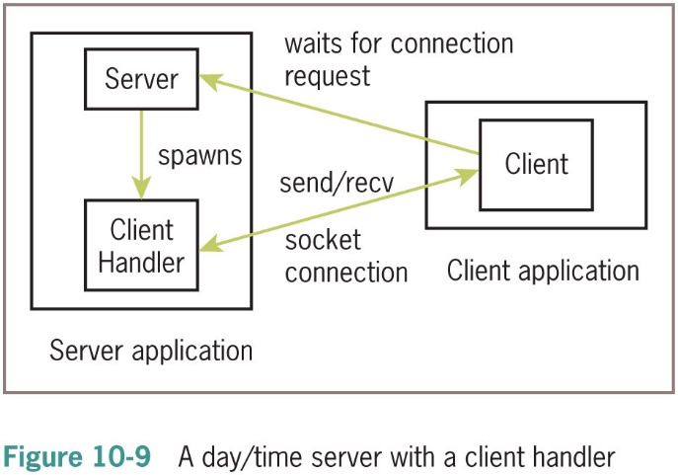
Handling Multiple Clients Concurrently
To solve the problem of giving many clients timely access to the server, we assign task of handling the client’s request a client-handler thread

Slide 40
Chapter Summary (1 of 2)
Thread synchronization problems can occur when two or more threads share data
Each computer on a network has a unique IP address that allows other computers to locate it
Servers and clients communicate on a network by sending bytes through their socket connections
A server can handle several clients concurrently by assigning each client request to a separate handler thread

Slide 41
Chapter Summary (2 of 2)
A class variable is a name for a value that all instances of a class share in common
Pickling is the process of converting an object to a form that can be saved to permanent file storage
try-except statement is used to catch and handle exceptions
Most important features of OO programming: encapsulation, inheritance, and polymorphism
Encapsulation restricts access to an object’s data to users of the methods of its class
Inheritance allows one class to pick up the attributes and behavior of another class for free
Polymorphism allows methods in several different classes to have the same headers
A data model is a set of classes that are responsible for managing the data of a program

