Slide 1
Fundamentals of Python: First Programs Second Edition
Chapter 11
Searching, Sorting, and Complexity Analysis

Slide 2
Objectives (1 of 2)
11.1 Measure the performance of an algorithm by obtaining running times and instruction counts with different data sets
11.2 Analyze an algorithm’s performance by determining its order of complexity, using big-O notation

Slide 3
Objectives (2 of 2)
11.3 Distinguish the common orders of complexity and the algorithmic patterns that exhibit them
11.4 Distinguish between the improvements obtained by tweaking an algorithm and reducing its order of complexity
11.5 Design, implement, and analyze search and sort algorithms

Slide 4
Measuring the Efficiency of Algorithms
When choosing algorithms, we often have to settle for a space/time tradeoff
An algorithm can be designed to gain faster run times at the cost of using extra space (memory), or the other way around
Memory is now quite inexpensive for desktop and laptop computers, but not yet for miniature devices

Slide 5
Measuring the Run Time of an Algorithm (1 of 5)
One way to measure the time cost of an algorithm is to use computer’s clock to obtain actual run time
Benchmarking or profiling
Can use time() in time module
Returns number of seconds that have elapsed between current time on the computer’s clock and January 1, 1970

Slide 6
Measuring the Run Time of an Algorithm (2 of 5)
“““
File: timing1.py
Prints the running times for problem sizes that double,
using a single loop.
”””
import time
problemSize = 10000000
print("%12s16s" % (“Problem Size”, “Seconds”))
for count in range(5):
start = time.time()
# The start of the algorithm
work = 1
for x in range(problemSize):
work += 1
work −= 1
# The end of the algorithm
elapsed = time.time() − start
print("%12d%16.3f" % (problemSize, elapsed))
problemSize *= 2

Slide 7
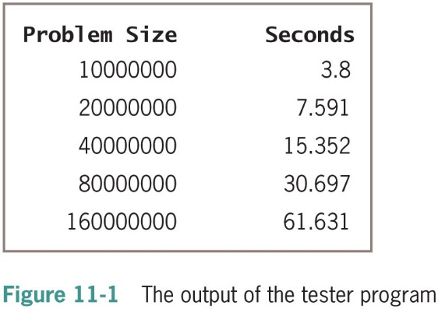
Measuring the Run Time of an Algorithm (3 of 5)

Slide 8
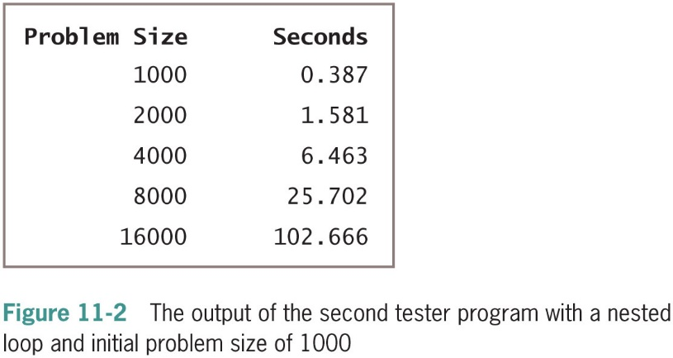
Measuring the Run Time of an Algorithm (4 of 5)
for j in range(problemSize):
for k in range(problemSize):
work += 1
work −= 1

Slide 9
Measuring the Run Time of an Algorithm (5 of 5)
This method permits accurate predictions of the running times of many algorithms
Problems:
Different hardware platforms have different processing speeds, so the running times of an algorithm differ from machine to machine
Running time varies with O S and programming language too
It is impractical to determine the running time for some algorithms with very large data sets

Slide 10
Counting Instructions (1 of 5)
Another technique is to count the instructions executed with different problem sizes
We count the instructions in the high-level code in which the algorithm is written, not instructions in the executable machine language program
Distinguish between:
Instructions that execute the same number of times regardless of problem size
For now, we ignore instructions in this class
Instructions whose execution count varies with problem size

Slide 11
Counting Instructions (2 of 5)
“““
File: counting.py
Prints the number of iterations for problem sizes
that double, using a nested loop.
”””
problemSize = 1000
print("%12s%15s" % (“Problem Size”, “Iterations”))
for count in range(5):
number = 0
# The start of the algorithm
work = 1
for j in range(problemSize):
for k in range(problemSize):
number += 1
work += 1
work −= 1
# The end of the algorithm
print("%12d%15d" % (problemSize, number))
problemSize *= 2

Slide 12
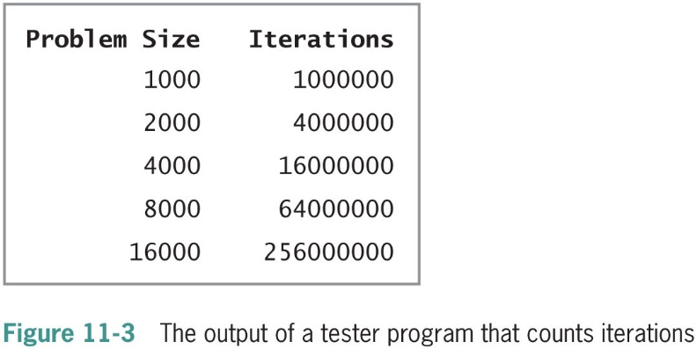
Counting Instructions (3 of 5)

Slide 13
Counting Instructions (4 of 5)
“““
File: countfib.py
Prints the number of calls of a recursive Fibonacci
function with problem sizes that double.
”””
from counter import Counter
def fib(n, counter = None):
“““Count the number of calls of the Fibonacci function.”””
if counter: counter.increment()
if n < 3:
return 1
else:
return fib(n − 1, counter) + fib(n - 2, counter)
problemSize = 2
print("%12s%15s" % (“Problem Size”, “Calls”))
for count in range(5):
counter = Counter()
# The start of the algorithm
fib(problemSize, counter)
# The end of the algorithm
print("%12d%15s" % (problemSize, counter))
problemSize *= 2

Slide 14
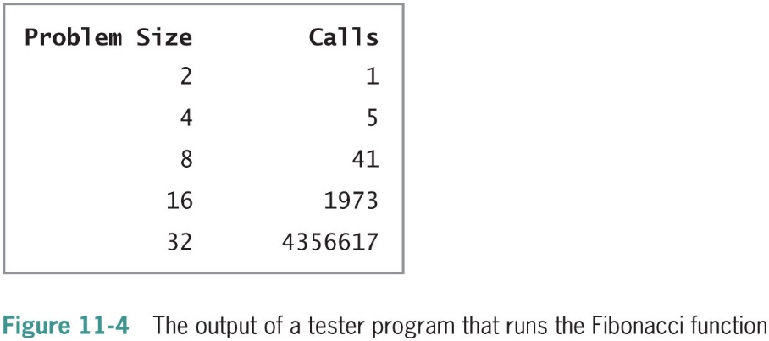
Counting Instructions (5 of 5)

Slide 15
Complexity Analysis
Complexity Analysis
Reading the algorithm and using pencil and paper to work out some simple algorithms

Slide 16
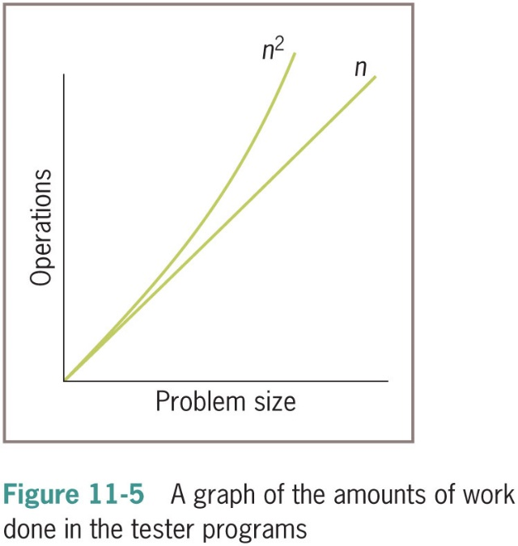
Orders of Complexity (1 of 4)
The performances of these algorithms differ by what we call an order of complexity
The performance of the first algorithm is linear in that its work grows in direct proportion to the size of the problem
The behavior of the second algorithm is quadratic in that its work grows as a function of the square of the problem size

Slide 17
Orders of Complexity (2 of 4)
An algorithm has constant performance if it requires the same number of operations for any problem size
List indexing is a good example of a constant-time algorithm
Another order of complexity that is better than linear but worse than constant is called logarithmic
The amount of work of a logarithmic algorithm is proportional to the log ₂ of the problem size
The work of a polynomial time algorithm grows at a rate of n_{k} Where k is a constant greater than 1
An order of complexity that is worse than polynomial is called exponential
An example rate of growth of this order is

Slide 18
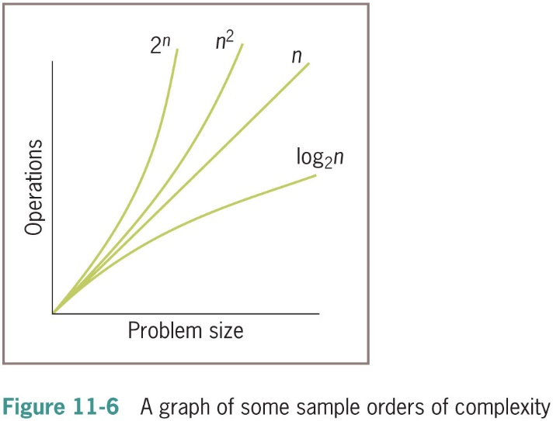
Orders of Complexity (3 of 4)

Slide 19
Orders of Complexity (4 of 4)
n | Logarithmic (log₂n) | Linear (n) | Quadratic (n²) n squared | Exponential (2^{n}) 2 to the n
100 | 7 | 100 | 10,000 | Off the charts
1,000 | 10 | 1000 | 1,000,000 | Off the charts
1,000,000 | 20 | 1,000,000 | 1,000,000,000,000 | Really off the charts

Slide 20
Big-O Notation
The amount of work in an algorithm typically is the sum of several terms in a polynomial
We focus on one term as dominant
As n becomes large, the dominant term becomes so large that the amount of work represented by the other terms can be ignored
Asymptotic analysis
Big-O notation: used to express the efficiency or computational complexity of an algorithm

Slide 21
The Role of the Constant of Proportionality
The constant of proportionality involves the terms and coefficients that are usually ignored during big-O analysis
Determine the constant of proportionality for the first algorithm discussed in this chapter. Here is the code:
work = 1
for x in range(problemSize):
work += 1
work −= 1

Slide 22
Measuring the Memory Used by an Algorithm
A complete analysis of the resources used by an algorithm includes the amount of memory required
We focus on rates of potential growth
Some algorithms require the same amount of memory to solve any problem
Other algorithms require more memory as the problem size gets larger

Slide 23
Search Algorithms
We now present several algorithms that can be used for searching and sorting lists
We first discuss the design of an algorithm,
We then show its implementation as a Python function, and,
Finally, we provide an analysis of the algorithm’s computational complexity
To keep things simple, each function processes a list of integers

Slide 24
Search for a Minimum
Python’s min function returns the minimum or smallest item in a list
Alternative version:
def ourMin(lyst):
“““Returns the position of the minimum item.”””
minpos = 0
current = 1
while current < len(lyst):
if lyst[current] < lyst[minpos]:
minpos = current
current += 1
return minpos
n – 1 comparisons for a list of size n
O(n)

Slide 25
Sequential Search of a List
Python’s in operator is implemented as a method named __contains__ in the list class
Uses a sequential search or a linear search
Python code for a linear search function:
def sequentialSearch(target, lyst):
“““Returns the position of the target item if found,
or −1 otherwise.”””
position = 0
while position < len(lyst):
if target == lyst[position]:
return position
position += 1
return −1

Slide 26
Best-Case, Worst-Case, and Average-Case Performance
Analysis of a linear search considers three cases:
In the worst case, the target item is at the end of the list or not in the list at all
O(n)
In the best case, the algorithm finds the target at the first position, after making one iteration
O(1)
Average case: add number of iterations required to find target at each possible position; divide sum by n
O(n)

Slide 27
Binary Search of a List (1 of 2)
A linear search is necessary for data that are not arranged in any particular order
When searching sorted data, use a binary search
def binarySearch(target, lyst):
“““Returns the position of the target item if found,
or −1 otherwise.”””
left = 0
right = len(lyst) − 1
while left <= right:
midpoint = (left + right) // 2
if target == lyst[midpoint]:
return midpoint
elif target < lyst[midpoint]:
right = midpoint – 1 # Search to left
else:
left = midpoint + 1 # Search to right
return −1

Slide 28
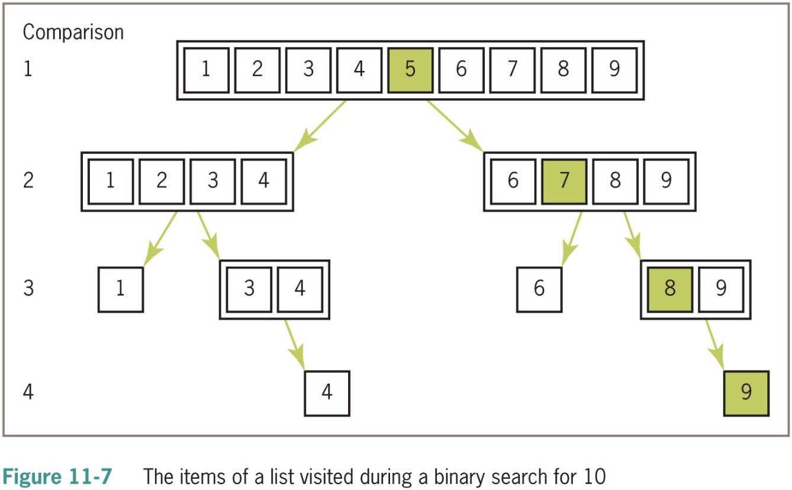
Binary Search of a List (2 of 2)

Slide 29
Basic Sort Algorithms
The sort functions that we develop here operate on a list of integers and uses a swap function to exchange the positions of two items in the list
def swap(lyst, i, j):
“““Exchanges the items at positions i and j.”””
# You could say lyst[i], lyst[j] = lyst[j], lyst[i]
# but the following code shows what is really going on
temp = lyst[i]
lyst[i] = lyst[j]
lyst[j] = temp

Slide 30
Selection Sort (1 of 2)
Perhaps the simplest strategy is to search the entire list for the position of the smallest item
If that position does not equal the first position, the algorithm swaps the items at those positions
Unsorted List | After 1st Pass | After 2nd Pass | After 3rd Pass | After 4th Pass
5 | 1* | 1 | 1 | 1
3 | 3 | 2* | 2 | 2
1 | 5* | 5 | 3* | 3
2 | 2 | 3* | 5* | 4*
4 | 4 | 4 | 4 | 5*

Slide 31
Selection Sort (2 of 2)
def selectionSort(lyst):
“““Sorts the items in lyst in ascending order.”””
i = 0
while i < len(lyst) − 1: # Do n – 1 searches
minIndex = I #for the smallest item
j = i + 1
while j < len(lyst): # Start a search
if lyst[j] < lyst[minIndex]:
minIndex = j
j += 1
if minIndex != i: # Swap if necessary
swap(lyst, minIndex, i)
i += 1

Slide 32
Bubble Sort (1 of 2)
Starts at beginning of list and compares pairs of data items as it moves down to the end
When items in pair are out of order, swap them
Unsorted List | After 1st Pass | After 2nd Pass | After 3rd Pass | After 4th Pass
5 | 4* | 4 | 4 | 4
4 | 5* | 2* | 2 | 2
2 | 2 | 5* | 1* | 1
1 | 1 | 1 | 5* | 3*
3 | 3 | 3 | 3 | 5*

Slide 33
Bubble Sort (2 of 2)
The Python function for a bubble sort:
def bubbleSort(lyst):
“““Sorts the items in lyst in ascending order.”””
n = len(lyst)
while n > 1: # Do n − 1 bubbles
i = 1 # Start each bubble
while i < n:
if lyst[i] < lyst[i − 1]: # Exchange if needed
swap(lyst, i, i − 1)
i += 1
n −= 1

Slide 34
Insertion Sort (1 of 2)
Code for the InsertionSort function:
def insertionSort(lyst):
“““Sorts the items in lyst in ascending order.”””
i = 1
while i < len(lyst):
itemToInsert = lyst[i]
j = i − 1
while j >= 0:
if itemToInsert < lyst[j]:
lyst[j + 1] = lyst[j]
j −= 1
else:
break
lyst[j + 1] = itemToInsert
i += 1

Slide 35
Insertion Sort (2 of 2)
The more items in the list that are in order, the better insertion sort gets until, in the best case of a sorted list, the sort’s behavior is linear
In the average case, insertion sort is still quadratic
Unsorted List | After 1st Pass | After 2nd Pass | After 3rd Pass | After 4th Pass
2 | 2 | 1* | 1 | 1
5 ← | 5 (no insertion) | 2 | 2 | 2
1 | 1 ← | 5 | 4* | 3*
4 | 4 | 4 ← | 5 | 4
3 | 3 | 3 | 3 ← | 5

Slide 36
Best-Case, Worst-Case, and Average-Case Performance Revisited
Thorough analysis of an algorithm’s complexity divides its behavior into three types of cases:
Best case
Worst case
Average case
There are algorithms whose best-case and average-case performances are similar, but whose performance can degrade to a worst case
When choosing/developing an algorithm, it is important to be aware of these distinctions

Slide 37
Faster Sorting
n | n Log n | n²
512 | 4,608 | 262,144
1,024 | 10,240 | 1,048,576
2,048 | 22,458 | 4,194,304
8,192 | 106,496 | 67,108,864
16,384 | 229,376 | 268,435,456
32,768 | 491,520 | 1,073,741,824

Slide 38
Quicksort (1 of 4)
An outline of the strategy used in the quicksort algorithm:
1. Begin by selecting the item at the list’s midpoint. We call this item the pivot. (
2. Partition items in the list so that all items less than the pivot are moved to the left of the pivot, and the rest are moved to its right.
3. Divide and conquer. Reapply the process recursively to the sublists formed by splitting the list at the pivot.
4. The process terminates each time it encounters a sublist with fewer than two items.

Slide 39
Quicksort (2 of 4)
Partitioning
1. Swap the pivot with the last item in the sublist.
2. Establish a boundary between the items known to be less than the pivot and the rest of the items
3. Starting with the first item in the sublist, scan across the sublist. Every time an item less than the pivot is encountered, swap it with the first item after the boundary and advance the boundary.
4. Finish by swapping the pivot with the first item after the boundary.

Slide 40
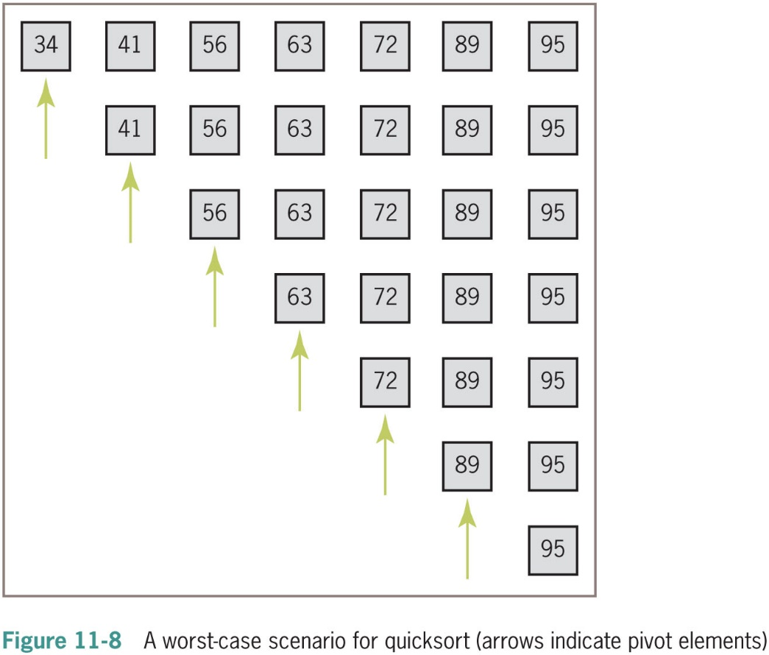
Quicksort (3 of 4)
Complexity Analysis of Quicksort

Slide 41
Quicksort (4 of 4)
Implementation of Quicksort
The quicksort algorithm is most easily coded using a recursive approach

Slide 42
Merge Sort (1 of 5)
Informal summary of the algorithm
Compute the middle position of a list and recursively sort its left and right sublists (divide and conquer).
Merge the two sorted sublists back into a single sorted list.
Stop the process when sublists can no longer be subdivided.
Three Python functions collaborate in this top-level design strategy:
mergeSort—The function called by users.
mergeSortHelper—A helper function that hides the extra parameters required by recursive calls.
merge—A function that implements the merging process.

Slide 43
Merge Sort (2 of 5)
Implementing the Merging Process
The merging process uses a temporary list of the same size as the list being sorted
We call this list the copyBuffer
To avoid the overhead of allocating and deallocating the copyBuffer each time merge is called, the buffer is allocated once in mergeSort and passed as an argument to mergeSortHelper and merge

Slide 44
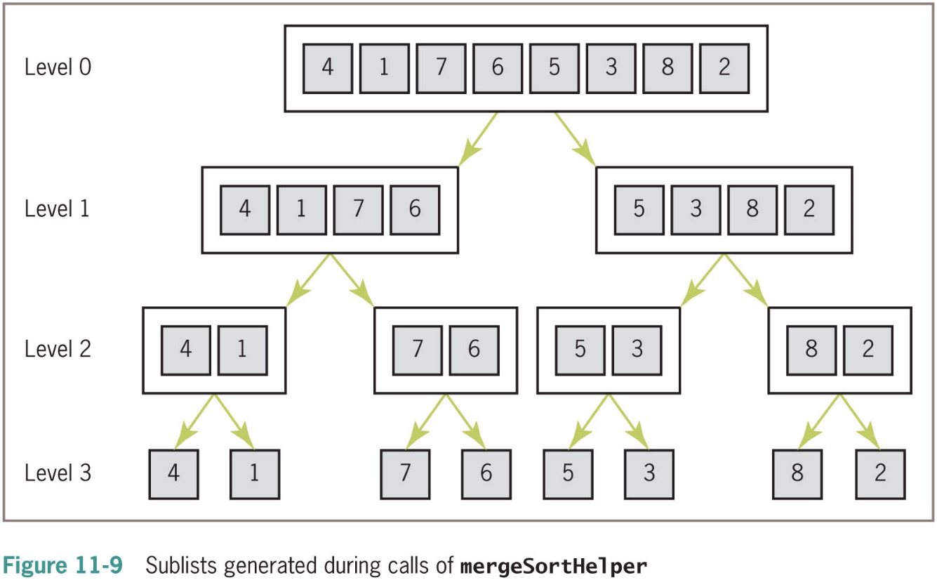
Merge Sort (3 of 5)

Slide 45
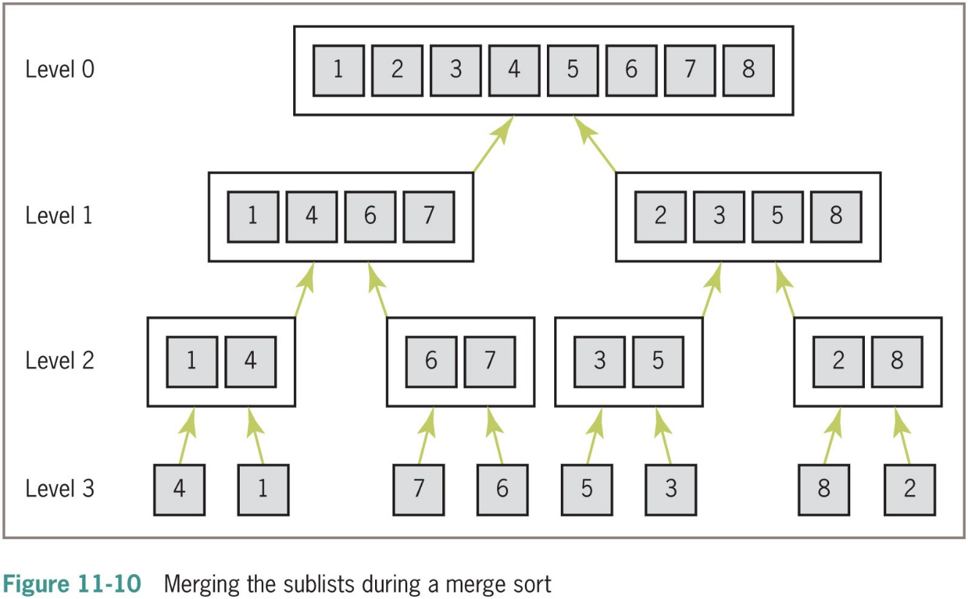
Merge Sort (4 of 5)

Slide 46
Merge Sort (5 of 5)
Complexity Analysis of Merge Sort
The running time of the merge function is dominated by the two for statements
Each of which loops (high 2 low 1 1) times
The function’s running time is O(high 2 low), and all the merges at a single level take O(n) time
Because mergeSortHelper splits sublists as evenly as possible at each level, the number of levels is O(log n)
And the running time for this function is O(n log n) in all cases.

Slide 47
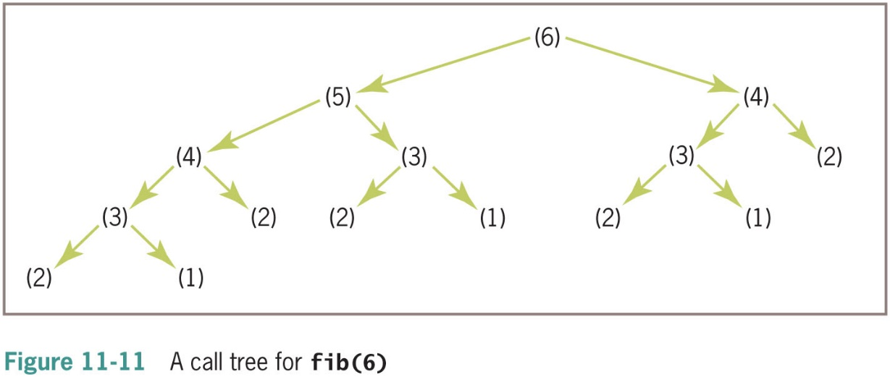
An Exponential Algorithm: Recursive Fibonacci (1 of 2)
Code for the Fibonacci function:
def fib(n):
“““Returns the nth Fibonacci number.”””
if n < 3:
return 1
else:
return fib(n − 1) + fib(n − 2)

Slide 48
An Exponential Algorithm: Recursive Fibonacci (2 of 2)
Exponential algorithms are generally impractical to run with any but very small problem sizes
Recursive functions that are called repeatedly with same arguments can be made more efficient by technique called memoization
Program maintains a table of the values for each argument used with the function
Before the function recursively computes a value for a given argument, it checks the table to see if that argument already has a value

Slide 49
Converting Fibonacci to a Linear Algorithm (1 of 3)
Pseudocode:
Set sum to 1
Set first to 1
Set second to 1
Set count to 3
While count <= N
Set sum to first + second
Set first to second
Set second to sum
Increment count

Slide 50
Converting Fibonacci to a Linear Algorithm (2 of 3)
def fib(n, counter = None):
“““Count the number of iterations in the Fibonacci
function.”””
theSum = 1
first = 1
second = 1
count = 3
while count <= n:
if counter: counter.increment()
theSum = first + second
first = second
second = theSum
count += 1
return theSum

Slide 51
Converting Fibonacci to a Linear Algorithm (3 of 3)
Problem Size | Iterations
2 | 0
4 | 2
8 | 6
16 | 14
32 | 30

Slide 52
Chapter Summary (1 of 2)
Thread synchronization problems can occur when two or more threads share data
Each computer on a network has a unique I P address that allows other computers to locate it
Servers and clients communicate on a network by sending bytes through their socket connections
A server can handle several clients concurrently by assigning each client request to a separate handler thread

Slide 53
Chapter Summary (2 of 2)
A class variable is a name for a value that all instances of a class share in common
Pickling is the process of converting an object to a form that can be saved to permanent file storage
try-except statement is used to catch and handle exceptions
Most important features of OO programming: encapsulation, inheritance, and polymorphism
Encapsulation restricts access to an object’s data to users of the methods of its class
Inheritance allows one class to pick up the attributes and behavior of another class for free
Polymorphism allows methods in several different classes to have the same headers
A data model is a set of classes that are responsible for managing the data of a program

