Slide 1
Fundamentals of Python: First Programs Second Edition
Chapter 6
Design with Functions

Slide 2
Objectives (1 of 2)
6.1 Explain why functions are useful in structuring code in a program
6.2 Employ top-down design to assign tasks to functions
6.3 Define a recursive function

Slide 3
Objectives (2 of 2)
6.4 Explain the use of the namespace in a program and exploit it effectively
6.5 Define a function with required and optional parameters
6.6 Use higher-order functions for mapping, filtering, and reducing

Slide 4
A Quick Review of What Functions Are and How They Work
A function packages an algorithm in a chunk of code that you can call by name
A function can be called from anywhere in a program’s code, including code within other functions
A function can receive data from its caller via arguments
When a function is called, any expression supplied as arguments are first evaluated
A function may have one or more return statements

Slide 5
Functions as Abstraction Mechanisms
An abstraction hides detail
Allows a person to view many things as just one thing
We use abstractions to refer to the most common tasks in everyday life
For example, the expression “doing my laundry”
Effective designers must invent useful abstractions to control complexity

Slide 6
Functions Eliminate Redundancy
Functions serve as abstraction mechanisms by eliminating redundant, or repetitious, code
def summation(lower, upper):
“““Arguments: A lower bound and an upper bound
Returns: the sum of the numbers from lower through
upper
”””
result = 0
while lower <= upper:
result += lower
lower += 1
return result
>>> summation(1,4) # The summation of the numbers 1..4
10
>>> summation(50,100) # The summation of the numbers 50..100
3825

Slide 7
Functions Hide Complexity
Functions serve as abstraction mechanisms is by hiding complicated details
For example, consider the previous summation function
The idea of summing a range of numbers is simple; the code for computing a summation is not
A function call expresses the idea of a process to the programmer
Without forcing him/her to wade through the complex code that realizes that idea

Slide 8
Functions Support General Methods with Systematic Variations
An algorithm is a general method for solving a class of problems
The individual problems that make up a class of problems are known as problem instances
What are the problem instances of our summation algorithm?
Algorithms should be general enough to provide a solution to many problem instances
A function should provide a general method with systematic variations

Slide 9
Functions Support the Division of Labor
In a well-organized system, each part does its own job in collaborating to achieve a common goal
In a computer program, functions can enforce a division of labor
Each function should perform a single coherent task
Example: Computing a summation
Each of the tasks required by a system can be assigned to a function
Including the tasks of managing or coordinating the use of other functions

Slide 10
Problem Solving with Top-Down Design
Top-down design starts with a global view of the entire problem and breaks the problem into smaller, more manageable subproblems
Process known as problem decomposition
As each subproblem is isolated, its solution is assigned to a function
As functions are developed to solve subproblems, solution to overall problem is gradually filled out
Process is also called stepwise refinement

Slide 11
The Design of the Text-Analysis Program (1 of 2)
Structure chart – a diagram that shows the relationship among a program’s functions and the passage of data between them
Each box in the structure is labeled with a function name
The main function at the top is where the design begins
Lines connecting the boxes are labeled with data type names
Arrows indicate the flow of data between them

Slide 12
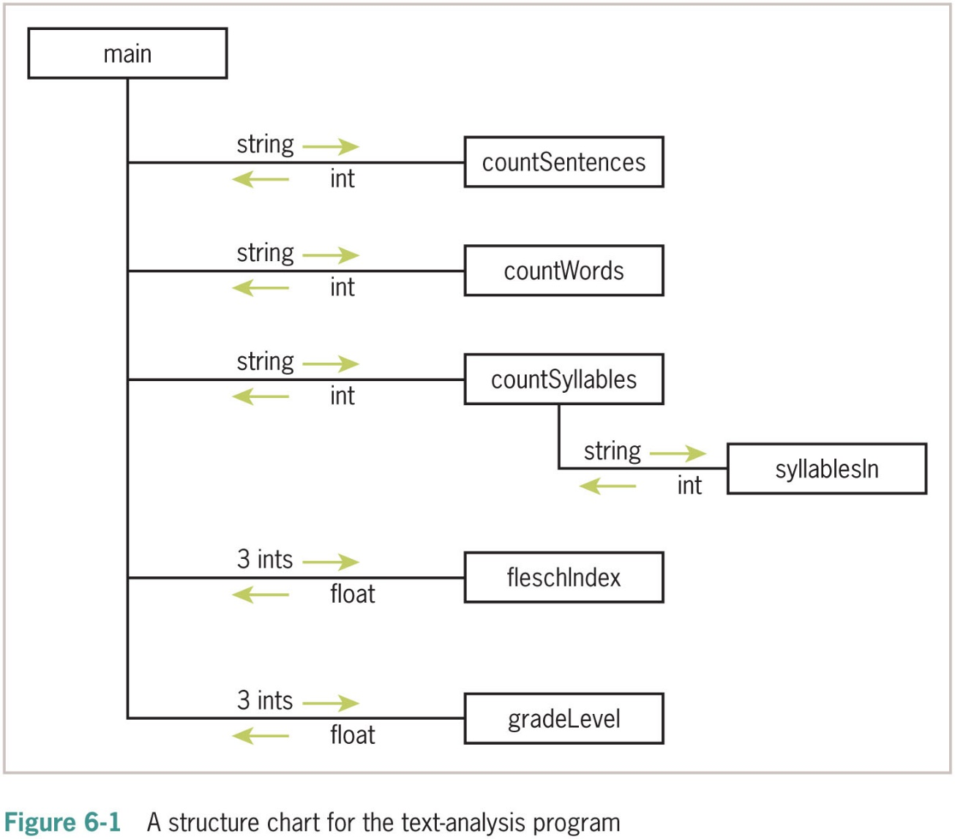
The Design of the Text-Analysis Program (2 of 2)

Slide 13
The Design of the Sentence-Generator Program (1 of 2)
The sentence-generator program consists of a main loop in which sentences are generated a user-specified number of times
The top-down design flows out of the top-down structure of the grammar
The structure of a problem can often give you a pattern for designing the structure of the program to solve it

Slide 14
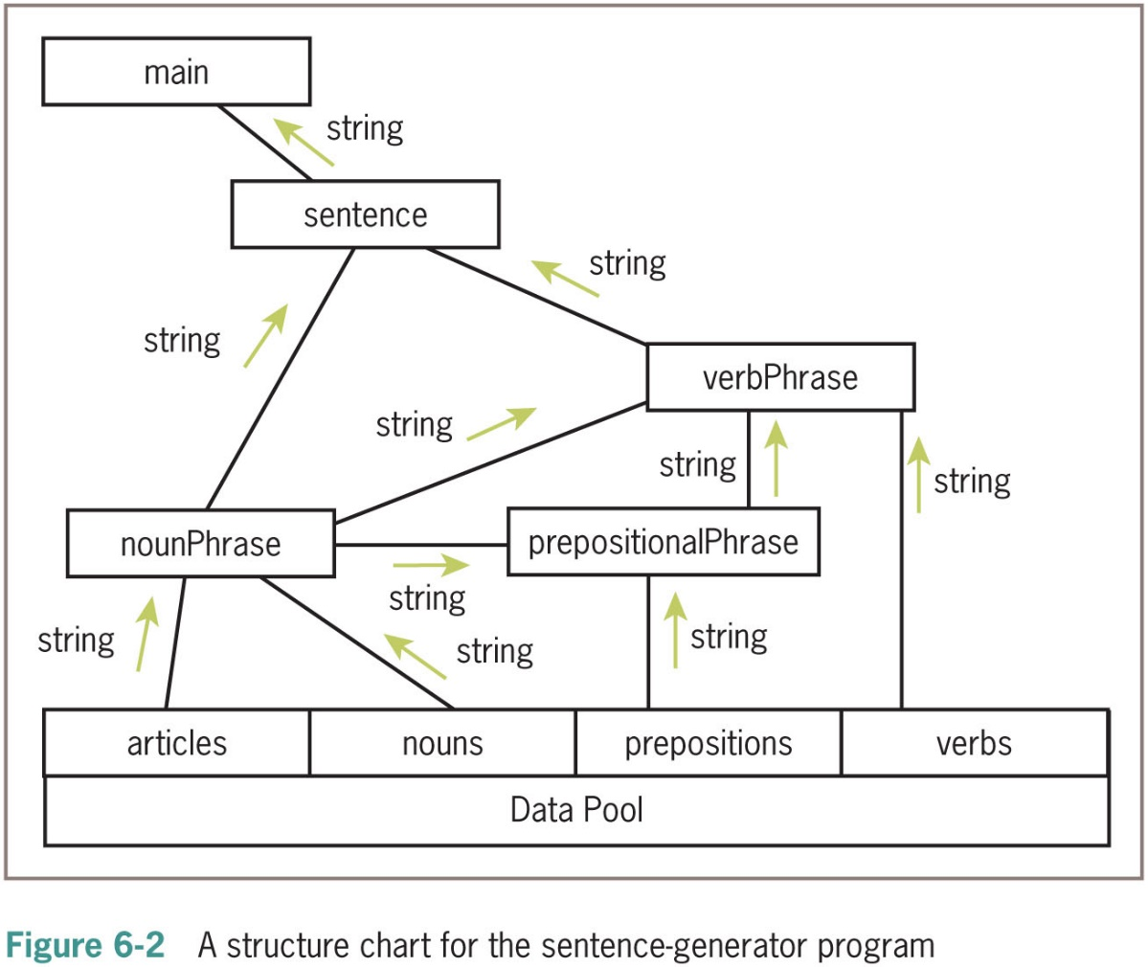
The Design of the Sentence-Generator Program (2 of 2)

Slide 15
The Design of the Doctor Program (1 of 2)
At the top level, the designs of the doctor program and the sentence-generator program are similar
Both programs have main loops that take a single user input and print a result
The doctor program processes input by responding to it as an agent would in a conversation

Slide 16
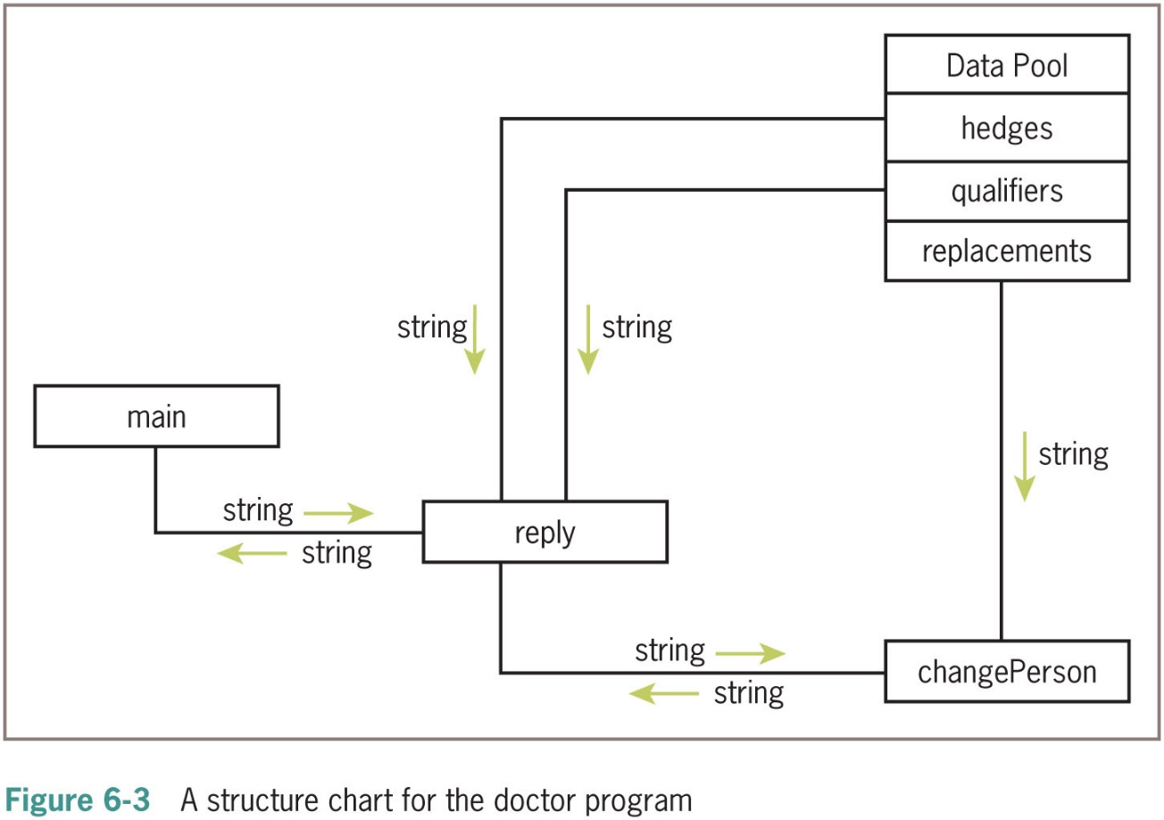
The Design of the Doctor Program (2 of 2)

Slide 17
Design with Recursive Functions
In top-down design, you decompose a complex problem into a set of simpler problems and solve these with different functions
In some cases, you can decompose a complex problem into smaller problems of the same form
Subproblems can be solved using the same function
This design strategy is called recursive design
Resulting functions are called recursive functions

Slide 18
Defining a Recursive Function (1 of 2)
A recursive function is a function that calls itself
To prevent function from repeating itself indefinitely, it must contain at least one selection statement
Statement examines base case to determine whether to stop or to continue with another recursive step
To convert displayRange to a recursive function:
def displayRange(lower, upper):
“““Outputs the numbers from lower through upper.”””
while lower <= upper:
print(lower)
lower = lower + 1
You can replace loop with a selection statement and assignment statement with a recursive call

Slide 19
Defining a Recursive Function (2 of 2)
Making displayRange recursive (continued):
def displayRange(lower, upper):
“““ Outputs the numbers from lower through upper.”””
if lower <= upper:
print(lower)
displayRange(lower + 1, upper)
Most recursive functions expect at least one argument
Another example: Recursive version of summation
def summation(lower, upper):
“““ Returns the sum of the numbers from lower through
upper. ”””
if lower > upper:
return 0
else:
return lower + summation (lower + 1, upper)

Slide 20
Tracing a Recursive Function (1 of 2)
def summation(lower, upper, margin):
“““ Returns the sum of the numbers from lower through upper,
and outputs a trace of the arguments and return values
on each call”””
blanks = “ ” * margin
print(blanks, lower, upper)
if lower > upper:
print(blanks, 0)
return 0
else:
result = lower + summation(lower + 1, upper, margin + 4)
print(blanks, result)
return result

Slide 21
Tracing a Recursive Function (2 of 2)
>>> summation (l, 4, 0)
1 4
2 4
3 4
4 4
5 4
0
4
7
9
10
10

Slide 22
Using Recursive Definitions to Construct Recursive Functions
Recursive functions are frequently used to design algorithms that have a recursive definition
A recursive definition consists of equations that state what a value is for one or more base cases and one or more recursive cases
Example: Fibonacci sequence
1 1 2 3 5 8 13 . . .
Fib(n) = 1, when n = 1 or n = 2
Fib(n) = Fib(n − 1) + Fib(n − 2), for all n > 2
def fib(n):
“““Returns the nth Fibonacci number.”””
if n < 3:
return 1
else:
return fib(n − 1) + fib(n − 2)

Slide 23
Recursion in Sentence Structure
Recursive solutions can often flow from the structure of a problem
Example: Structure of sentences in a language
A noun phrase can be modified by a prepositional phrase, which also contains another noun phrase
Nounphrase = Article Noun [Prepositionalphrase]
Code for a revised nounPhrase function:
def nounPhrase():
“““Returns a noun phrase, which is an article followed
by a noun, and an optional prepositional phrase.”””
phrase = random.choice(articles) + “ ” + random.choice(nouns)
prob = random.randint(1, 4)
if prob == 1:
return phrase + “ ” + prepositionalPhrase()
else:
return phrase

Slide 24
Infinite Recursion
Infinite recursion arises when programmer fails to specify base case or to reduce size of problem in a way that terminates the recursive process
>>> def runForever(n):
if n > 0:
runForever(n)
else:
runForever(n − 1)
>>> runForever(1)
Traceback (most recent call last):
File “<py shell#6>”, line 1, in <module>
runForever(1)
File “<py shell#5>”, line 3, in runForever
runForever(n)
[Previous line repeated 991 more times]
File “<py shell#5>”, line 2, in runForever
if n > 0:
RecursionError: maximum recursion depth exceeded in comparison

Slide 25
The Costs and Benefits of Recursion (1 of 2)
PVM reserves an area of memory for the call stack
For each call of a function, the P V M must allocate on the call stack a stack frame, which contains:
Values of the arguments
Return address for the particular function call
Space for the function call’s return value
When a call returns, return address is used to locate the next instruction, and stack frame is deallocated
Amount of memory needed for a loop does not grow with the size of the problem’s data set

Slide 26
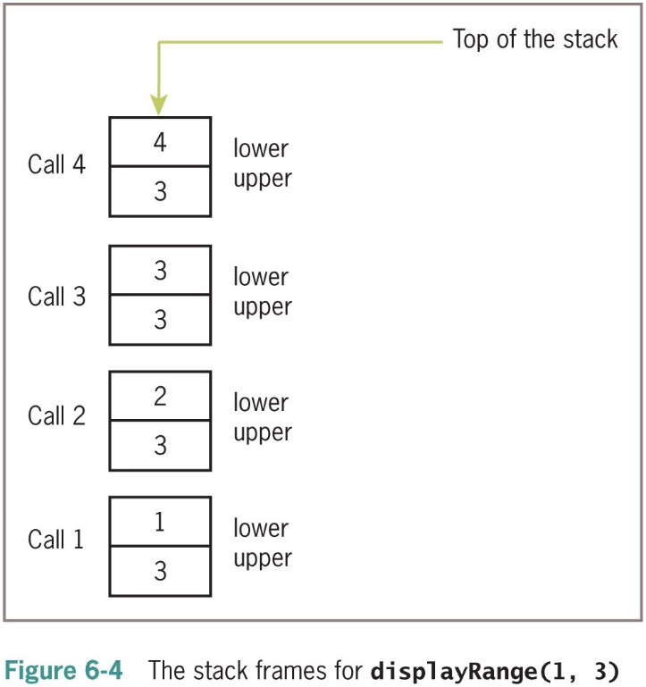
The Costs and Benefits of Recursion (2 of 2)

Slide 27
Managing a Program’s Namespace
A program’s namespace is the set of its variables and their values
You can control it with good design principles

Slide 28
Module Variables, Parameters, and Temporary Variables (1 of 2)
Analyze the namespace of the doctor program of Case Study 5.5
Focus on the code for the variable replacements and the function
changePerson
replacements = {“I”: “you”, “me”: “you”, “my”: “my” “your”,
“we”: “you”, “us”: “you”, “mine”:“yours”}
def changePerson(sentence):
“““ Replaces first person pronouns with second person
pronouns.”””
words = sentence.split( )
replyWords = []
for word in words:
replyWords.append(replacements.get(word, word))
return “ ”.join(replyWords)

Slide 29
Module Variables, Parameters, and Temporary Variables (2 of 2)
Module variables and temporary variables receive their values as soon as they are introduced
Parameters behave like a variable and are introduced in a function or method header
Do not receive a value until the function is called
Method names
A method reference always uses an object followed by a dot and the method name

Slide 30
Scope (1 of 2)
Scope: Area in which a name refers to a given value
Temporary variables are restricted to the body of the functions in which they are introduced
Parameters are invisible outside function definition
The scope of module variables includes entire module below point where they are introduced
A function can reference a module variable, but can’t under normal circumstances assign a new value to it

Slide 31
Scope (2 of 2)
Although a Python function can reference a module variable for its value, it cannot under normal circumstances assign a new value to a module variable
When such an attempt is made, the P V M creates a new, temporary variable of the same name within the function
The following script shows how this works:
x = 5
def f():
x = 10 # Attempt to reset x
f() # Does the top-level x change?
print(x) # No, this displays 5

Slide 32
Lifetime
Variable’s lifetime: Period of time when variable has memory storage associated with it
When a variable comes into existence, storage is allocated for it; when it goes out of existence, storage is reclaimed by the P V M
Module variables come into existence when introduced and generally exist for lifetime of program that introduces or imports them
Parameters and temporary variables come into existence when bound to values during call, but go out of existence when call terminates

Slide 33
Using Keywords for Default and Optional Arguments (1 of 4)
Arguments provide the function’s caller with the means of transmitting information to the function
Programmer can specify optional arguments with default values in any function definition:
def <function name>(<required arguments>,
<key-1> = <val−1>, ... <key−n> = <val−n>)
Following the required arguments are one or more default or keyword arguments
When function is called with these arguments, default values are overridden by caller’s values

Slide 34
Using Keywords for Default and Optional Arguments (2 of 4)
Suppose we define a function, repToInt, to convert string representations of numbers in a given base to their integer values
The function expects a string representation of the number and an integer base as arguments
Here is the code:
def rep To Int(rep String, base):
“““Converts the rep String to an int in the base
and returns this int.”””
decimal = 0
exponent = len(rep String) − 1
for digit in rep String:
decimal = decimal + int(digit) * base ** exponent
exponent − = 1
return decimal

Slide 35
Using Keywords for Default and Optional Arguments (3 of 4)
As written, this function can be used to convert string representations in bases 2 through 10 to integers
Might need to alter the function header to provide a default of 2 for base
Here is the proposed change, followed by a session that shows its impact:
def repToInt(repString, base = 2):
>>> repToInt(“10”, 10)
10
>>> repToInt(“10”, 8) # Override the default to here
8
>>> repToInt(“10”, 2) # Same as the default, not necessary
2
>>> repToInt(“10”) # Base 2 by default
2

Slide 36
Using Keywords for Default and Optional Arguments (4 of 4)
The default arguments that follow can be supplied in two ways:
By position
By keyword
>>> def example(required, option1 = 2, option2 = 3):
print(required, option1, option2)
>>> example(1) # Use all the defaults
1 2 3
>>> example(1, 10) # Override the first default
1 10 3
>>> example(1, 10, 20) # Override all the defaults
1 10 20
>>> example(1, option2 = 20) # Override the second default
1 2 20
>>> example(1, option2 = 20, option1 = 10) # In any order
1 10 20

Slide 37
Higher-Order Functions
A higher-order function expects a function and a set of data values as arguments
Argument function is applied to each data value and a set of results or a single data value is returned
A higher-order function separates task of transforming each data value from logic of accumulating the results

Slide 38
Functions as First-Class Data Objects (1 of 2)
Functions can be assigned to variables, passed as arguments, returned as the values of other functions, and stored in data structures
>>> abs # See what abs looks like
<built-in function abs>
>>> import math
>>> math.sqrt
<built-in function sqrt>
>>> f = abs # f is an alias for abs
>>> f # Evaluate f
<built-in function abs>
>>> f(-4) # Apply f to an argument
4
>>> funcs = [abs, math.sqrt] # Put the functions in a list
>>> funcs
[<built-in function abs>, <built-in function sqrt>]
>>> funcs[l](2) # Apply math.sqrt to 2
1.4142135623730951

Slide 39
Functions as First-Class Data Objects (2 of 2)
Passing a function as an argument is no different from passing any other datum:
>>> def example(function Arg, data Arg):
return function Arg(data Arg)
>>> example(abs, −4)
4
>>> example(math.sqrt, 2)
1.4142135623730951

Slide 40
Mapping (1 of 3)
Mapping applies a function to each value in a sequence and returns a new sequence of the results
Example:
A list named words that contains strings that represent integers
Want to replace each string with corresponding integer value
>>> words = [“231”, “20”, “−45”, “99”]
>>> map(int, words) # Convert all strings to ints
<map object at 0xl4cbd90>
>>> words # Original list is not changed
[‘231’, ‘20’, ‘−45’, ‘99’]
>>> words = list(map(int, words)) # Reset variable to change it
>>> words
[231, 20, −45, 99]

Slide 41
Mapping (2 of 3)
Another example:
The changePerson function of the doctor program
def changePerson(sentence):
“““Replaces first person pronouns with second person pronouns.”””
words = sentence.split( )
replyWords = []
for word in words:
replyWords.append(replacements.get(word, word))
return “ ”.join(replyWords)

Slide 42
Mapping (3 of 3)
Simplify the logic by defining an auxiliary function that is mapped onto the list of words:
def changePerson(sentence):
“““Replaces first person pronouns with second person pronouns.”””
def getWord(word):
return replacements.get(word, word)
return “ ”.join(map(getWord, sentence.split())

Slide 43
Filtering
When filtering, a function called a predicate is applied to each value in a list
If predicate returns True, value is added to a new list; otherwise, value is dropped from consideration
Python includes a filter function that is used in the next example to produce a list of the odd numbers in another list:
>>> def odd(n): return n % 2 == 1
>>> list(filter(odd, range(l O)))
[1, 3, 5, 7, 9]

Slide 44
Reducing
When reducing, we take a list of values and repeatedly apply a function to accumulate a single data value
The following example shows reduce used twice—once to produce a sum and once to produce a product:
>>> from functools import reduce
>>> def add(x, y): return x + y
>>> def multiply(x, y): return x * y
>>> data = [1, 2, 3, 4]
>>> reduce(add, data)
10
>>> reduce(multiply, data)
24

Slide 45
Using Lambda to Create Anonymous Functions (1 of 2)
A lambda is an anonymous function
When the lambda is applied to its arguments, its expression is evaluated and its value is returned
The syntax of lambda is very tight and restrictive:
lambda <argname−1, ..., argname−n>: <expression>
All of the code must appear on one line and, although it is sad, a lambda cannot include a selection statement, because selection statements are not expressions

Slide 46
Using Lambda to Create Anonymous Functions (2 of 2)
We can now specify addition or multiplication on the fly, as the next session
illustrates:
>>> data = [1, 2, 3, 4]
>>> reduce(lambda x, y: x + y, data) # Produce the sum
10
>>> reduce(lambda x, y: x * y, data) # Produce the product
24
The next example shows the use of range, reduce, and lambda to simplify the definition of the summation function
def summation(lower, upper):
“““Returns the sum of the numbers from lower
through upper.”””
if lower > upper:
return 0
else:
return reduce(lambda x, y: x + y, range(lower, upper + 1))

Slide 47
Creating Jump Tables
A jump table is a dictionary of functions keyed by command names
The function runCommand uses its command argument to look up the function in the jump table and then calls this function
def runCommand(command): # How simple can it get?
jumpTable[command]()
# The functions named insert, replace, and remove
# are defined earlier
jumpTable = {}
jumpTable[‘1’] = insert
jumpTable[‘2’] = replace
jumpTable[‘3’] = remove

Slide 48
Chapter Summary (1 of 3)
A function serves as abstraction mechanism and eliminates redundant patterns of code
A function hides a complex chunk of code in a single named entity
Allows a general method to be applied in varying situations
Top-down design is strategy that decomposes complex problem into simpler sub-problems and assigns their solutions to functions
A structure chart is diagram of relationships among cooperating functions
Recursive design is special case of top-down design, in which complex problem is decomposed into smaller problems of the same form

Slide 49
Chapter Summary (2 of 3)
A recursive function is a function that calls itself
Parts: Base case and recursive step
Can be computationally expensive
Programmers must avoid infinite recursion
Program namespace is structured in terms of module variables, parameters, and temporary variables
Scope can be used to control the visibility of names in a namespace
The lifetime of a variable is duration of program execution during which it uses memory storage

Slide 50
Chapter Summary (3 of 3)
Functions are first-class data objects
Higher-order functions can expect other functions as arguments and/or return functions as values
A mapping function expects a function and a list of values as arguments
A predicate is a Boolean function
A filtering function expects a predicate and a list of values as arguments
A reducing function expects a function and a list of values as arguments

