Slide 1

Breast Cancer Prediction
Soma Shekar Vayuvegula
Notes:
Hello everyone, I am Soma Shekar Vayuvegula. Today’s we are going to have a session on Breast Cancer Prediction. I hope this will be an informative session. Please feel free to stop me whenever you have any queries.

Slide 2
Introduction
Breast Cancer is caused by healthy cells of the tissue are invaded and mutated, which will further grow in large numbers to form a malignant tumor.
As Cancer is troubling the world and especially Breast Cancer in women, I have worked on the available public datasets, which will help us identify cancer at its early stages depending on the various attributes provided by the patients who have been diagnosed with Breast Cancer.
Notes:
Let’s have a brief Introduction about Breast Cancer and my project.
Breast Cancer is caused when healthy cells of the tissue are invaded and mutated, which will further grow in large numbers to form a malignant tumor.
As Cancer is troubling the world and especially Breast Cancer in women, I have worked on the available public datasets, which will help us identify cancer at its early stages depending on the various attributes provided by the patients who have been diagnosed with Breast Cancer.

Slide 3
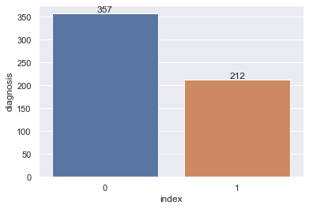
Dataset Processing
Removed the columns which are not necessary for the analysis
Converted diagnosis column from String to Boolean (1,0)
Implemented SMOTE analysis to balance the dataset as ratio of Malignant and Benign tumors are 60:40
Notes:
Now, Let’s see Dataset Processing. I have processed the data which will help reduce the dataset size but still it will have all the required data for analysis. As part of this process, I have done the following steps:
Removed the columns which are not necessary for the analysis
Converted diagnosis column from String to Boolean (1,0)
Implemented SMOTE analysis to balance the dataset as ratio of Malignant and Benign tumors are 60:40. I have applied SMOTE to get the balanced data set and get the prediction right. In general, if one diagnosis value has more rows than other, predictions will be more towards diagnosis which has more rows.
If you see the bar graph provided here, benign tumor has more data than the malignant tumor. I felt this is not balanced data and implemented SMOTE to get Balanced dataset.

Slide 4
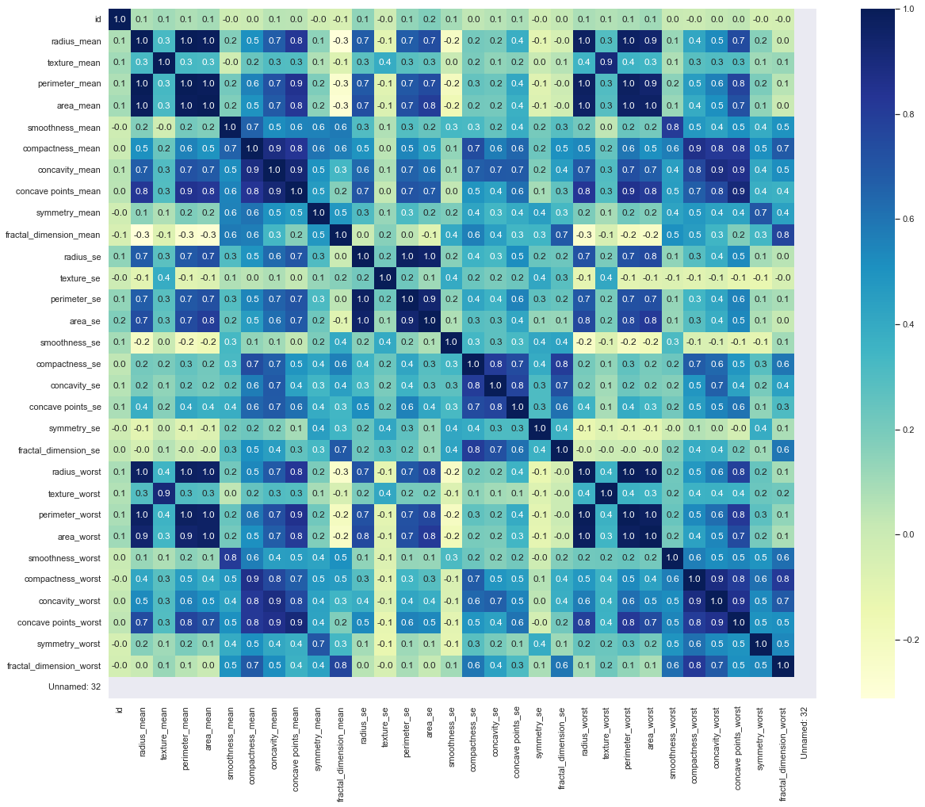
Data Visualizations
Notes:
Now, Let’s see HeatMap.
This Heatmap will provide a correlation between every feature/symptom of Breast Cancer. This will provide data on which two signs have the best correlation between them.

Slide 5
Methods
I have applied the following methods:
Logistic Regression
KNN Model
Decision Tree Classifier
Random Forest
Notes:
Moving on. We are going to see the methods used as part of this project. I have used the following methods:
Logistic Regression
KNN Model
Decision Tree Classifier
Random Forest

Slide 6
Logistic Regression
As part of Logistic Regression, I have used the below Model Params:
Penalty : l1 and l2
C: 0.001, 0.009, 0.01, 0.09, 1, 5, 10, 25
Solver: lbfgs, newton-cg, liblinear, sag, saga
Scoring roc-auc has been used.
ROC-AUC score : 0.976444560124935
Accuracy score : 0.9767441860465116
Notes:
Let’s discuss on Logistic Regression,
As part of Logistic Regression, I have used the below Model Params:
Penalty : l1 and l2. With L1 all the less important features will become zero. If we use L2 , the wi values will become small but not necessarily zero
C: 0.001, 0.009, 0.01, 0.09, 1, 5, 10, 25, C is known as a hyperparameter. the hyperparameters instruct the model on how to choose parameters
Solver: lbfgs, newton-cg, liblinear, sag, saga, we have use differnet solvers
roc-auc Scoring has been used.
ROC-AUC score is 0.976
Accuracy score is 0.976

Slide 7
KNN Model
As part of KNN Model, I have used the below Model Params:
n_neighbors : range(1, 15, 2)
weights: iniform, distance
metric: cosine
leaf_size: [1,50,5]
Scoring roc-auc has been used.
ROC-AUC score : 0.9685493666493147
Accuracy score : 0.9674418604651163
Notes:
Moving on, let’s discuss on KNN model.
As part of KNN Model, I have used the below Model Params:
n_neighbors : range(1, 15, 2) rang of 1 to 15 with difference between each integer is 2.
weights: iniform, distance
We are using cosine metric. I have decided upon trying all the available metrics.
We have also used leaf size which controls the minimum number of points in a given node
roc-auc scoring has been used.
ROC-AUC score : 0.968
Accuracy score : 0.967

Slide 8
Decision Tree Classifier
As part of Decision Tree Classifier Model, I have used the below Model Params:
random_state : 1
Scoring roc-auc has been used.
ROC-AUC score : 0.9715425993406213
Accuracy score : 0.9720930232558139
(Contd..)
Notes:
Moving on, next model is Decision Tree Classifier.
As part of Decision Tree Classifier Model, I have used the below Model Params:
random_state as 1
Scoring roc-auc has been used.
ROC-AUC score : 0.9715425993406213
Accuracy score : 0.9720930232558139

Slide 9
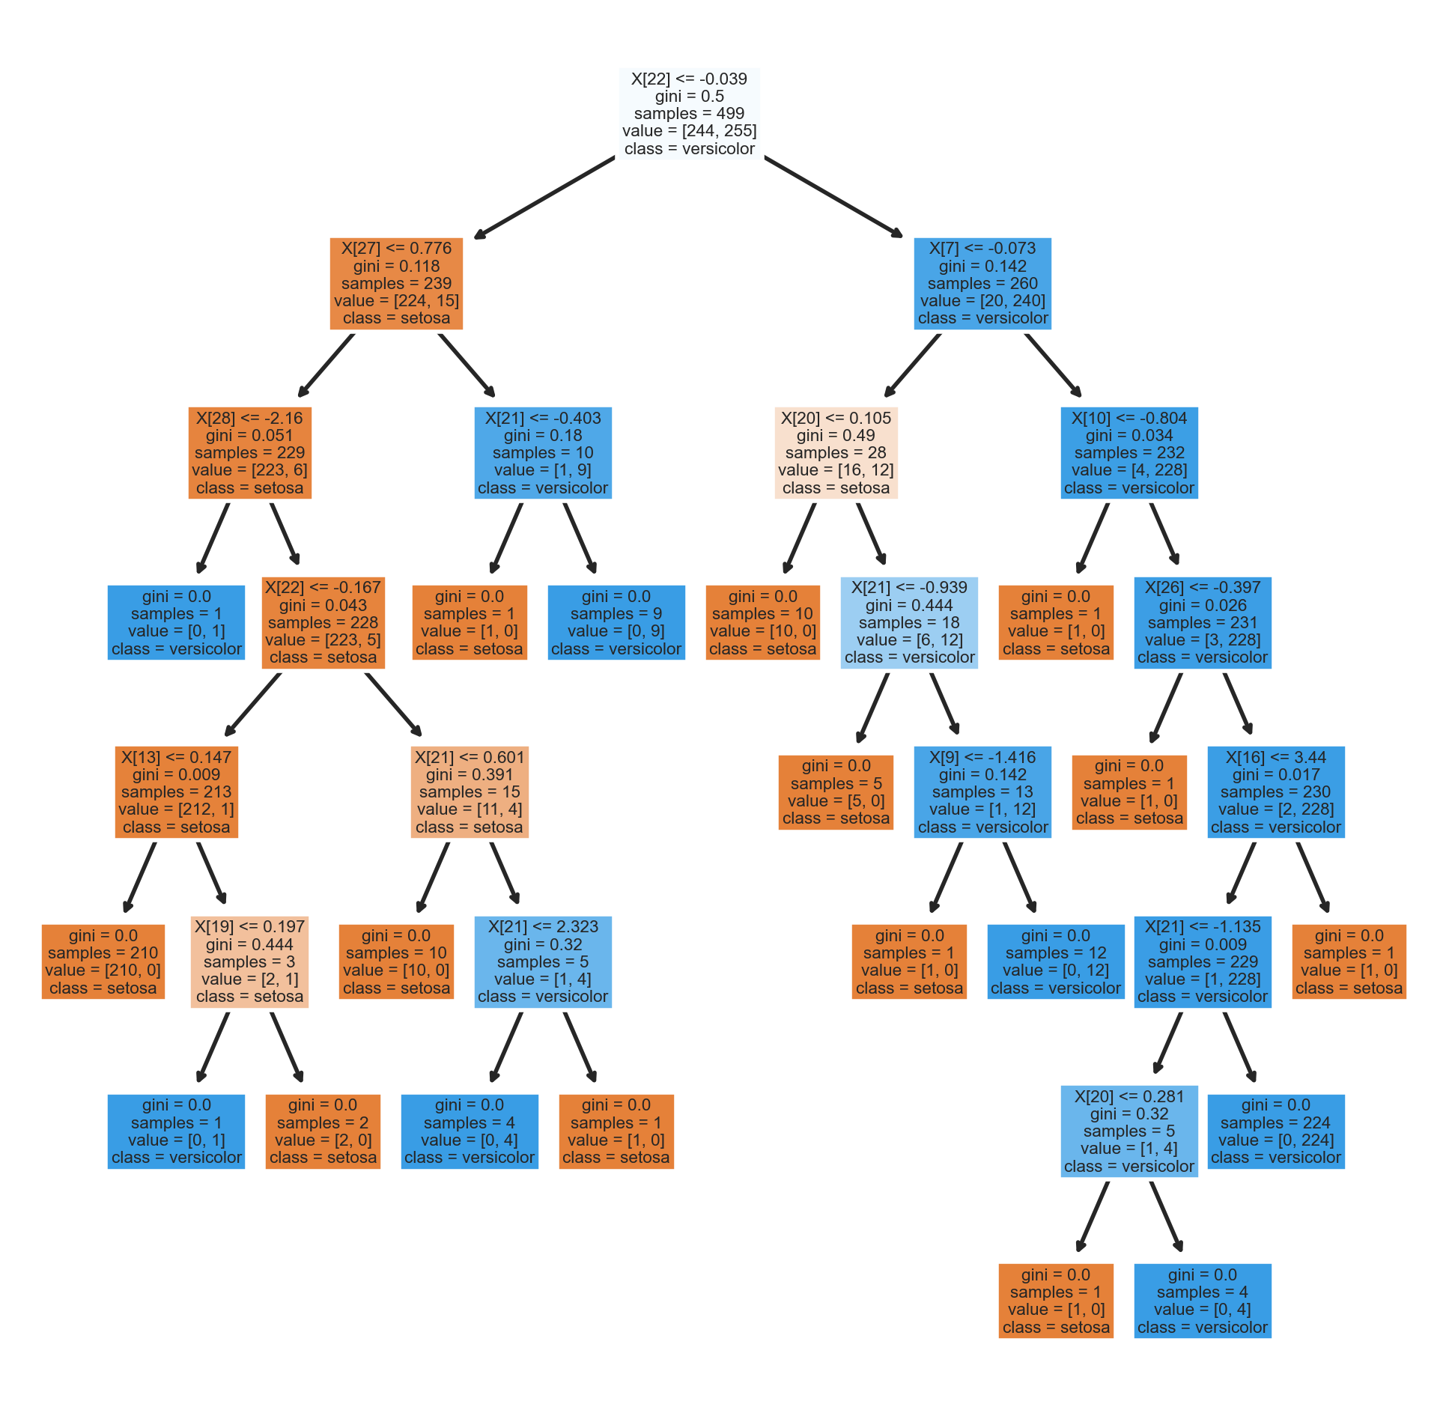
Decision Tree Classifier
Notes:
This slide shows the Decision Tree Classifier image which is self explanatory. I will pause for a minute for everyone to look through it.

Slide 10
Random Forest
As part of Random Forest Model, I have used the default Model Params.
ROC-AUC score : 0.9675950026028111
Accuracy score : 0.9674418604651163
Notes:
The last model. Nd it is Random Forest.
As part of Random Forest Model, I have used the default Model Params.
ROC-AUC score : 0.967
Accuracy score : 0.967

Slide 11

Results
 | Logistic Regression | KNN Model | Decision Tree Classifier | Random Forest
Accuracy Score | 0.976 | 0.968 | 0.972 | 0.967
ROC – AUC Score | 0.976 | 0.967 | 0.972 | 0.968
Notes:
Next important slide, This slide shows the accuracy score and ROC-AUC score comparison among the different models implemented. I don’t find a major difference between the models. Next slide please

Slide 12
Results Interpretation
I have implemented 4 models i.e., KNN Model, Logistic Regression, Decision Tree and Random Forest to compare which model is performing the best amongst them.
On comparison, though there is no much difference, Logistic Regression model is the best with Accuracy score of 0.976.
Other three models i.e., KNN Model, Decision Tree Classifier and Random Forest have the Accuracy score of 0.968, 0.972 and 0.967 respectively.
Notes:
This slide explains the Results in the previous slide. Of all the 4 models implemented, we are going to see which model is performing better amongst these.
On comparison, though there is no much difference, Logistic Regression model is the best with Accuracy score of 0.976.
Other three models i.e., KNN Model, Decision Tree Classifier and Random Forest have the Accuracy score of 0.968, 0.972 and 0.967 respectively.

Slide 13
Ethical Implications
As we have used data from public dataset, we are not sure if have accurate data.
The size of the dataset if very small, the results will be more accurate if we have larger dataset.
We don’t see any legal implications as we don’t have any patient’s PII data.
Notes:
Now, let’s discuss on ethical implications
As we have used data from public dataset, we are not sure if have accurate data.
The size of the dataset is very small, the results will be more accurate if we have larger dataset.
We don’t see any legal implications as we don’t have any patient’s PII data.

Slide 14
Next Steps
Our plan is to implement a system to predict cancer with different symptoms so that it will be useful to general public.
This will be like recommendation system which will accept the input values for different symptoms and will return the prediction result as Malignant or Benign tumor.
I would like to build a proper decision tree for different stages of cancer.
Notes:
Most important step, this slide speaks what my team will be doing this quarter. This will help us improve on work done this quarter an make our prediction system much more better. I am sure our work will put as front runner in the market.
Our next focus would be:
implement a system to predict cancer with different symptoms so that it will be useful to general public.
This will be like recommendation system which will accept the input values for different symptoms and will return the prediction result as Malignant or Benign tumor.
build a proper decision tree for different stages of cancer.
Due to time constraint, we were not able to implement the above recommendations. It would be much more pleasuring if we had implemented them.
However, we will target to implement them in the next quarter.

Slide 15
References
Kaggle. (n.d.). breast_cancer_detection (November 2022). www.kaggle.com. Retrieved December 11, 2022,from https://www.kaggle.com/code/architkuiya/breast-cancer-detection/data
Notes:
To be transparent with the analysis, I have provided the data source references here.

Slide 16
Q&A
Notes:
Please let me know in case of any queries, I will be happy to answer them.

Slide 17
Thank You
Notes:
Thanks for joining us for this session and hope to see you again for next session which includes further analysis.

