Slide 1
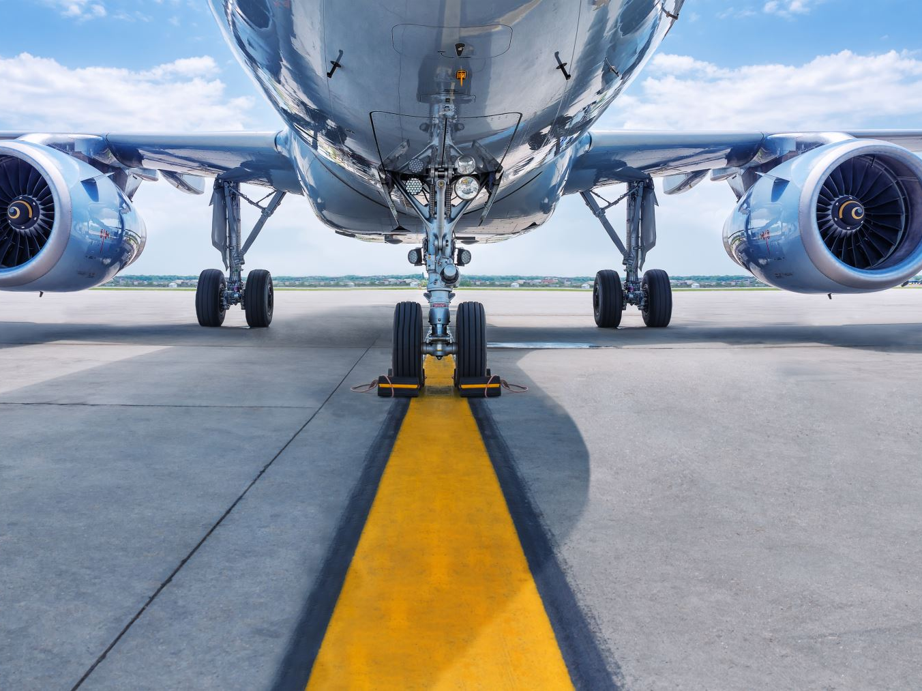
Airline Safety
Soma Shekar Vayuvegula
Notes:
Hello everyone, This is Soma Shekar Vayuvegula. Today, we are going to discuss about Airline Safety

Slide 2
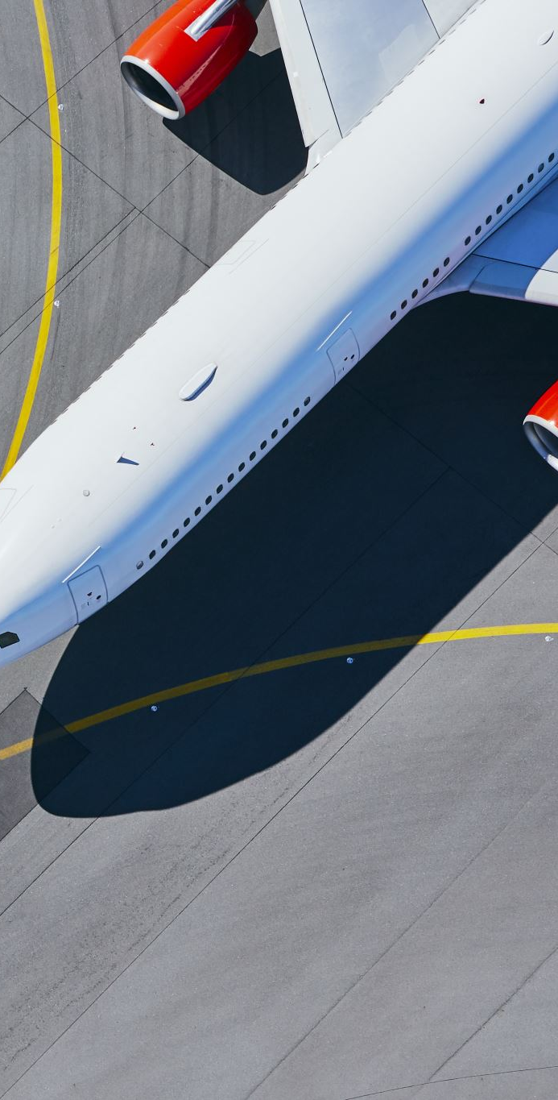
Introduction
As air travel has gained pace over a period time, airlines are trying to provide safe travel and best in class facilities to their passengers.
We are going to analyze airline safety using various visualizations.
Notes:
Let’s have a brief introduction about today’s topic. As air travel has gained pace over a period of time, airlines are trying to provide safe travel and best in class facilities to their passengers.
We are going to analyze the various visualizations created from the public datasets available for the period 1908 - 2014.

Slide 3
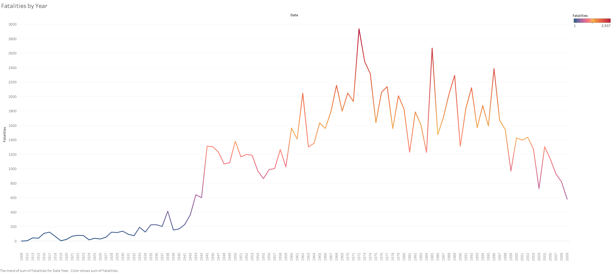
Decrease in Airline fatalities
Notes:
As we look this chart, we see that the fatalities at its peak during 1973-1975 but the fatalities are on decline towards late 2000. This is due to the technology advancements in aircraft manufacturing and airline operations.

Slide 4
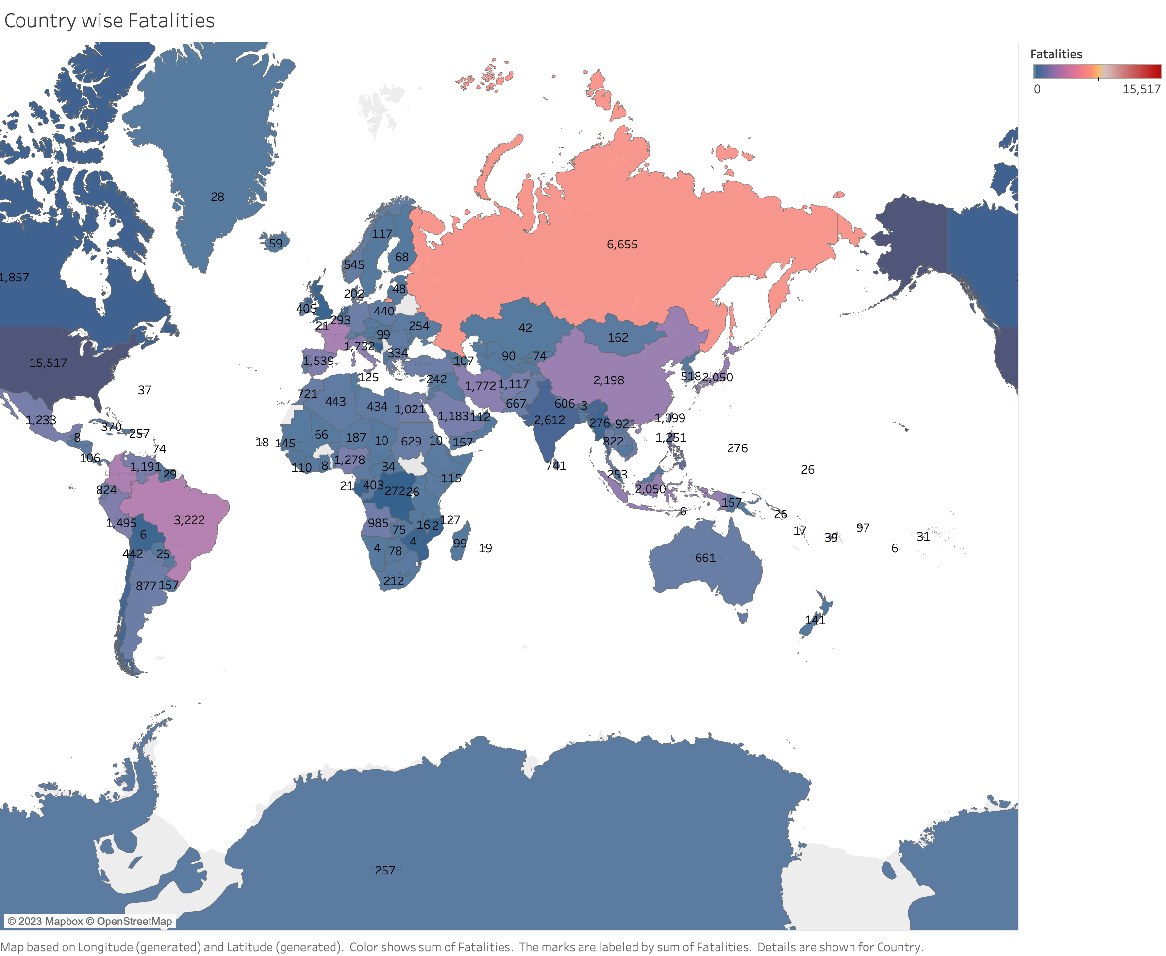
Country wise fatalities
Notes:
Looking at this chart, we can conclude that countries like USA and Russia have more fatalities. This can be because of the higher air traffic in these countries. Airline operations and modernization of aircrafts can reduce this. Even passengers can plan their travel in advance to avoid peak hours and holiday seasons.

Slide 5
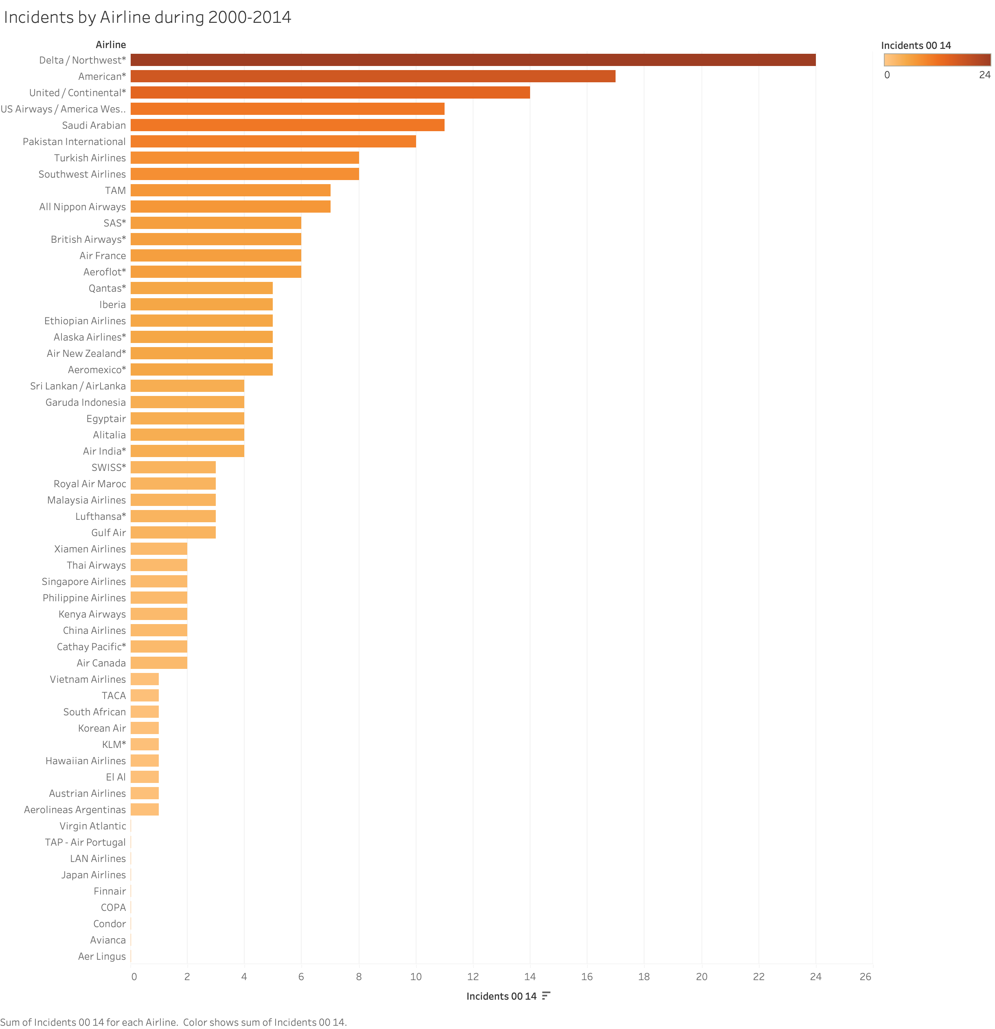
Incidents by Airline
Notes:
If we look at this chart, we see that top airlines of USA at the top three places, this needs to be investigated by the airlines to avoid the fatalities and assure their passengers that they are in safe hands and reach home safely.

Slide 6
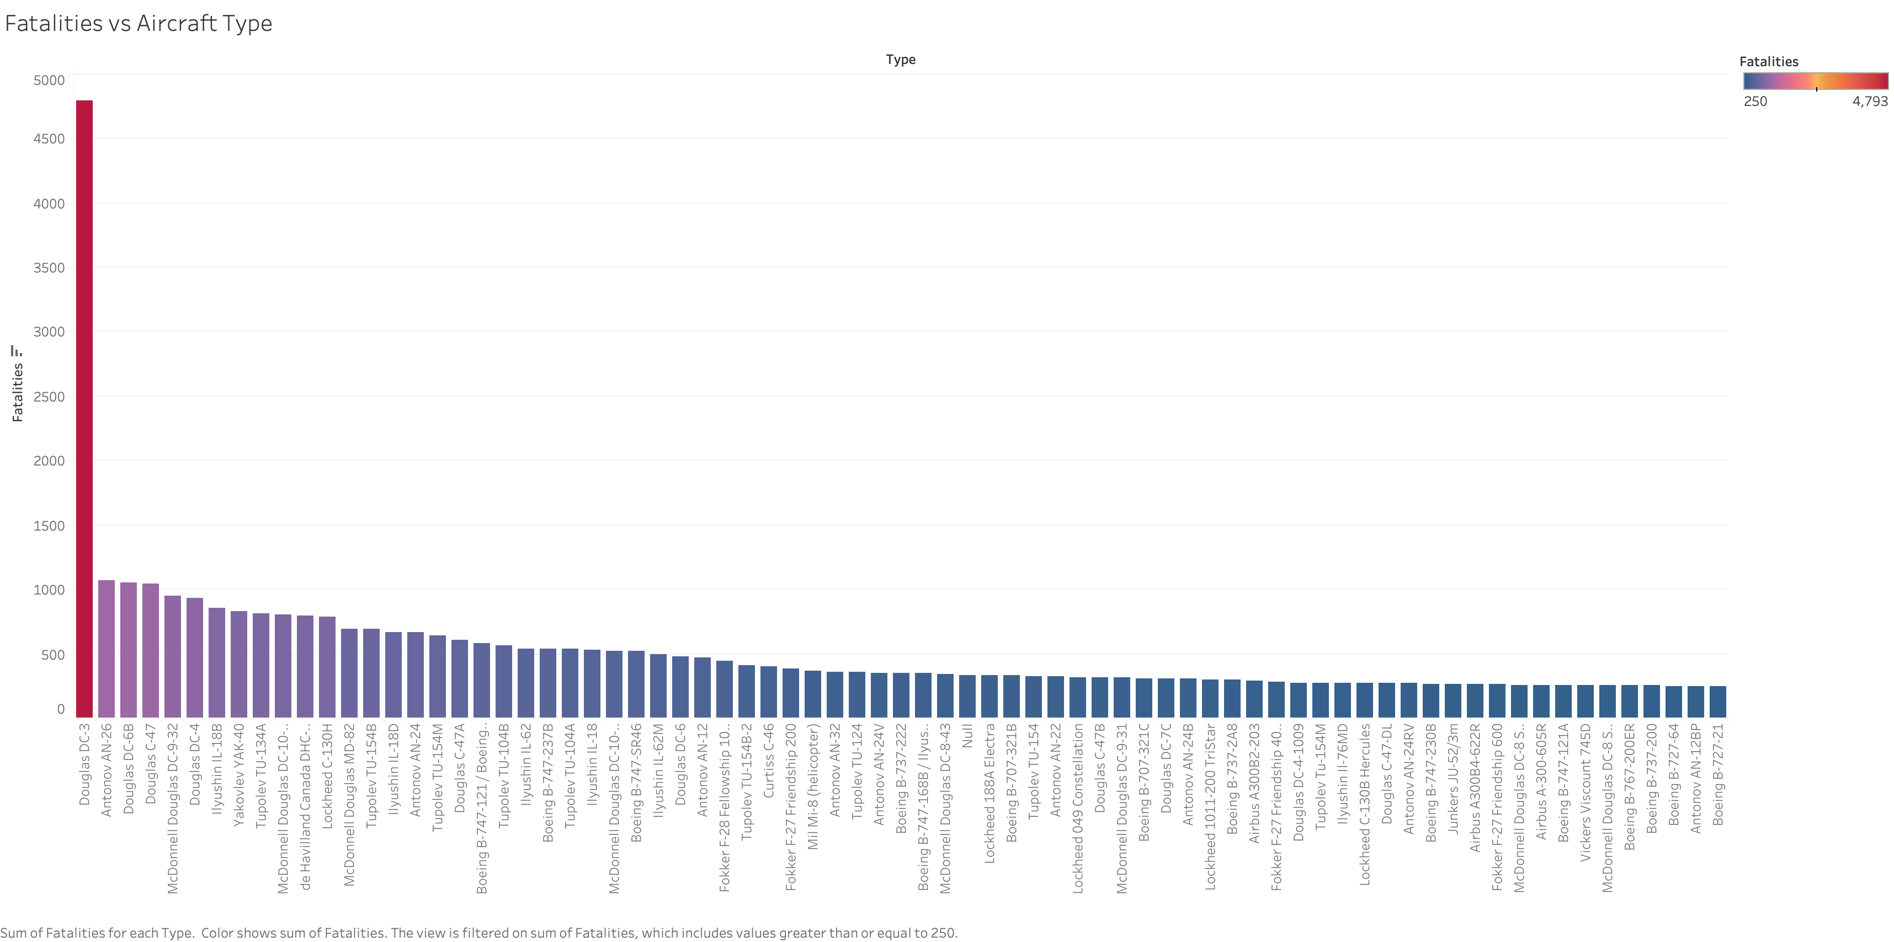
Fatalities by Aircraft Type
Notes:
In this chart, we can see fatalities by Aircraft, Douglas Dc3 tops the list and its nowhere near to the second one in chart. Douglas should investigate and improve their safety standards else this can put their business at risk.

Slide 7
Conclusion
Technology advancements have improved the safety of airline operations and aircraft manufacturing.
Airline operators and aircraft manufacturers should work together and bring in best-in class technology to avoid the incidents and fatalities.
Notes:
Technology advancements have improved the safety of airline operations and aircraft manufacturing.
Airlines and aircraft manufacturers should work together and bring in best-in class technology to avoid the incidents and fatalities.
As the data is a decade old, the visualizations might change and technology advancements during this period might have reduced the incidents.

Slide 8
References
Airline Safety. (n.d.). www.kaggle.com. Retrieved March 4, 2023, from https://www.kaggle.com/datasets/danoozy44/airline-safety
Airplane Crashes and Fatalities Since 1908. (n.d.). www.kaggle.com. Retrieved March 4, 2023, from https://www.kaggle.com/datasets/saurograndi/airplane-crashes-since-1908
Notes:
In this slide, I am also providing the data references as we want to be transparent with the analysis done.

Slide 9

Q&A
Notes:
Please let me know in case of any queries, I will be happy to answer them.

Slide 10
Thank you
Notes:
Thanks for joining us today and hope we will meet you in another session.

