Slide 1

STOCK MARKET PREDICTION
Soma Shekar Vayuvegula

Slide 2
INTRODUCTION
Stock market prediction attempts to determine the future value of the company's stock or other financial instruments traded on an exchange. Successful prediction of a stock's future price could help gain significant profits.
Stock market data is complicated, and predictions are not straightforward as they depend on various factors. The stock market prediction is not always accurate, but we need some prediction to be done to invest in stocks.
Prediction depends on the stock's previous performance, factors like company revenue and particular sector performance, and multiple announcements made by organizations and the Government.
Stock prediction methodologies fall under the following categories: fundamental analysis, technical analysis, and technological methods.

Slide 3
PROJECT STEPS
Data Collection
Data Transformation
Build and Train Model
Exploratory Data Analysis
Model Evaluation

Slide 4
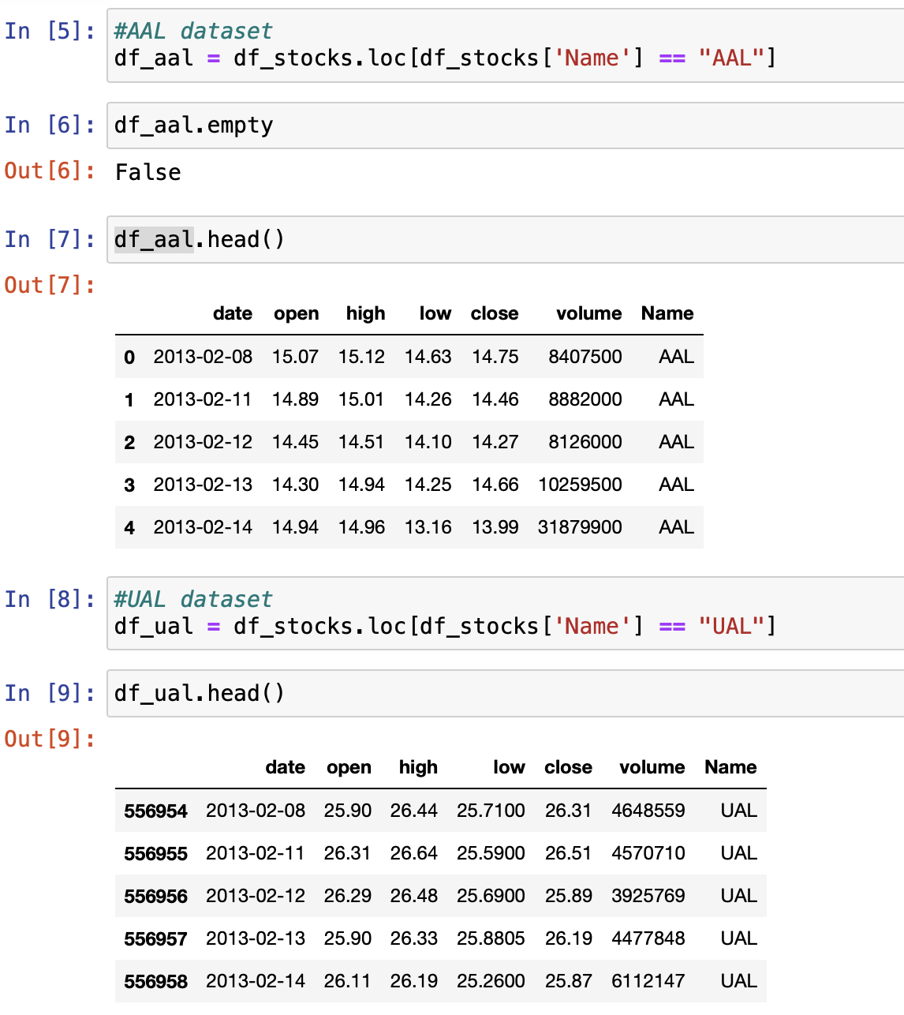
DATA PREPARATION

Slide 5
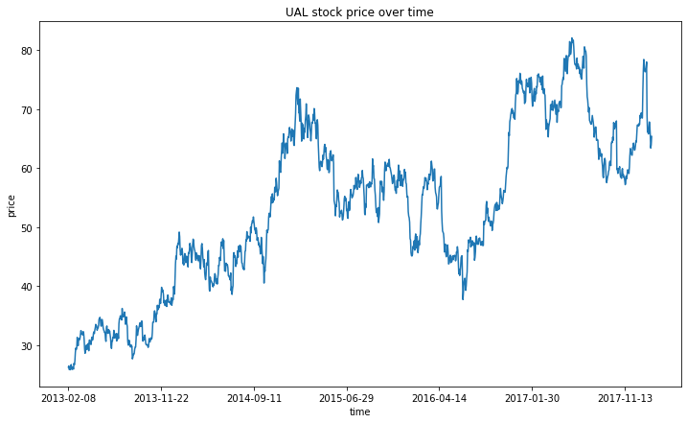
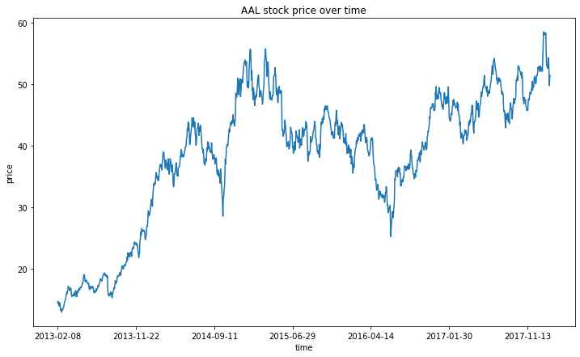
DATA EXPLORATORY ANALYSIS (Closing Price)

Slide 6
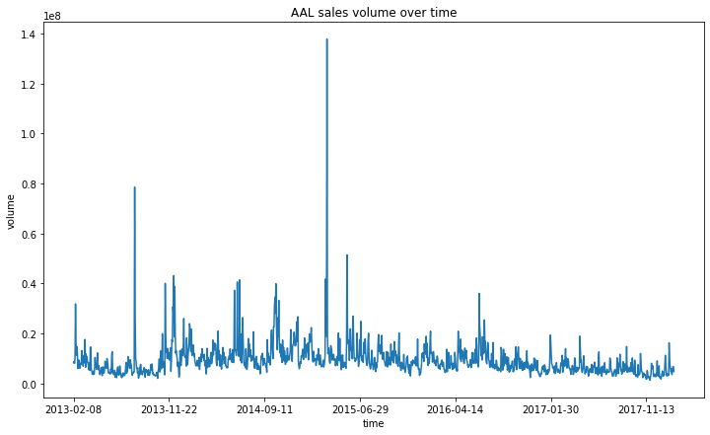

DATA EXPLORATORY ANALYSIS (Sales Volume)

Slide 7
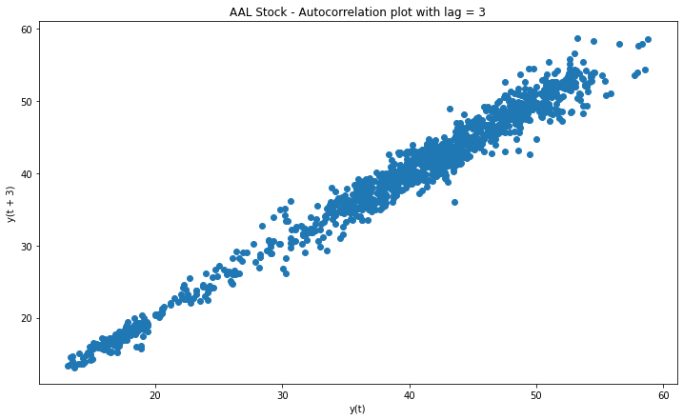
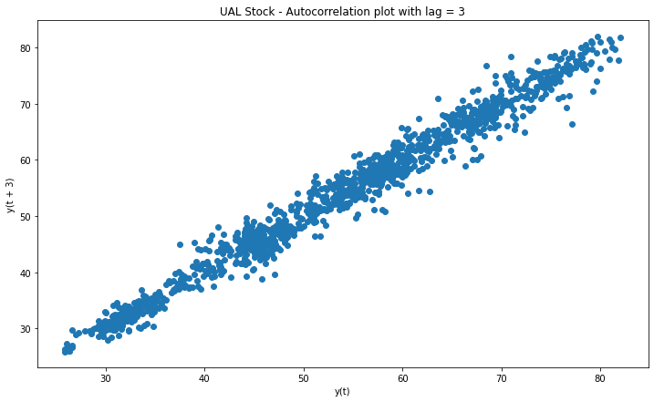
AUTO CORRELATION PLOT

Slide 8
ARIMA PREDICTION MODEL
Time-series forecasting models predict future values considering values previously observed. Time-series forecasting is used widely for non-stationary data like temperature data for a period of time and stock prices over a period of time.
For this time series data, we will be using the ARIMA model.
ARIMA models can capture different standard temporal structures in time-series data.

Slide 9
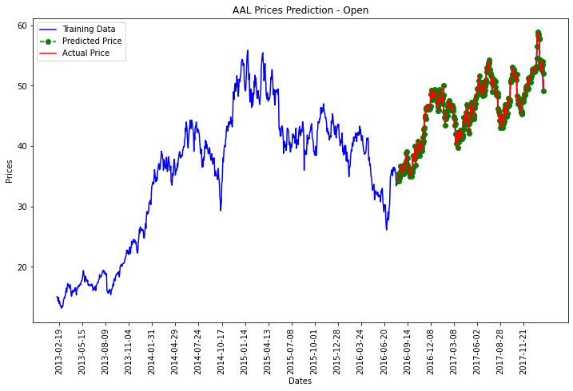
ARIMA MODEL VISUALIZATION
Notes:
This graph shows the predicted values. Predicted values are marked in green. Actual price is marked in red and training data is marked in blue.

Slide 10
ETHICAL IMPLICATIONS
We don't foresee any privacy issues when sourcing this data from public sites. However, stock-related data is always posted on websites that are accessible to the public. Hence, there are no ethical issues.
The only issue is that the data is not the latest, which might impact the model predictions.

Slide 11
CONCLUSION
After evaluating the model, we have observed that this model has an accuracy of approx. 98%
I have implemented a simple interface in Python to accept Stock Symbol as input and provide predictions to show that we can deploy this as an application and open to public usage.
We can use the stock market data APIs to get the latest predictions.

Slide 12
REFERENCES
Damarla, R. (n.d.). Stock Market Prediction using Decision Tree. Kaggle. Retrieved March 18, 2023, from https://www.kaggle.com/datasets/camnugent/sandp500?resource=download
Mooney, P. (n.d.). Stock Market Data (NASDAQ, NYSE, S&P500). Kaggle. Retrieved March 18, 2023, from https://www.kaggle.com/datasets/camnugent/sandp500?resource=download

Slide 13
THANK YOU

