Slide 1


Airline fatalities dashboard - soma shekar vayuvegula

Slide 2
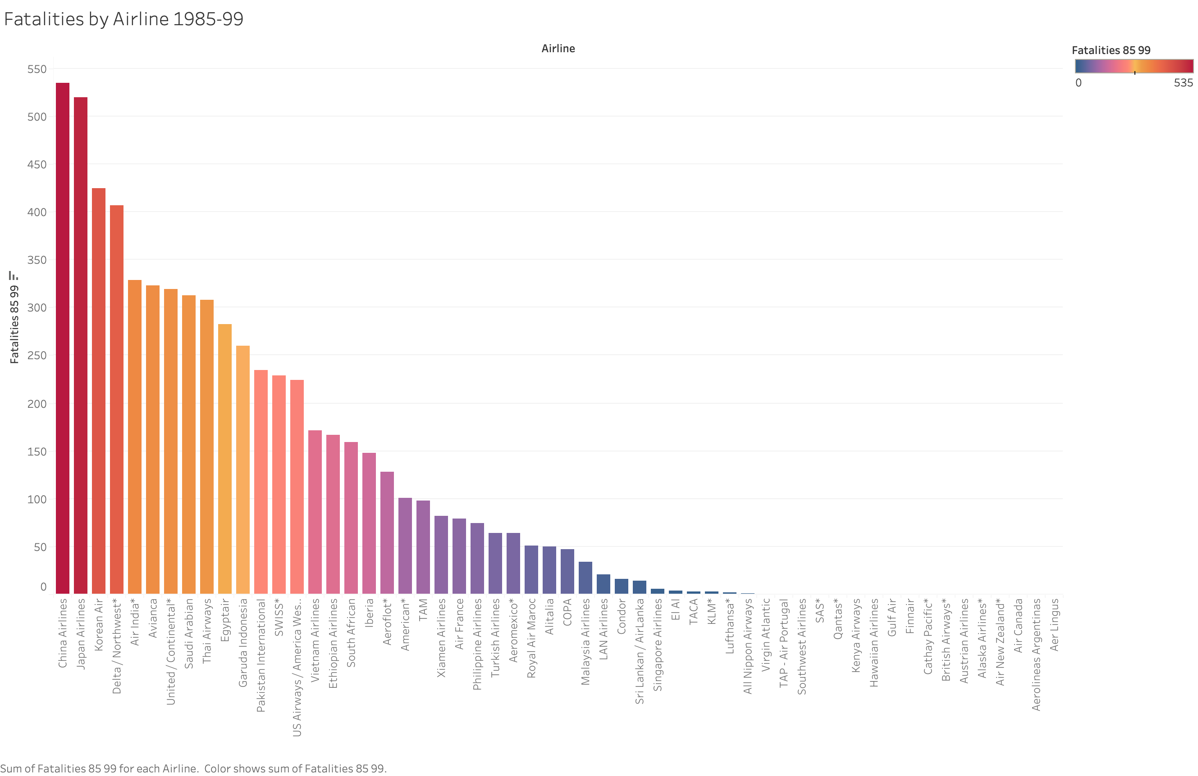
Fatalities by Airline during 1985-1999

Slide 3
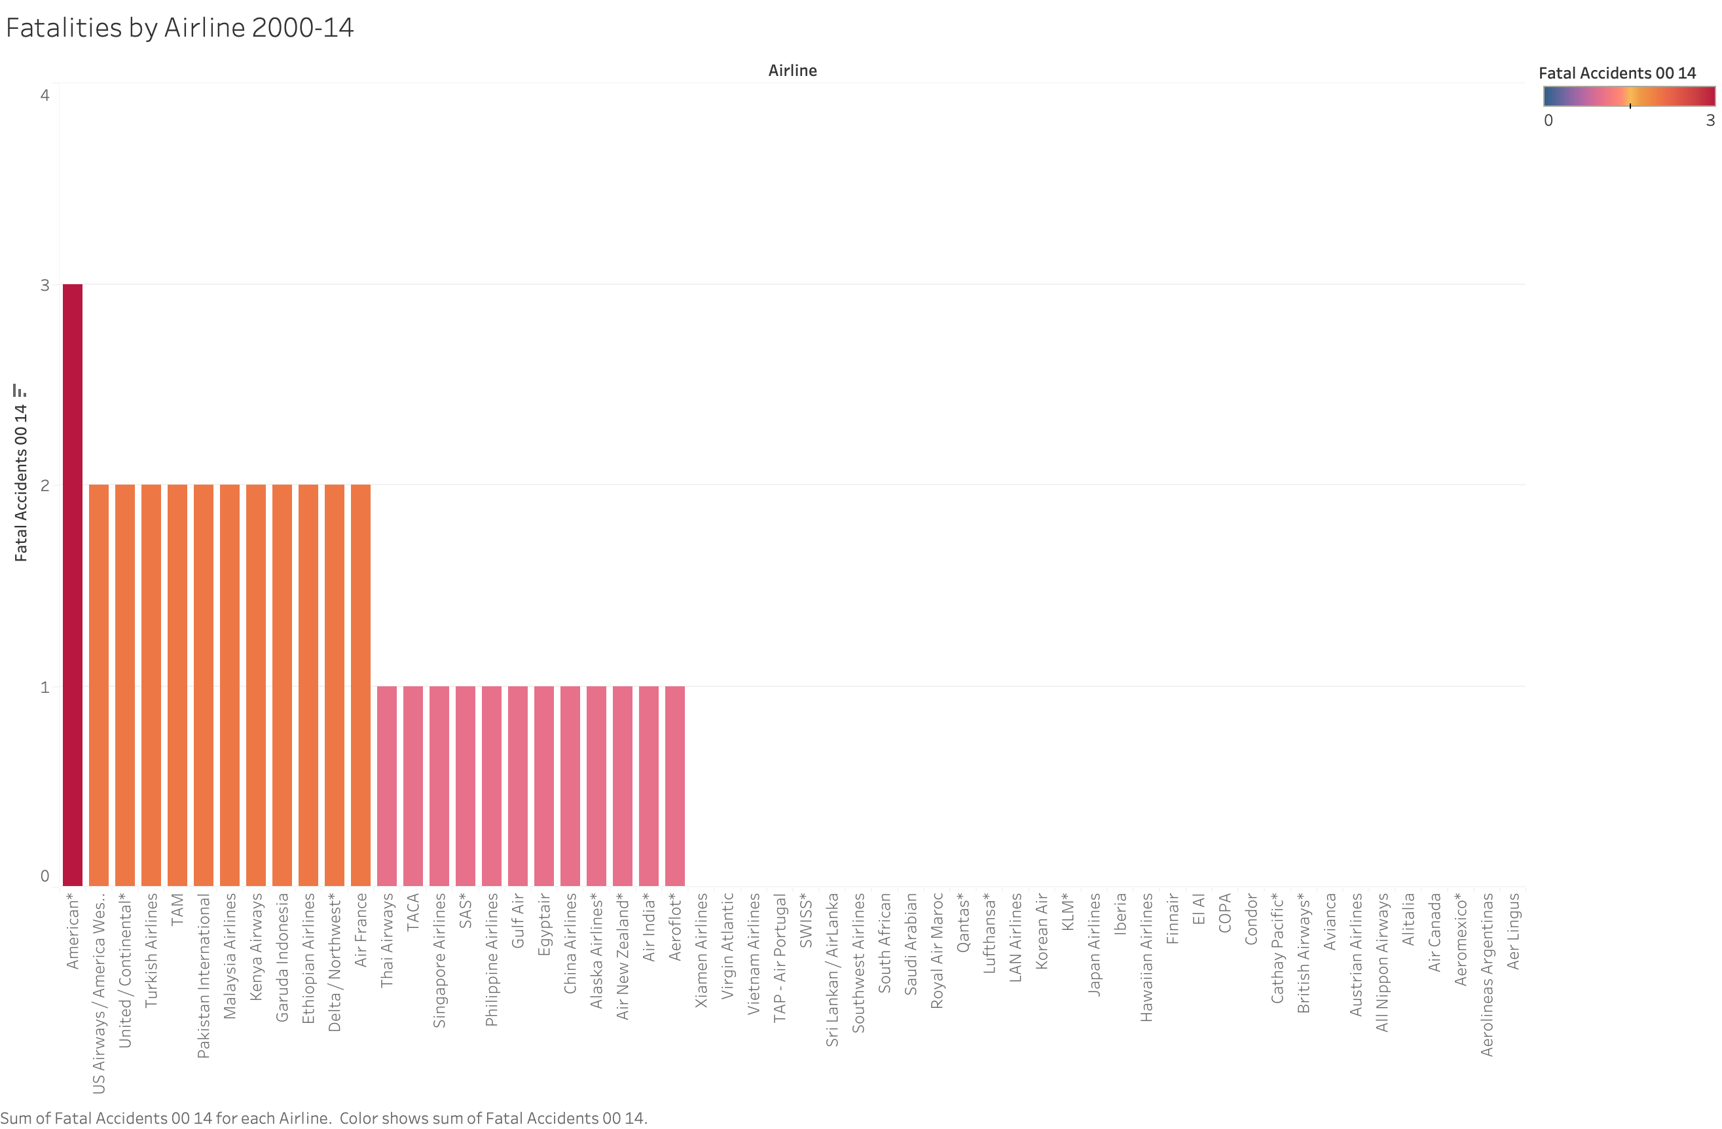
Fatalities by Airline during 2000-2014

Slide 4
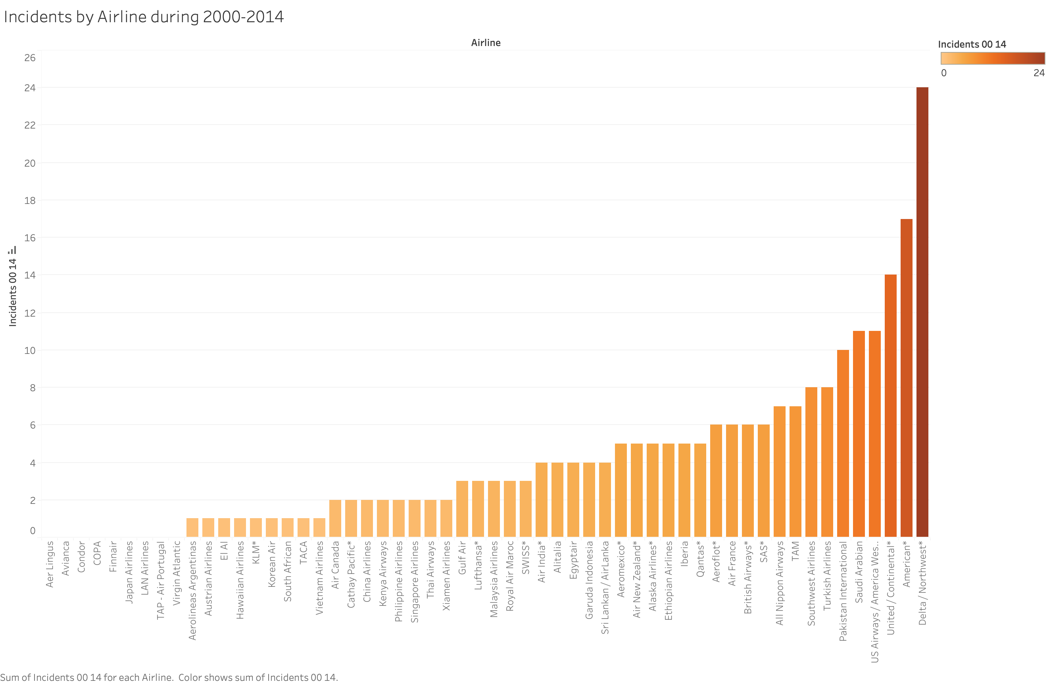
Incidents by Airline during 2000-2014

Slide 5
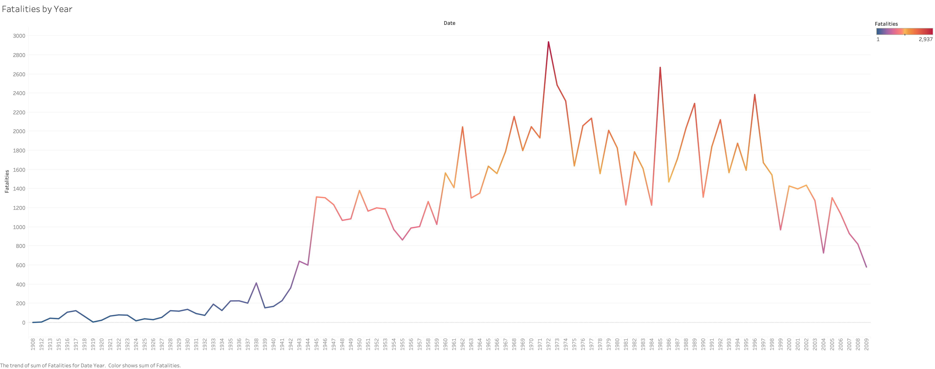
Fatalities by Year

Slide 6
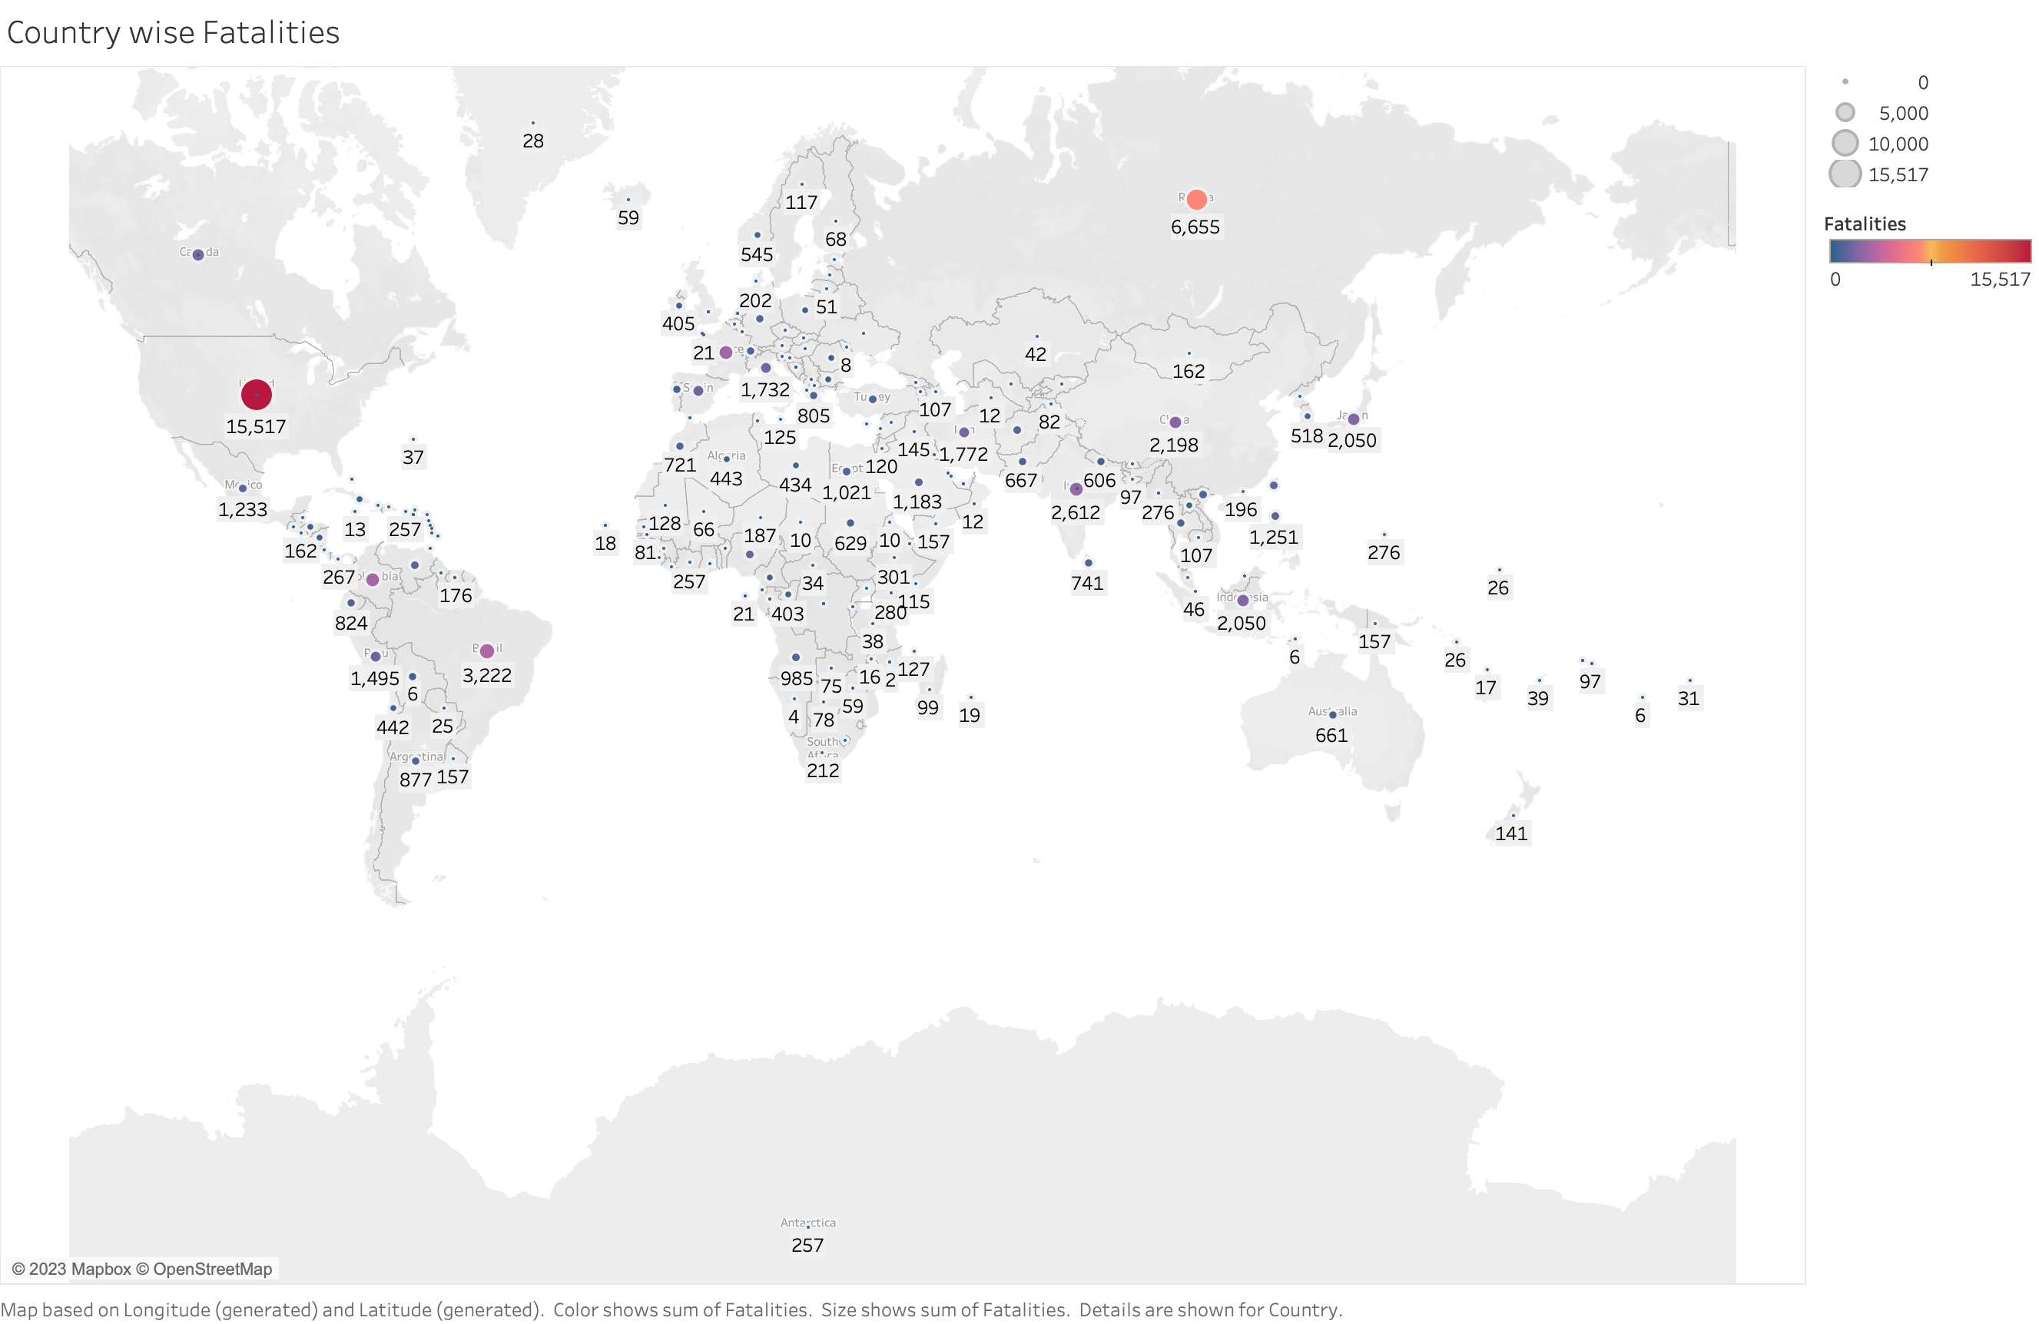
Country-wise Fatalities

Slide 7
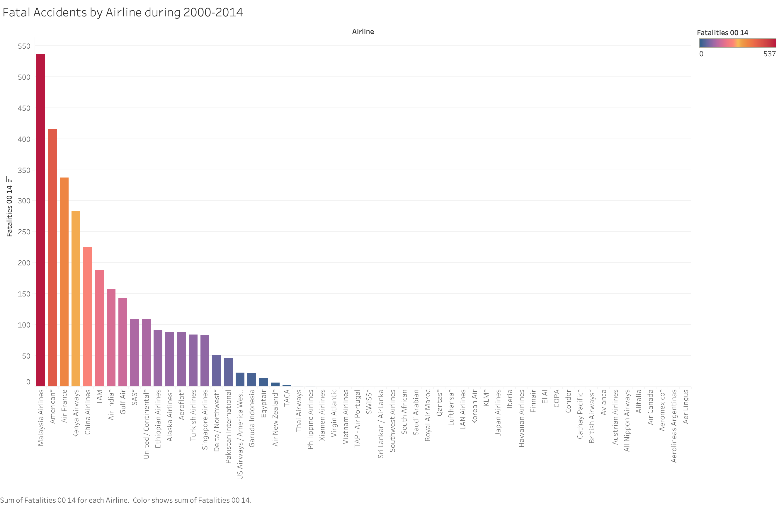
Fatalities Accidents by Airline during 2000-2014

Slide 8
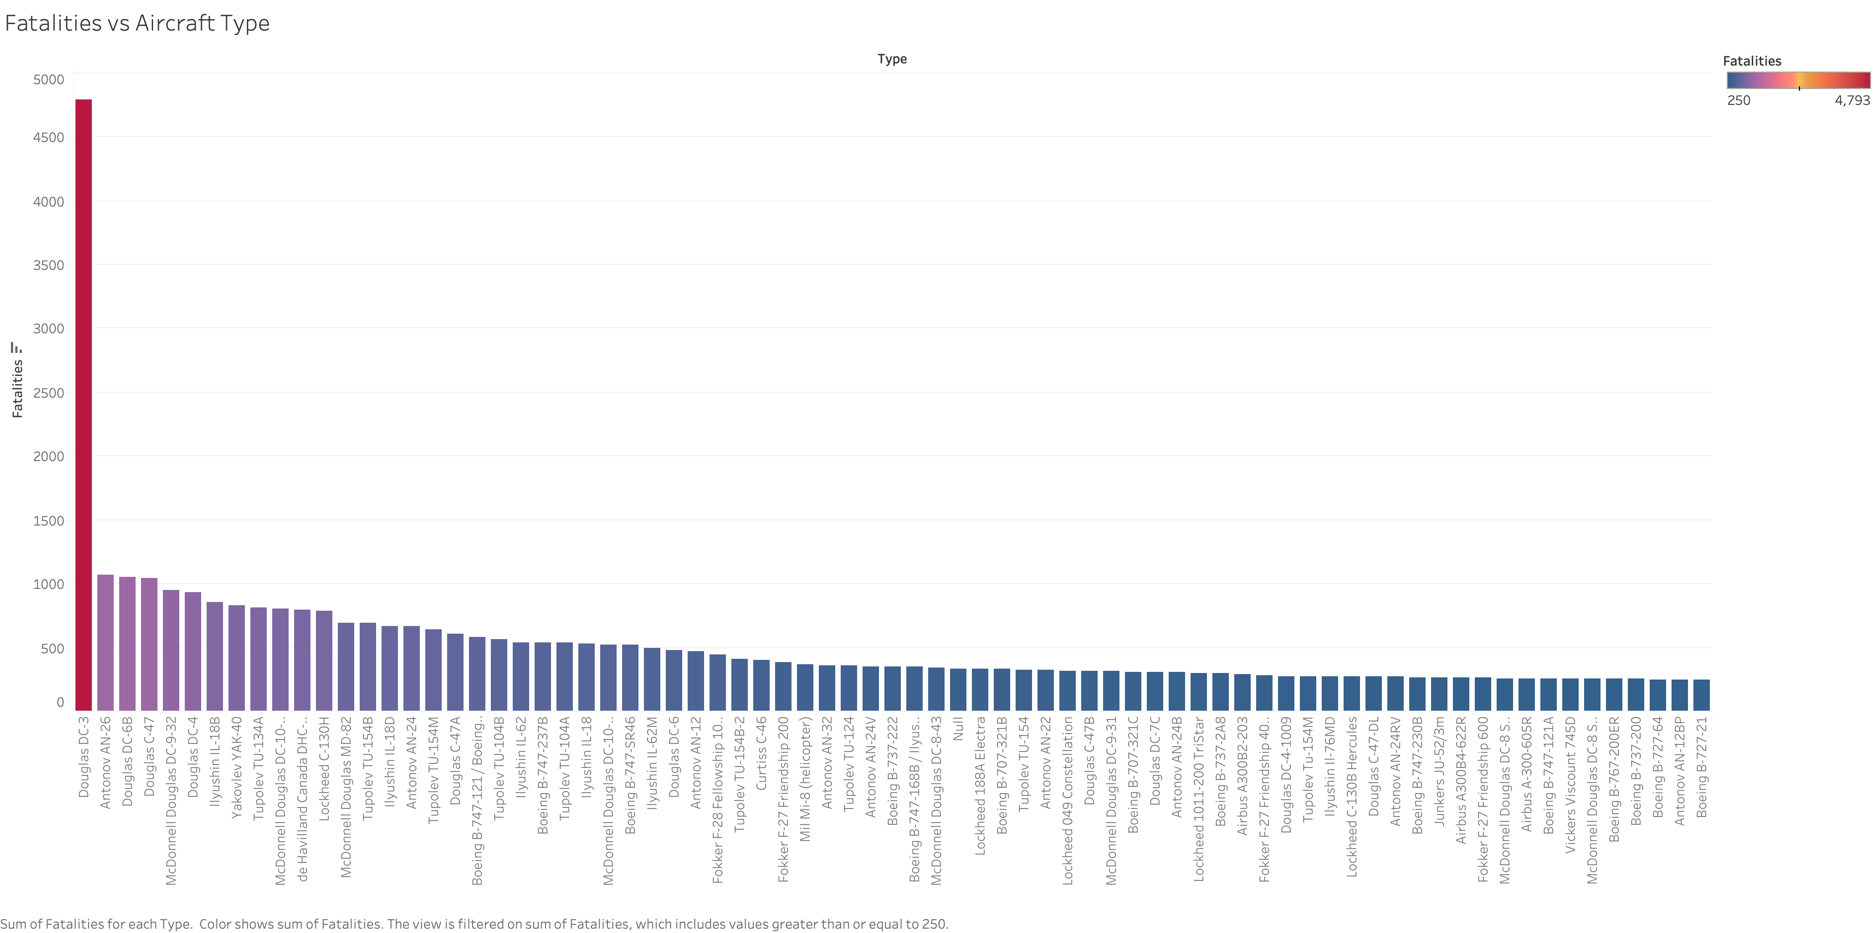
Fatalities vs Aircraft Type

Slide 9
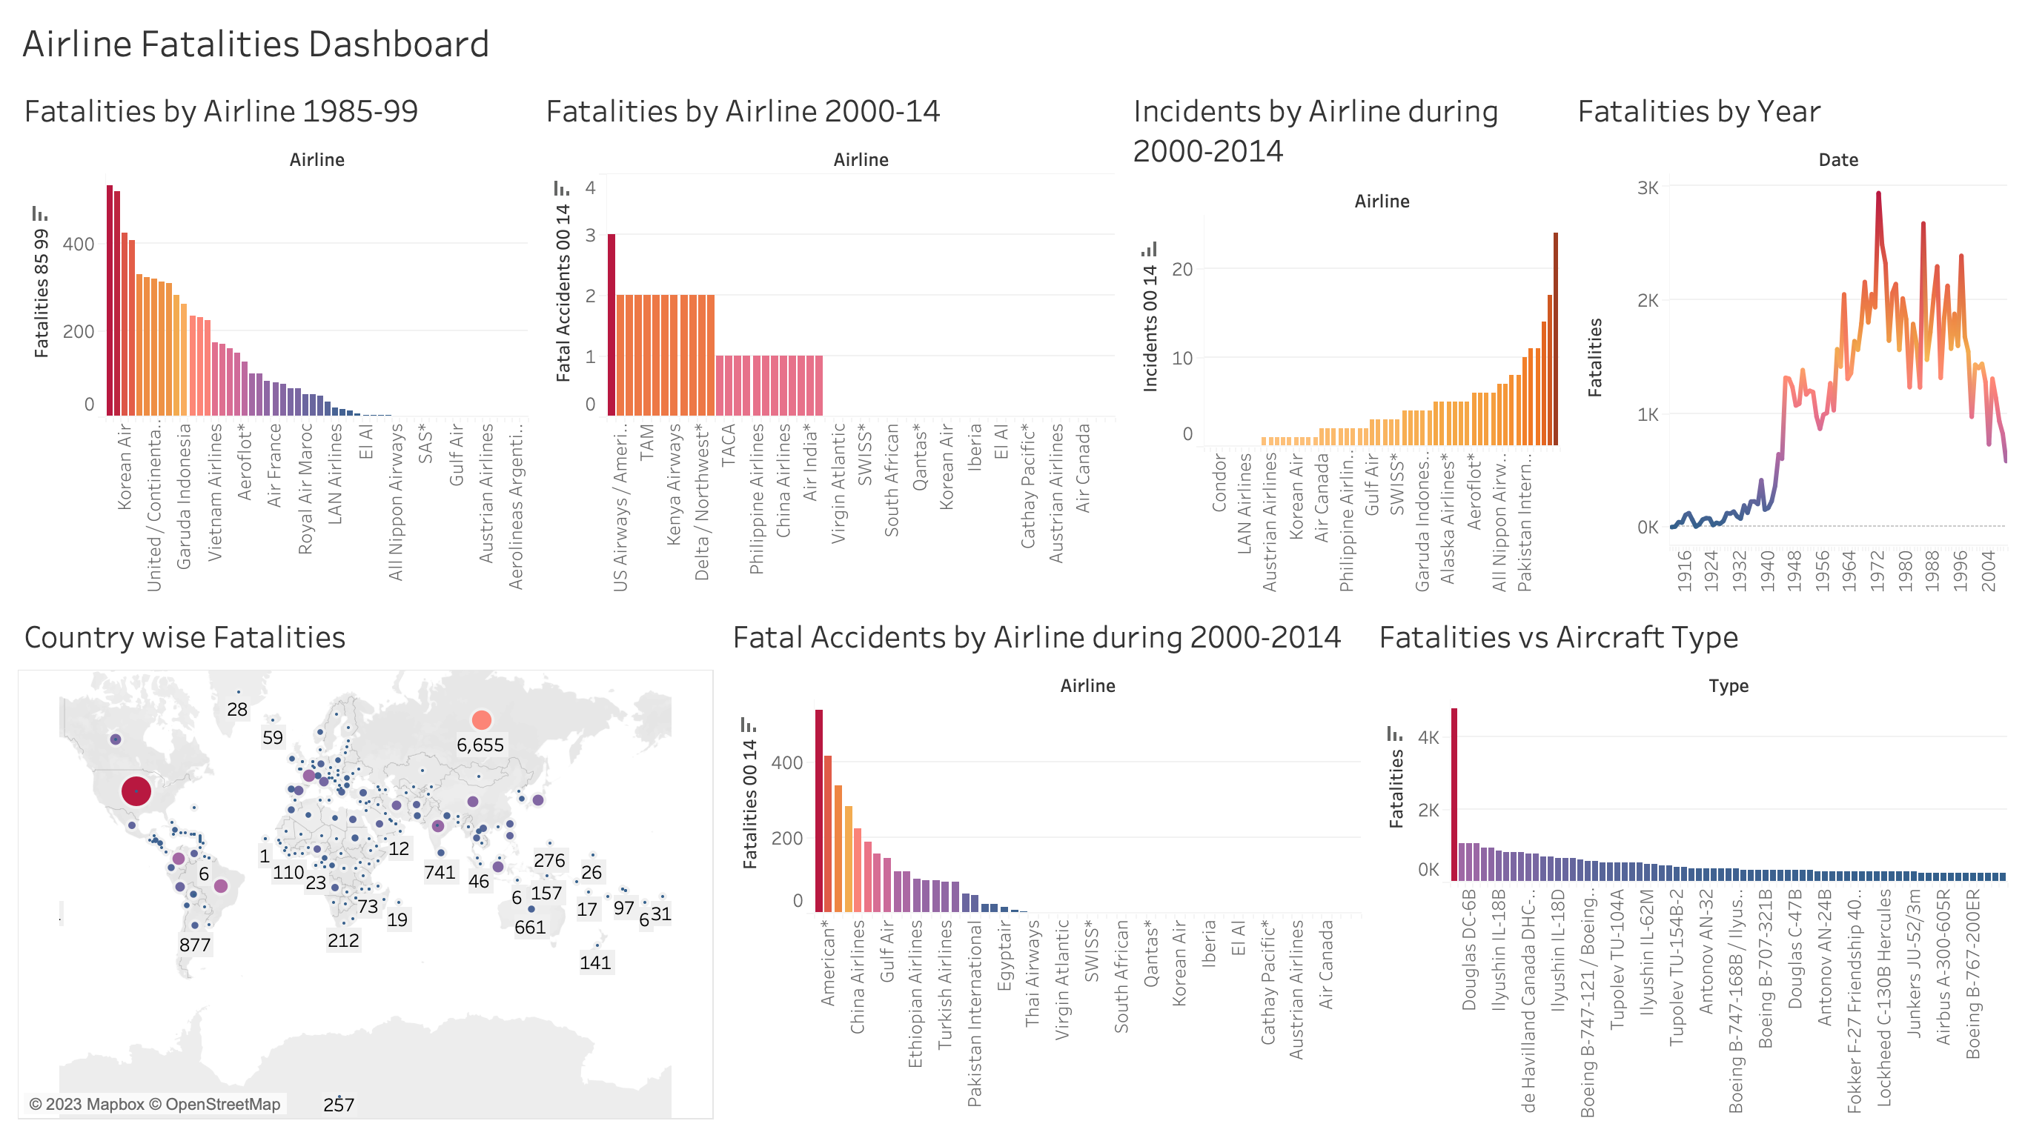

Slide 10


Slide 11
Thank you!

