Slide 1
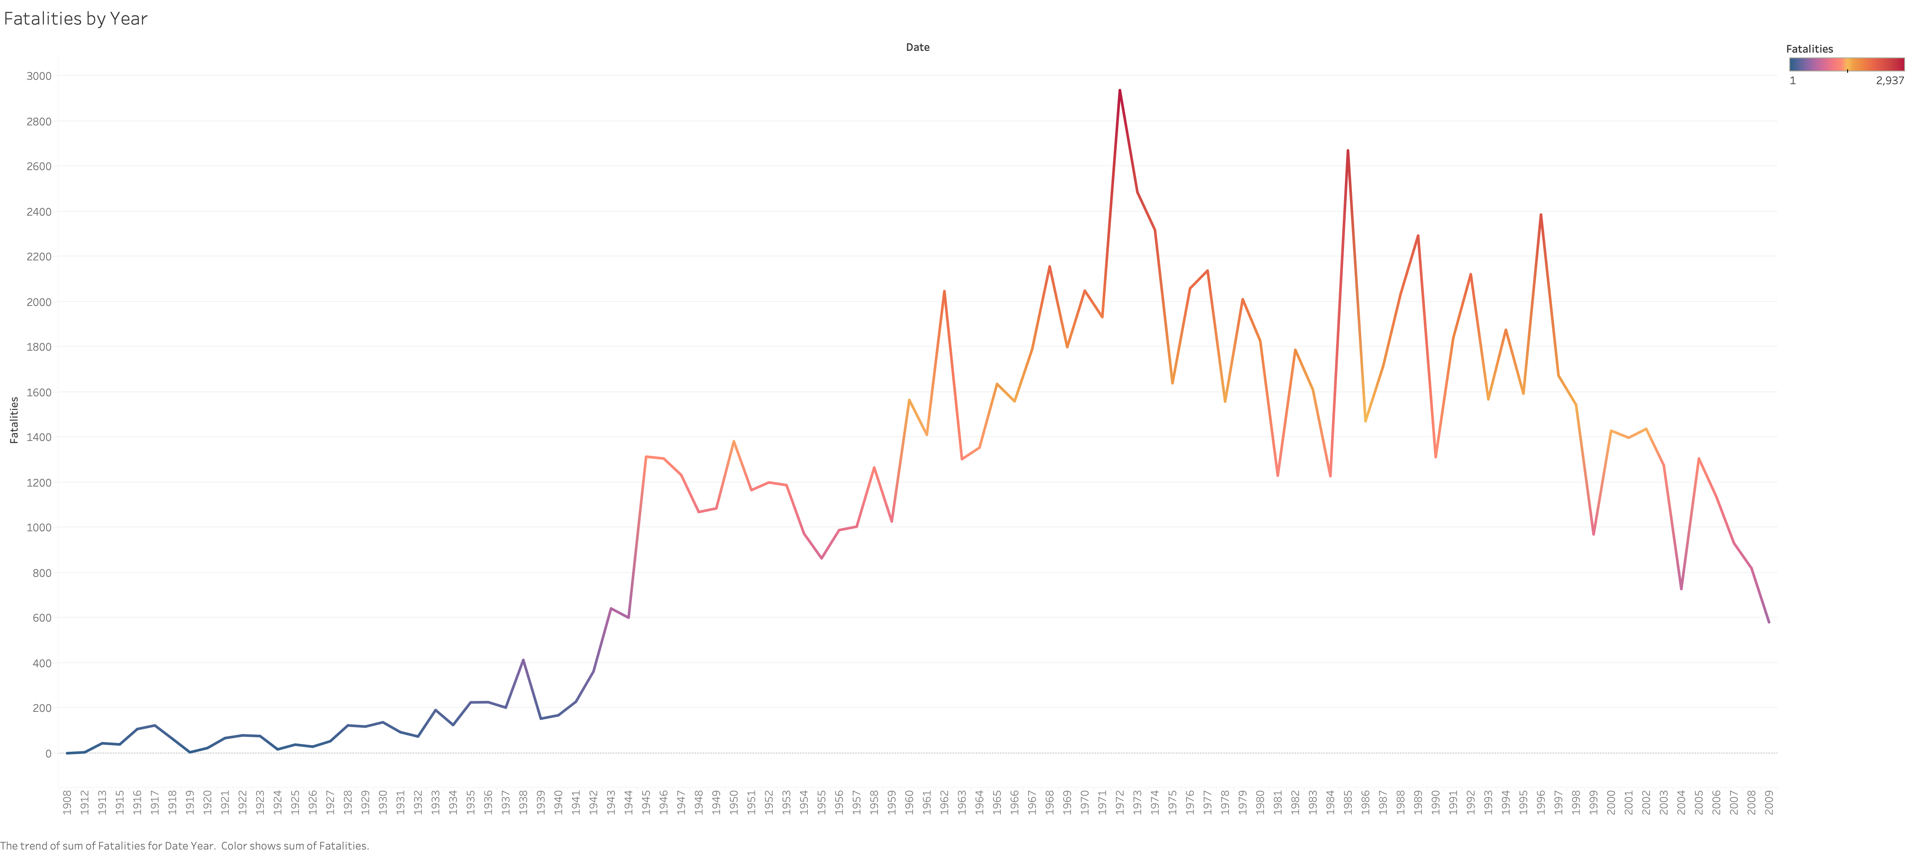
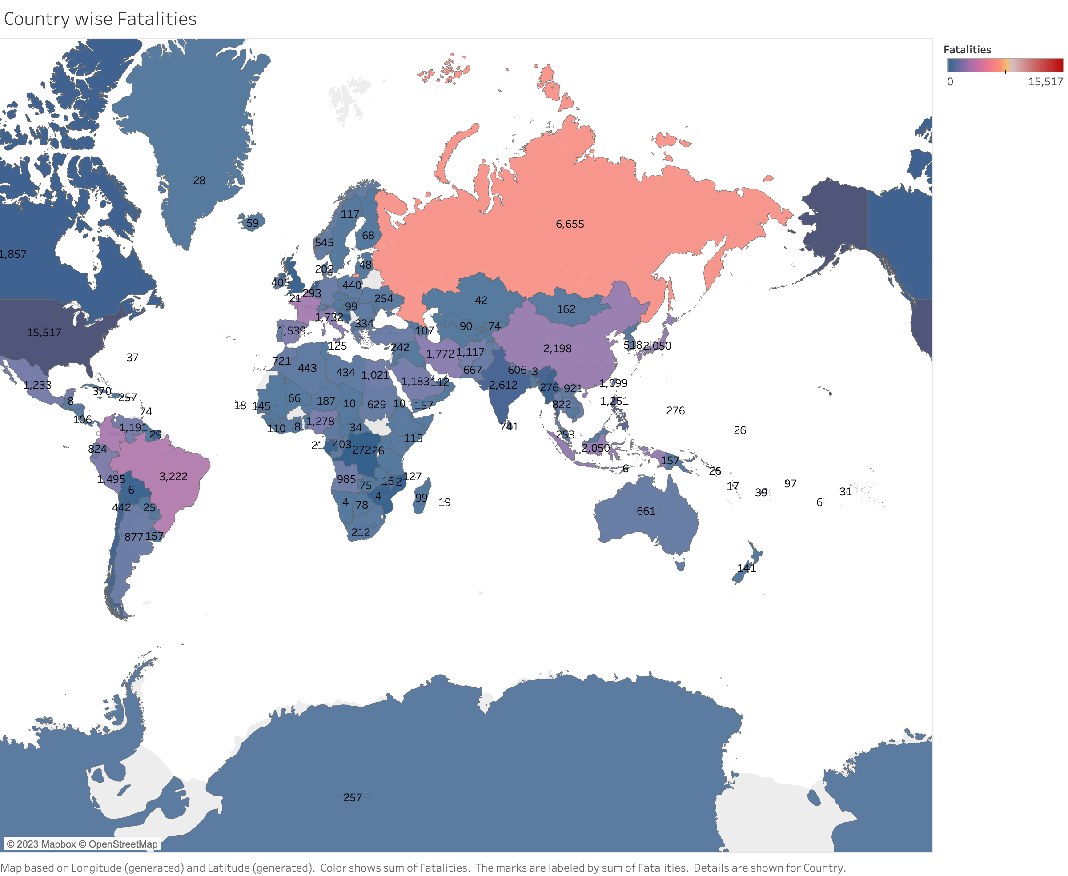
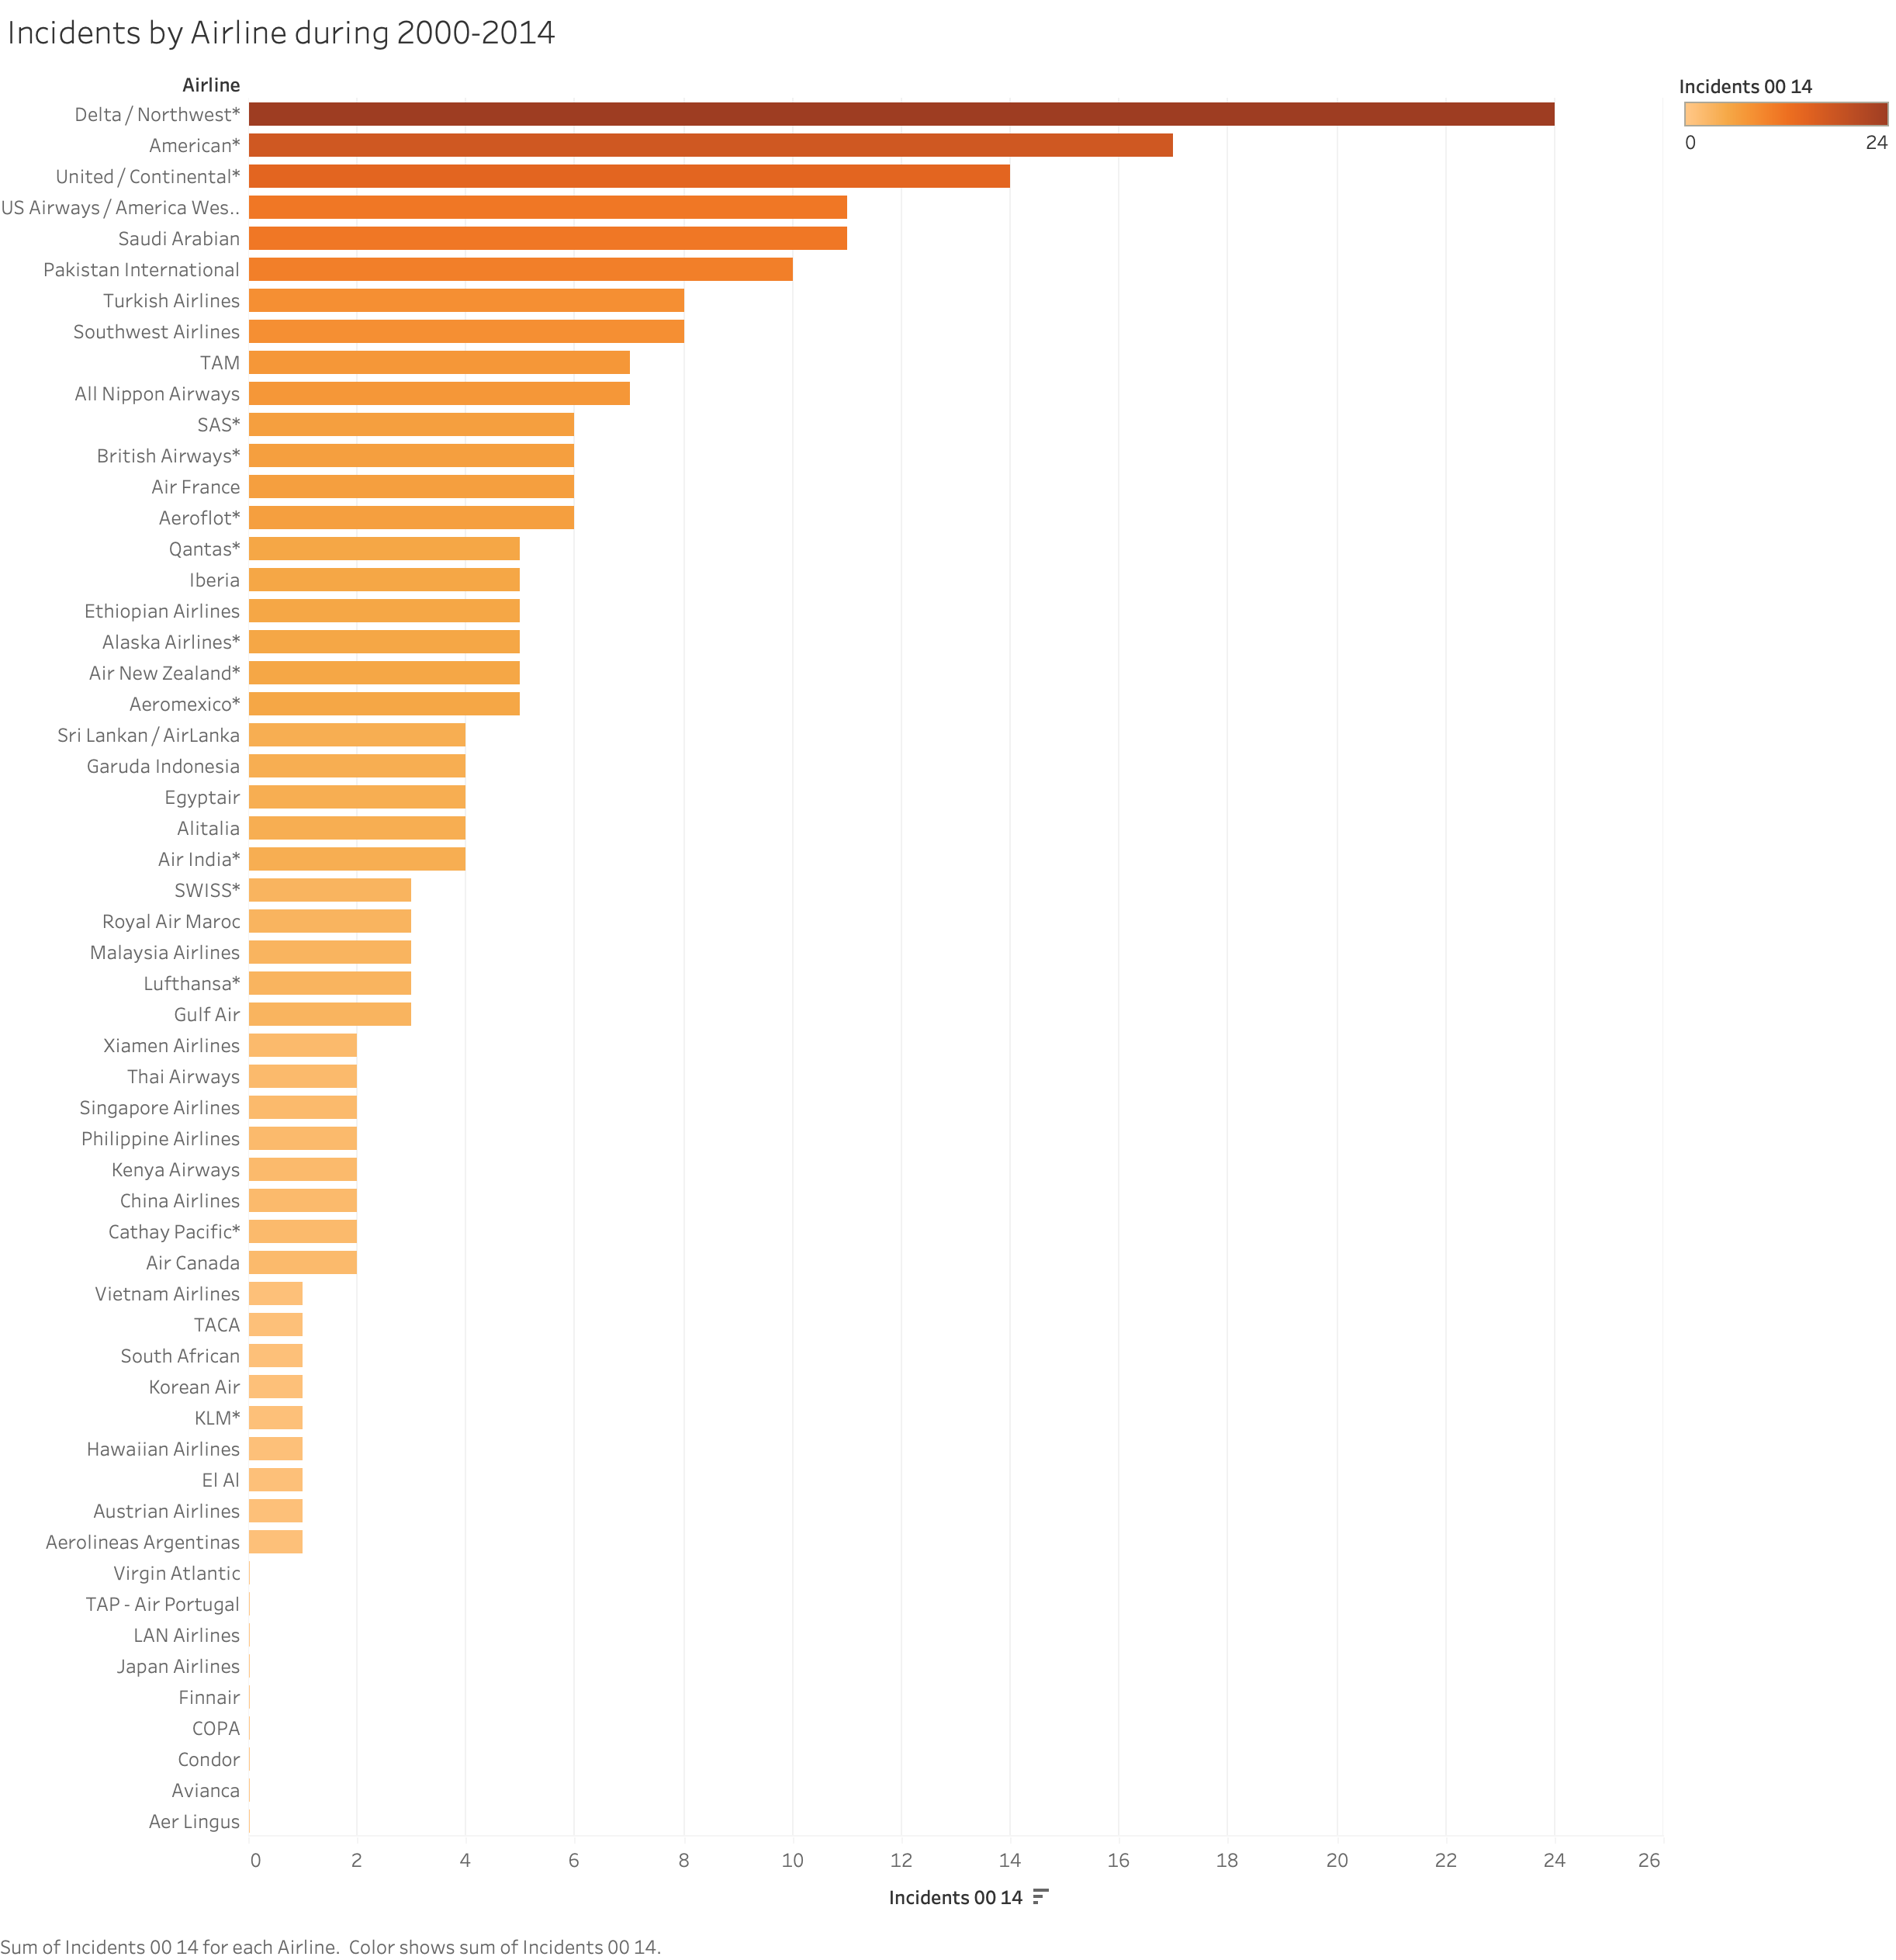
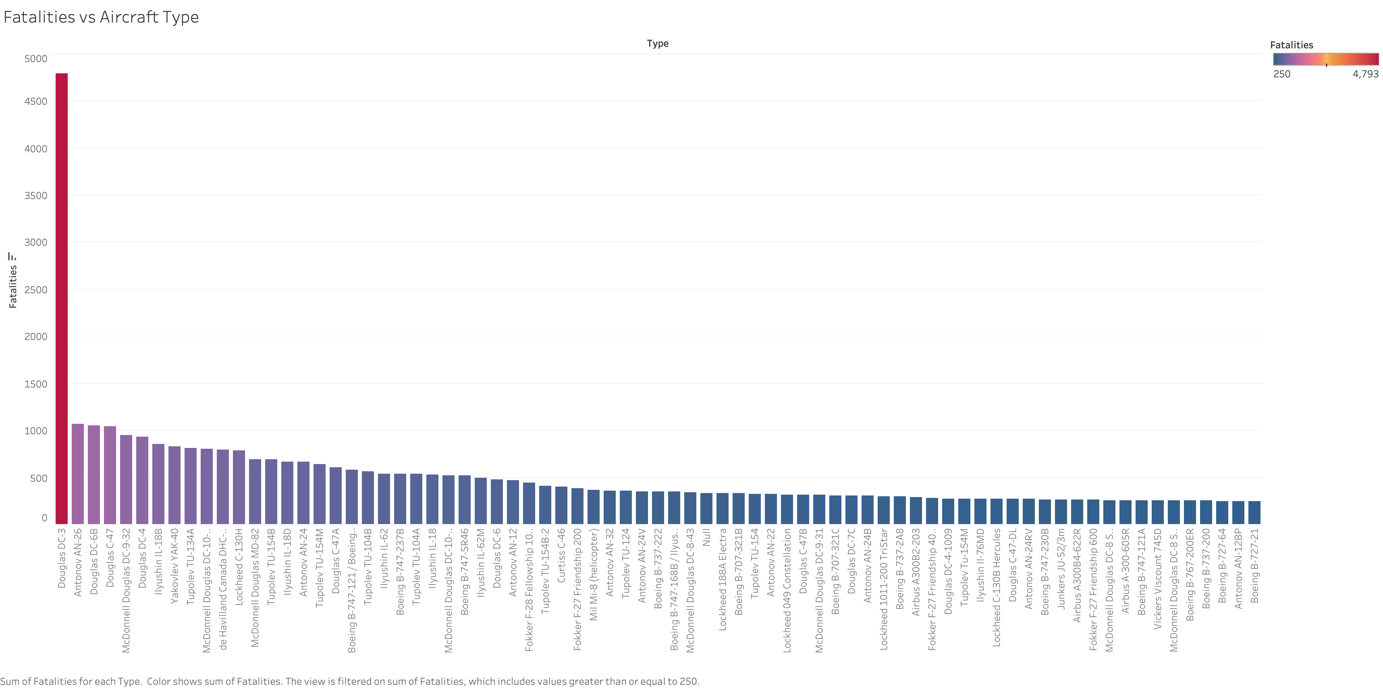
Airline Safety - Infographic
01
Decrease in fatalities
Year 1972 had the highest fatality rate. The fatalities have decreased from 1972 to 2009 by 80%. This is a considerable reduction because of technology advancement.
Country wise fatalities
02
Countries like Russia and USA top the fatalities. This can be due to the increase air traffic and geo graphical areas.
Incidents by Airline
03
Top four incidents are from US based airlines. USA based airlines needs to take steps to reduce the incidents. Airline passengers needs to avoid peak hours and holiday season in USA to avoid mishaps.
Fatalities by Aircraft Type
04
Douglas DC-3 has the highest fatalities and distant second is Antonov AN-26. Airlines needs to work with Aircraft manufacturer to upgrade safety features on Douglas DC-3.

