Slide 1
Assignement_6.2_Vayuvegula_Soma_Shekar_Tableu
File created on: 2/26/23 12:46:28 AM CST

Slide 2
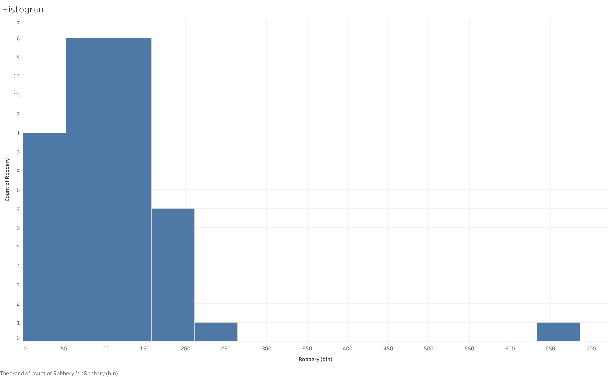

Slide 3
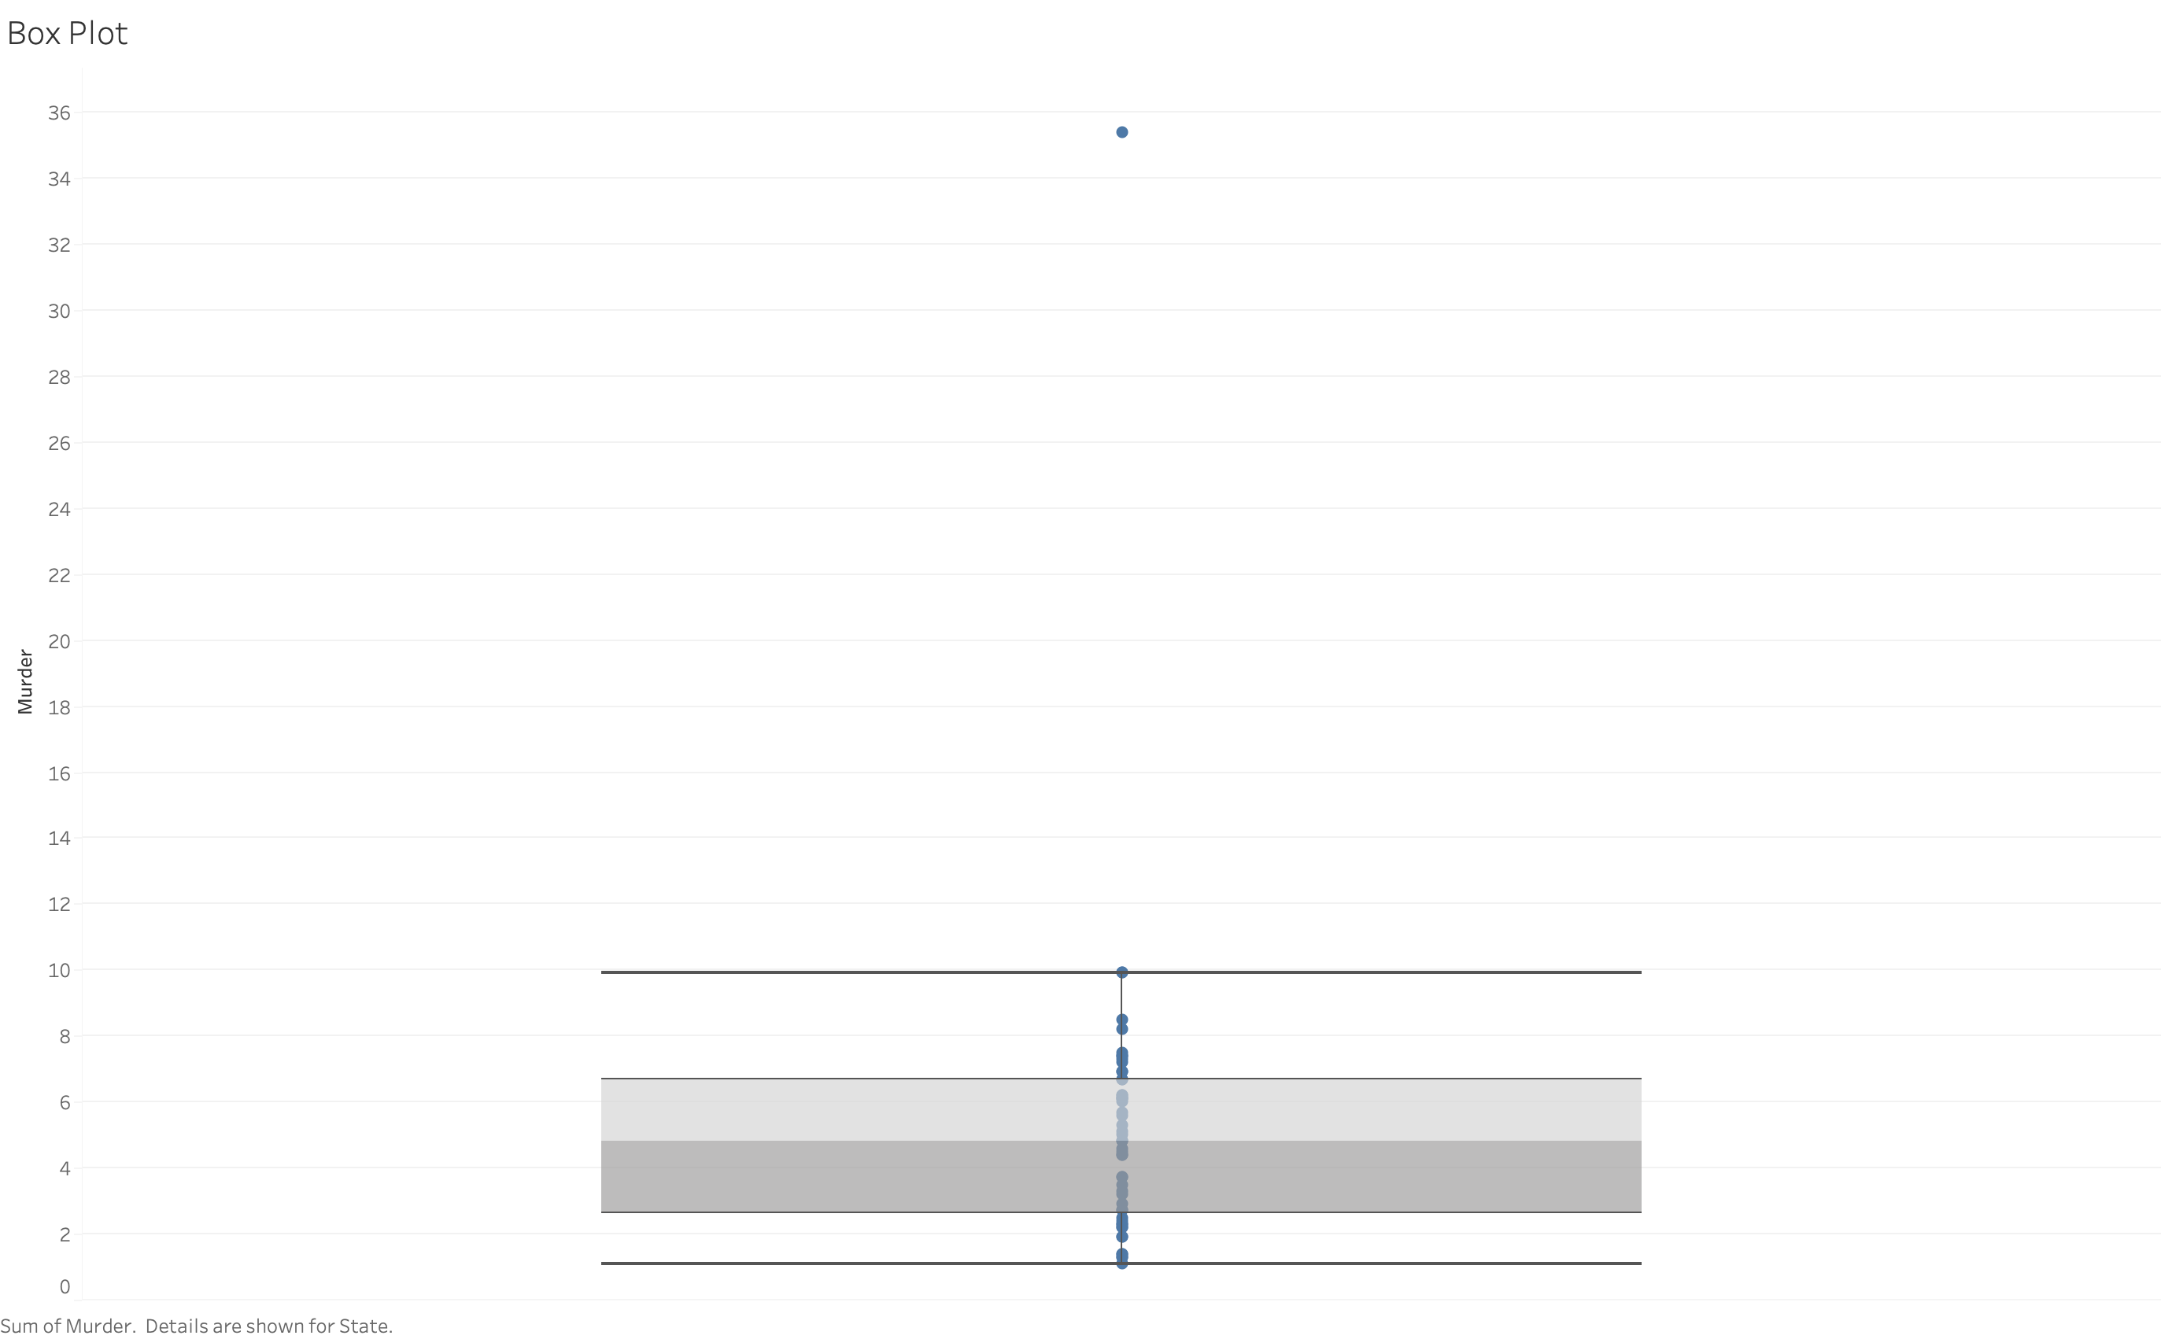

Slide 4
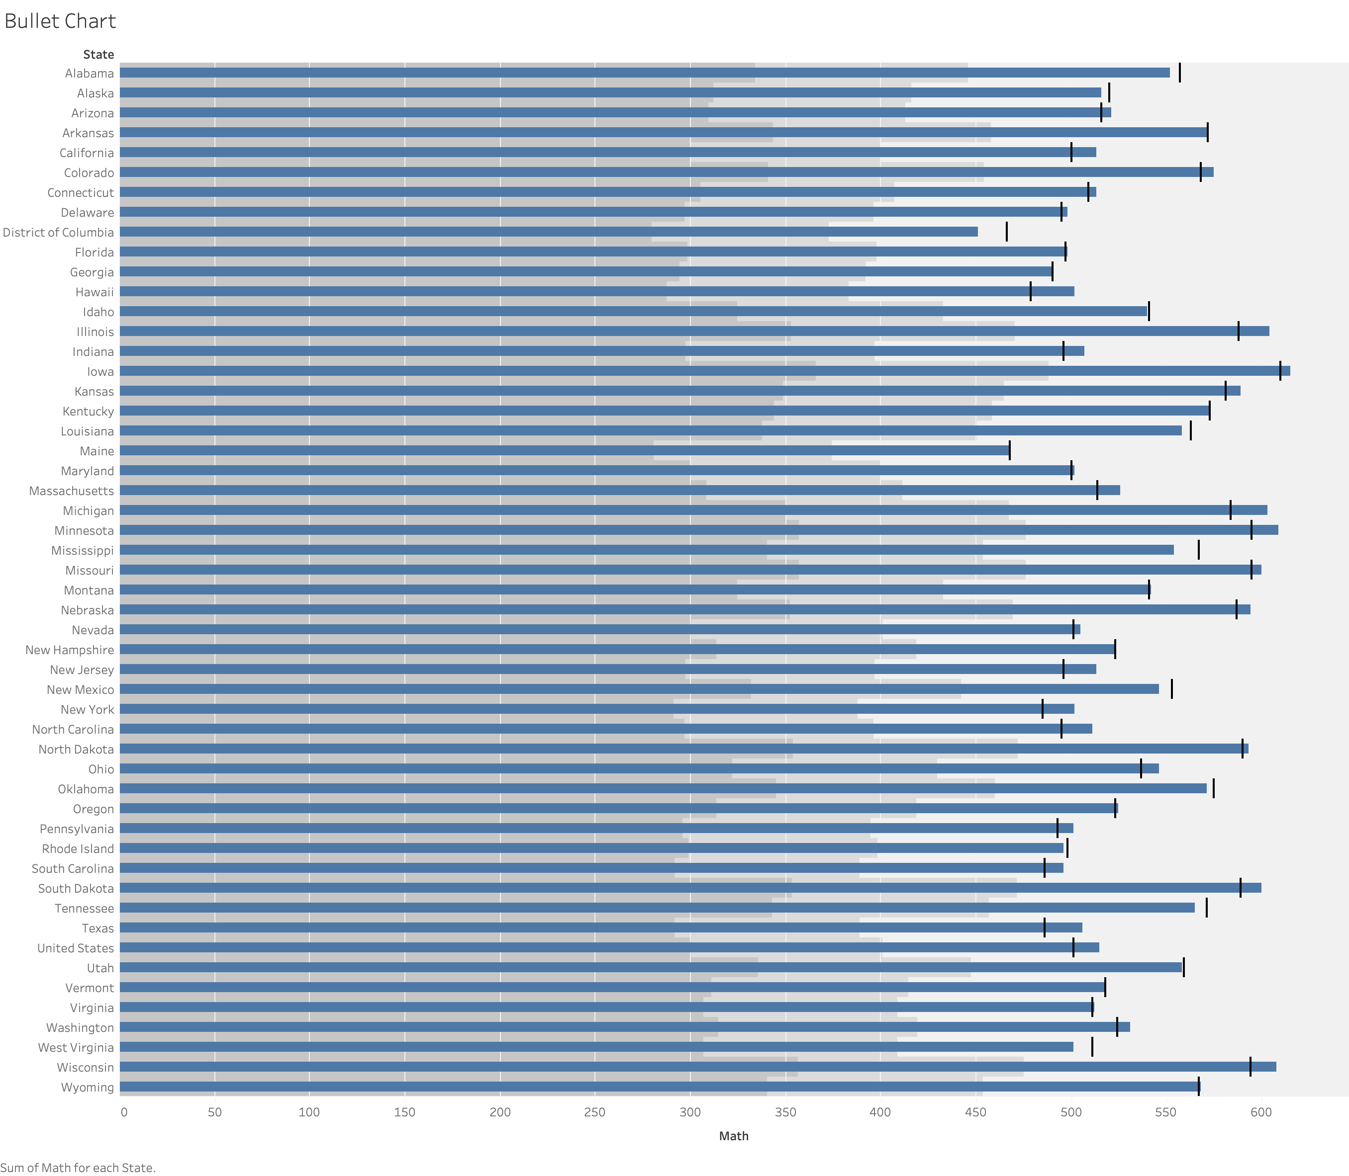

Slide 5
