Slide 1
Assignment_5_6_Vayuvegula_Soma_Shekar
File created on: 1/22/23 12:38:28 AM CST

Slide 2
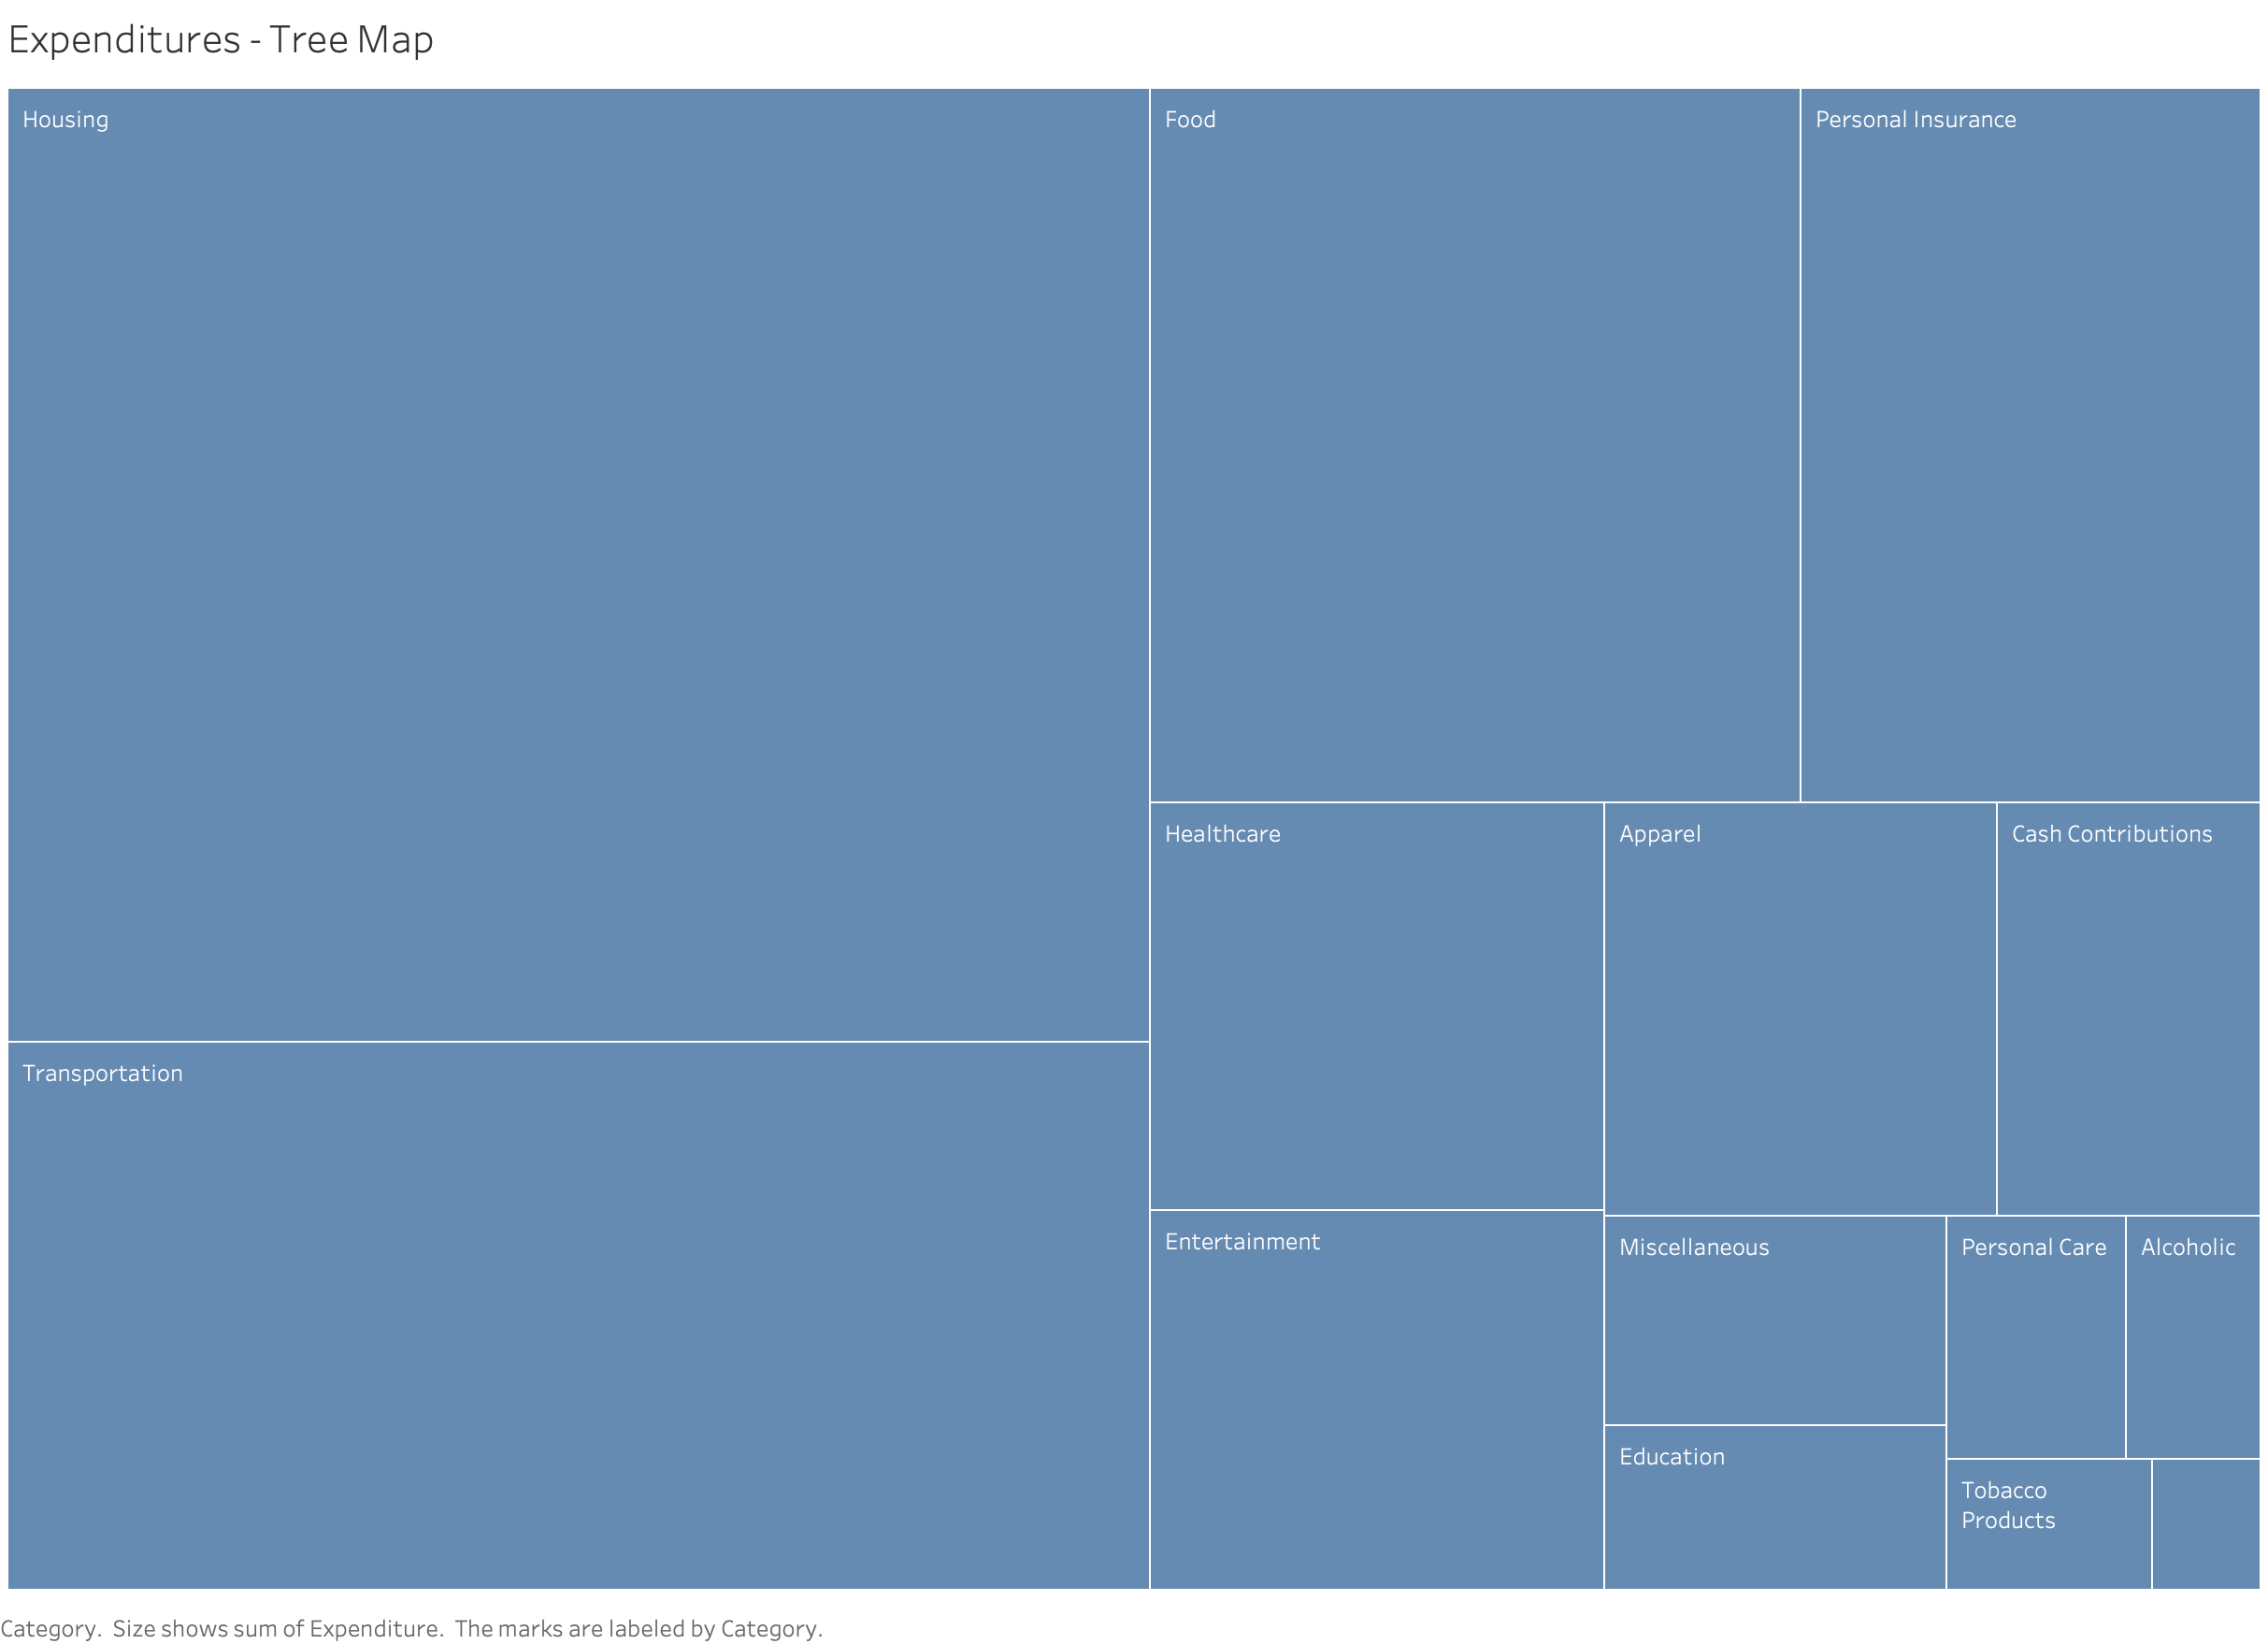

Slide 3
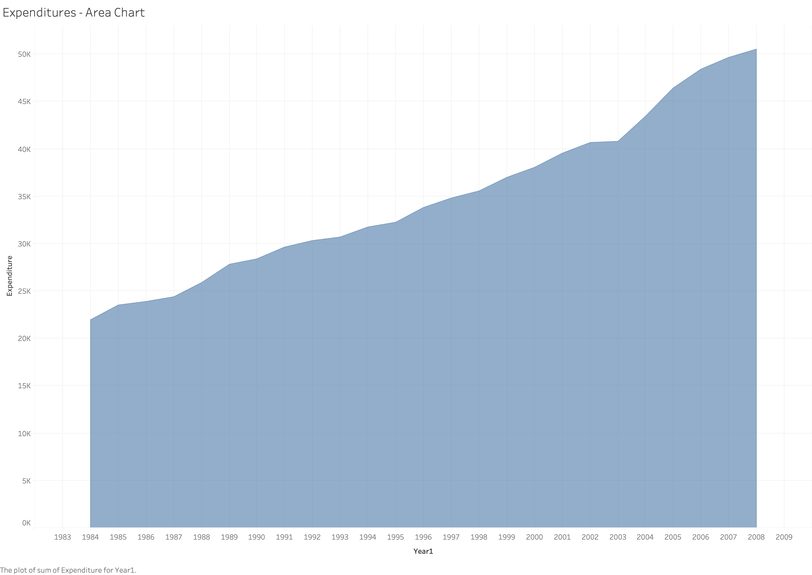

Slide 4
