Slide 1
Assignment_5_6_Vayuvegula_Soma_Shekar_Tableau
File created on: 1/22/23 8:53:36 AM CST

Slide 2
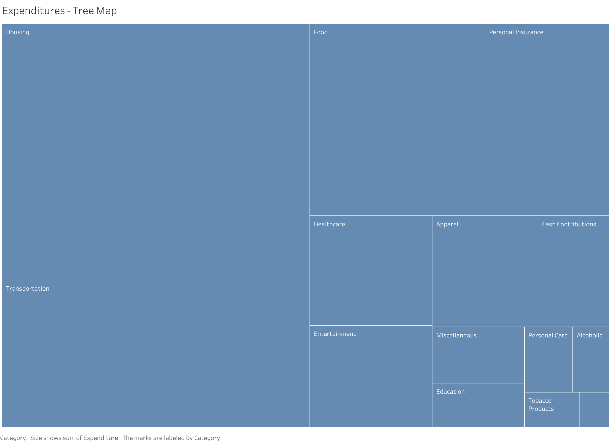

Slide 3
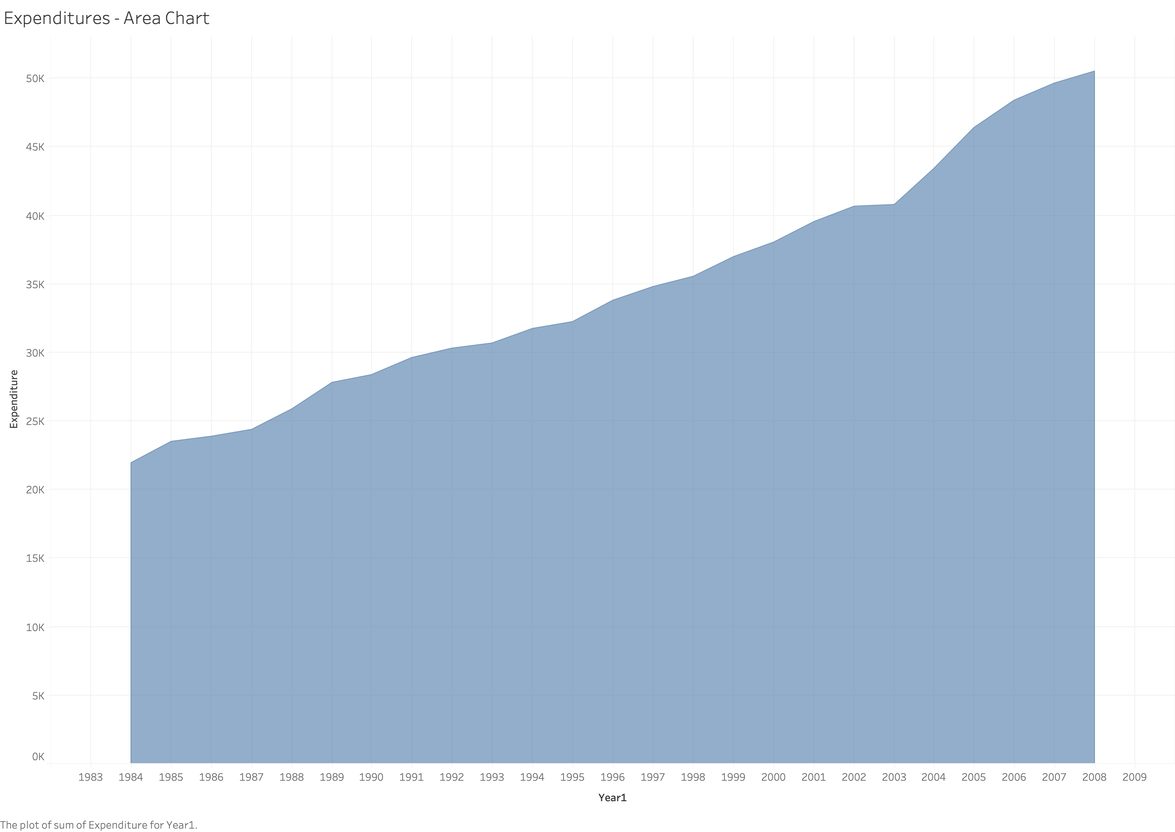

Slide 4
