Slide 1
Assignment_4.2_Vayuvegula_Soma_Shekar_Tableau
File created on: 2/5/23 12:21:30 AM CST

Slide 2
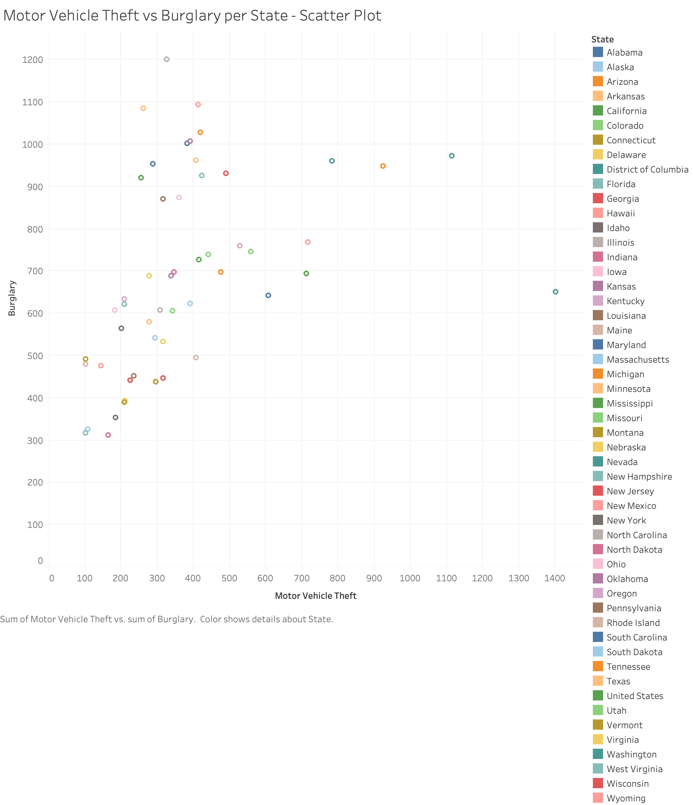

Slide 3
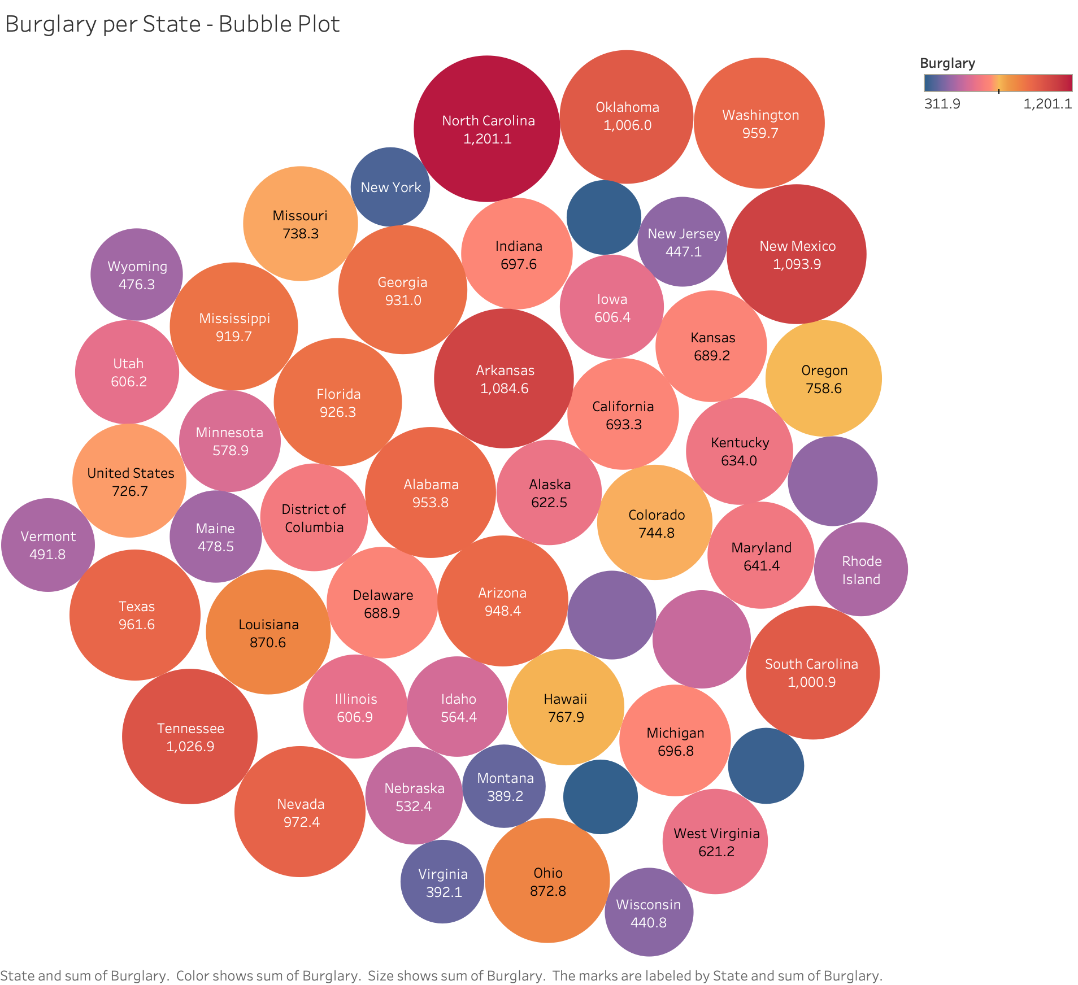

Slide 4
