Slide 1
Assignment_5.2_Vayuvegula_Soma_Shekar_Tableau
File created on: 2/19/23 2:58:01 AM CST

Slide 2
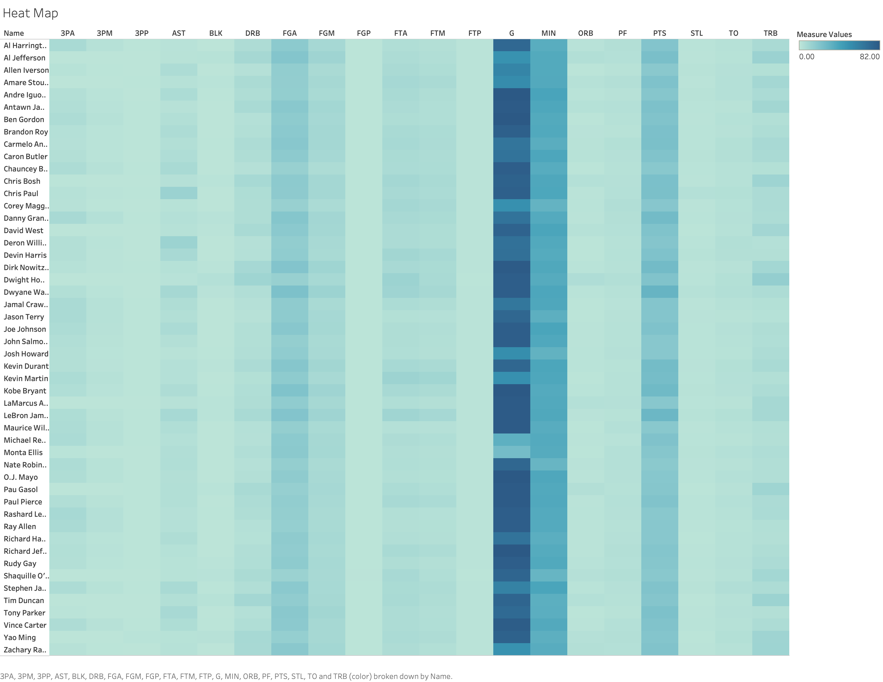

Slide 3
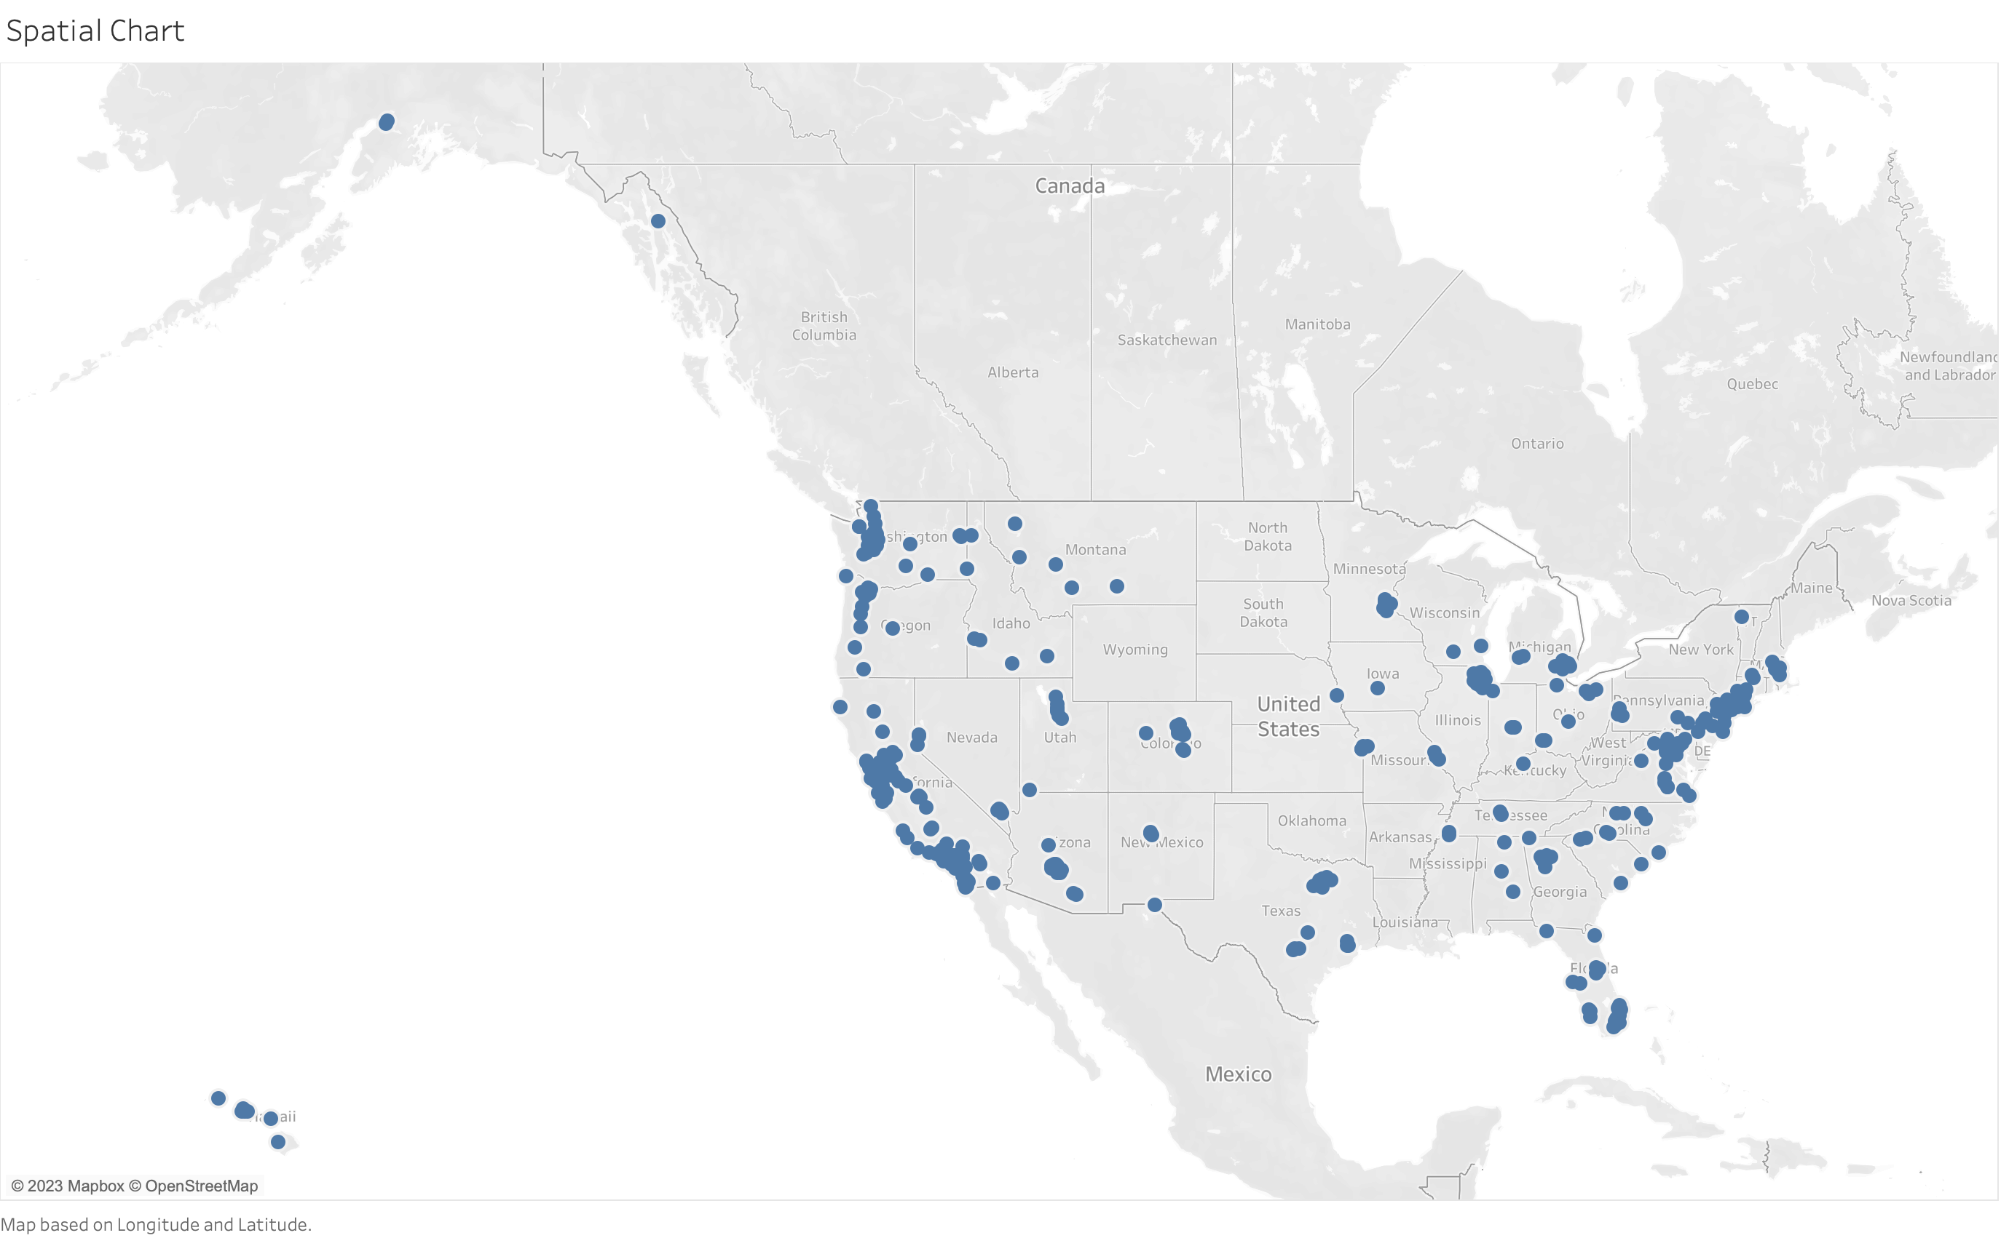

Slide 4
