Slide 1
Assignment_3_4_Vayuvegula_Soma_Shekar_Tableau
File created on: 1/7/23 10:33:51 PM CST

Slide 2
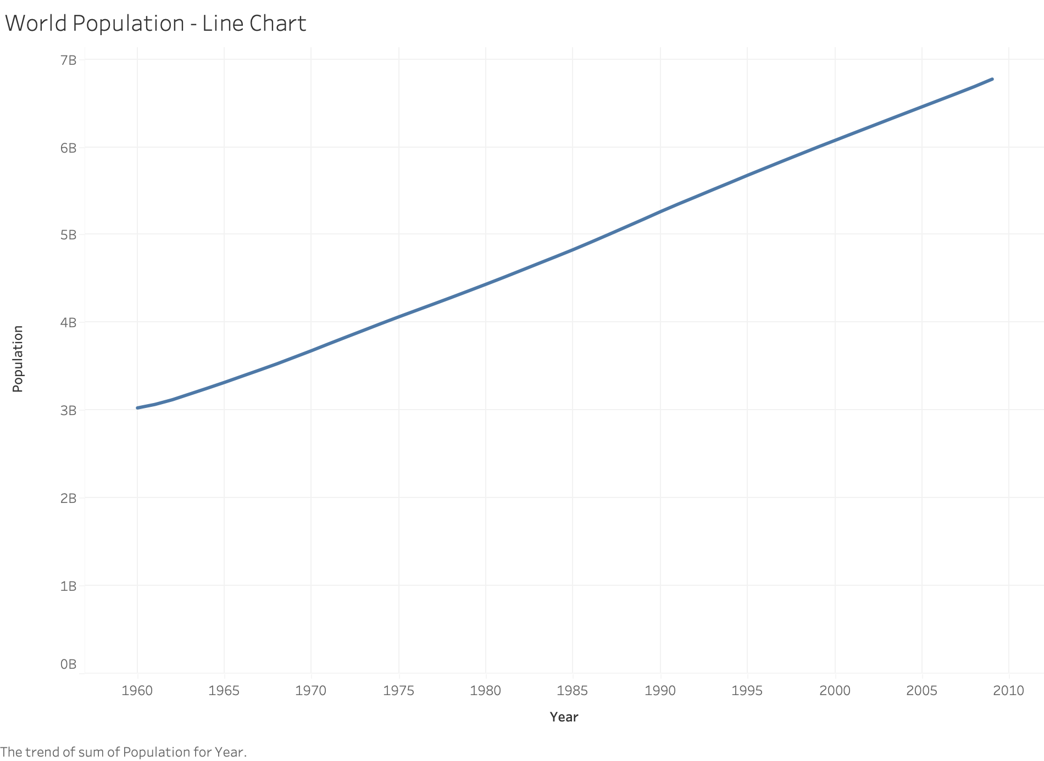

Slide 3
