Slide 1
Task1_Vayuvegula_Soma_Shekar
File created on: 1/8/23 8:21:46 PM CST

Slide 2
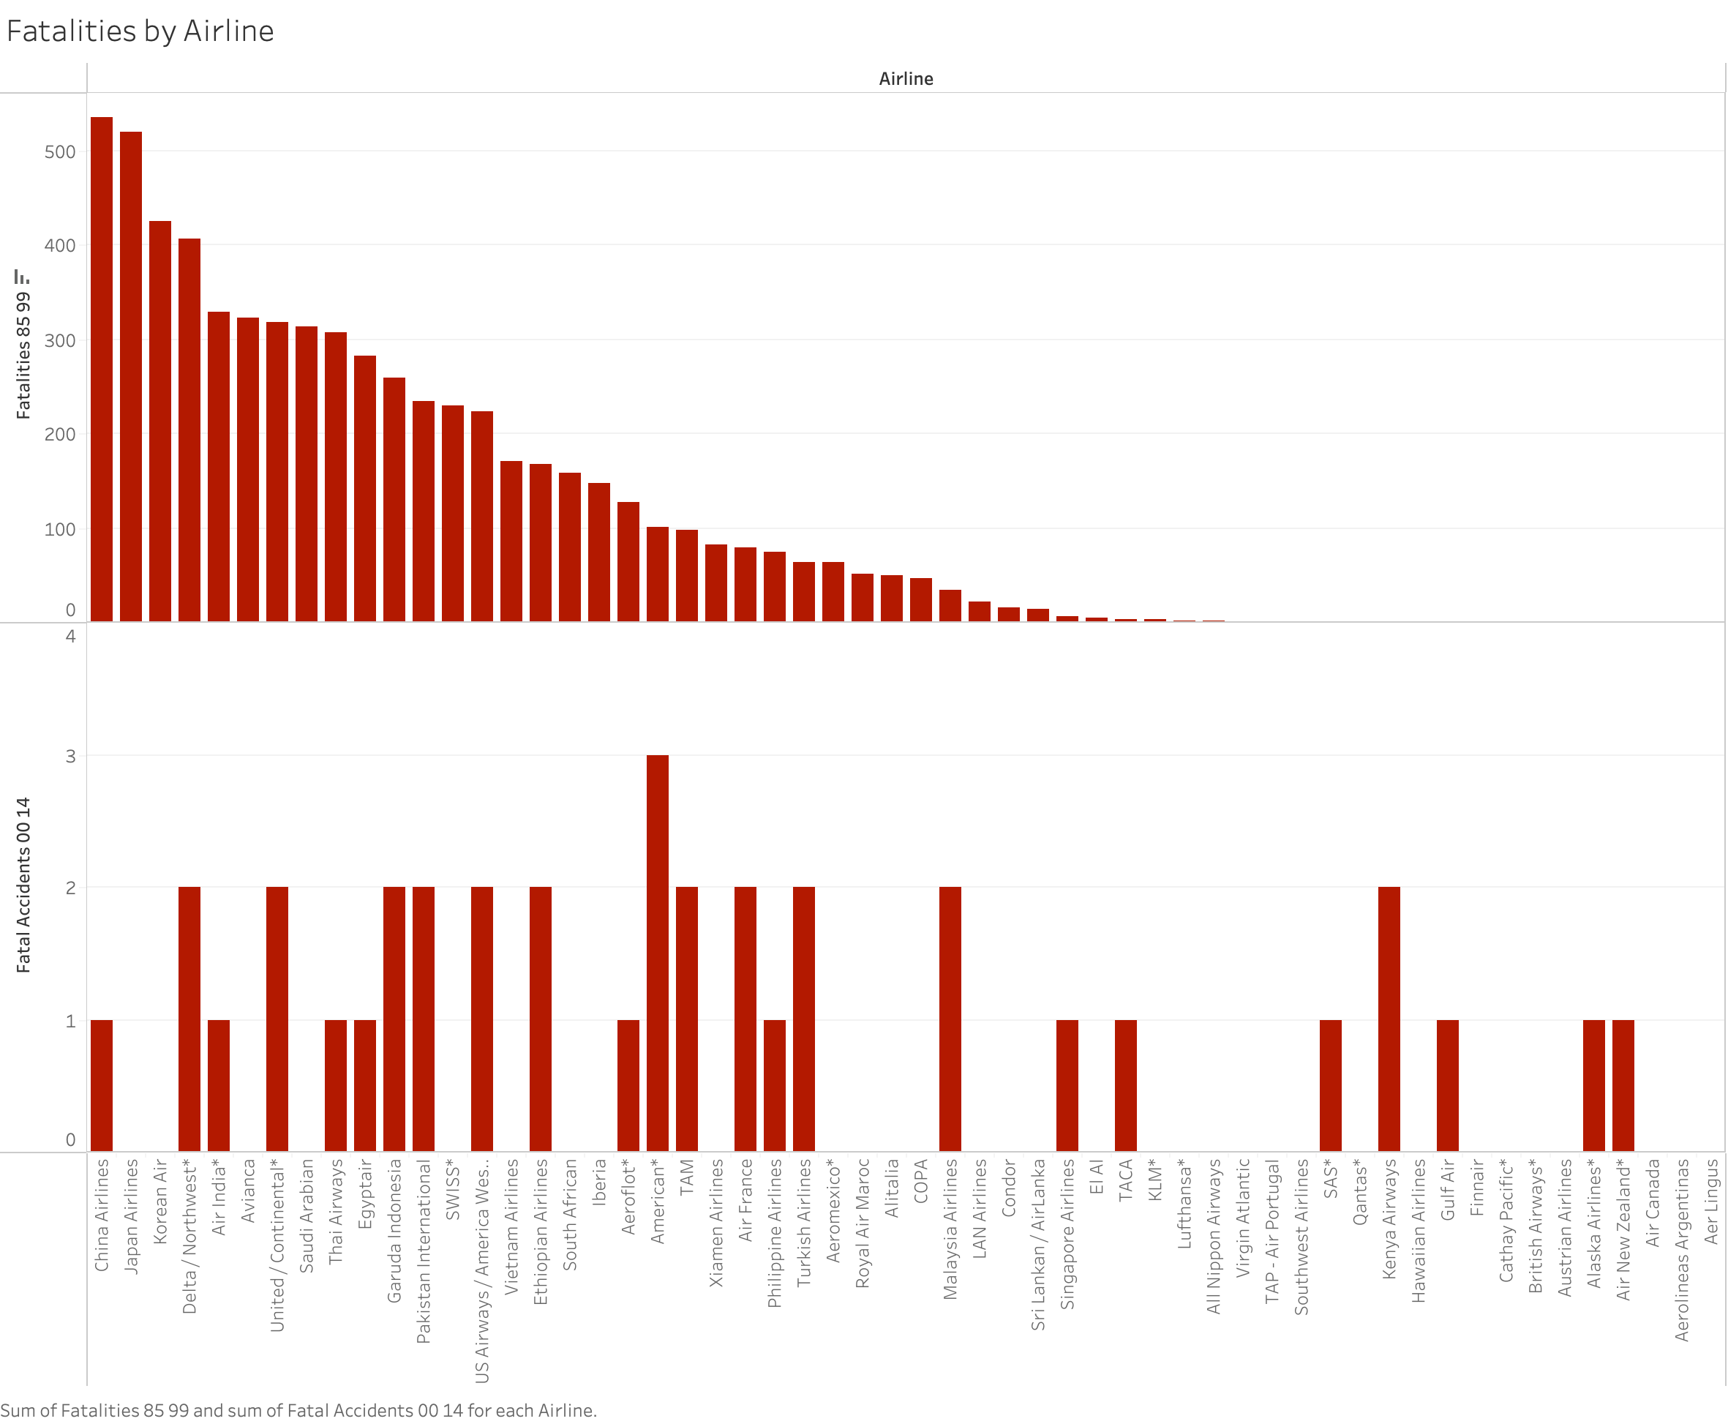

Slide 3
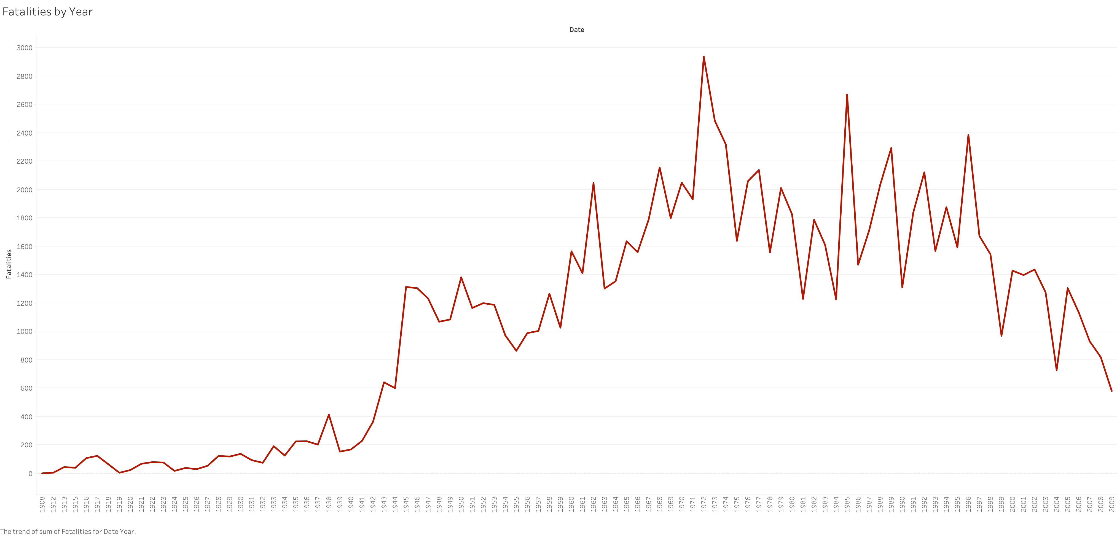

Slide 4
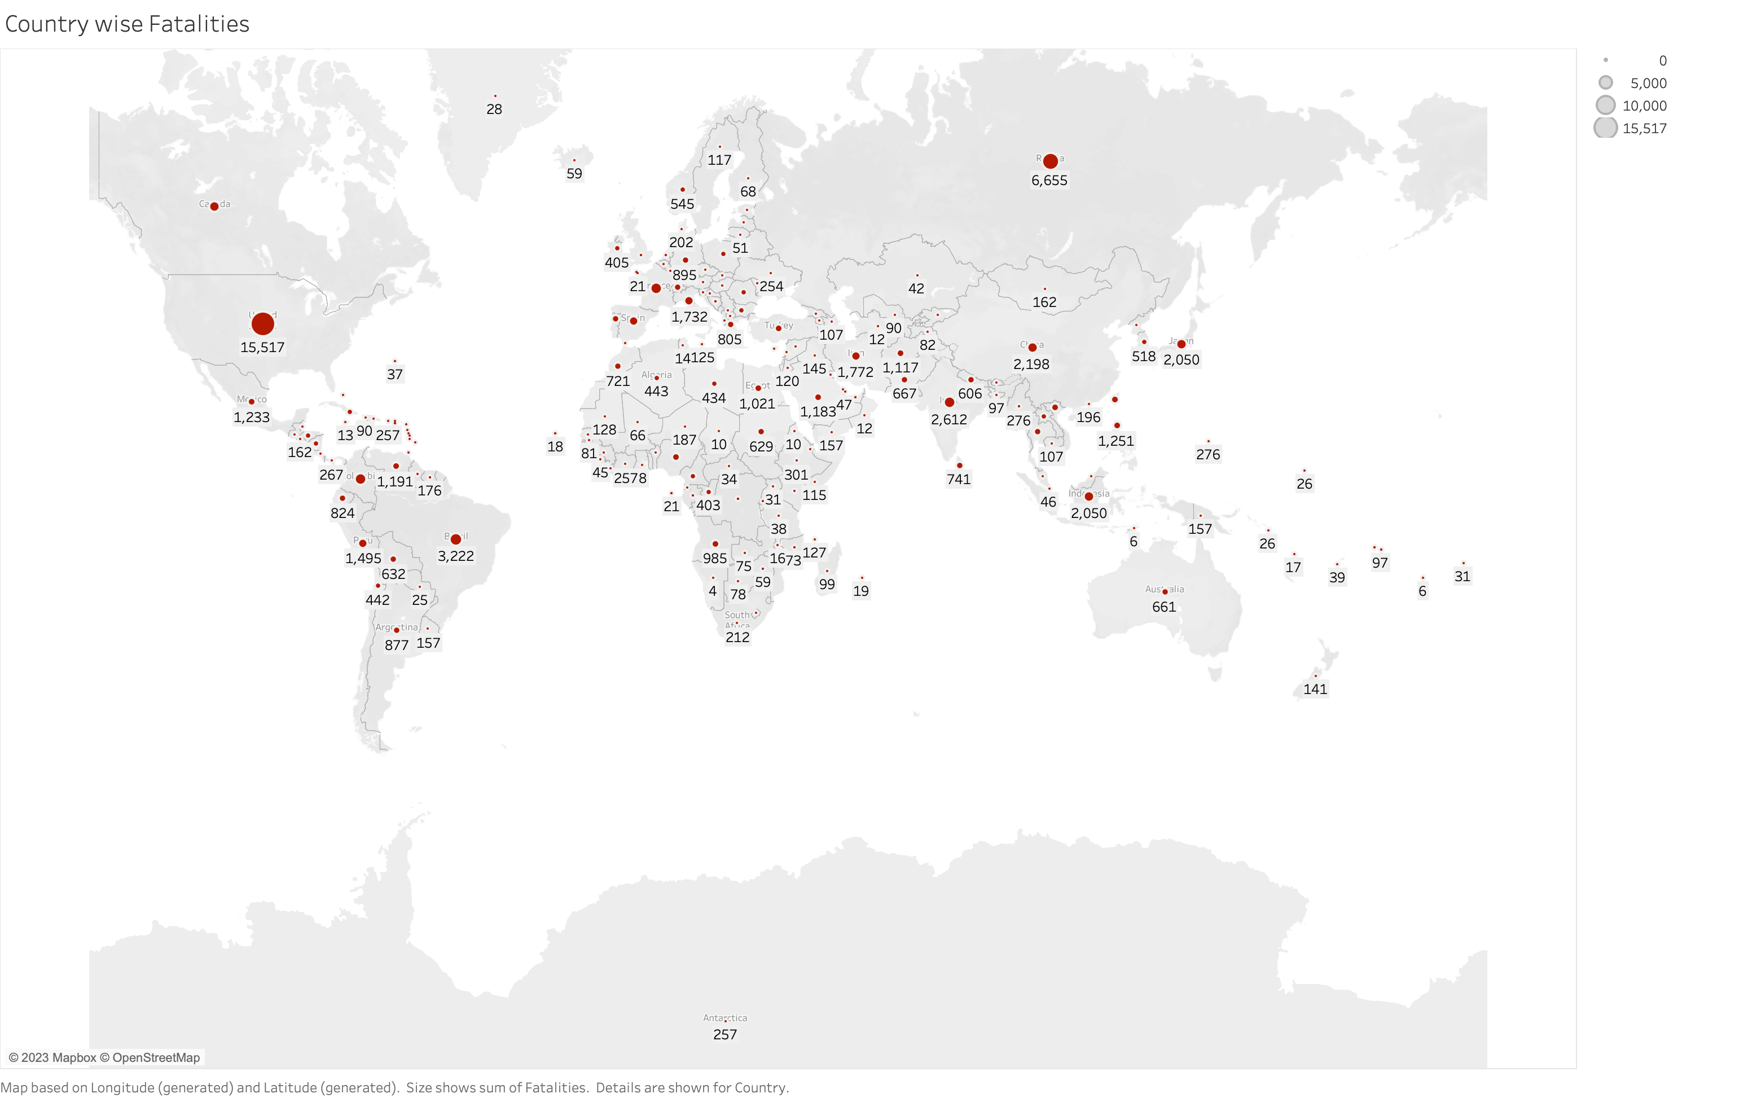

Slide 5
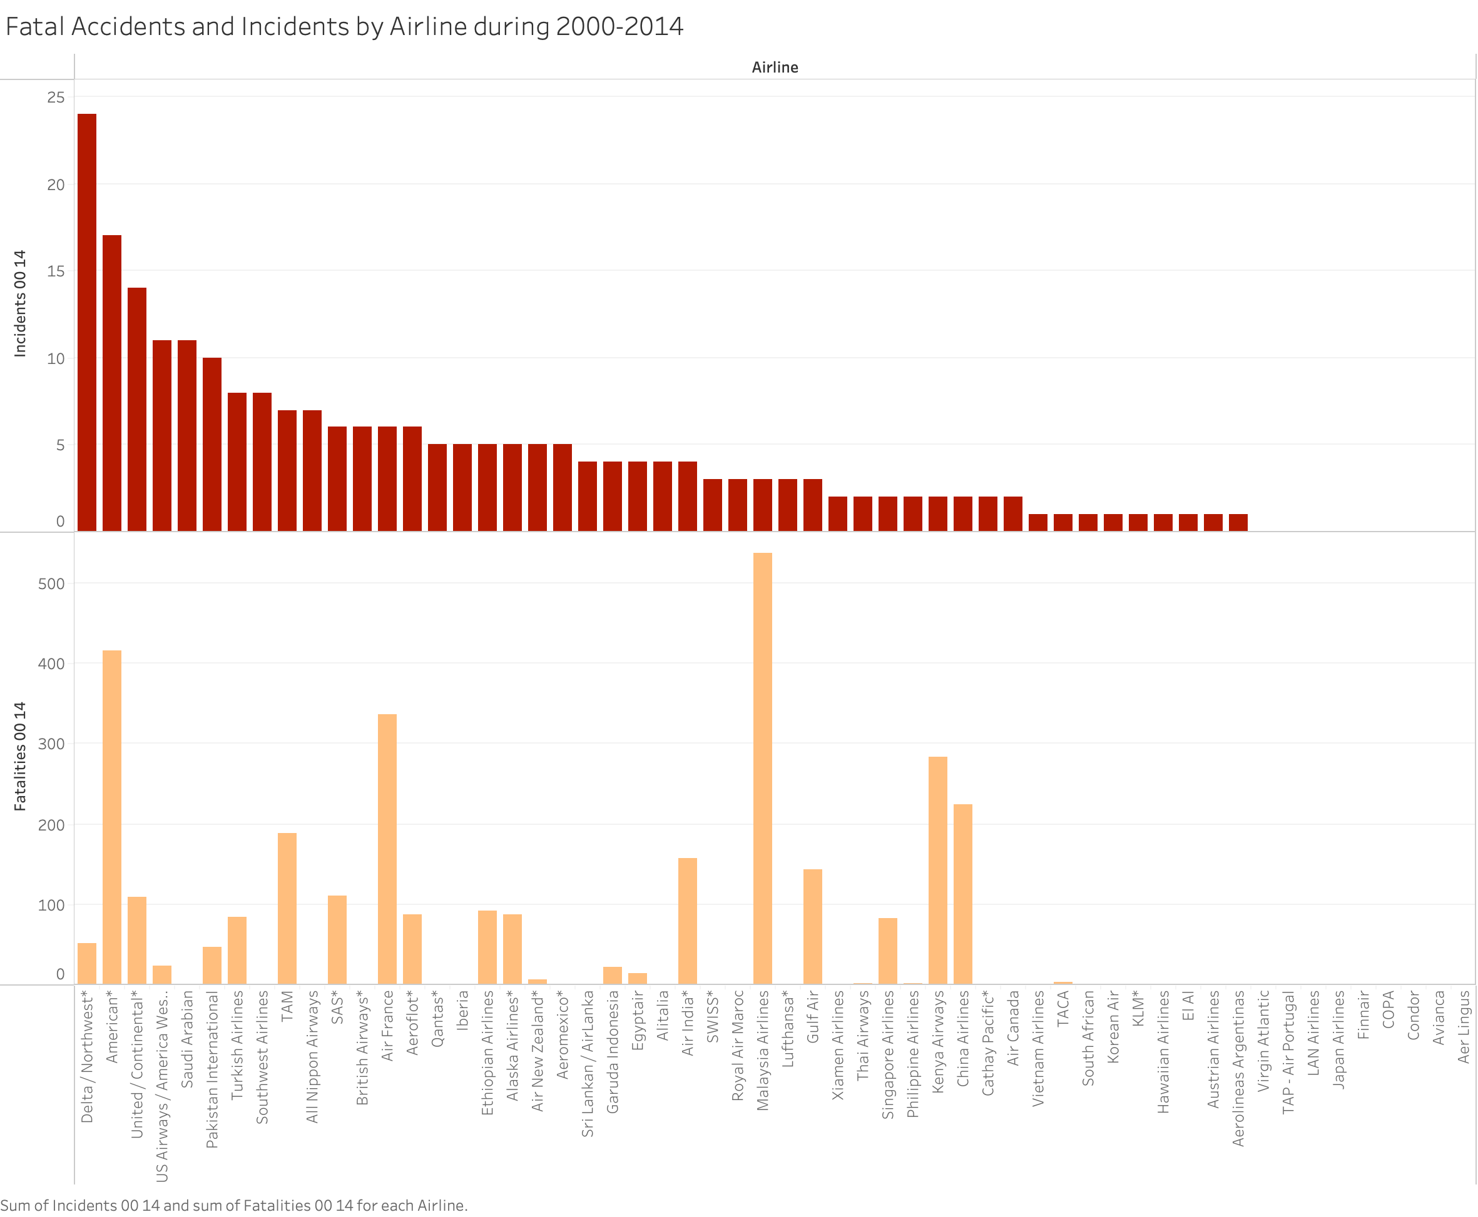

Slide 6
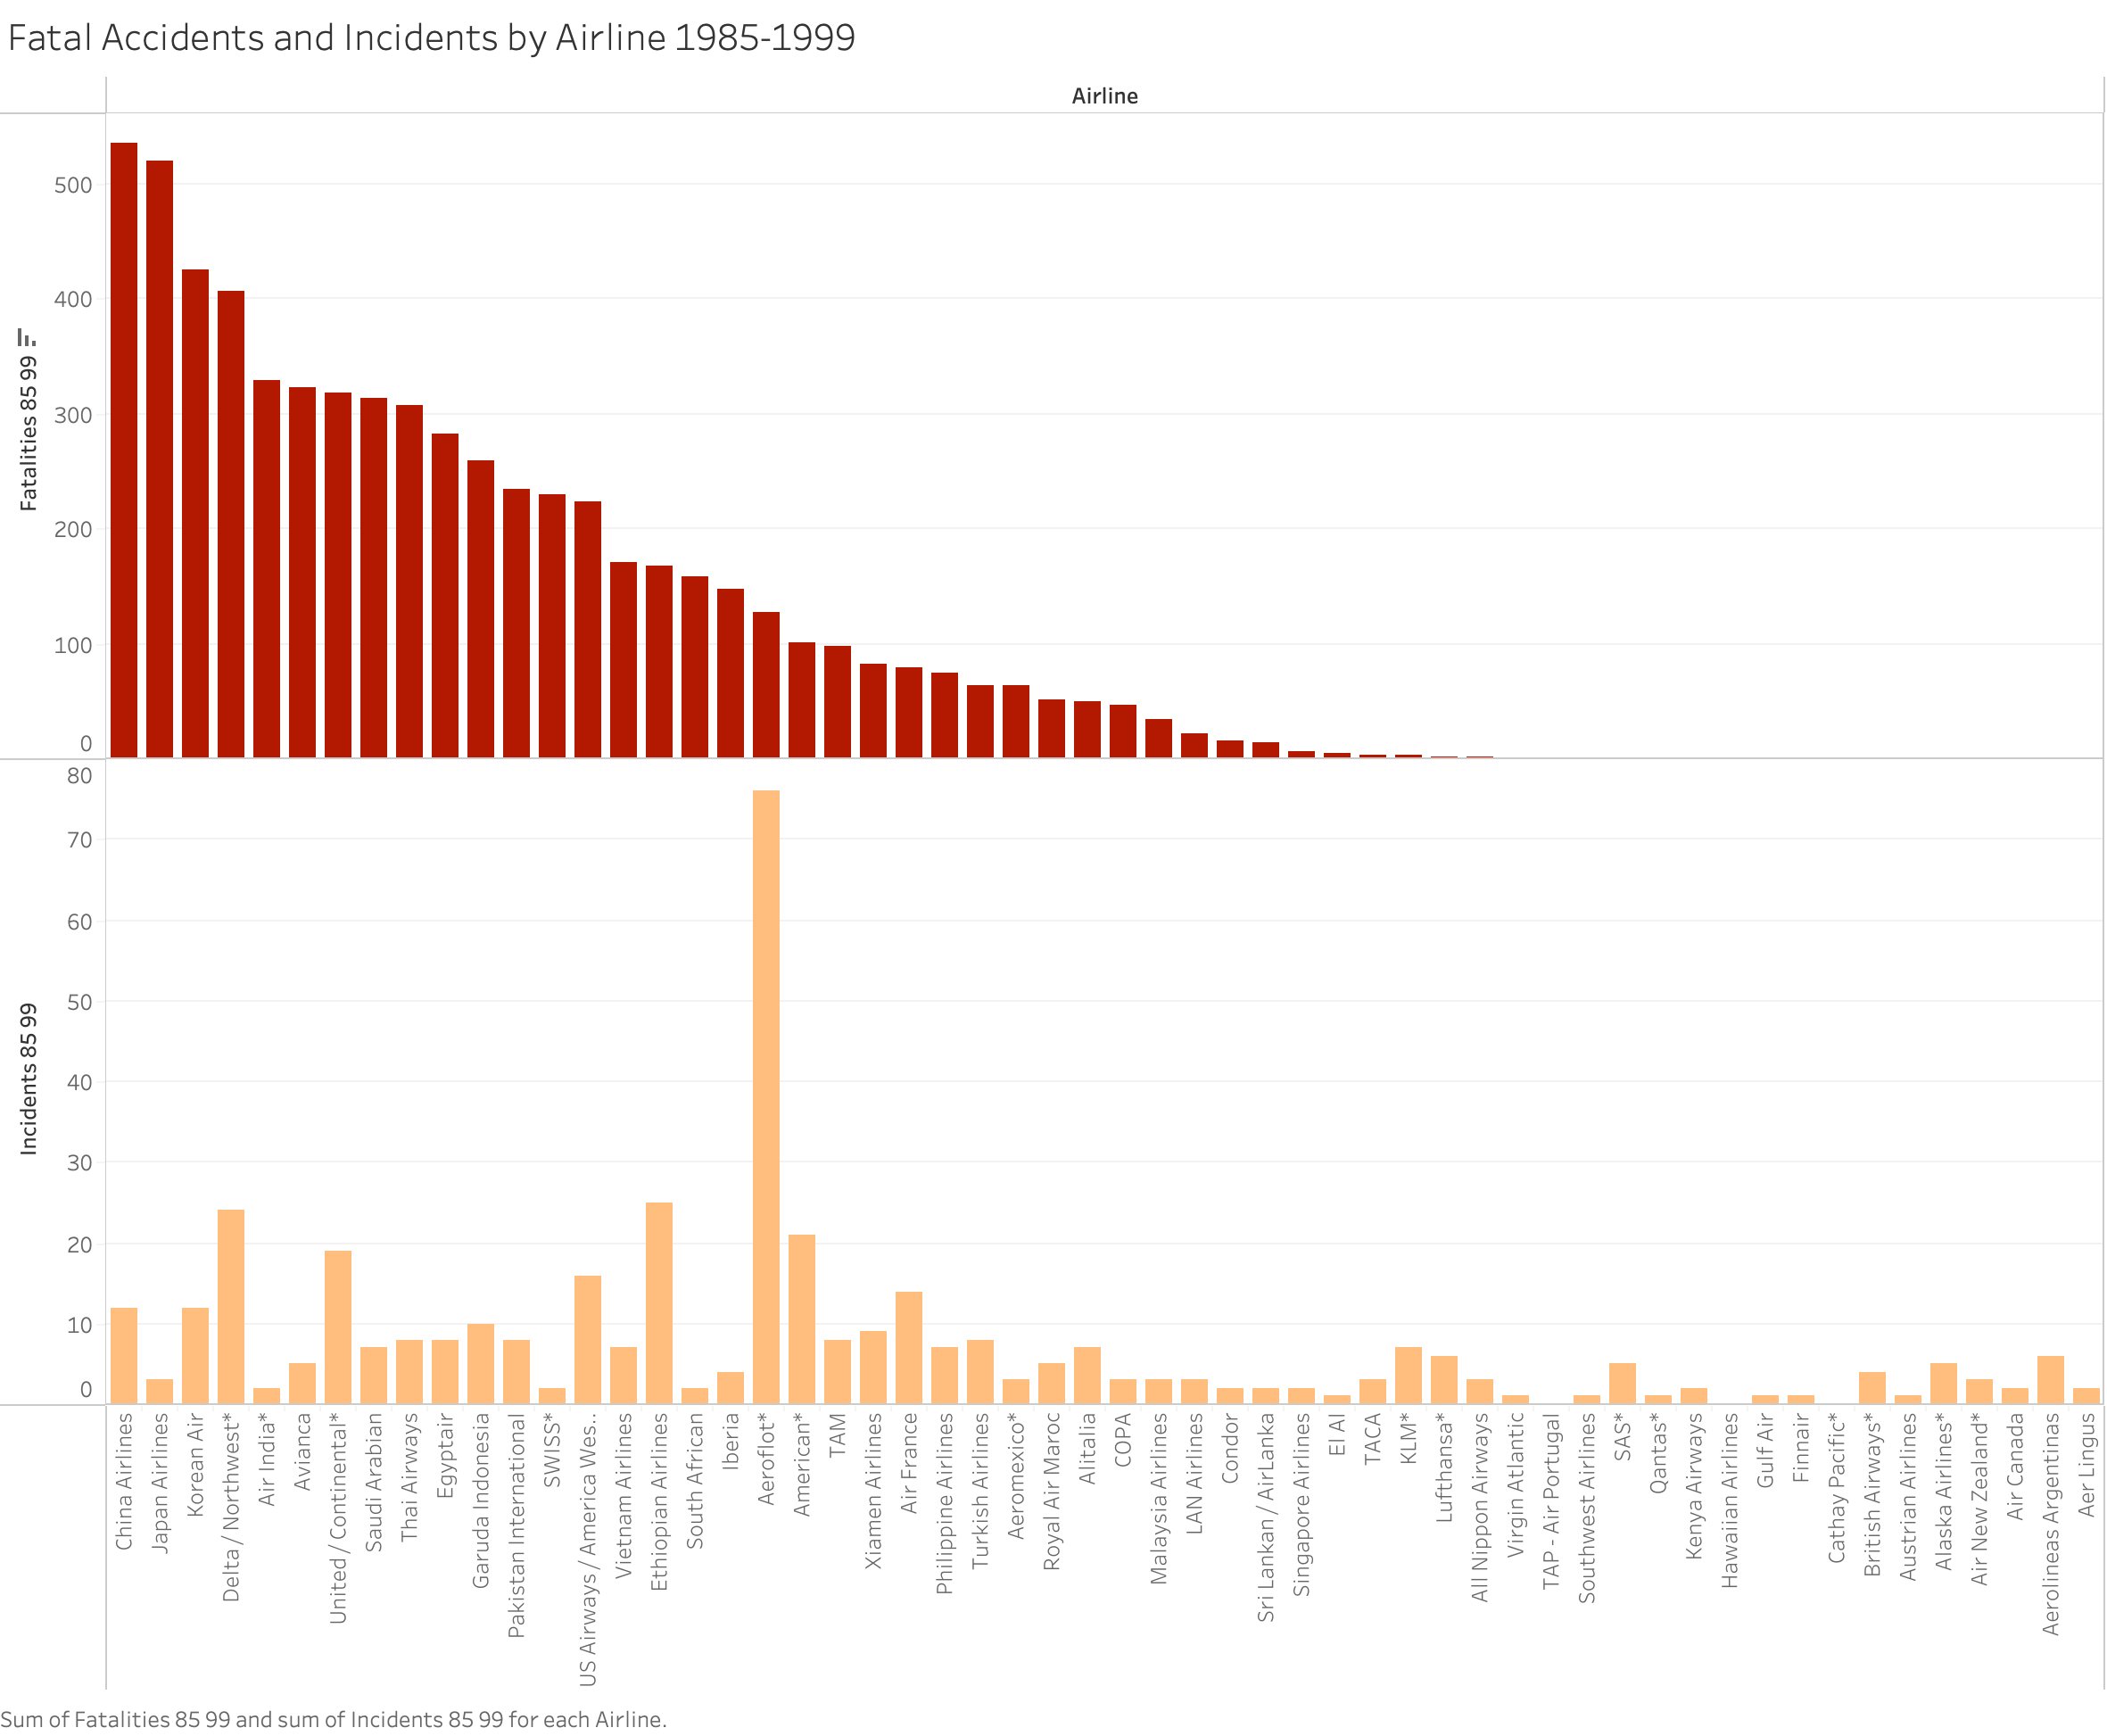

Slide 7
