Slide 1
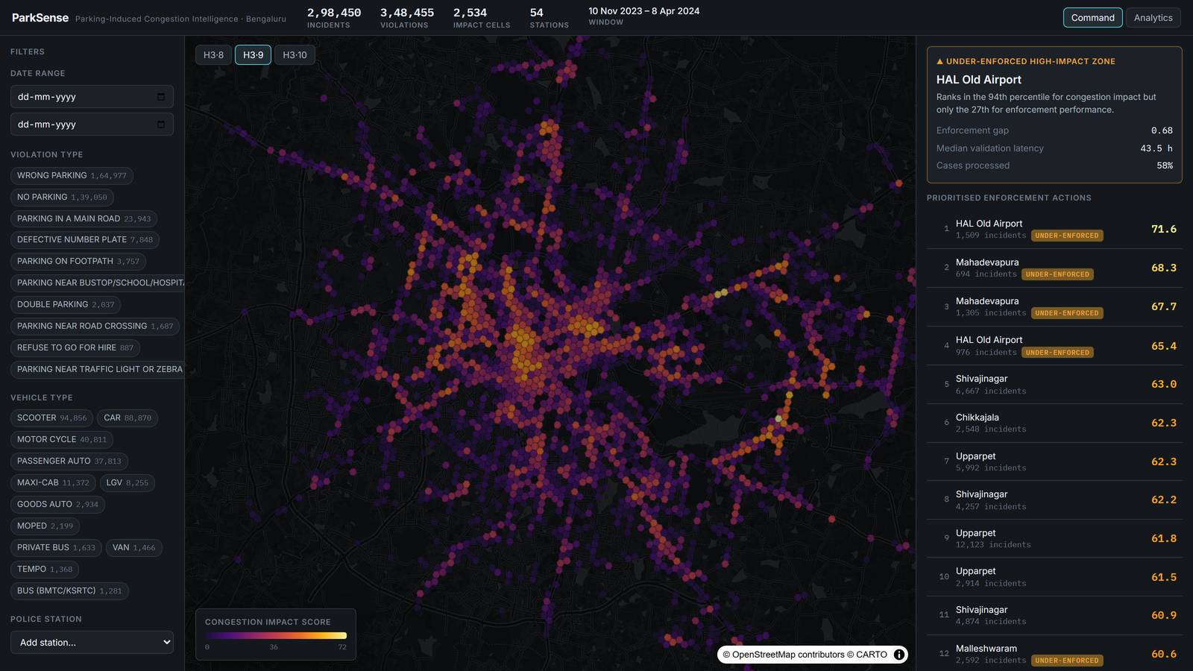
FLIPKART GRIDLOCK 2.0 · ROUND 2
ParkSense
Parking-Induced Congestion Intelligence
A decision tool for traffic-enforcement command centres — turning 298,450 violation records into a ranked patrol plan.
Keshav Singla · Aadya Jain · Purva Jain · Shravani Singh
parksense-e1w1.onrender.com

Slide 2
01 THE PROBLEM
Detection is solved.
Prioritisation isn't.
Every violation in this dataset is already detected and labelled. The hard part is deciding where enforcement should go first.
298,450
incidents analysed
A command centre cannot act on 298,000 dots on a map. It needs to know which locations are doing the most damage to traffic flow — and where enforcement is failing to match it.
348,455
violations, multi-label & exploded
The brief asks to quantify impact to enable targeted enforcement. That quantification is the product.
2,534
geographic impact cells
PARKSENSE
02 / 10

Slide 3
02 OUR THESIS
We don't compete on detection.
We compete on impact.
MOST SUBMISSIONS
PARKSENSE
Plot the violations on a map.
Score and rank the impact.
— Re-states what is already known
→ Weights what the violation is, not just how many
— A wall of undifferentiated dots
→ An explainable Congestion Impact Score
— No priority, no explanation
→ A ranked, prioritised action list
— No link to enforcement effort
→ Flags high-impact, under-enforced zones
PARKSENSE
03 / 10

Slide 4
03 THE SOLUTION
Three instruments, one action list
01
Congestion Impact Score
A transparent per-location score — severity, vehicle footprint, density, persistence and peak pressure, normalised to 0–100.
02
Enforcement Efficiency Gap
Impact vs. enforcement performance per station. Surfaces the high-impact, under-enforced zones to reallocate patrols.
03
Hotspot Forecasting
A backtested per-cell model for next-day intensity, plus emerging-hotspot watch zones — pre-position, don't react.
PARKSENSE
04 / 10

Slide 5
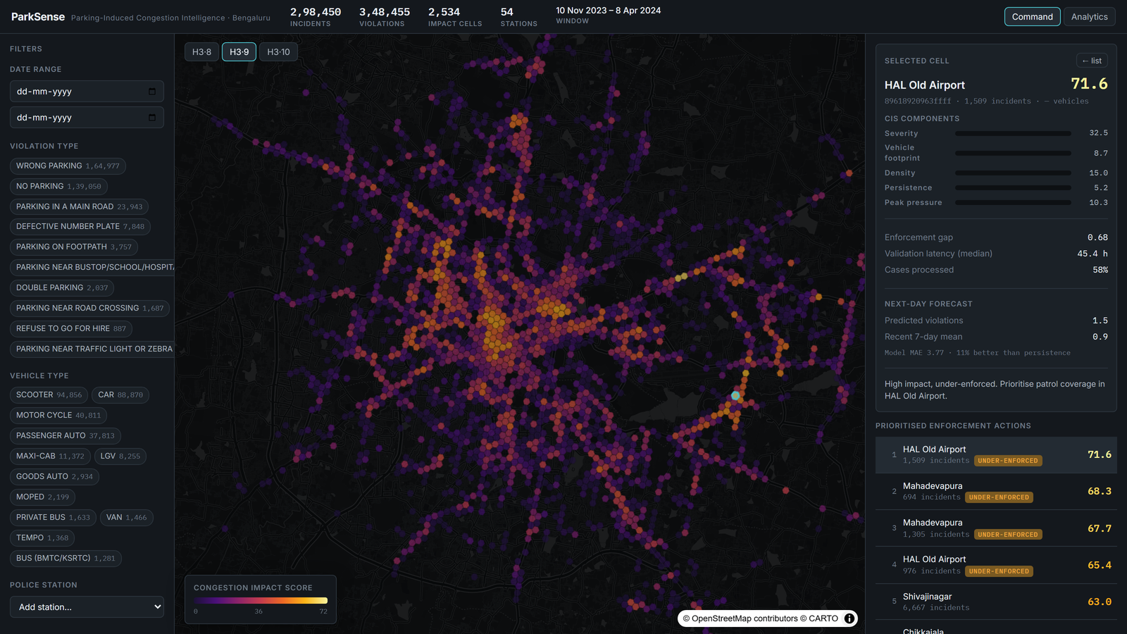
04 INSTRUMENT 01 — CONGESTION IMPACT SCORE
A score you can defend
CIS = (Σ wᵢ·componentᵢ / Σw) · 100 · n/(n+k)
0.35
Severity
footpath / main-road obstruction
0.20
Footprint
carriageway width by vehicle type
0.20
Density
incident volume, log-scaled
0.10
Persistence
chronic vs. one-off activity
0.15
Peak pressure
share in data-derived peak hours
Every component is shown on hover — the score is auditable in one glance, never a black box.
Peak hours are derived from the data (04, 05, 08–11), not assumed. A confidence factor stops one-off incidents ranking beside chronic hotspots.
PARKSENSE
05 / 10

Slide 6
05 INSTRUMENT 02 — ENFORCEMENT EFFICIENCY GAP
The line that changes the shift plan
We compare each station's congestion impact against its enforcement performance, then rank the divergence.
WORKED EXAMPLE · HAL OLD AIRPORT
94th
27th
0.68
percentile for
congestion impact
percentile for
enforcement performance
enforcement gap
(impact − performance)
High damage, low coverage. ParkSense flags 18 such stations — a ready-made patrol-reallocation list.
PARKSENSE
06 / 10

Slide 7
06 INSTRUMENT 03 — HOTSPOT FORECASTING
Forecast the next day — honestly
A daily per-cell LightGBM model on lag, calendar and spatial-neighbour features, validated on a held-out final 21 days the model never trains on.
3.77
4.23
+11%
Model MAE
Naïve baseline MAE
Skill vs. baseline
We publish the persistence baseline next to the model, so the gain is provable — not asserted. A rolling z-score flags 28 emerging watch zones before they peak.
PARKSENSE
07 / 10

Slide 8
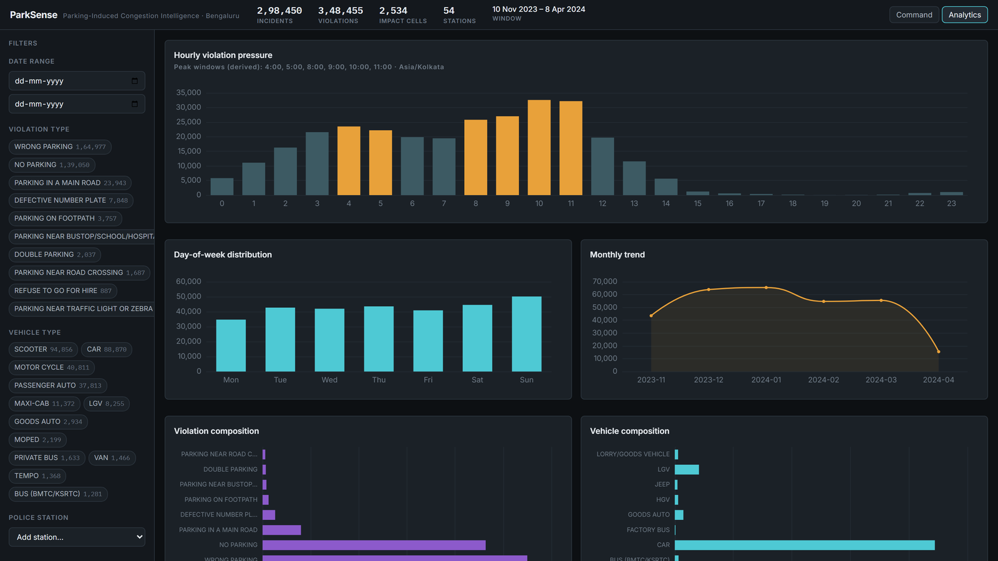
07 THE PRODUCT
Built for a control room
Command view — live impact heatmap, filter rail, prioritised action panel.
Analytics view — temporal pressure, composition, enforcement latency.
PARKSENSE
08 / 10

Slide 9
08 ENGINEERING
Engineered like a product, not a demo
Zero hardcoding
Intellectual honesty
Peak hours, thresholds, quantiles and filters are derived at runtime; all tunables live in one config.
On finding action/closed fields 100% empty, we used the populated validation lifecycle — no invented metrics.
Reproducible
Real stack
One command rebuilds parquet, scores and the model from raw data in ~30s. Unit tests cover the scoring core.
FastAPI · DuckDB · Uber H3 · LightGBM backend; React · TypeScript · MapLibre · deck.gl console.
PARKSENSE
09 / 10

Slide 10
FROM A 298K-ROW LOG
To a daily
patrol plan.
Live parksense-e1w1.onrender.com
Code github.com/keshavhacker1609/parksense
Keshav Singla · Aadya Jain · Purva Jain · Shravani Singh

