Slide 1
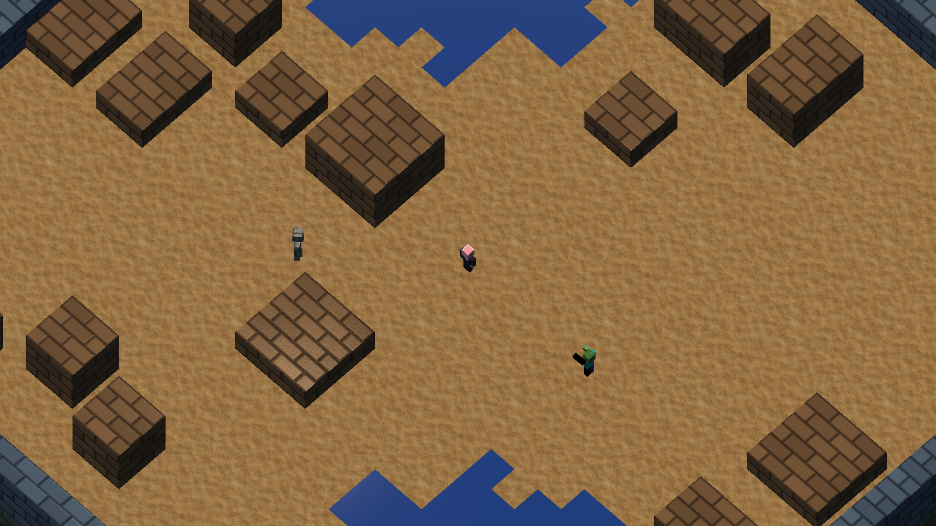
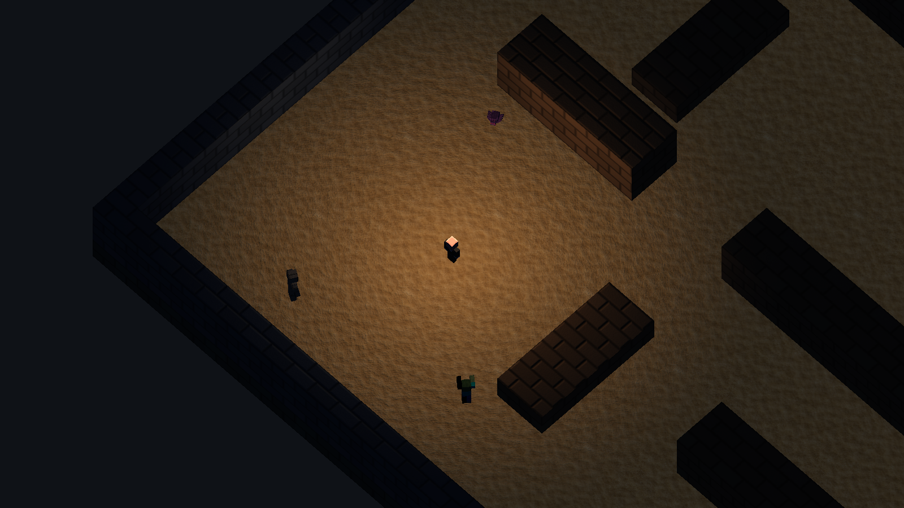
VOXEL ARENA / MEMBER A
Voxel Arena
2.5D survival shooter / Survive 180 seconds
DAY
NIGHT
Zombies + Golems
Spiders + Zombies + Golems
XINGYU YANG · COMP9415
DAY + NIGHT / 01
Notes:
Hello, I’m Xingyu, Member A. Voxel Arena is a 2.5D survival shooter with Day and Night maps. Players survive one hundred and eighty seconds. Day starts with Zombies; Golems gradually join after sixty seconds. Night starts with Spiders; Zombies join after thirty seconds and Golems after sixty. By two minutes, Day reaches seventy percent Zombies and thirty percent Golems. Night reaches thirty percent Spiders, fifty percent Zombies and twenty percent Golems. These are spawn weights, not living enemy quotas.

Slide 2
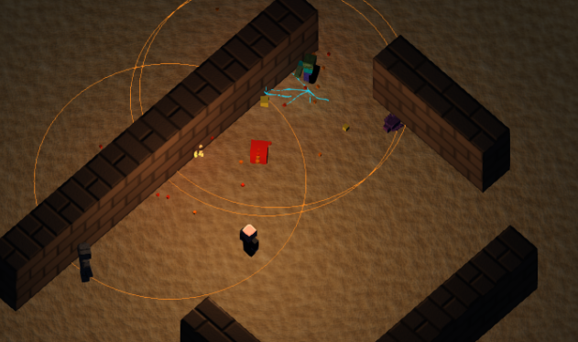
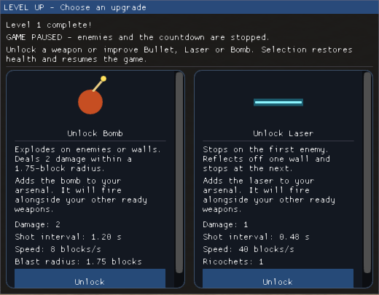
VOXEL ARENA / MEMBER A
Survive. Upgrade. Repeat.
Choose. Heal. Resume.
MOVE / AIM / FIRE / COLLECT
180 s
SURVIVE
5 HP
PLAYER HEALTH
Up to 2
UPGRADE CHOICES
XINGYU YANG · COMP9415
GAMEPLAY / 02
Notes:
Players move in eight directions, aim with the mouse and collect experience. Level-up pauses the action and offers up to two choices: upgrade, evolve or unlock a weapon. Each accepted choice restores full health. Owned weapons fire independently. Victory and defeat screens explain the outcome and allow a restart.

Slide 3
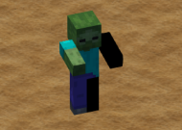
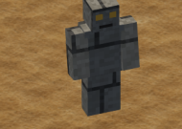
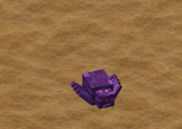
VOXEL ARENA / MEMBER A
Three enemies. Different pressures.
Zombie
4 HP
Golem
14 HP
Spider
3 HP
BASELINE
SLOW / DOUBLE DAMAGE
SMALL / FAST
6 blocks
24 enemies
0.35 s
SAFE SPAWN CLEARANCE
MAP-WIDE CAP
BLOCKED → REPLAN
XINGYU YANG · COMP9415
ENCOUNTERS / 03
Notes:
Zombies are the baseline. Golems have fourteen health, double contact damage and larger experience drops, but move slowly. Spiders have three health and move faster, while remaining slower than the player. Spawning keeps six blocks of body clearance and caps enemies at twenty-four. Committed routes and delayed replanning handle corners and congestion.

Slide 4
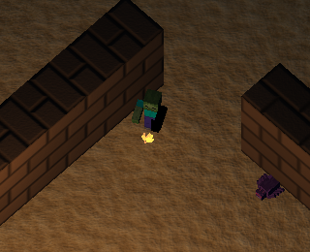
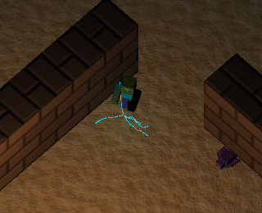
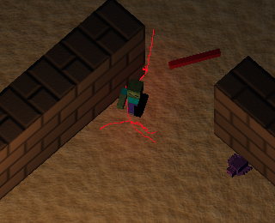
VOXEL ARENA / MEMBER A
Readable hits. Distinct weapons.
Bullet
Laser
Evolved Laser
WARM DEBRIS
CYAN ELECTRICAL ARCS
RED ELECTRICAL ARCS
CONTACT EVENTS → BOUNDED PARTICLES → LOCAL NIGHT GLOW
XINGYU YANG · COMP9415
HIT EFFECTS / 04
Notes:
Bullets produce warm debris. Lasers produce branching cyan electrical arcs, changing to red after evolution. Enemy and wall contacts share the same event path. Swept collision checks prevent fast projectiles passing through obstacles. A separate visual random generator keeps particles independent of spawning and damage. Instanced rendering and bounded buffers control the workload.

Slide 5
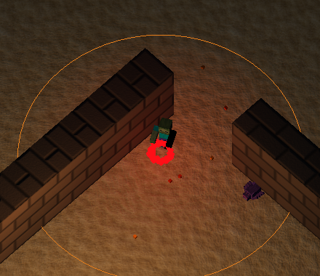
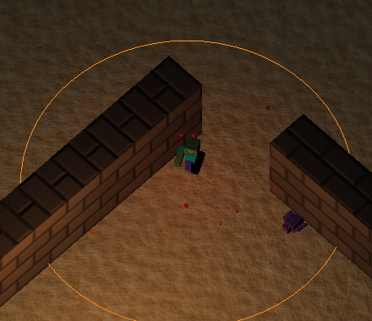
VOXEL ARENA / MEMBER A
An explosion that keeps moving.
3 seconds
BURNING AREA
Rise + rotate
01 RADIAL BURST
02 RISING VORTEX
Four-spark flight trail
Night-local lighting
64 particles
10 rotating fire particles
VISUALS PAUSE WITH GAMEPLAY · DAMAGE REMAINS IN THE SIMULATION
XINGYU YANG · COMP9415
BOMB VORTEX / 05
Notes:
The evolved bomb leaves four sparks in flight, then sends sixty-four particles outward on impact. Its three-second burning area shows ten rising fire particles rotating around the centre. Weak local lights improve night visibility. Visuals pause with gameplay and clear on restart, independently of damage. Together, these systems complete the survival loop. Thank you.

