Slide 1
MLOPS FINAL PROJECT · PHASE 2
Customer Churn
Prediction
An end-to-end MLOps pipeline — from raw data to a deployed,
monitored, self-retraining model in production.
MAI201NAA.06381.2264
Final presentation · Solo submission · August 2026

Slide 2
OVERVIEW
What we'll cover
01
Problem & objective
02
Dataset
Why churn prediction, and what the course project demonstrates
Synthetic data, schema, and why it was generated this way
03
System architecture
04
Experiment tracking
How every MLOps component connects end to end
Baseline vs. two experiments in MLflow, and model selection
05
Serving, CI/CD & monitoring
06
Model card, limitations & demo
FastAPI, Docker, GitHub Actions, and drift-triggered retraining
Honest assessment, and the live system
Overview
MAI201NAA.06381.2264
1

Slide 3
THE BUSINESS PROBLEM
Problem & objective
Telecom companies lose recurring revenue every time a customer churns — retention teams need to know who is at risk before they leave, not after.
Objective: predict each customer's churn probability from account, billing, and service-usage data so retention efforts can be prioritized.
Course objective: build the full MLOps lifecycle around this model — data versioning, experiment tracking, containerized serving, CI/CD, and automated drift monitoring — not just a notebook that trains once.
38.7%
baseline churn rate in the training data
7,043
customer records used to train and evaluate the model
3 phases
team formation -> pipeline -> deployment & monitoring
Problem & objective
MAI201NAA.06381.2264
2

Slide 4
DATA FOUNDATION
Dataset
Synthetic dataset mimicking IBM/Kaggle "Telco Customer Churn" — generated because this build environment has no direct internet access to Kaggle. Same schema, same size (7,043 rows x 21 columns).
21 columns = customerID + 19 predictive features + the Churn label. After dropping the ID and separating the label, the model trains on exactly 19 features — the number referenced everywhere else in this project (MLflow, the API schema, drift monitoring).
The Churn label is not random noise: it's generated from a logistic function over realistic churn drivers (contract type, tenure, internet service, tech support, payment method, monthly charges), so the pipeline has genuine signal to learn.
80/20 stratified train/test split. Label encoding for categoricals (documented ordinal-assumption limitation for the Logistic Regression baseline). Median imputation on TotalCharges — the one column with missing values in the real dataset (11 rows); this synthetic version has none, but the step runs regardless for compatibility.
Dataset
MAI201NAA.06381.2264
3

Slide 5
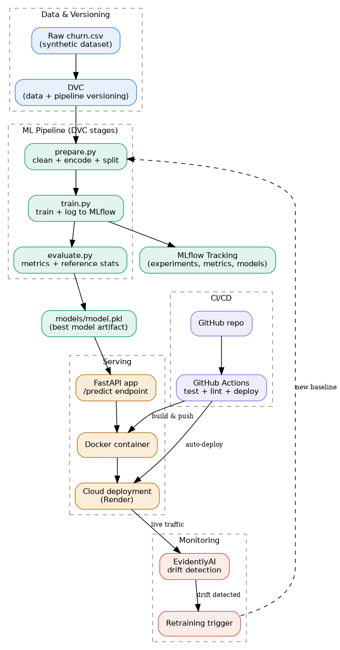
HOW IT ALL CONNECTS
System architecture
Data (DVC)
Pipeline (prepare/train/evaluate)
MLflow tracking
FastAPI + Docker
CI/CD
Cloud (Render)
Drift monitoring
Retrain -> auto-redeploy
System architecture
MAI201NAA.06381.2264
4

Slide 6
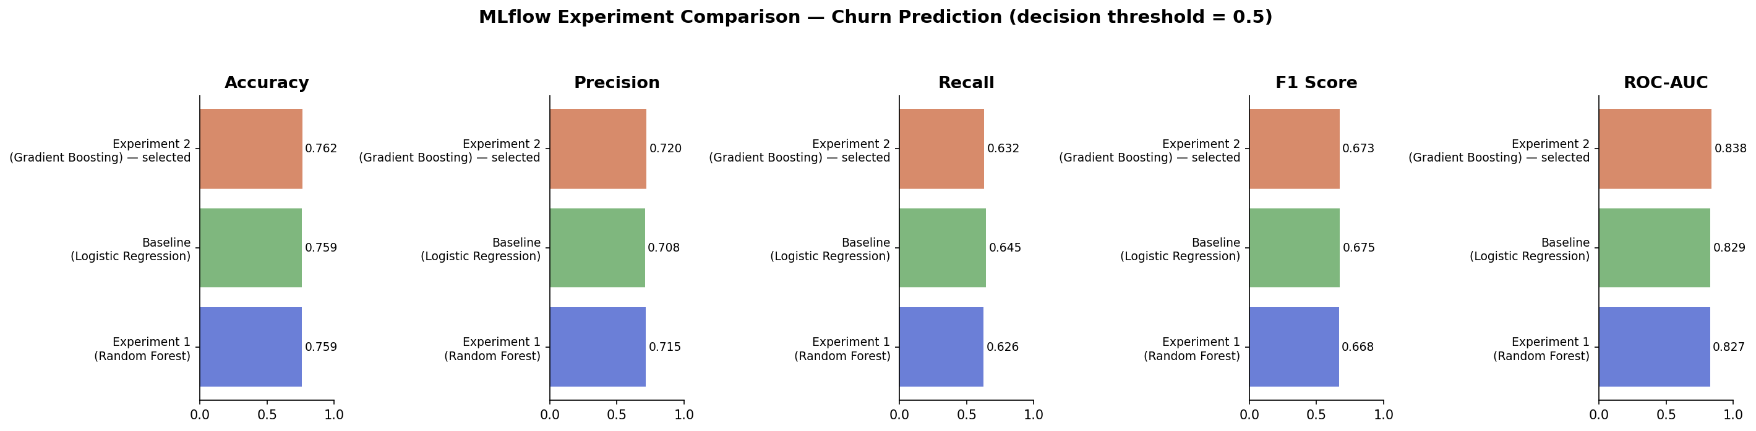
MODEL SELECTION
Experiment tracking (MLflow)
Selected: Gradient Boosting (n_estimators=150, learning_rate=0.05, max_depth=3) — highest ROC-AUC (0.838)
All 5 metrics computed at decision threshold = 0.5. ROC-AUC (threshold-independent) is the model-selection metric because the retention team ranks customers by risk rather than acting on a fixed cutoff.
Recall is tracked alongside precision because missing an actual churner (false negative) costs more than one unnecessary retention call (false positive) — a production system could lower the threshold below 0.5 to trade precision for recall without changing which model wins on ROC-AUC.
Experiment tracking
MAI201NAA.06381.2264
5

Slide 7
FROM MODEL TO ENDPOINT
Serving & deployment
Model served through a FastAPI app exposing /predict, /health, and /model-info.
A Pydantic model validates the full request against all 19 required fields (types, allowed categories, numeric ranges) before prediction — the JSON shown here is truncated for slide space, not what the API actually accepts.
Packaged into a Docker image (python:3.11-slim base, health-checked).
Deployed to Render, triggered automatically by GitHub Actions on every push to main.
5 automated pytest tests cover valid predictions, input validation, and health checks.
POST /predict (all 19 fields required)
{
"gender": "Female", "SeniorCitizen": 0,
"Partner": "No", "Dependents": "No",
"tenure": 5, "PhoneService": "Yes",
"MultipleLines": "No",
"InternetService": "Fiber optic",
"OnlineSecurity": "No", "OnlineBackup": "No",
"DeviceProtection": "No", "TechSupport": "No",
"StreamingTV": "No", "StreamingMovies": "No",
"Contract": "Month-to-month",
"PaperlessBilling": "Yes",
"PaymentMethod": "Electronic check",
"MonthlyCharges": 85.0, "TotalCharges": 425.0
}
Response
{ "churn_prediction": "Yes", "churn_probability": 0.932,
"model_version": "gradient_boosting_v1" }
Serving & deployment
MAI201NAA.06381.2264
6

Slide 8
AUTOMATION
CI/CD pipeline (GitHub Actions)
1
2
3
4
Lint & test
Build & push
Deploy
Monitor & retrain
→
→
→
flake8 + pytest on every push/PR
Docker image built and pushed to registry
Render deploy hook triggered automatically
Daily drift check; if triggered, commits new model and redeploys automatically (separate job, no manual step)
Workflow file: .github/workflows/ci-cd.yml — triggers on push to main, pull requests, and a daily 06:00 UTC schedule.
If drift is detected, retrain.py's commit is deliberately NOT tagged [skip ci] — it flows into a redeploy-after-retrain job that rebuilds the image and re-hits the Render deploy hook automatically.
CI/CD pipeline
MAI201NAA.06381.2264
7

Slide 9
STAYING ACCURATE IN PRODUCTION
Monitoring & drift detection
EvidentlyAI compares live production data against the training-time reference distribution, feature by feature.
Simulated a realistic drift scenario for the demo: a marketing push shifted new sign-ups toward shorter tenure and higher monthly charges.
Result: 3 of 19 features drifted (15.8% drift share) — exceeded the 15% threshold, so retraining was flagged automatically.
monitoring/retrain.py backs up the current model, then re-runs the DVC pipeline to produce a fresh one; the CI/CD pipeline then redeploys it (see previous slide).
3 / 19
features drifted in the simulated batch
15.8%
drift share — above the 15% retrain threshold
Auto
retraining + redeploy, no manual intervention
Monitoring & drift detection
MAI201NAA.06381.2264
8

Slide 10
HONEST ASSESSMENT
Model card & limitations
Gradient Boosting @ threshold=0.5 — Accuracy 0.762, Precision 0.720, Recall 0.632, F1 0.673, ROC-AUC 0.838 on held-out test data.
Selected on ROC-AUC (ranking quality) because the model ranks customers by risk for a capacity-limited retention team; precision/recall/F1 are reported at the standard 0.5 threshold for interpretability.
Known limitations
Trained on synthetic data — never seen real customer behavior.
No fairness/bias audit across demographic groups yet.
Label encoding creates an ordinal assumption for the Logistic Regression baseline (documented, not hidden).
Class imbalance (38.7% churn) affects recall on the minority class.
Model card & limitations
MAI201NAA.06381.2264
9

Slide 11
LIVE DEMO & REPOSITORY
Let's see it running
Live API
[public Render URL after deployment]
GitHub repository
[repo URL]
Demo flow
submit a customer profile to /predict -> inspect response -> show MLflow UI -> show drift report
Thank you — questions welcome.
MAI201NAA.06381.2264 · Project Phase 2 final presentation

