Slide 1


Team 38
Arnav Sharma
Sai Praneeth
Somay Jain
Sri Harsha
Notes:
10/15/12
10/15/12

Slide 2
Problem Statement
Build a web-based animation tool to teach basic arithmetic.
Should also work as a stand alone android application.
Notes:
10/15/12
10/15/12

Slide 3
Our Clients
Dr. Suresh Purini
Dr. Sudhakar Puttagunta
.
Notes:
10/15/12
10/15/12

Slide 4


Choose between
Illiustration and Exercise
Notes:
10/15/12
10/15/12

Slide 5
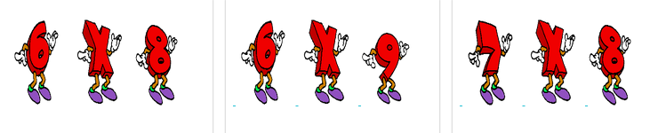
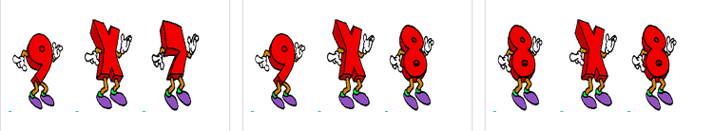
Select The Multiplication
Notes:
10/15/12
10/15/12

Slide 6


Select an Image from Gallery
Notes:
10/15/12
10/15/12

Slide 7
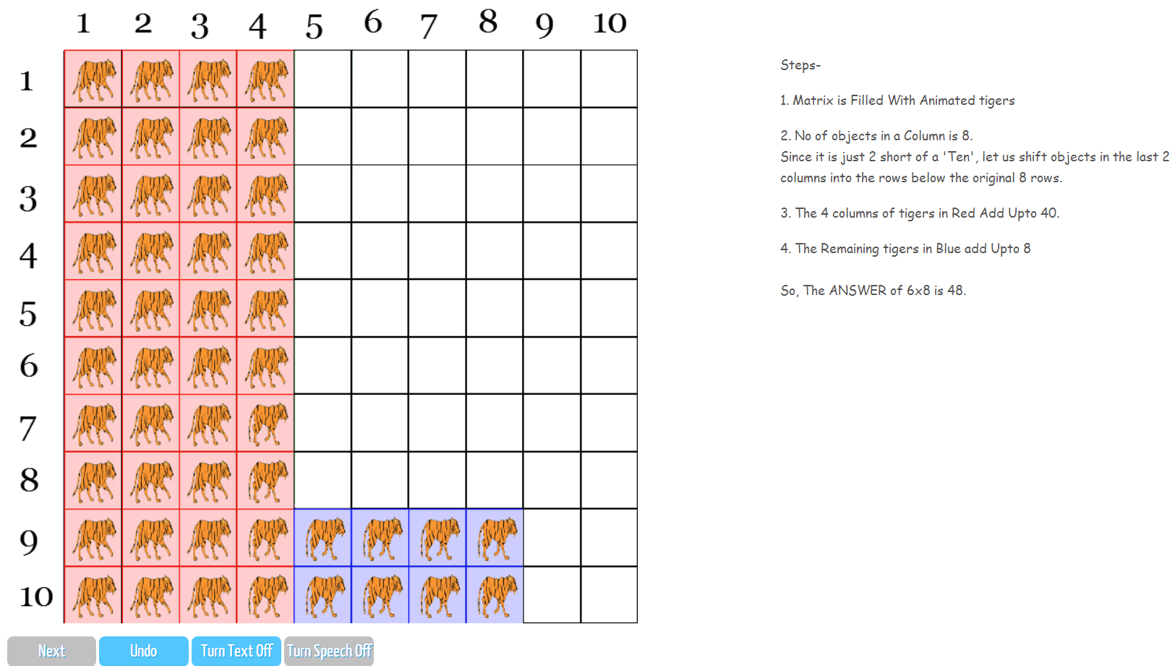
Illustration
Notes:
10/15/12
10/15/12

Slide 8
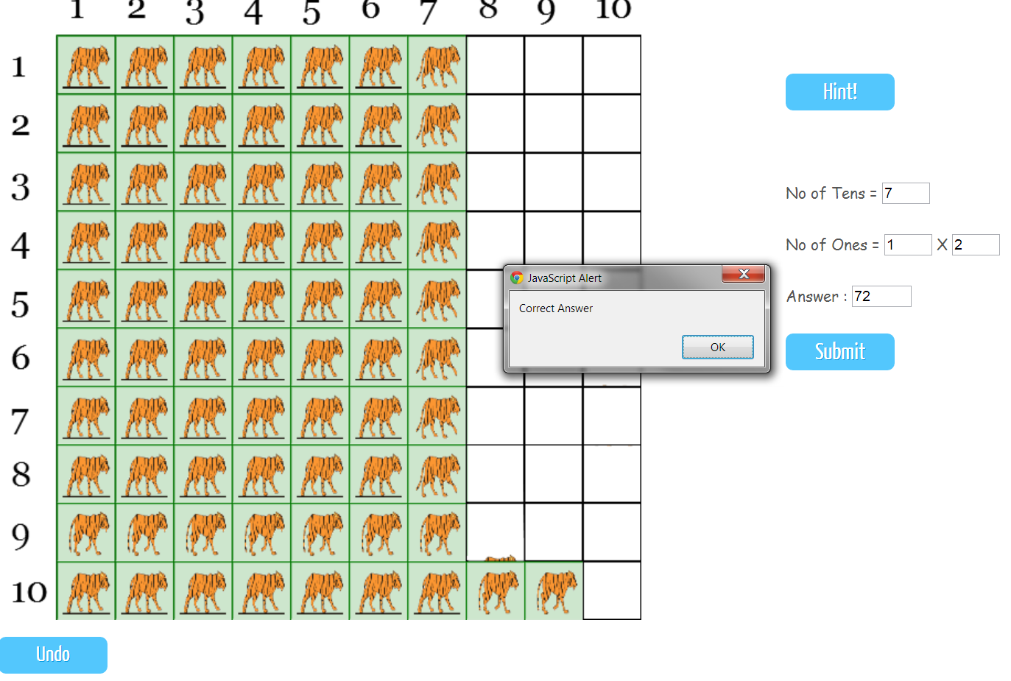
Exercise
Notes:
10/15/12
10/15/12

Slide 9
Demonstration.......
Notes:
10/15/12
10/15/12

Slide 10
Thank You…..
Notes:
10/15/12
10/15/12

