Slide 1
From Coupa to Zip
Modernizing Vendor Onboarding & Procurement Orchestration
Briefing for Procurement & FP&A Teams
Prepared by: Procurement Transformation Office

Slide 2
Why we are deprecating Coupa
Coupa has served us, but it no longer fits how we buy today
Where Coupa is holding us back
What we need instead
• Heavy, IT-dependent configuration — every workflow change is a project
• Low employee adoption: requesters bypass the system, creating maverick spend
• Fragmented intake — separate tools for legal, security, finance reviews
• Manual vendor onboarding with limited automated risk checks
• Limited visibility into request status for FP&A and budget owners
• Total cost of ownership (license + admin) growing faster than value
• A single, intuitive front door for every purchase request
• No-code workflows owned by Procurement, not IT
• AI-powered vendor risk, compliance and data validation
• Real-time spend visibility for FP&A and budget owners
• Native integrations with our ERP, contract and AP systems
• Faster cycle times so the business stops working around us
Procurement Transformation | Coupa → Zip
2

Slide 3

Why Zip
The AI-powered procurement orchestration platform
What Zip gives us
• Single intake portal — one place for any request, from any team
• No-code workflow engine owned by Procurement
• AI agents that pre-screen suppliers, contracts and risk
• 1.2M vendors managed and 6M approvals orchestrated on the platform
• Native ERP, contract and AP integrations — no double entry
• Trusted by Lyft, Snowflake, Reddit, Sephora, Canva and Northwestern Mutual
85%
98%
2x
50%+
Faster onboarding cycle time
Supplier portal completion rate
Supplier risk coverage
Reduction in approval cycle time
Procurement Transformation | Coupa → Zip
3

Slide 4
Coupa vs. Zip — at a glance
Dimension
Coupa (today)
Zip (target)
Intake experience
Multiple forms, email, Slack workarounds
Single AI-guided intake portal
Workflow changes
IT ticket, weeks of lead time
No-code, owned by Procurement
Vendor onboarding
Manual data collection & checks
AI agents auto-collect & validate
Risk & compliance
Bolt-on tools, manual reviews
Built-in TIN, VAT, OFAC, D&B, bank checks
FP&A visibility
Lagging reports, limited drill-down
Real-time spend insights & dashboards
Adoption
Low — requesters bypass the tool
High — guided, self-service for everyone
Procurement Transformation | Coupa → Zip
4

Slide 5
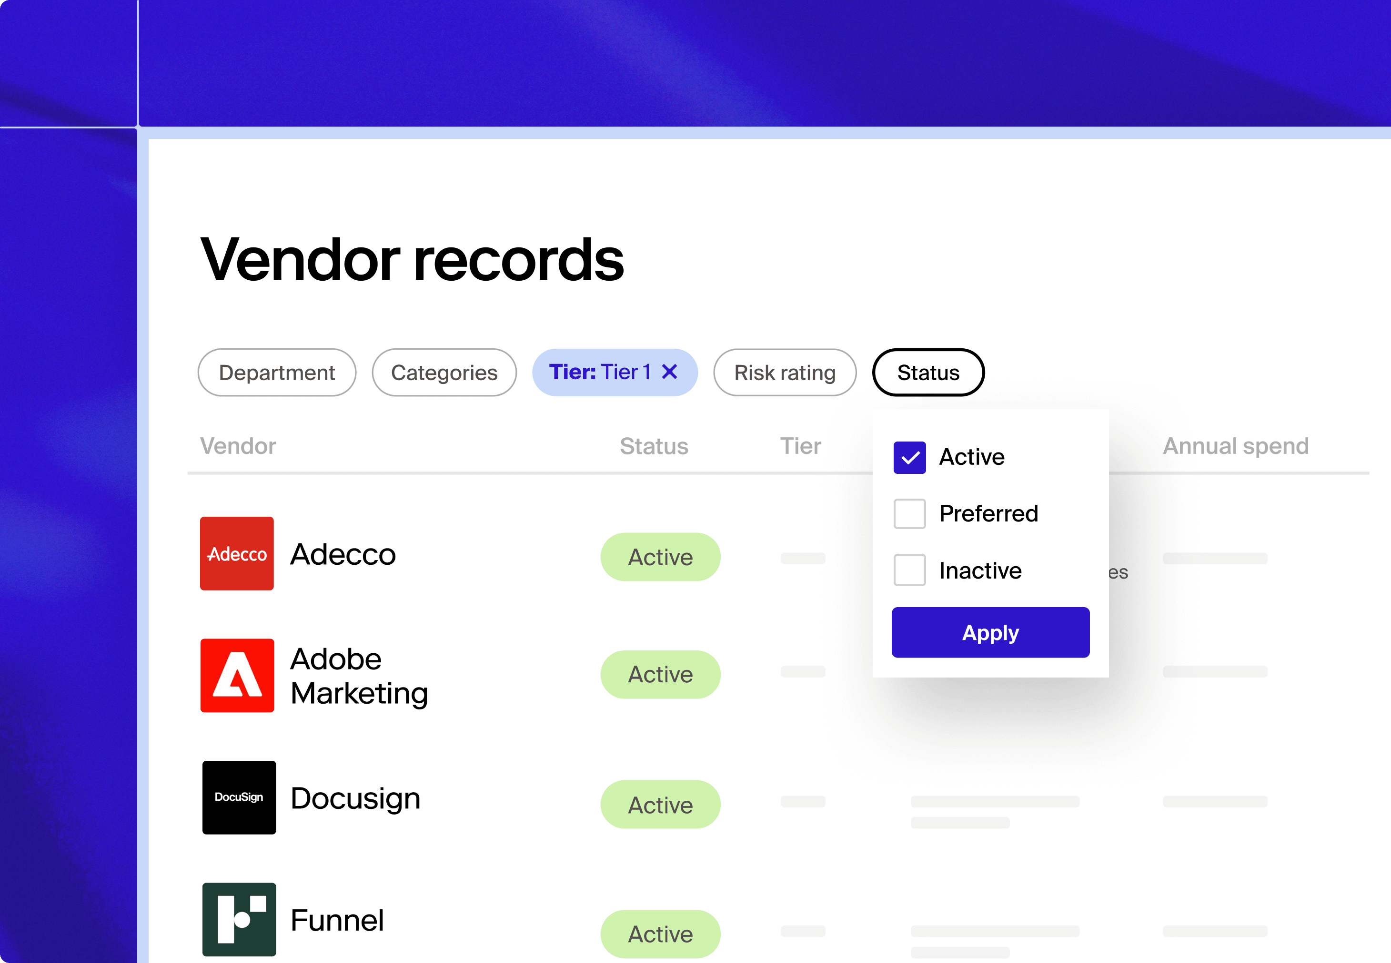
Vendor onboarding in Zip
One guided journey — from request to ERP-ready supplier
1. Intake request
2. Risk & compliance
3. Cross-functional review
4. Contract & terms
5. ERP sync
Each step is automated and tracked. Requesters get a single status view; Procurement, Legal, Security, IT and FP&A reviewers are pulled in only when their input is needed. Suppliers complete every requirement through a single branded portal — no email back-and-forth.
Procurement Transformation | Coupa → Zip
5

Slide 6
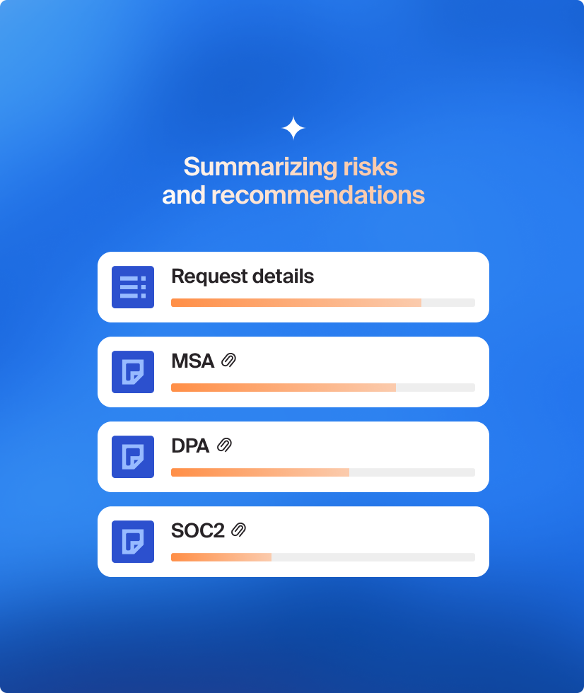
Step 1 — Intake: a single front door
Requesters describe what they need; Zip figures out the rest
• Guided, conversational intake form — no procurement jargon
• AI suggests the right category, owner and reviewers automatically
• Detects duplicate suppliers and existing contracts before a new request opens
• Pulls budget owner and GL coding from the ERP at the point of request
• Auto-routes to Procurement, Legal, Security, IT, Privacy and FP&A in parallel
• Requester sees a single status timeline end-to-end
Zip Procurement Precheck Agent screening incoming requests
Procurement Transformation | Coupa → Zip
6

Slide 7
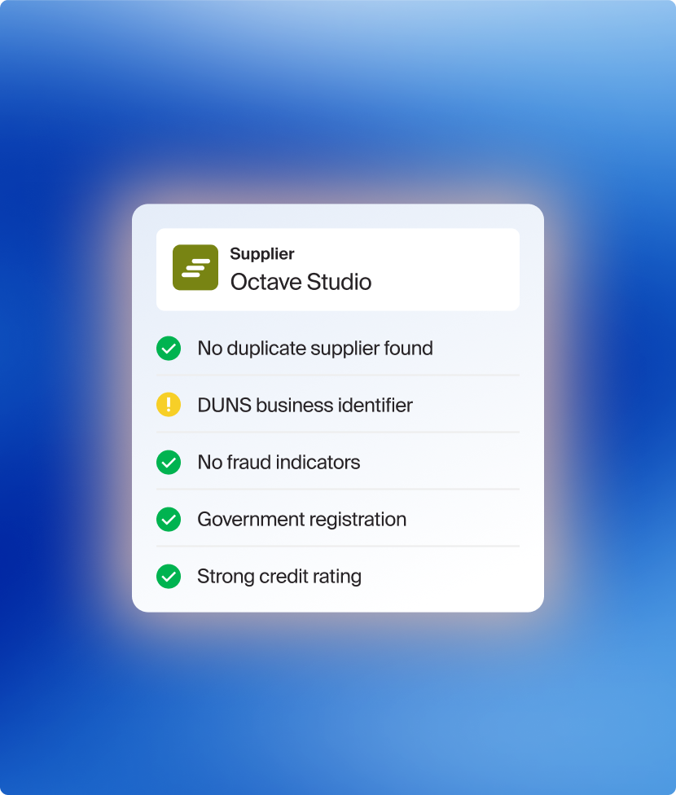
Step 2 — Supplier data collection via the Zip portal
The vendor does the work, in one place, once
What the supplier provides
• Legal entity, tax IDs (W-9 / W-8), VAT, addresses
• Banking details with automated bank verification
• Diversity certifications and ESG attestations
• Insurance certificates and SOC 2 / ISO documentation
• DPA, MSA, NDA — pulled in for Legal review
• Security questionnaires routed to the IT Security team
Zip Supplier 360 — a unified vendor record
Procurement Transformation | Coupa → Zip
7

Slide 8
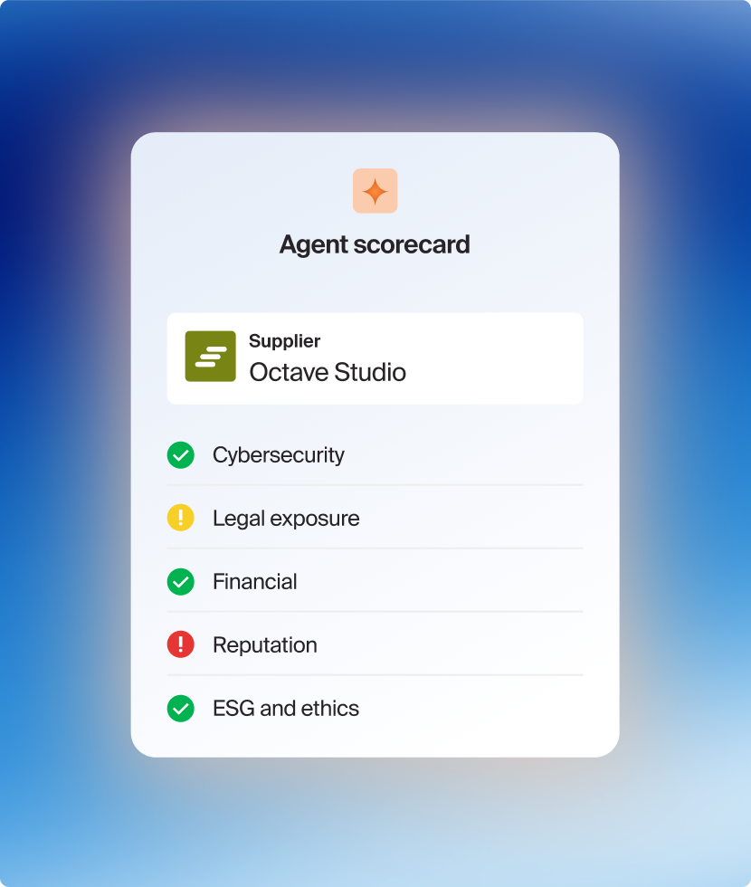
Step 3 — Automated risk & compliance checks
AI agents run the checks we used to do by hand
Supplier 360 Agent
Procurement Precheck Agent
Adverse Media Agent
Analyzes supplier documents, external data sources and news to surface risks before approval.
Reviews MSAs, DPAs, SOC 2 and other documents to flag legal and security risks early.
Scans public news and watchlists for any reputational or sanctions risk on the supplier.
Automated third-party checks at every onboarding:
TIN match
VAT validation
OFAC / sanctions
D&B financial
Bank account verification
Watchlist & adverse media
Procurement Transformation | Coupa → Zip
8

Slide 9
Steps 4 & 5 — Reviews, contracts & ERP sync
Parallel reviews, then a clean handoff to the systems of record
Step 4 — Cross-functional review
Step 5 — Contracts & ERP sync
• Procurement, Legal, Security, IT, Privacy, FP&A reviews in parallel
• Conditional steps — reviewers only see requests that need them
• Built-in SLAs, reminders, escalations — no chasing in Slack
• Audit trail captured automatically for SOX and internal audit
• FP&A sees committed spend before approval, not after
• Contract drafted and signed in our CLM, mirrored to the vendor record
• One-click supplier creation in the ERP — no rekeying, no duplicates
• Banking and tax data pushed to AP, ready for first invoice
• PO generated from the approved request, tied to the budget
• Status visible to requester, FP&A and Procurement in real time
Procurement Transformation | Coupa → Zip
9

Slide 10
What this means for your team
Procurement
FP&A
• Own and edit your own workflows — no IT ticket required
• Automated risk checks free up time for strategic sourcing
• Cleaner vendor master — one record, one source of truth
• Stronger compliance posture with built-in audit trail
• Better data to negotiate with — full spend & supplier history
• Real-time view of committed and pending spend by department
• Budget checks at request time — no surprises at month-end
• GL coding validated upstream, fewer journal entries to fix
• Cleaner accruals — POs and invoices reconcile automatically
• Self-serve dashboards for cost center owners
Procurement Transformation | Coupa → Zip
10

Slide 11
Migration plan
Phased rollout — minimal disruption to the business
Phase 1
Discover & Design
Weeks 1–4
Map current Coupa workflows, define future-state in Zip, identify integrations.
Phase 2
Configure & Integrate
Weeks 5–10
Build no-code workflows, connect ERP, CLM, SSO, AP and security tools.
Phase 3
Pilot
Weeks 11–14
Pilot with one BU. Migrate active vendors, train requesters, refine workflows.
Phase 4
Company-wide rollout
Weeks 15–20
Cut over remaining BUs, run Coupa in parallel for 30 days, then deprecate.
Phase 5
Deprecate Coupa
Week 21+
Read-only archive of Coupa data, terminate licenses, realize savings.
Procurement Transformation | Coupa → Zip
11

Slide 12
What we need from you
Procurement & FP&A as design partners
Procurement
FP&A
• Nominate workstream leads for sourcing, vendor mgmt and contracts
• Validate the future-state intake form and approval matrix
• Help clean the vendor master before migration
• Lead requester training and change communications
• Define the budget-check rules per cost center
• Confirm GL mapping and accrual logic with Accounting
• Review the new spend dashboards and KPIs
• Co-own quarterly business reviews on savings & cycle time
Next steps
1. Approve the migration plan · 2. Confirm workstream leads · 3. Kick-off workshop in 2 weeks
Procurement Transformation | Coupa → Zip
12

Slide 13
Faster. Smarter. Together.
Modern procurement, built for Procurement and FP&A.
Questions? procurement-transformation@company.com

