Slide 1
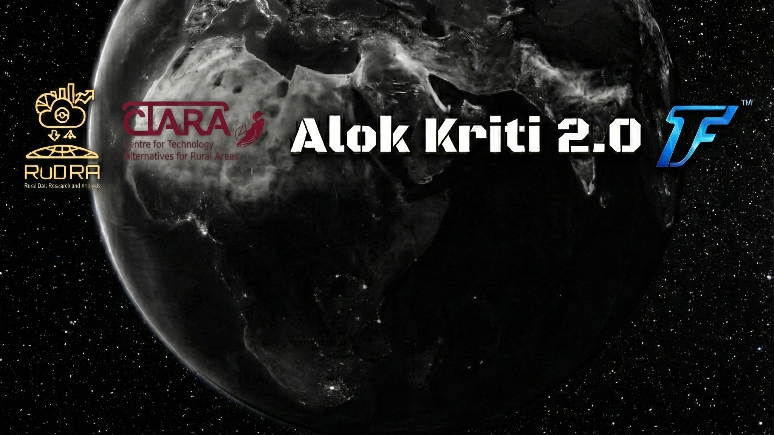
Under the supervision of Prof. Pennan Chinnasamy
Somdeep Kundu
22.12.2025
tinyurl.com/sktf25

Slide 2
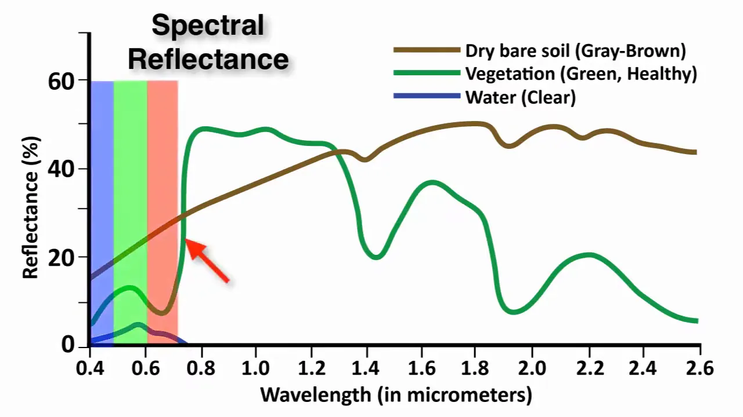
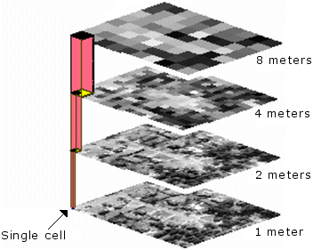

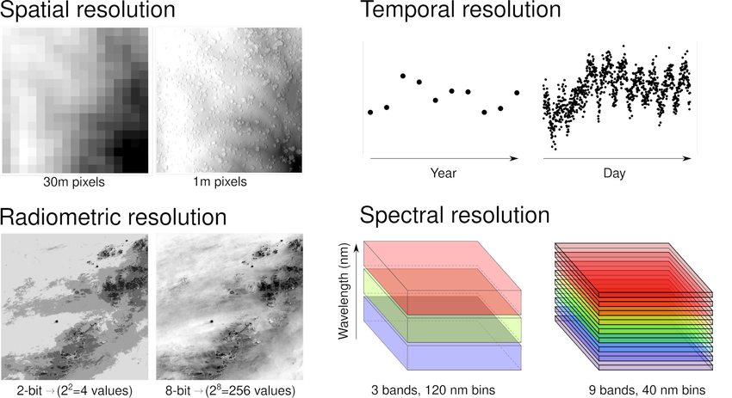
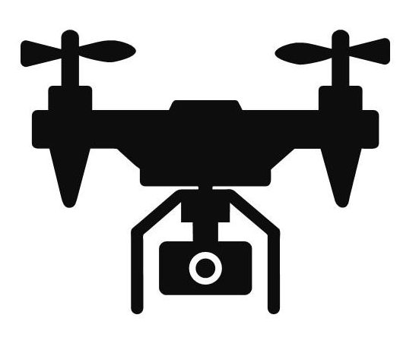
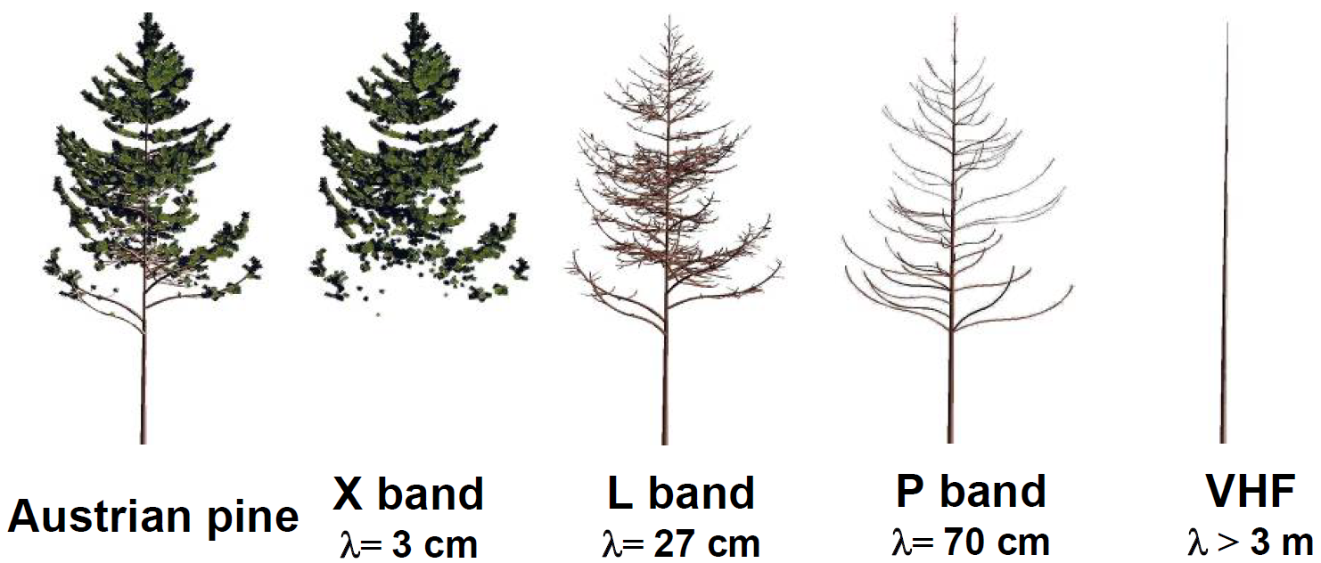
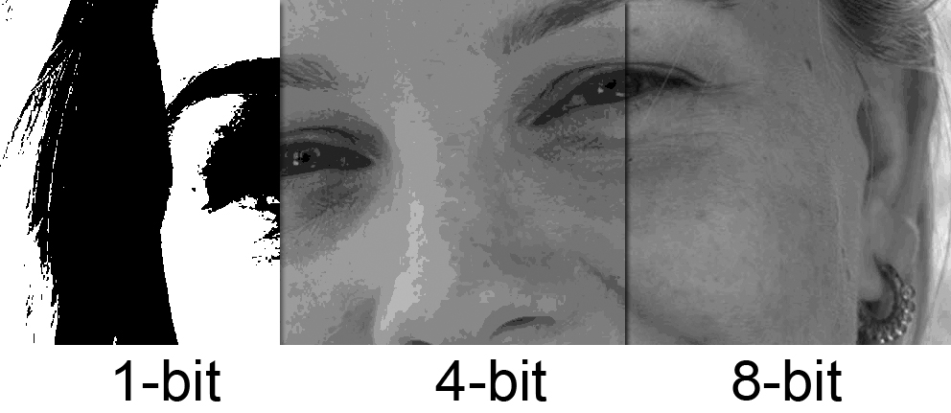
Earth Observation
Remote Sensing (RS): Philosophy of abstraction about an object without physical contact, using sensors on satellites or drones.
Passive RS: Uses natural energy (Sun) to measure indicators like NDVI for plant health.
Active RS: Uses its own energy source (e.g., Radar) to see through clouds and measure soil moisture or crop height.
http://www.intro2radar.com/
Spectral
Spatial
Temporal
Radiomatic
Resolutions in EO (Figs from ESRI)

Slide 3
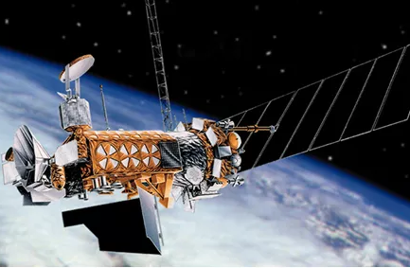
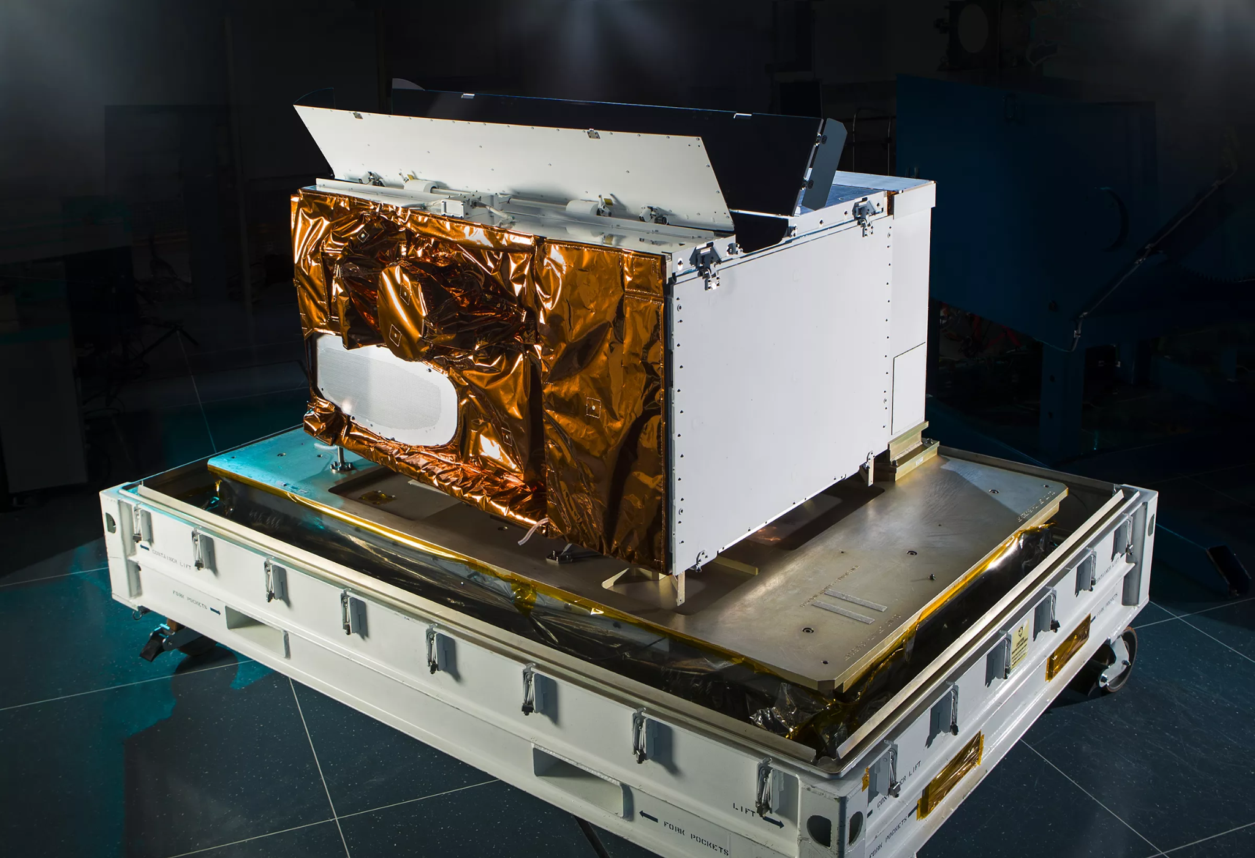



Data Used
DMSP (1992 – 2013)
OLS VNIR band
Defense Meteorological Satellite Program
VIIRS (2012 – present)
Visible Infrared Imaging Radiometer Suite
Raster Data Source: Harmonized Global NTL (Li, X et. al, 2020)
[Spatial Resolution: 1km x 1km, Temporal Resolution: Yearly Composite]

Slide 4

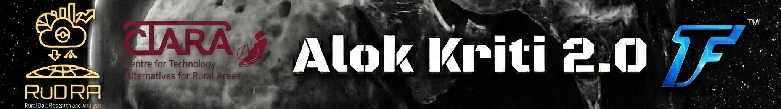
App Demonstrated in TechConnect 2025
Admin2 Level Web App
Change Detection Web App

Slide 5
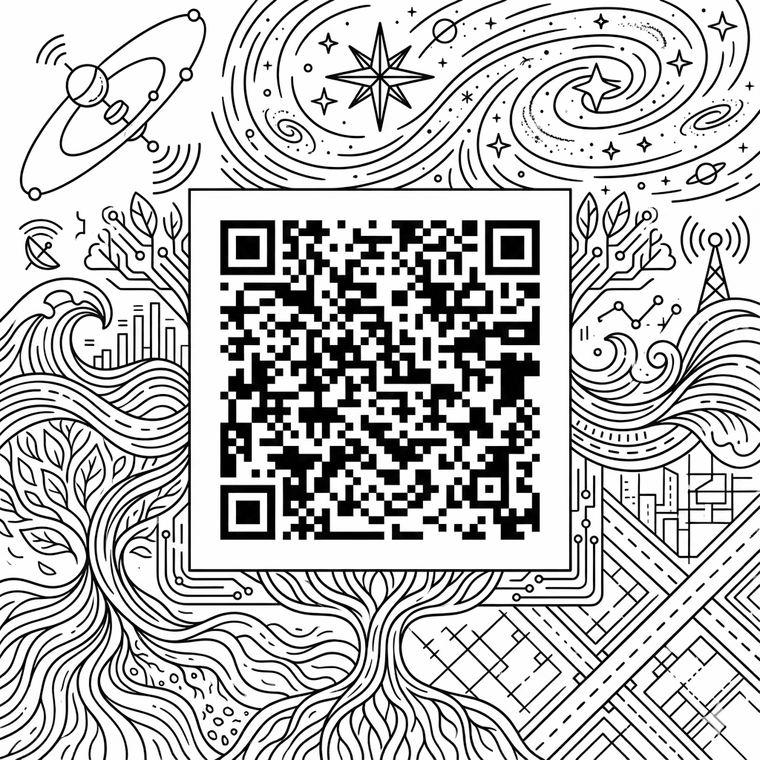




© Somdeep Kundu, IIT Bombay

Slide 6
Some other facts
Proville et al. (2017) found the strongest correlations between nighttime lights, electricity consumption, C02 emissions, and GDP, followed by population, CH4 emissions, N20 emissions, poverty and F-gas emissions.
Sun Synchronous Polar Orbiting Satellite
≈ 850km

Slide 7




Our lab
Our Center
Rural Data Research and Analysis (RuDRA) Lab
Centre for Technology Alternatives for Rural Areas (C-TARA)

Slide 8

My Research funding Agency
Rajiv Gandhi Science & Technology Commission (RGSTC)
Government of Maharashtra

Slide 9
Additional Resources
World Bank’s Open Night Lights tutorial
Extracting Nighttime Lights Statistics by Spatial Thoughts
EEFA Book Tutorial on Images
Night-time lights: A global, long term look at links to socio-economic trends Proville et al. (2017)
Live Coading Tutorial on my YouTube channel on Temporal Compositing. YouTube
Thank You

