Slide 1
AI-Powered Fraud Detection System
Real-Time Transaction Analysis & Chatbot

Slide 2
Fraud Statistics - The Growing Problem

Slide 3
Fraud Types Distribution (2024)

Slide 4
Case Study: Michael Chen - Transaction Analysis

Slide 5
Risk Score Distribution - Last 1000 Transactions

Slide 6
Model Accuracy Improvement Over Time

Slide 7
Risk Factor Contribution (Max Points)

Slide 8
Monthly Fraud Prevention Impact

Slide 9
System Response Time Distribution

Slide 10
Return on Investment (ROI) - 6 Month Period

Slide 11
Key Performance Metrics
96.2%
<1 sec
85%
Detection Accuracy
Analysis Time
Prevention Rate
$20.5M
720:1
99.9%
Fraud Prevented
ROI Ratio
Uptime
2.8%
1M+
24/7
False Positive Rate
Daily Transactions
Monitoring

Slide 12
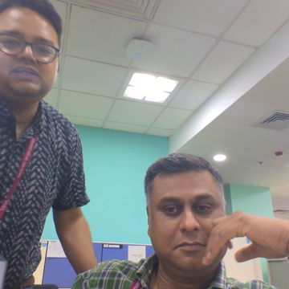
Ready to Protect Your Customers?
Next Steps:
1. Try the Live Demo at localhost:8501
2. Schedule Implementation Meeting
3. Start Pilot Program
4. Full Production Rollout
Thank You!

