Slide 1
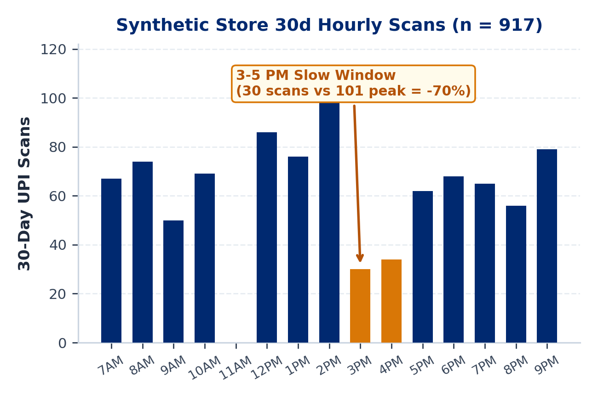
MAIN 1 / 5 : PROBLEM & OPPORTUNITY
PaytmAI VyaparVoice | Team SemiTechnical (Kevin Joseph)
1.64 Cr Merchants Pay for Subscriptions; Retention Stays Manual
Reported Paytm Scale: 1.64 Cr subscription merchants (+27L YoY), Rs 7.1L Cr GMV, Rs 2,648 Cr revenue (Reported: Paytm Q2 FY27 release, 26 Oct 2026).
Silent Repeat Churn: Small shops lose an estimated 25% to 35% of repeat buyers yearly without customer-level alerts (Assumption).
Dashboard Friction: Single-counter operators work 12+ hr shifts; SMB BI dashboards see <8% weekly usage (Assumption).
Slow Hours & Rush Prep: In our synthetic Bengaluru ledger, 3 to 5 PM scans fall 70% below peak while weekend rushes risk stockouts.
PaytmAI VyaparVoice (Track 1)
8:30 PM closing-time voice retention & ops copilot for Soundbox + Paytm for Business.
Team SemiTechnical | Kevin Joseph
Paytm Build for India AI Hackathon (Bengaluru Track 1) | Traced to results/slide_numbers.md (Paytm Q2 FY27)
Main 1 / 5 (Slide 1 / 16)
Notes:
Good morning. I am Kevin Joseph from Team SemiTechnical, presenting PaytmAI VyaparVoice for Track 1, Merchant Growth AI. In its Q2 FY27 earnings release on 26 October 2026, Paytm reported 1.64 crore subscription-paying merchants, Rs 7.1 lakh crore in merchant GMV, and Rs 2,648 crore in operating revenue. Yet once a QR payment clears, Soundbox goes quiet: counter shopkeepers lack customer-level retention alerts and rarely open analytics dashboards. In our synthetic Bengaluru darshini ledger, afternoon scans between 3 and 5 PM also drop 70 percent below peak.

Slide 2

MAIN 2 / 5 : SOLUTION & LIVE DEMO
PaytmAI VyaparVoice | Team SemiTechnical (Kevin Joseph)
One 8:30 PM Voice Action, Governed by Deterministic SQL Rules
Plain Voice Brief: Speaks 8:30 PM brief in English, Kannada, or Hindi (KN/HI marked Draft; zero jargon).
Synthetic Store Slice: Sri Krishna Darshini (240 payers, 1,613 scans); flags 48 regulars silent 16 to 38d.
Policy & ITT Split: Filters to 40 DPDP & 14d-cooldown clear buyers: 32 nudged vs 8 silent control.
Passes vs Spend Stop: All 32 nudged get Rs 25 pass (Rs 800 face); hard stop at Rs 300 spend (>10% risk alert).
Zero LLM Math: SQLite computes every rupee and cap; per-visitor cloud sandboxes block paid calls.
TRY LIVE SANDBOX DEMO
https://paytmai-vyaparvoice
.onrender.com
Cloud Safeguards Active:
Isolated SQLite session per visitor.
Zero paid API calls on public URL.
Switch Merchant vs Technical View.
Paytm Build for India AI Hackathon (Bengaluru Track 1) | Traced to results/slide_numbers.md (Paytm Q2 FY27)
Main 2 / 5 (Slide 2 / 16)
Notes:
At 8:30 PM closing time, VyaparVoice delivers a plain-language brief with zero statistical jargon. On our seeded synthetic ledger of 240 payers and 1,613 scans, SQL filters 48 lapsed regulars down to 40 eligible buyers, holding 8 in silent control and issuing Rs 25 passes to all 32 nudged buyers, with an atomic Rs 300 hard stop on actual cashback spend and an upfront warning when cap-overrun risk exceeds 10 percent. Judges can scan the QR code to open our live Render deployment, where each visitor receives an isolated SQLite session.

Slide 3
MAIN 3 / 5 : ARCHITECTURE (BUILT VS PLANNED)
PaytmAI VyaparVoice | Team SemiTechnical (Kevin Joseph)
Deterministic Core & Keyless Caps Built; Rail Hooks Scoped
[BUILT IN STAGE 1] ITT Stats & Atomic Cap Engine: Fisher exact p, Wilson 95% CIs, allocation-ratio power, atomic BEGIN IMMEDIATE spend stop, 25-thread concurrency test.
[BUILT IN STAGE 1] Merchant Copy & Isolation: Merchant vs Technical View, banned-jargon lint, Evidence Grades A/B/C, per-visitor SQLite sandboxes, ADMIN_TOKEN gate.
[BUILT KEYLESS / PENDING LIVE] Sarvam & Caps: Keyless Bulbul TTS + Saaras STT adapter, mock-server selftest, SHA-256 audio cache, 15%/15% (30% max) fail-closed credit ledger.
[PRODUCTION PLAN] Paytm Ecosystem Hooks: Paytm QR dynamic coupon settlement, 4G Soundbox push audio, WhatsApp Cloud supplier POs, Postgres/Redis.
make preflight : PASS
25-Thread Lock : PASS
Cloud Sandbox : PASS
Zero leaked keys, render.yaml untouched, zero formatting errors, 21/21 QA battery green.
Simultaneous QR redemptions stop at exact Rs 300 cap; ITT lift invariant when cap binds.
PUBLIC_DEPLOY=true blocks paid APIs; concurrent visitors get isolated SQLite files.
Paytm Build for India AI Hackathon (Bengaluru Track 1) | Traced to results/slide_numbers.md (Paytm Q2 FY27)
Main 3 / 5 (Slide 3 / 16)
Notes:
Slide 3 separates verified code running in our repository today from pending live sponsor keys and production integrations. Stage 1 added exact Fisher and Wilson tests, unequal-allocation power math, atomic thread-safe spend stopping, banned-jargon copy linting, Evidence Grades A/B/C, visitor session isolation, and a mock-tested keyless Sarvam adapter capped at 30 percent of credits.

Slide 4
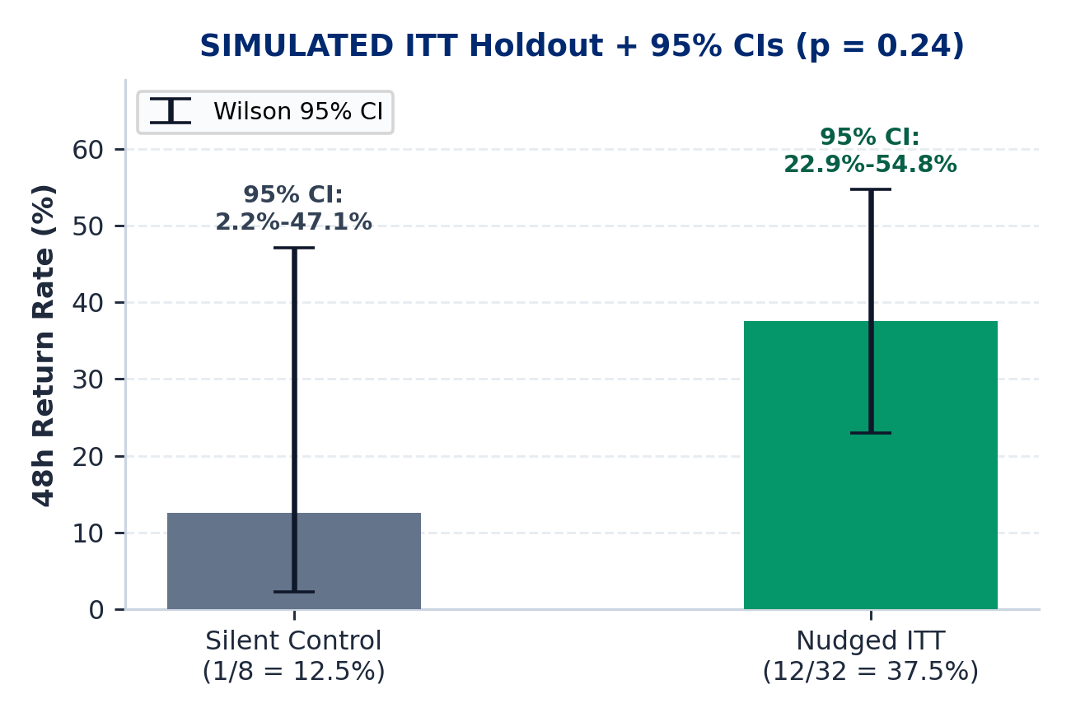
MAIN 4 / 5 : SIMULATED ITT PROOF & PROFIT MATH
PaytmAI VyaparVoice | Team SemiTechnical (Kevin Joseph)
Intention-to-Treat Holdout, Power & Merchant Net Profit
Simulated ITT Return: 12/32 nudged (37.5%) vs 1/8 control (12.5%); Fisher p = 0.24; simulated 12 equals the Rs 300 cap (0 refused).
80% Power Target: At 80/20 (40/wave): ~31 control + ~124 nudged (155 total, ~4 waves), or 46/arm at 50/50 split.
Sales vs Subsidy: 8 net visits = Rs 1,740 sales (5.8x sales/promo); 4 organic returners absorb Rs 100 cashback.
Merchant Net Profit: At 30% margin: Rs 522 GP (1.74x); +Rs 222 pre-fee (+74%), +Rs 91.50 after Rs 130.50 fee.
5% Fee Base: Rs 130.50 = 5% of all Rs 2,610 redeemed bills (12 bills, including organic returners).
CAP & BREAK-EVEN DISCLOSURE (SIMULATED)
Simulated 12 returners = 12 x Rs 25 = Rs 300 hard spend stop (42.2% overrun risk at p=37.5% triggers >10% alert; suggests Rs 400 cap).
Break-even shop margin: 17.2% pre-fee | 24.7% post-fee.
ITT Invariance Verified: Outcomes are drawn before applying the spend stop, so holdout lift stays unchanged if the cap binds.
Paytm Build for India AI Hackathon (Bengaluru Track 1) | Traced to results/slide_numbers.md (Paytm Q2 FY27)
Main 4 / 5 (Slide 4 / 16)
Notes:
Slide 4 presents our Intention-to-Treat holdout and profit waterfall. 12 of 32 nudged buyers return versus 1 of 8 in control, with Fisher exact p equals 0.24, where the simulated 12 returning buyers equals the 12-redemption Rs 300 cap. At our 80/20 allocation of 40 buyers per wave, 80 percent power requires about 31 control and 124 nudged buyers, or 155 total across roughly 4 waves, compared to 46 per arm at a 50/50 split. At a 30 percent store margin, Rs 522 gross profit minus Rs 300 cashback leaves Rs 222 pre-fee, and Rs 91.50 after Paytm's Rs 130.50 5 percent fee levied on all Rs 2,610 redeemed bills including organic returners.

Slide 5
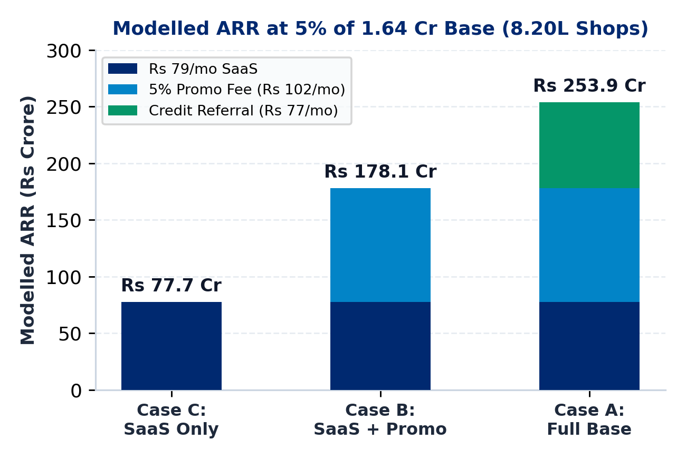
MAIN 5 / 5 : BUSINESS MODEL & PILOT PLAN
PaytmAI VyaparVoice | Team SemiTechnical (Kevin Joseph)
Three Revenue Cases (5% of 1.64 Cr Q2 Base = 8.20L Shops)
Case C (SaaS Only): Rs 79/mo Soundbox add-on x 8.20L shops = Rs 77.7 Cr ARR (zero promo/credit fees).
Case B (Core Excl. Credit): +Rs 102/mo steady promo fee (~0.78 waves/mo, Rs 2,040 redeemed bills) = Rs 178.1 Cr ARR.
Case A (Full Base): +Rs 77/mo credit referral (~7% loan pen. Assumption) = Rs 253.9 Cr ARR.
Unit COGS & Margin: Rs 48/mo cached (Rs 5 AI + Rs 43 msg; 81.4% margin) vs Rs 71.80 uncached TTS (72.2%).
Powered 4-Week Pilot: 50 Bengaluru shops; 4 waves/shop (~160 >= 155 needed at 80/20) + native KN/HI teach-back.
Q2 FY27 BASE & TTS CACHE NOTE
5% of 1.64 Cr subscription merchants (Reported: Paytm Q2 FY27, 26 Oct 2026) = 8.20L shops.
Bulbul v3 = Rs 27/mo uncached (9k chars); ~88% phrase cache hit yields Rs 3.20/mo TTS.
Fee Reconciliation: Single backlog wave = Rs 130.50 (5% of Rs 2,610); steady state = Rs 102/mo (~0.78 waves/mo as 14d pool refills).
Paytm Build for India AI Hackathon (Bengaluru Track 1) | Traced to results/slide_numbers.md (Paytm Q2 FY27)
Main 5 / 5 (Slide 5 / 16)
Notes:
Slide 5 updates our scale model to Paytm's Q2 FY27 base of 1.64 crore subscription-paying merchants: 5 percent adoption equals 8.20 lakh shops. SaaS alone at Rs 79 per month yields Rs 77.7 crore ARR; adding steady-state promo fees of Rs 102 per month, corresponding to 0.78 full waves per month or Rs 2,040 in total redeemed bills including organic returners, reaches Rs 178.1 crore ARR with zero lending assumptions; adding credit referrals reaches Rs 253.9 crore ARR. Pooling 4 weekly 80/20 waves per pilot store reaches 160 observations, exceeding the 155 required for 80 percent power.

Slide 6
APPENDIX A1 | TRACK 1: MERCHANT GROWTH AI (UPDATED TO PAYTM Q2 FY27)
PaytmAI VyaparVoice
Closing-Time Voice Growth, Operations & Retention Copilot
Built for Paytm's 1.64 Cr subscription-paying merchant deployments (Reported: Paytm Q2 FY27 release, 26 Oct 2026). Combines deterministic SQL segmentation, ITT spend-cap accounting, and plain-language voice briefings.
01 : Plain Voice + Button
02 : ITT Cap-vs-Holdout
03 : Profit & Power Audit
EN reviewed + KN/HI draft templates; banned-jargon lint
All 32 nudged get passes; Rs 300 hard spend stop & >10% risk alert
+Rs 222 pre-fee / +Rs 91.50 post-fee; 31C+124T (80/20) for 80% power
TEAM: SemiTechnical | Member: Kevin Joseph | Live: paytmai-vyaparvoice.onrender.com
Deck v2 Status: Stage 1 verified (stage1-ok); all Q2 FY27, ITT cap, power, and fee reconciliations applied.
Notes:
Appendix A1 summarizes the updated Q2 FY27 attribution, Intention-to-Treat cap accounting, and Stage 1 verification status.

Slide 7
APPENDIX A2 : PROBLEM & Q2 FY27 SOURCES
PaytmAI VyaparVoice | Team SemiTechnical (Kevin Joseph)
Problem Details, Primary Paytm Q2 FY27 Sources & Synthetic Persona
1. Silent Repeat Churn (25% to 35% Yearly - ASSUMPTION)
Merchants hear isolated payment alerts without customer-level retention tracking, losing repeat buyers before cashflow drops are noticed.
2. Dashboard Friction (<8% WAU - ASSUMPTION)
Counter-operated kirana, darshini, and pharmacy shops lack time to write prompts, export CSVs, or configure CRM rules.
3. Slow Hours & Rush Prep (SYNTHETIC STORE)
Reported (Paytm Q2 FY27, 26 Oct 2026): 1.64 Cr subscription merchants, Rs 7.1L Cr GMV, Rs 2,648 Cr rev, 8.8L FS customers, >50% repeat merchant loans.
Assumptions vs Synthetic: ~7% merchant loan pen. & Rs 90-100/mo Soundbox fee (Assumptions); Ramesh Rao store is synthetic (917 scans/30d).
In our 60-day synthetic Indiranagar ledger, 3 to 5 PM scans fall 70% below peak while weekend morning rushes risk staple stockouts.
Paytm Build for India AI Hackathon (Bengaluru Track 1) | Traced to results/slide_numbers.md (Paytm Q2 FY27)
Appendix A2 (Slide 7 / 16)
Notes:
Appendix A2 cites Paytm's 26 October 2026 Q2 FY27 earnings release directly and tags ~7 percent merchant loan penetration and Rs 90 to 100 monthly Soundbox rental as assumptions.

Slide 8
APPENDIX A3 : 3-PILLAR MAPPING
PaytmAI VyaparVoice | Team SemiTechnical (Kevin Joseph)
Track 1 Coverage: Growth, Operations, and Customer Recovery
PILLAR 1 : GROW BUSINESS
PILLAR 2 : MANAGE OPERATIONS
PILLAR 3 : SERVE CUSTOMERS
Retention & Slow-Hour Copilot
Rush Prep & Credit Signals
Privacy-Safe Service Recovery
Churn Detection (Built): SQL flags regulars silent 16+ days (16-38d in synthetic DB).
Slow-Hour Group (Built): Identifies 3-5 PM snack buyers (55 detected, 34 eligible).
ITT Spend Stop (Built): Issues passes to all nudged buyers; atomic cap stops spend.
QR Coupon Hook (Planned): Production hook into Paytm QR redemption rail.
Rush Alert (Simulated): Flags weekend morning demand spikes from scan history.
Supplier PO (Simulated): Dispatches pre-filled WhatsApp restock (+18L milk, +12kg batter).
Dual Ledgers (Built): Separates merchant cashback stop from 30% Sarvam credit cap.
Credit Signal (Planned): Feeds verified cashflow stability to partner NBFC funnel.
Delay Tagging (Simulated): Flags peak-hour queue delays and 3-star feedback tags.
Goodwill Pass (Simulated): 1-tap bilingual apology + Rs 30 next-scan coffee voucher.
Zero PII Leakage (Built): No raw phone numbers or payer IDs ever leave SQLite.
DPDP & Cooldown (Built): Hard opt-in filter and 14-day per-payer anti-spam cooldown.
Paytm Build for India AI Hackathon (Bengaluru Track 1) | Traced to results/slide_numbers.md (Paytm Q2 FY27)
Appendix A3 (Slide 8 / 16)
Notes:
Appendix A3 maps built Stage 1 modules, simulated MVP flows, and planned Paytm production hooks across Track 1's three pillars.

Slide 9
APPENDIX A4 : ITT WORKFLOW & SPEND STOP
PaytmAI VyaparVoice | Team SemiTechnical (Kevin Joseph)
Intention-to-Treat Cap-vs-Holdout Design (Decision 1)
STEP 1 : PASS ISSUANCE
STEP 2 : >10% RISK ALERT
STEP 3 : INDEPENDENT DRAW
STEP 4 : ITT EVALUATION
Filter 48 -> 40 eligible (80/20: 32 nudged, 8 control). Issue Rs 25 passes to ALL 32 nudged buyers (Rs 800 face exposure); never restrict reach to 12.
At approval, compute P(Binomial(32, p) > 12). At p=37.5%, overrun risk is 42.2% (>10% threshold): warn merchant and suggest Rs 400 cap (<=10% risk).
48h simulator draws customer return visits independently of max_budget first, then applies atomic BEGIN IMMEDIATE stop at Rs 300 (12 paid).
Record cap_reached & refused_redemptions (12 = cap, 0 refused in base run; 6 refused at Rs 150 cap). Analyse ITT (32 vs 8): holdout lift is unchanged when cap binds.
DISCLOSED TRADE-OFF & VERIFIED INVARIANCE TESTS
Face Exposure vs Hard Spend Stop: Issuing 32 passes creates Rs 800 face exposure while guaranteeing actual merchant spend stops at Rs 300; late redeemers after #12 are declined and logged in refused_redemptions.
Automated Concurrency & ITT Tests: 25-thread simultaneous scan test verifies budget_spent == Rs 300 (12 paid, 13 refused); multi-seed test proves ITT holdout comparison is identical whether cap is Rs 800 or Rs 100.
Paytm Build for India AI Hackathon (Bengaluru Track 1) | Traced to results/slide_numbers.md (Paytm Q2 FY27)
Appendix A4 (Slide 9 / 16)
Notes:
Appendix A4 documents our Intention-to-Treat cap-versus-holdout architecture: all 32 nudged buyers receive passes, overrun risk above 10 percent triggers a pre-approval warning and cap suggestion, outcomes are drawn independently before applying the atomic spend stop, and both concurrency and ITT invariance are verified by automated tests.

Slide 10
APPENDIX A5 : SYSTEM ARCHITECTURE
PaytmAI VyaparVoice | Team SemiTechnical (Kevin Joseph)
Component Status: Built in Stage 1 vs Pending vs Production Plan
TOUCHPOINTS
[BUILT] Merchant & Technical View UI
[BUILT] 1-Tap & Voice Chip Fallback
[PLANNED] Soundbox 4G Push & WhatsApp Cloud
VOICE & LLM
[BUILT] Browser Speech + SHA-256 Cache
[PENDING LIVE] Keyless Sarvam (30% Cap)
[STAGE 2] Keyless Groq Grounded English Q&A
CORE ENGINE
[BUILT] FastAPI + Per-Visitor Sessions
[BUILT] 5-Rule Guardrails + Jargon Lint
[BUILT] ITT Fisher/Wilson/Power + Profit ROI
DATA & OPS
[BUILT] Atomic SQLite Spend-Stop Ledger
[BUILT] Preflight + 25-Thread Stress Test
[PLANNED] PostgreSQL & Redis Cluster
Paytm Build for India AI Hackathon (Bengaluru Track 1) | Traced to results/slide_numbers.md (Paytm Q2 FY27)
Appendix A5 (Slide 10 / 16)
Notes:
Appendix A5 reflects all Stage 1 modules built and tested today, distinguishing them from pending live Sarvam activation and production infrastructure.

Slide 11
APPENDIX A6 : POSITIONING (USP)
PaytmAI VyaparVoice | Team SemiTechnical (Kevin Joseph)
Differentiation vs Manual Khata Apps and Generic Chatbots
Dimension | Manual BI / Khata Apps | Generic LLM Chatbots | PaytmAI VyaparVoice
Merchant UX | Charts & manual ledger entry | Requires typing business prompts | 8:30 PM plain voice brief + 1-tap button
Customer Graph | Incomplete manual phonebooks | No link to payment history | Paytm QR repeat-payer IDs (synthetic in MVP)
Financial Safety | Manual coupon rules | LLM can invent unsafe offers | Deterministic floor, atomic spend stop & >10% alert
Privacy (DPDP) | Raw phone lists exposed | Prompt data leakage risk | SQL opt-in filter; zero PII sent to voice/LLM
Causal Proof | Vanity message counts | No comparison group | 80/20 ITT holdout + Wilson CIs + net profit ROI
Paytm Build for India AI Hackathon (Bengaluru Track 1) | Traced to results/slide_numbers.md (Paytm Q2 FY27)
Appendix A6 (Slide 11 / 16)
Notes:
Appendix A6 compares VyaparVoice against manual dashboards and unconstrained LLM chatbots.

Slide 12
APPENDIX A7 : PILOT TARGETS & POWER
PaytmAI VyaparVoice | Team SemiTechnical (Kevin Joseph)
Hypothesized Pilot Targets vs Simulated ITT Metrics
MERCHANT METRICS (SIMULATED MVP & PILOT TARGETS)
Simulated Profit ROI: +Rs 222 pre-fee (+74%) / +Rs 91.50 post-fee at 30% margin (simulated 12 = Rs 300 cap).
Repeat Visit Target: +14% to +22% monthly repeat visits (PILOT TARGET - unvalidated).
Waste Reduction Target: -18% afternoon perishable loss (PILOT TARGET - unvalidated).
PAYTM ECOSYSTEM HYPOTHESES (PILOT TARGETS)
Device Retention: -35% Soundbox churn reduction (PILOT TARGET - unvalidated).
Store QR Share: +12% to +15% store Paytm QR GMV lift (PILOT TARGET - unvalidated).
Credit Funnel: Expand ~7% merchant loan pen. (ASSUMPTION) toward 15% (LONG-TERM TARGET).
1.74x
31C + 124T
Rs 5.00
Gross Profit / Promo
(30% Margin Sim.)
80/20 Power (155, ~4w)
46/arm at 50/50
Cached AI Cost/Mo
(Rs 28.80 Uncached)
Paytm Build for India AI Hackathon (Bengaluru Track 1) | Traced to results/slide_numbers.md (Paytm Q2 FY27)
Appendix A7 (Slide 12 / 16)
Notes:
Appendix A7 updates the power tile to show both 80/20 allocation (31 control and 124 nudged = 155 total, ~4 waves) and 50/50 even allocation (46 per arm), and labels ~7 percent loan penetration as an assumption.

Slide 13
APPENDIX A8 : UNIT ECONOMICS & FEE MATH
PaytmAI VyaparVoice | Team SemiTechnical (Kevin Joseph)
Q2 FY27 ARR Cases, Fee Reconciliation & TTS Cache Sensitivity
Stream 1 (SaaS - Rs 79/mo): Add-on to Soundbox (~Rs 90-100/mo rental ASSUMPTION) x 8.20L shops (5% of 1.64 Cr Q2 FY27 base) = Rs 77.7 Cr ARR.
Stream 2 (Promo Fee - Rs 102/mo): 5% fee on ALL redeemed bills incl. organic returners: 1 wave = Rs 130.50 (Rs 2,610 bills); steady state assumes ~0.78 waves/mo (Rs 2,040/mo bills) = Rs 102/mo (+Rs 100.4 Cr -> Rs 178.1 Cr ARR).
Stream 3 (Credit - Rs 77/mo): Amortized 1.5%-2.5% partner origination uplift (~7% loan pen. ASSUMPTION) -> +Rs 75.8 Cr (Rs 253.9 Cr ARR).
Cached COGS (Rs 48.00/mo): Rs 1.80 SLM + Rs 3.20 TTS (~88% phrase cache hit on Bulbul v3) + Rs 43 msg = 81.4% gross margin.
Uncached COGS (Rs 71.80/mo): Uncached Bulbul v3 (9k chars at Rs 30/10k = Rs 27 TTS) = 72.2% margin (39.2% cached margin on SaaS-only).
FEE & BASE RECONCILIATION
1. Fee Base: 5% applies to gross QR-redeemed promo bills including organic returners.
2. Cadence: Initial backlog wave yields Rs 130.50; steady replenishment (~0.78 waves/mo) yields Rs 102/mo.
3. Q2 FY27 Base: 5% x 1.64 Cr = 8.20L shops.
Paytm Build for India AI Hackathon (Bengaluru Track 1) | Traced to results/slide_numbers.md (Paytm Q2 FY27)
Appendix A8 (Slide 13 / 16)
Notes:
Appendix A8 explicitly reconciles the Rs 130.50 single-campaign fee on Slide 4 with the Rs 102 per month steady-state promo fee assumption and updates ARR to Paytm's 1.64 crore Q2 FY27 merchant base.

Slide 14
APPENDIX A9 : VALIDATION & ROLLOUT ROADMAP
From Stage-1 Verified MVP to Powered 50-Store Bengaluru Pilot
STAGE A : BUILT & TESTED (STAGE 1)
STAGE B : DAYS 1 TO 30 PILOT
STAGE C : PRODUCTION SCALE
Deterministic Core & Safeguards
Bengaluru 50-Store Validation
Paytm Ecosystem Integration
FastAPI + per-visitor SQLite sandboxes (240 payers, 1,613 scans)
ITT cap-vs-holdout, >10% alert, 25-thread concurrency & preflight
Keyless Sarvam mock selftest (30% cap) + banned-jargon lint
Complete 3-merchant native Kannada & Hindi teach-back review
Pool ~4 weekly 80/20 waves (~31C + ~124T = 155; or 46/arm at 50/50)
Advance only if net merchant profit post-fee & refusals has p < 0.05
Bind Paytm QR dynamic coupon settlement & 4G Soundbox push
Self-host compact intent models; keep >=88% audio phrase caching
Scale across 8.20L target stores (Rs 77.7 Cr to Rs 253.9 Cr ARR)
PaytmAI VyaparVoice | Team SemiTechnical (Kevin Joseph)
Appendix A9 (Slide 14 / 16) | Live Demo: https://paytmai-vyaparvoice.onrender.com
Notes:
Appendix A9 specifies our exact 80/20 power sample target of about 31 control and 124 nudged buyers across 4 waves, or 46 per arm at an even split.

Slide 15
APPENDIX A10 : DUAL SCORECARD & COPY LINT
PaytmAI VyaparVoice | Team SemiTechnical (Kevin Joseph)
Merchant Plain-Language View vs Technical Audit View (Task 14)
MERCHANT VIEW (ZERO JARGON - LINT VERIFIED)
TECHNICAL & AUDIT VIEW (ANALYST / JUDGE)
Plain Outcome Copy: Early check (run ~4 weekly waves to be sure): 12 of 32 customers with an offer came back vs 1 of 8 without.
Clear Spend Stop: Your 300 rupee limit was reached after 12 paid redemptions (0 extra declined in base run).
Estimated Shop Profit: At 30% shop margin, estimated profit is Rs 222 before Paytm fee (Rs 91.50 after 5% fee).
Draft Copy Honesty: Kannada & Hindi carry visible [DRAFT - UNREVIEWED] badges until 3-merchant teach-back sign-off.
ITT & Wilson 95% CIs: 37.5% [22.9%, 54.8%] vs 12.5% [2.2%, 47.1%]; two-sided Fisher exact p = 0.24.
Power Calculator: 80/20 split (r=4): 31C + 124T = 155 (~4 waves); 50/50 split (r=1): 46C + 46T = 92.
Cap Risk & Refusals: Face exposure Rs 800; P(X > 12 | p=0.375) = 42.2% (>10% alert -> suggests Rs 400 cap).
Banned Merchant Terms: Automated regex blocks cohort, holdout, p-value, Fisher, Wilson, ROI, DPDP, RFM, ITT.
GRADE A : OBSERVED LEDGER
GRADE B : SIMULATED ITT
GRADE C : ASSUMPTIONS
SQLite store counts (240 payers, 1,613 scans, 48 silent -> 40 eligible; synthetic seed 20261025).
Randomized 32 vs 8 split, independent outcome draw, Fisher p & Wilson CIs (simulated).
30% shop gross margin, 5% fee on redeemed bills, ~0.78 waves/mo steady cadence.
Paytm Build for India AI Hackathon (Bengaluru Track 1) | Traced to results/slide_numbers.md (Paytm Q2 FY27)
Appendix A10 (Slide 15 / 16)
Notes:
Appendix A10 demonstrates our Task 14 communication layer separating jargon-free merchant scorecards from full statistical audit metrics and grading every claim A, B, or C.

Slide 16
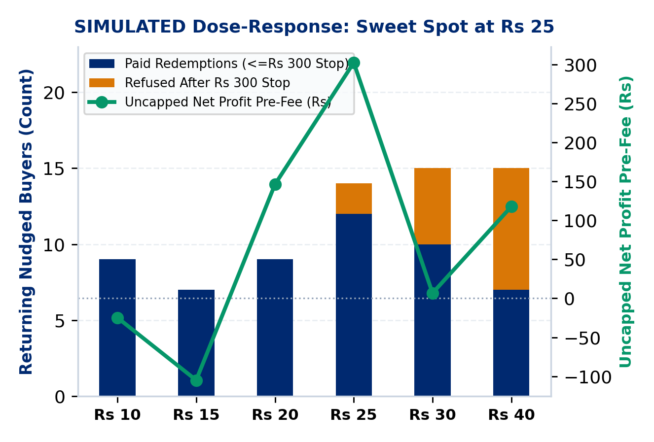
APPENDIX A11 : CAP LEDGERS & DOSE-RESPONSE
PaytmAI VyaparVoice | Team SemiTechnical (Kevin Joseph)
Merchant Spend Stop, Sarvam Credit Cap & Dose-Response Curve
Merchant Cashback Stop: Issues passes to all 32 nudged buyers; atomic SQLite lock stops spend at Rs 300 (12 paid) and records cap_reached + refused_redemptions.
Dose-Response Sweet Spot: In simulation, Rs 25 peaks uncapped profit: offers of Rs 30 to 40 erode uncapped net profit via organic subsidy AND trigger 5 to 8 cap refusals under a Rs 300 stop.
Shop Margin Break-Even: On CMP-WINBACK-01, store breaks even at 17.2% gross margin pre-fee and 24.7% post-5%-fee; 30% darshini margin nets +Rs 91.50 post-fee.
Sarvam 30% Credit Ledger: Separate JSON ledger caps TTS <=15% and STT <=15% (30% total of 500 sponsor credits = 150 max) and halts fail-closed on HTTP 402/429/5xx.
Public Cloud Lock: PUBLIC_DEPLOY=true (auto-enabled on Render) hard-blocks live paid calls while SHA-256 audio cache replays at 0 credits.
DUAL CAP SUMMARY (SIMULATED & BUILT)
1. Merchant Cap: Protects shopkeeper pocket (Rs 300 stop; >10% overrun warning).
2. Sponsor API Cap: Protects hackathon credits (<=15% TTS, <=15% STT, fail-closed).
Paytm Build for India AI Hackathon (Bengaluru Track 1) | Traced to results/slide_numbers.md (Paytm Q2 FY27)
Appendix A11 (Slide 16 / 16)
Notes:
Appendix A11 shows how our simulated dose-response curve interacts with the Rs 300 spend stop and contrasts the merchant rupee cap against our separate 30 percent Sarvam API credit ledger.

