Slide 1
PaytmAI VyaparVoice
Voice-delivered customer win-back copilot for neighbourhood shops
* Team SemiTechnical: Kevin Joseph | Track 1: Merchant Growth AI
* Live Demo: https://paytmai-vyaparvoice.onrender.com/
* GitHub: https://github.com/somebeing2/paytmai-vyaparvoice
Notes:
Hi, I am Kevin Joseph from Team SemiTechnical presenting PaytmAI VyaparVoice for Track 1, Merchant Growth AI. VyaparVoice helps neighbourhood darshinis and kiranas detect silent repeat buyers from QR payment history, launch a cashback offer with a hard rupee cap, hear briefings in Kannada, Hindi, or English, and measure extra visits against an 80/20 non-offer holdout group. All store metrics in this deck come from our deterministic 60-day synthetic ledger (Sri Krishna Darshini, seed 20261025). To our knowledge the standard Paytm Soundbox is speaker-based with no microphone; this is to be validated with Paytm, so spoken replies are proposed via the Paytm for Business app and demonstrated through the browser microphone.

Slide 2
Regular Customers Slip Away Quietly
Synthetic 60-day ledger: 175 repeat regulars of 240 buyers
48 Silent Regulars
Monthly Spend at Risk
70% Dead-Hour Drop
Unseen 16-38 days; 40 eligible after permission and cooldown.
Rs 4,920 (2 x Rs 205 x 12), possibly after a busy rush.
3-5 PM scans drop to 30 and 34 vs 101 at 2 PM.
Notes:
Neighbourhood shops lose regulars quietly because QR payment alerts arrive as raw rupee amounts with no churn warning, and owners avoid open-ended discounts that could wipe out thin margins. Reading directly from our synthetic 60-day store ledger (240 unique buyers, 175 repeat buyers with 3 or more scans, Rs 1,74,685 30-day sales across 917 scans): CMP-WINBACK-01 detects 48 evening regulars silent for 16 to 38 days, with 40 eligible after DPDP consent and a 14-day cooldown. OPS-CARE-02 flags 2 frequent regulars unseen for 8 days possibly after a busy rush, putting Rs 4,920 of historical monthly spend at risk (2 x Rs 205 x 12 visits, not guaranteed lift). CMP-DEADHOUR-02 spots a 70 percent scan drop between 3 and 5 PM (30 and 34 scans versus 101 at 2 PM).

Slide 3
Win-Back Copilot: Detect, Propose, Cap, Measure
1. Detect
2. Propose
3. Cap
4. Measure
Spot silent regulars
Rs 25 off Rs 150+
Hard Rs 300 stop
80/20 holdout check
BUILT
PROPOSED
* Voice out: Briefings, cap alerts, plain readout (KN/HI/EN).
* Screens: Merchant, Why?, and Technical views.
* Soundbox: Speaker-based, no mic (validate with Paytm).
* Paytm app: Voice replies (browser mic in demo).
Notes:
VyaparVoice runs a four-step loop: detect silent regulars from QR scan gaps, propose a policy-checked cashback pass (Rs 25 off Rs 150 or more, within the 22 percent discount limit), enforce a merchant-approved Rs 300 rupee cap with spoken 50, 80, and 100 percent alerts, and measure return visits against an 80/20 silent holdout. Voice in Kannada, Hindi, and English is the delivery layer so a shopkeeper never needs to read charts. To our knowledge the standard Paytm Soundbox is speaker-based with no microphone; this is to be validated with Paytm. Spoken briefings and alerts target the Soundbox speaker, while spoken replies and budget commands are proposed via the Paytm for Business app, with the browser microphone standing in during our live demo.

Slide 4
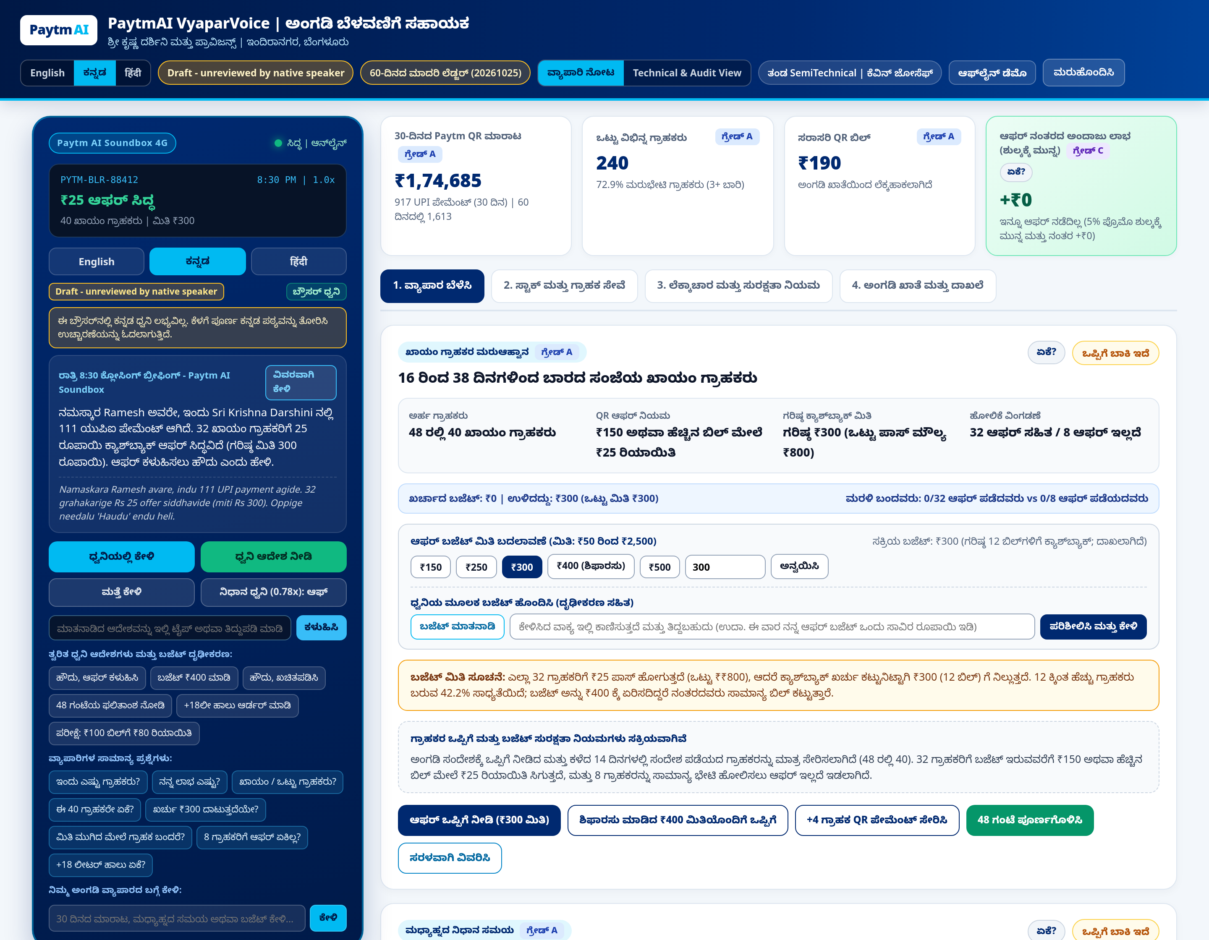
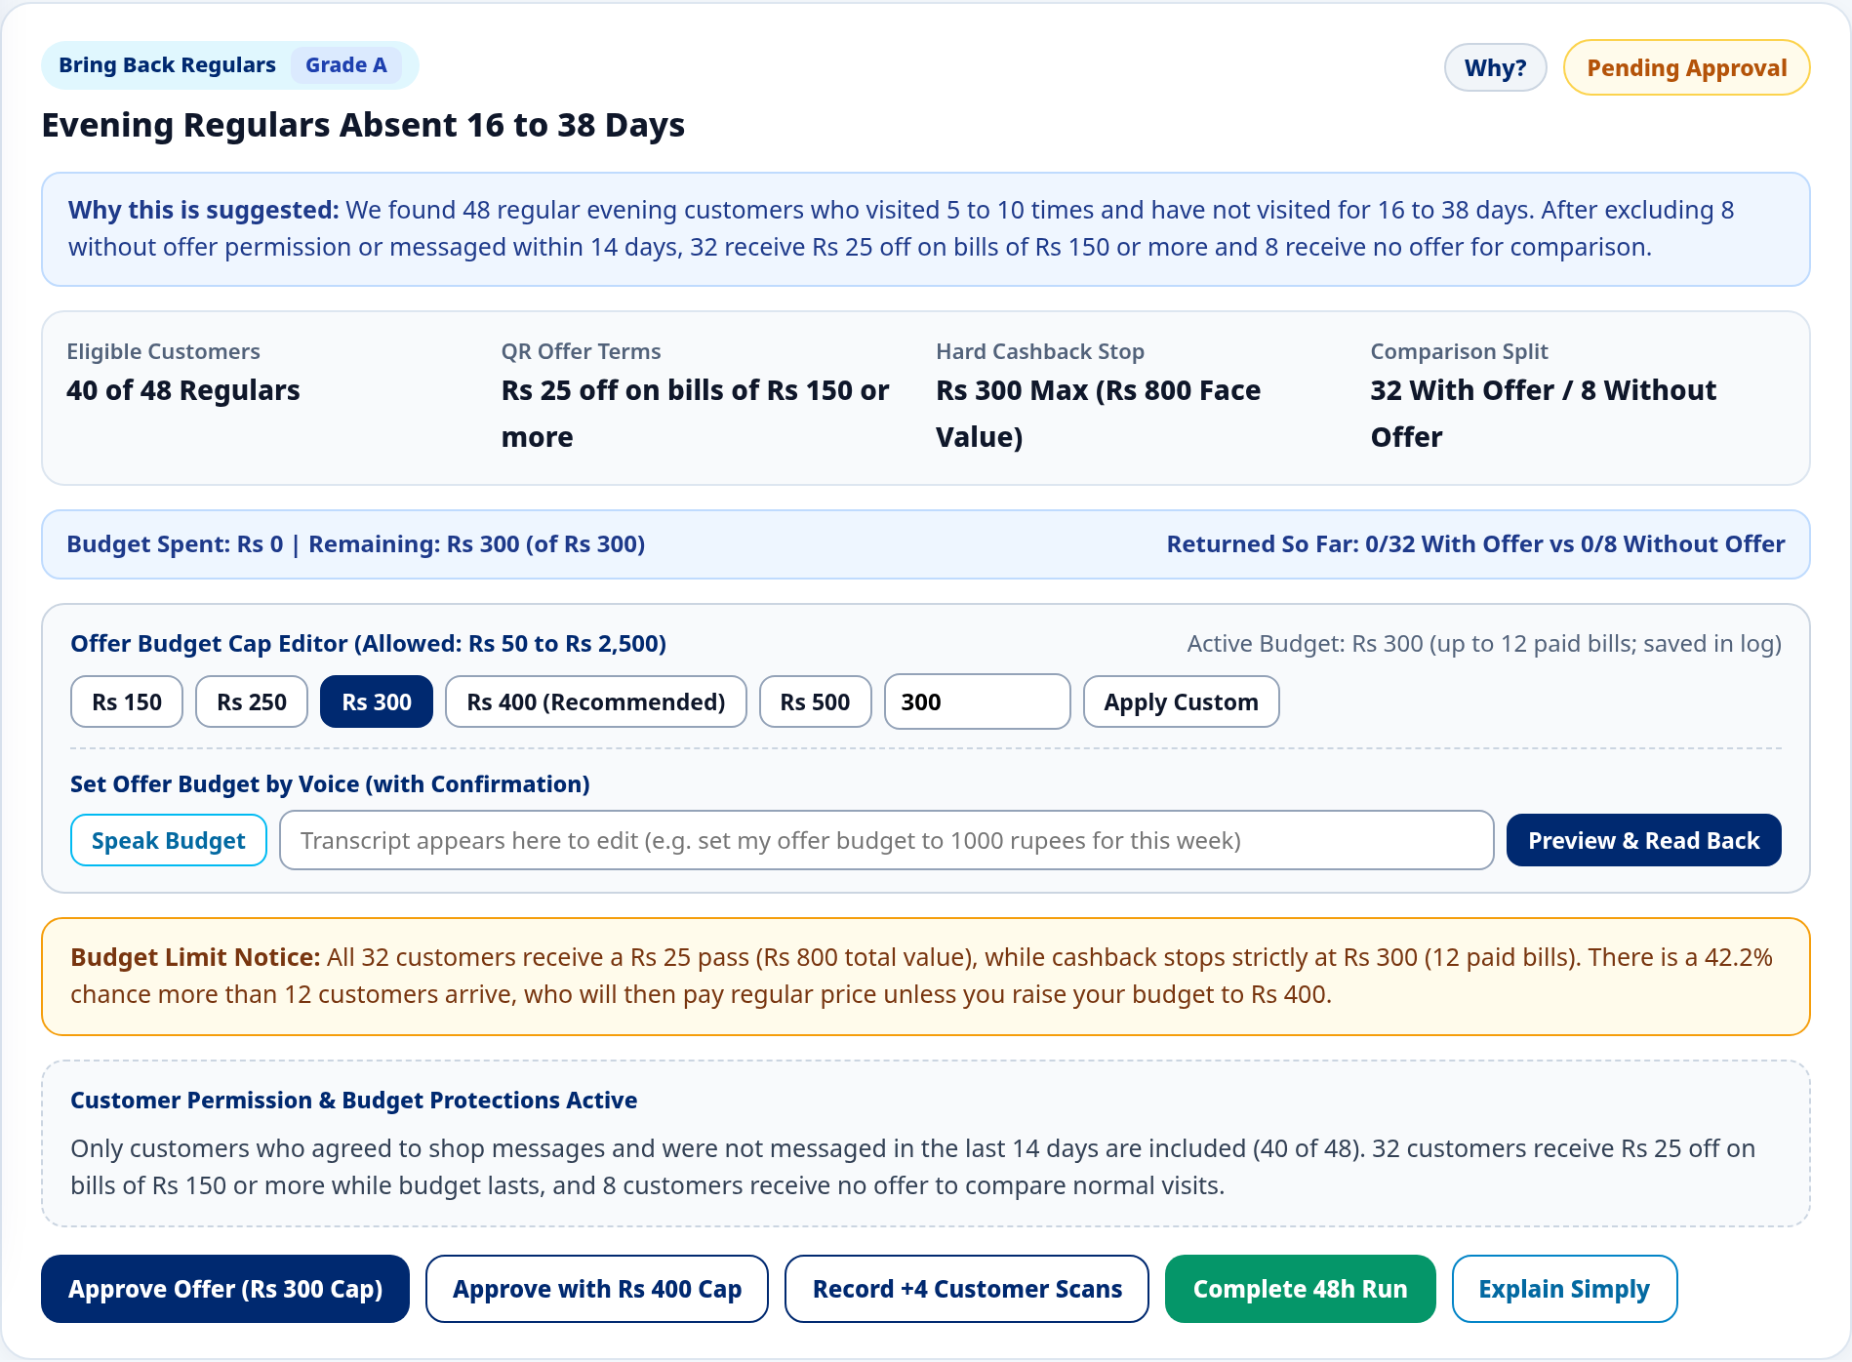
Product in Action (Local App, Zero Keys)
Kannada Merchant View & Win-Back Card
Expanded Why? Provenance Panel
Notes:
Both screenshots on Slide 4 were captured directly from our local FastAPI application running with zero API keys set right after clicking Reset Session, using headless Chromium. On the left is the Kannada Merchant View showing the closing Soundbox briefing (111 recent QR payments), store KPIs (Rs 1,74,685 30-day sales, 240 buyers), the Draft translation badge, and the CMP-WINBACK-01 card with its Rs 300 cap. On the right is the expanded Why? provenance drawer explaining how 48 silent regulars filter to 40 eligible buyers split 32 with offer versus 8 without offer, alongside the 42.2 percent cap-overrun warning suggesting a Rs 400 cap.

Slide 5
Holdout Design and Simulated 48h Outcome
Illustrative simulation on synthetic data, not evidence of lift
* Design: Rs 300 cap; 80/20 holdout (32 vs 8).
* Grade A: Observed ledger counts.
* Grade B: Offer vs holdout returns.
* Grade C: Assumed margin and fee profit.
* Returns: 12/32 (37.5%) vs 1/8 (12.5%).
* Extra visits: 8 visits (Rs 1,740 sales).
* Pre-fee: +Rs 222 (assumed 30% margin).
* Post-5%-fee: +Rs 91.50 (assumed fee).
Notes:
Slide 5 shows how we separate real extra visits from regulars who would have walked in anyway, followed by the canonical 48-hour simulation in simulate_campaign_48h. Out of 40 eligible regulars, 32 get the Rs 25 pass (capped at Rs 300, 12 bills) and 8 get no offer. In our canonical synthetic simulation, 12 of 32 (37.5 percent) return versus 1 of 8 (12.5 percent) in holdout. Subtracting 4 expected organic visits leaves 8 extra visits worth Rs 1,740. At an assumed 30 percent margin, profit is +Rs 222 before fee and +Rs 91.50 after an assumed 5 percent promo fee on Rs 2,610 redeemed bills (Explain Simply rounds post-fee profit to about Rs 92). Single-wave Fisher p is 0.2364 and Bayesian P(post-fee > 0) is 52.1 percent, so one wave is directional only; pooling 50 shops (n = 2,000) reaches 92.5 percent power at +7 percentage points.

Slide 6
Why Every Number Can Be Trusted
1. Code Math
2. Fallback
3. Digit Gate
4. Safeguards
Python computes figures; zero PII leaves.
Sarvam -> Groq -> Browser speech & templates.
Verifies EN, HI, KN digits on AI replies.
Audit log, cache, call caps, PIN gate.
Repo verification: 12 preflight gates, 7 test suites (311 asserts), 21 QA checks.
Notes:
Every rupee figure, count, and confidence interval is computed deterministically in Python from SQLite; external models never calculate math and assert_zero_pii strips customer names, IDs, phones, and UPI handles before any outbound call. ProviderRouter tries Sarvam AI first (bulbul:v3, saaras:v4, sarvam-105b-conversations), fails over silently to Groq (openai/gpt-oss-20b, whisper-large-v3-turbo, orpheus-v1-english), and falls back to browser Web Speech plus deterministic templates. Before any AI sentence is shown, verify_numeric_grounding checks ASCII, Devanagari, and Kannada digits against store facts. An immutable audit_logs table records approvals and alerts, while persistent SQLite caching, call caps (60 global, 35 session), IP rate limits, and DEMO_PIN gating protect credits on Render. Repo preflight runs 12 gates, 7 test suites (311 asserts), and a 21-check QA battery.

Slide 7
Business Case and Store Margin Limits
For Merchants
For Paytm (Assumption)
Capped, measured win-back in Kannada, Hindi, or English.
More use of Soundbox and QR with measurable offers.
Who Pays & Modelled Cost
Margin Limitation
Open assumption (5% fee assumed); Rs 48/mo cached cost (modelled assumption).
Positive near 30% margin (darshinis first); kiranas need smaller presets.
Notes:
Slide 7 outlines a qualitative business case with zero invented market sizes or adoption numbers. Merchants get capped, holdout-measured win-back in Kannada, Hindi, or English. For Paytm (assumption, to verify with Paytm), this could deepen engagement on existing Soundbox and QR surfaces with measurable offers. Who pays remains an open assumption; our waterfall models a 5 percent promo fee on redeemed bills solely as an assumption. Our unit economics script models per-merchant delivery at Rs 48 per month cached (Rs 71.80 uncached, modelled assumption including Rs 43 modelled messaging not sent by this demo). Crucially, a Rs 25 pass breaks even post-fee at 24.7 percent margin: it suits 30 percent margin darshinis (+Rs 91.50) first, whereas 15 to 20 percent margin kiranas (-Rs 82.50 at 20 percent) need smaller category presets.

Slide 8
Proposed Pilot Plan and Honest Limits
PROPOSED OPT-IN PILOT
HONEST LIMITATIONS
* Design: Multi-shop darshini pilot with randomized 80/20 holdout.
* Stop rules: Halt on negative post-fee return, cap overrun, or opt-outs.
* Data: Synthetic 60-day ledger and simulated returns.
* Language: Draft Hindi and Kannada pending native review.
* Hardware: Speaker-based Soundbox, no mic (validate with Paytm).
* Sample: Single-wave results are directional only.
Notes:
To test whether real customers respond, we propose an opt-in multi-shop darshini pilot (sized at 50 shops, 2,000 eligible buyers, 1,600 offer versus 400 holdout for 92.5 percent power at +7 percentage points) governed by strict stop rules: halt if pooled post-fee profit is negative, if any cap overruns, or if opt-outs spike. Right-hand limitations are stated plainly: all 60-day store transactions and 48-hour returns are synthetic; Hindi and Kannada copy are drafts awaiting native speaker review; to our knowledge the standard Paytm Soundbox is speaker-based with no microphone, which is to be validated with Paytm alongside Paytm for Business voice input; and any single 40-buyer wave is directional only.

Slide 9
AI Tools, Safeguards, and Team
* Build tools: Claude for planning/review; AI coding agent for code.
* Runtime AI: Sarvam primary, Groq backup, browser speech fallback.
* Human role: Problem, caps, holdout rules, disclosures, 12-gate checks.
Team SemiTechnical
Kevin Joseph
Live Demo:
paytmai-vyaparvoice.onrender.com
GitHub Repository:
github.com/somebeing2/paytmai-vyaparvoice
Notes:
Slide 9 summarizes our AI tools note (docs/AI_TOOLS_NOTE.pdf) and team attribution. During development, Claude (by Anthropic) was used in chat for planning, drafting prompts, and reviewing outputs, paired with an AI coding agent for implementation (exact coding-agent model to be confirmed by the team). At runtime, Sarvam AI (bulbul:v3, saaras:v4, sarvam-105b-conversations) is primary, Groq (openai/gpt-oss-20b, whisper-large-v3-turbo, orpheus-v1-english) is secondary, and browser Web Speech with deterministic templates is tertiary. Kevin Joseph defined the customer-loss framing, hard rupee caps, holdout evaluation, and disclosures, verified in the repository by 12 preflight gates, 7 test suites, and secret scans (manual testing by the team to be confirmed by the team).

