Slide 1
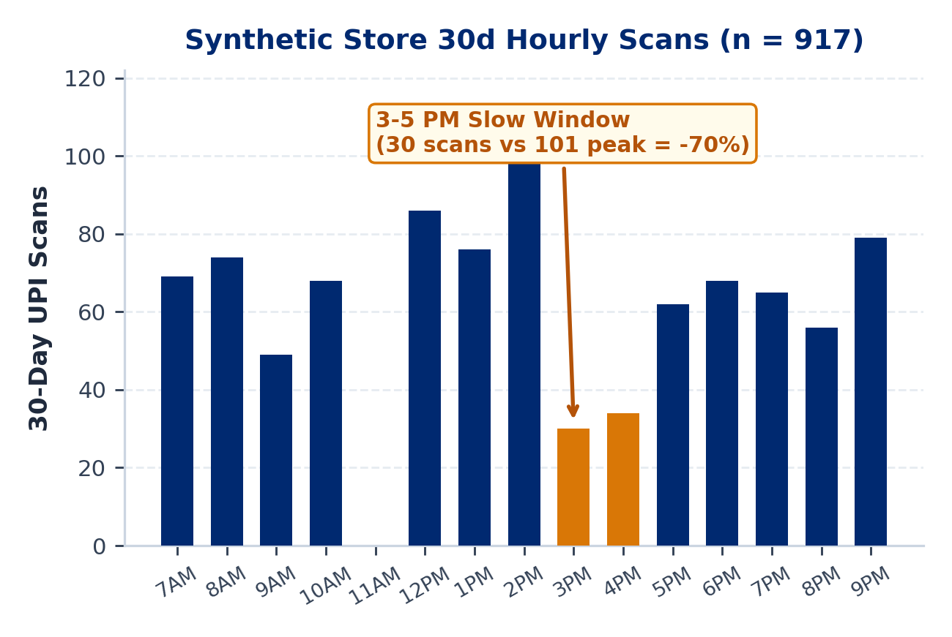
MAIN 1 / 5 : PROBLEM & OPPORTUNITY
PaytmAI VyaparVoice | Team SemiTechnical (Kevin Joseph)
1.64 Cr Merchants Pay for Subscriptions; Retention Stays Manual
Reported Paytm Scale: 1.64 Cr subscription merchants (+27L YoY), Rs 7.1L Cr GMV, Rs 2,648 Cr revenue (Reported: Paytm Q2 FY27 release, 26 Oct 2026).
Silent Repeat Churn: Small shops lose an estimated 25% to 35% of repeat buyers yearly without customer-level alerts (Assumption).
Dashboard Friction: Single-counter operators work 12+ hr shifts; SMB BI dashboards see <8% weekly usage (Assumption).
Slow Hours & Rush Prep: In our synthetic Bengaluru ledger, 3 to 5 PM scans fall 70% below peak while weekend rushes risk stockouts.
PaytmAI VyaparVoice (Track 1)
8:30 PM closing-time voice retention & ops copilot for Soundbox + Paytm for Business.
Team SemiTechnical | Kevin Joseph
Paytm Build for India AI Hackathon (Bengaluru Track 1) | Traced to results/slide_numbers.md & unit_economics.md (Deck v3)
Main 1 / 5 (Slide 1 / 18)
Notes:
Good morning. I am Kevin Joseph from Team SemiTechnical, presenting PaytmAI VyaparVoice for Track 1, Merchant Growth AI, anchored to Paytm's 26 October 2026 Q2 FY27 earnings release.

Slide 2

MAIN 2 / 5 : SOLUTION & LIVE DEMO
PaytmAI VyaparVoice | Team SemiTechnical (Kevin Joseph)
One 8:30 PM Voice Action, Governed by Deterministic SQL Rules
Plain Voice & Ergonomics: EN author-checked, native review pending; KN/HI draft; Repeat, 0.78x Slower, Question Chips & Why? drawers.
Synthetic Store Slice: Sri Krishna Darshini (240 payers, 1,613 scans); flags 48 regulars silent 16 to 38d.
Policy & 80/20 Split: Filters to 40 DPDP & 14d-cooldown clear buyers: 32 nudged vs 8 silent control.
Cap Editor & Stop-Loss: All 32 get Rs 25 pass; Cap Editor (Rs 50-2,500), 2-step voice confirm & 1-tap Stop-Loss protect pocket.
Zero LLM Math: SQLite computes every rupee; per-visitor cloud sandboxes block paid API calls.
TRY LIVE SANDBOX DEMO
https://paytmai-vyaparvoice
.onrender.com
Cloud Safeguards Active:
Isolated SQLite per visitor (30m TTL,
64-session LRU, 2MB/32MB disk caps).
Zero paid API calls on public URL.
Paytm Build for India AI Hackathon (Bengaluru Track 1) | Traced to results/slide_numbers.md & unit_economics.md (Deck v3)
Main 2 / 5 (Slide 2 / 18)
Notes:
Slide 2 highlights our built Stage 2 merchant controls: Repeat and 0.78x Slower counter playback, five plain-language Question Chips, a bounded Cap Editor with two-step voice confirmation, and an atomic 1-tap Stop-Loss.

Slide 3
MAIN 3 / 5 : ARCHITECTURE (BUILT VS PLANNED)
PaytmAI VyaparVoice | Team SemiTechnical (Kevin Joseph)
Deterministic Core, Cap Controls & Scorecard Built; Rail Hooks Scoped
[BUILT] ITT Stats, Cap Editor & Stop-Loss: Fisher/Wilson/power math, Cap Editor (Rs 50-2,500), 2-step voice confirm, atomic Stop-Loss, What-If & Guardrail Lab.
[BUILT] Bayesian Scorecard & Copy Ergonomics: Plain verdict, Beta(1,1) profit posterior, 6x4 margin-fee table, Evidence Meter, Repeat/0.78x Slower, banned-jargon lint.
[BUILT KEYLESS / PENDING LIVE] Sarvam & Caps: Keyless Bulbul TTS + Saaras STT adapter, mock-server selftest, SHA-256 audio cache, 15%/15% (30% max) credit cap.
[PRODUCTION PLAN] Paytm Ecosystem Hooks: Paytm QR dynamic coupon settlement, 4G Soundbox push audio, WhatsApp Cloud supplier POs, Postgres/Redis.
6-Rule Guardrail Stress Lab
Atomic Cap & Stop-Loss Lock
Bounded Visitor Sandboxes
Blocks prompt injection, >22% discounts, unconsented blasts, and holdout removal.
SQLite write locking enforces hard rupee stops and instant 1-tap campaign pause.
Per-visitor SQLite files enforce 30-min TTL, 64-session LRU eviction, and 32 MB disk cap.
Paytm Build for India AI Hackathon (Bengaluru Track 1) | Traced to results/slide_numbers.md & unit_economics.md (Deck v3)
Main 3 / 5 (Slide 3 / 18)
Notes:
Slide 3 reflects our completed Stage 2 codebase: the Cap Editor with two-step voice confirmation, live interim Stop-Loss, Guardrail Red-Team Lab, What-If explorer, and Bayesian plus margin-fee sensitivity scorecard.

Slide 4
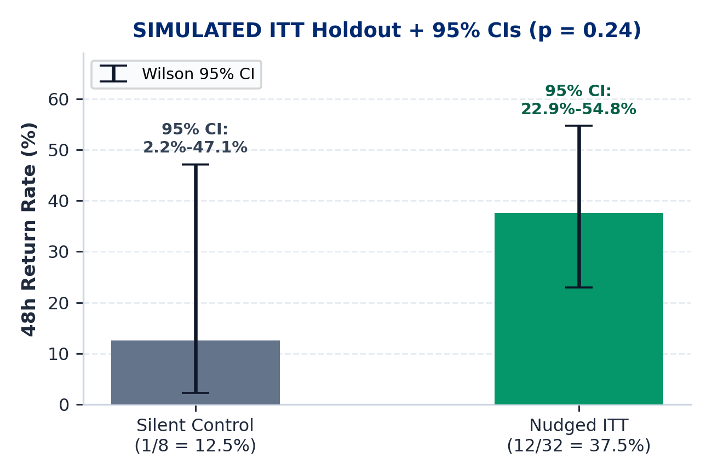
MAIN 4 / 5 : SIMULATED ITT PROOF & PROFIT MATH
PaytmAI VyaparVoice | Team SemiTechnical (Kevin Joseph)
Intention-to-Treat Holdout, Bayesian Posterior & Net Profit
Simulated ITT Return: 12/32 nudged (37.5%) vs 1/8 control (12.5%); Fisher p = 0.24; simulated 12 equals the Rs 300 cap (0 refused).
Bayesian Posterior (n=40): Beta(1,1) prior: 88.8% P(lift>0), 67.0% P(pre-fee profit>0), 52.1% P(post-fee profit>0); proves 50-shop pool is needed.
Sales vs Subsidy: 8 net visits = Rs 1,740 sales (5.8x sales/promo); 4 organic returners absorb Rs 100 cashback.
Merchant Net Profit: At 30% margin: Rs 522 GP (1.74x); +Rs 222 pre-fee (+74%), +Rs 91.50 after Rs 130.50 fee.
5% Fee Base: Rs 130.50 = 5% of all Rs 2,610 redeemed bills (12 bills, including organic returners).
CAP & BREAK-EVEN DISCLOSURE (SIMULATED)
Simulated 12 returners = 12 x Rs 25 = Rs 300 hard spend stop (42.2% overrun risk at p=37.5% triggers >10% alert; suggests Rs 400 cap).
Break-even margin: 17.2% pre-fee | 24.7% post-fee.
Break-even lift (30% margin): +7.8 pp pre | +15.3 pp post.
Intention-to-Treat (ITT) Definition: Compares all 32 assigned nudged buyers vs all 8 assigned silent controls regardless of redemption or cap stops, preventing selection bias and keeping lift invariant if the cap binds.
Paytm Build for India AI Hackathon (Bengaluru Track 1) | Traced to results/slide_numbers.md & unit_economics.md (Deck v3)
Main 4 / 5 (Slide 4 / 18)
Notes:
Slide 4 pairs frequentist Fisher and Wilson readouts with our built Bayesian Beta(1,1) profit posterior: on one 40-customer wave, post-fee profit probability is 52.1 percent with a 95 percent credible interval of minus Rs 19.97 to plus Rs 14.73 per nudged customer, demonstrating why our 50-shop pooled pilot is essential.

Slide 5
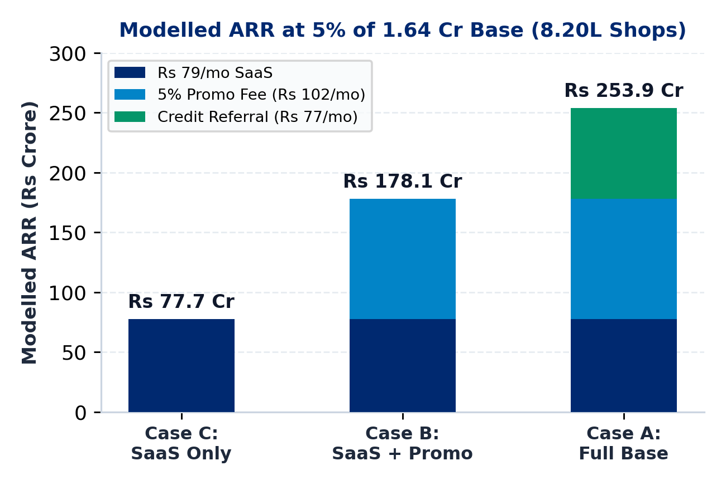
MAIN 5 / 5 : BUSINESS MODEL & POOLED PILOT
PaytmAI VyaparVoice | Team SemiTechnical (Kevin Joseph)
Three Revenue Cases (8.20L Shops) & 50-Shop Pooled Pilot
Case C (SaaS Only): Rs 79/mo Soundbox add-on x 8.20L shops = Rs 77.7 Cr ARR (zero promo/credit fees).
Case B (Core Excl. Credit): +Rs 102/mo steady promo fee (~0.78 waves/mo, Rs 2,040 redeemed bills) = Rs 178.1 Cr ARR.
Case A (Full Base): +Rs 77/mo credit referral (~7% loan pen. Assumption) = Rs 253.9 Cr ARR.
Unit COGS & Margin: Rs 48/mo cached (Rs 5 AI + Rs 43 msg; 81.4% margin) vs Rs 71.80 uncached TTS (72.2%).
Pooled 50-Shop Pilot: 50 shops x 1 wave (~400C + ~1,600T, stratified by shop): 83.3% power at +6 pp, 97.2% at +8 pp.
Q2 FY27 BASE & FEE RECONCILIATION
5% of 1.64 Cr subscription merchants (Reported: Paytm Q2 FY27, 26 Oct 2026) = 8.20L shops.
1 backlog wave = Rs 130.50 fee; steady state (~0.78 waves/mo) = Rs 102/mo.
Why Pool 50 Shops (Not 4 Waves/Shop): 14d cooldown & ~0.78 waves/mo replenishment preclude 4 weekly waves in 1 shop; pooling 50x1 gives 50.3%/68.8%/83.3%/92.5%/97.2%/99.8% power at +4/+5/+6/+7/+8/+10 pp.
Paytm Build for India AI Hackathon (Bengaluru Track 1) | Traced to results/slide_numbers.md & unit_economics.md (Deck v3)
Main 5 / 5 (Slide 5 / 18)
Notes:
Slide 5 presents our reproducible unit_economics.py outputs across 8.20 lakh shops (5 percent of Paytm's 1.64 crore Q2 FY27 merchant base) and our pooled 50-shop stratified pilot.

Slide 6
APPENDIX A1 | TRACK 1: MERCHANT GROWTH AI (STAGE 2 VERIFIED - DECK V3)
PaytmAI VyaparVoice
Closing-Time Voice Growth, Operations & Retention Copilot
Built for Paytm's 1.64 Cr subscription-paying merchant deployments (Reported: Paytm Q2 FY27 release, 26 Oct 2026). Includes Cap Editor, 2-step voice confirmation, Stop-Loss, and Bayesian scorecard.
01 : Voice + Teach-Back
02 : Cap Editor & Stop-Loss
03 : Bayesian Scorecard
Repeat, 0.78x Slower, 5 Question Chips & Why? drawers
Rs 50-2,500 bounds, 2-step voice confirm & 1-tap halt
Beta(1,1) profit posterior + 6x4 margin-fee table
TEAM: SemiTechnical | Member: Kevin Joseph | Live: paytmai-vyaparvoice.onrender.com
Deck v3 Status: Stage 2 verified (stage2-ok); Cap Editor (A12) and Bayesian/Sensitivity Scorecard (A13) added.
Notes:
Appendix A1 introduces the 13-slide Deck v3 technical appendix.

Slide 7
APPENDIX A2 : PROBLEM & Q2 FY27 SOURCES
PaytmAI VyaparVoice | Team SemiTechnical (Kevin Joseph)
Problem Details, Primary Paytm Q2 FY27 Sources & Synthetic Persona
1. Silent Repeat Churn (25% to 35% Yearly - ASSUMPTION)
Merchants hear isolated payment alerts without customer-level retention tracking, losing repeat buyers before cashflow drops are noticed.
2. Dashboard Friction (<8% WAU - ASSUMPTION)
Counter-operated kirana, darshini, and pharmacy shops lack time to write prompts, export CSVs, or configure CRM rules.
3. Slow Hours & Rush Prep (SYNTHETIC STORE)
Reported (Paytm Q2 FY27, 26 Oct 2026): 1.64 Cr subscription-paying merchants, Rs 7.1L Cr merchant GMV, Rs 2,648 Cr operating revenue.
Assumptions vs Synthetic: ~7% merchant loan pen. & Rs 90-100/mo Soundbox fee (Assumptions); Ramesh Rao store is synthetic (917 scans/30d).
In our 60-day synthetic Indiranagar ledger, 3 to 5 PM scans fall 70% below peak while weekend morning rushes risk staple stockouts.
Paytm Build for India AI Hackathon (Bengaluru Track 1) | Traced to results/slide_numbers.md & unit_economics.md (Deck v3)
Appendix A2 (Slide 7 / 18)
Notes:
Appendix A2 cites Paytm's Q2 FY27 release and separates market assumptions from synthetic store data.

Slide 8
APPENDIX A3 : 3-PILLAR MAPPING
PaytmAI VyaparVoice | Team SemiTechnical (Kevin Joseph)
Track 1 Coverage: Growth, Operations, and Customer Recovery
PILLAR 1 : GROW BUSINESS
PILLAR 2 : MANAGE OPERATIONS
PILLAR 3 : SERVE CUSTOMERS
Retention & Slow-Hour Copilot
Rush Prep & Credit Signals
Privacy-Safe Regular Retention
Churn Detection (Built): SQL flags regulars silent 16+ days (16-38d in synthetic DB).
Slow-Hour Group (Built): Identifies 3-5 PM snack buyers (55 detected, 34 eligible).
Cap & Stop-Loss (Built): Cap Editor (Rs 50-2,500), 2-step voice confirm & Stop-Loss.
QR Coupon Hook (Planned): Production hook into Paytm QR redemption rail.
Rush Alert (Simulated): Flags weekend morning demand spikes from scan history.
Supplier PO (Simulated): Dispatches pre-filled WhatsApp restock (+18L milk, +12kg batter).
Dual Ledgers (Built): Separates merchant cashback stop from 30% Sarvam credit cap.
Credit Signal (Planned): Feeds verified cashflow stability to partner NBFC funnel.
Ledger Gap Detection (Built): Spots 12+ visit regulars (~2d gap) silent 8+ days after dense rush scans.
Goodwill Pass (Simulated): 1-tap polite welcome-back note + Rs 30 next-scan coffee voucher.
Zero PII Leakage (Built): No raw phone numbers or payer IDs ever leave SQLite.
DPDP & Cooldown (Built): Hard opt-in filter and 14-day per-payer anti-spam cooldown.
Paytm Build for India AI Hackathon (Bengaluru Track 1) | Traced to results/slide_numbers.md & unit_economics.md (Deck v3)
Appendix A3 (Slide 8 / 18)
Notes:
Appendix A3 maps built modules, simulated MVP flows, and planned Paytm hooks across all three Track 1 pillars.

Slide 9
APPENDIX A4 : ITT WORKFLOW & SPEND STOP
PaytmAI VyaparVoice | Team SemiTechnical (Kevin Joseph)
Intention-to-Treat Cap-vs-Holdout & Late-Arrival Handling
STEP 1 : PASS ISSUANCE
STEP 2 : >10% & 80% ALERTS
STEP 3 : INDEPENDENT DRAW
STEP 4 : ITT & DECLINE LOG
Filter 48 -> 40 eligible (80/20: 32 nudged, 8 control). Issue Rs 25 passes ('valid while shop offer budget lasts') to ALL 32 nudged buyers (Rs 800 face).
At approval, P(Binomial(32, 0.375) > 12) = 42.2% (>10% alert -> suggests Rs 400 cap). Live at 80% cap (10/12 paid), prompt merchant 1-tap top-up.
48h simulator draws customer return visits independently of max_budget first, then applies atomic BEGIN IMMEDIATE stop at Rs 300 (12 paid).
After cap, normal UPI clears, cashback withholds, refused_redemptions + audit_log increment (brand risk tracked). ITT (32 vs 8) stays unchanged.
DISCLOSED BRAND RISK & VERIFIED INVARIANCE TESTS
Post-Cap Customer Experience & Brand Risk: Pass terms state 'valid while shop offer budget lasts'; declining a 13th regular still risks counter disappointment, so overrun alerts, 80%-cap top-up prompts, and logged declines are mandatory.
Automated Concurrency & ITT Tests: 25-thread simultaneous scan test verifies budget_spent == Rs 300 (12 paid, 13 refused); multi-seed test proves ITT holdout comparison is identical whether cap is Rs 800 or Rs 100.
Paytm Build for India AI Hackathon (Bengaluru Track 1) | Traced to results/slide_numbers.md & unit_economics.md (Deck v3)
Appendix A4 (Slide 9 / 18)
Notes:
Appendix A4 details pass validity terms, late-arrival brand risk, and automated concurrency plus ITT invariance tests.

Slide 10
APPENDIX A5 : SYSTEM ARCHITECTURE
PaytmAI VyaparVoice | Team SemiTechnical (Kevin Joseph)
Component Status: Built vs Pending vs Production Plan
TOUCHPOINTS
[BUILT] Merchant & Technical View UI
[BUILT] Mic + Fallback Chips + Repeat/0.78x
[PLANNED] Soundbox 4G Push & WhatsApp Cloud
VOICE & LLM
[BUILT] Browser Speech + SHA-256 Cache
[PENDING LIVE] Keyless Sarvam (30% Cap)
[BUILT/OPT] Keyless Local Q&A Guard
CORE ENGINE
[BUILT] FastAPI + TTL/LRU/Byte Sessions
[BUILT] 6-Rule Guardrail Lab + Cap Editor
[BUILT] ITT + Bayesian + Sensitivity Engine
DATA & OPS
[BUILT] Atomic SQLite Cap & Stop-Loss
[BUILT] Preflight + Unit-Econ Generator
[PLANNED] PostgreSQL & Redis Cluster
Paytm Build for India AI Hackathon (Bengaluru Track 1) | Traced to results/slide_numbers.md & unit_economics.md (Deck v3)
Appendix A5 (Slide 10 / 18)
Notes:
Appendix A5 maps built Stage 1 and Stage 2 modules, pending live Saturday sponsor keys, and planned production hooks.

Slide 11
APPENDIX A6 : POSITIONING (USP)
PaytmAI VyaparVoice | Team SemiTechnical (Kevin Joseph)
Differentiation vs Manual Khata Apps and Generic Chatbots
Dimension | Manual BI / Khata Apps | Generic LLM Chatbots | PaytmAI VyaparVoice
Merchant UX | Charts & manual ledger entry | Requires typing business prompts | 8:30 PM plain voice + Repeat/0.78x + 1-tap
Customer Graph | Incomplete manual phonebooks | No link to payment history | Paytm QR repeat-payer IDs (synthetic in MVP)
Financial Safety | Manual coupon rules | LLM can invent unsafe offers | 6-rule guardrail lock, Cap Editor & Stop-Loss
Privacy (DPDP) | Raw phone lists exposed | Prompt data leakage risk | SQL opt-in filter; zero PII sent to voice/LLM
Causal Proof | Vanity message counts | No comparison group | 80/20 ITT + Bayesian posterior + 50-shop pilot
Paytm Build for India AI Hackathon (Bengaluru Track 1) | Traced to results/slide_numbers.md & unit_economics.md (Deck v3)
Appendix A6 (Slide 11 / 18)
Notes:
Appendix A6 contrasts VyaparVoice against manual dashboards and unconstrained LLM chatbots.

Slide 12
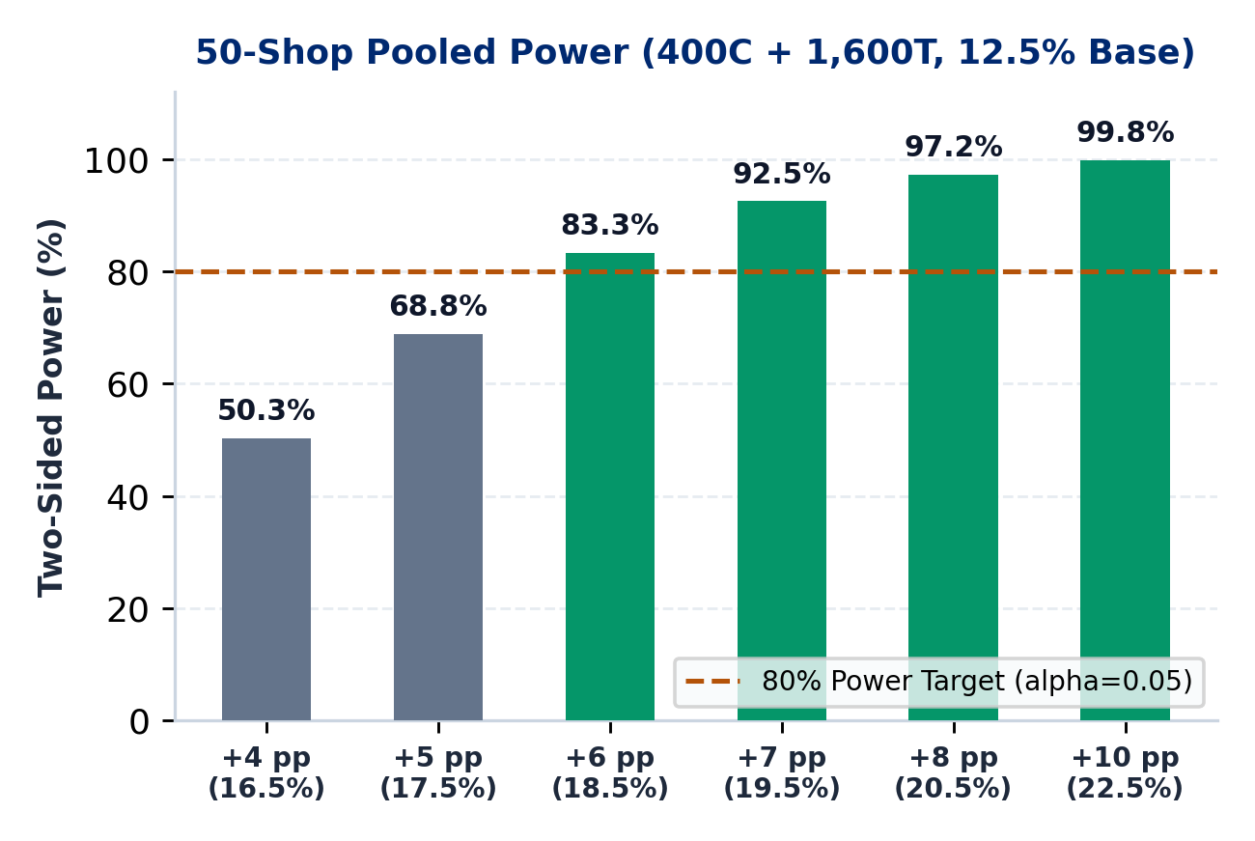
APPENDIX A7 : POOLED POWER & TARGETS
PaytmAI VyaparVoice | Team SemiTechnical (Kevin Joseph)
50-Shop Stratified Power (400C + 1,600T) & Pilot Targets
POOLED 50-SHOP X 1-WAVE POWER (12.5% BASELINE, ALPHA=0.05)
Why Pool Stores: 50 shops x 1 wave (~400C + ~1,600T, stratified by shop); avoids claiming 1 shop runs 4 waves in 4w under a 14d cooldown (~0.78 waves/mo).
Exact Power Curve: +4 pp: 50.3% | +5 pp: 68.8% | +6 pp: 83.3% | +7 pp: 92.5% | +8 pp: 97.2% | +10 pp: 99.8%.
Break-Even Lift: +7.8 pp pre-fee (20.3%) and +15.3 pp post-5%-fee (27.8% at 30% shop margin; >99.9% power).
ECOSYSTEM HYPOTHESES (UNVALIDATED PILOT TARGETS)
Repeat & Waste Targets: +14% to +22% repeat visits; -18% afternoon perishable loss (PILOT TARGETS).
Device & QR Share: -35% Soundbox churn; +12% to +15% store Paytm QR GMV lift (PILOT TARGETS).
Credit Funnel: Expand ~7% merchant loan pen. (ASSUMPTION) toward 15% (LONG-TERM TARGET).
83.3%
+15.3 pp
Rs 5.00
Power at +6 pp Lift
(400C + 1,600T)
Post-Fee Break-Even
(+7.8 pp Pre-Fee)
Cached AI Cost/Mo
(Rs 28.80 Uncached)
Paytm Build for India AI Hackathon (Bengaluru Track 1) | Traced to results/slide_numbers.md & unit_economics.md (Deck v3)
Appendix A7 (Slide 12 / 18)
Notes:
Appendix A7 presents the exact power curve for pooling 50 shops times one wave stratified by shop.

Slide 13
APPENDIX A8 : UNIT ECONOMICS & FEE MATH
PaytmAI VyaparVoice | Team SemiTechnical (Kevin Joseph)
Q2 FY27 ARR Cases, Fee Reconciliation & TTS Cache Sensitivity
Stream 1 (SaaS - Rs 79/mo): Add-on to Soundbox (~Rs 90-100/mo rental ASSUMPTION) x 8.20L shops (5% of 1.64 Cr Q2 FY27 base) = Rs 77.7 Cr ARR.
Stream 2 (Promo Fee - Rs 102/mo): 5% fee on ALL redeemed bills incl. organic returners: 1 wave = Rs 130.50 (Rs 2,610 bills); steady state assumes ~0.78 waves/mo (Rs 2,040/mo bills) = Rs 102/mo (+Rs 100.4 Cr -> Rs 178.1 Cr ARR).
Stream 3 (Credit - Rs 77/mo): Amortized 1.5%-2.5% partner origination uplift (~7% loan pen. ASSUMPTION) -> +Rs 75.8 Cr (Rs 253.9 Cr ARR).
Cached COGS (Rs 48.00/mo): Rs 1.80 SLM + Rs 3.20 TTS (~88% phrase cache hit on Bulbul v3) + Rs 43 msg = 81.4% gross margin.
Uncached COGS (Rs 71.80/mo): Uncached Bulbul v3 (9k chars at Rs 30/10k = Rs 27 TTS) = 72.2% margin (39.2% cached margin on SaaS-only).
REPRODUCIBLE SCRIPT (scripts/unit_economics.py)
1. Fee Base: 5% applies to gross QR-redeemed promo bills including organic returners.
2. Cadence: Initial backlog wave yields Rs 130.50; steady replenishment (~0.78 waves/mo) yields Rs 102/mo.
3. Q2 FY27 Base: 5% x 1.64 Cr = 8.20L shops.
Paytm Build for India AI Hackathon (Bengaluru Track 1) | Traced to results/slide_numbers.md & unit_economics.md (Deck v3)
Appendix A8 (Slide 13 / 18)
Notes:
Appendix A8 summarizes results/unit_economics.md generated reproducibly from config/default.yaml and app/stats.py.

Slide 14
APPENDIX A9 : VALIDATION & GO / NO-GO DECISION RULE
From Verified Stage 2 MVP to Pooled 50-Shop Stratified Pilot
STAGE A : BUILT & VERIFIED
STAGE B : POOLED 50-SHOP PILOT
STAGE C : PRODUCTION SCALE
Deterministic Core & Stage 2 UX
Stratified Single-Wave Validation
Paytm Ecosystem Integration
Bounded visitor SQLite sandboxes (204 KB/visitor; 55 MB peak RSS)
Cap Editor (Rs 50-2,500), 2-step voice confirm, Stop-Loss & Guardrail Lab
Bayesian profit posterior, 6x4 sensitivity matrix & 5-point teach-back
3-merchant counter teach-back across EN (author-checked), KN & HI (draft)
50 shops x 1 wave (~400C + ~1,600T, stratified by shop; 83.3% power at +6 pp)
Advance only if lower 95% bound of post-5%-fee net profit/nudged > 0 AND lift > break-even (+15.3 pp)
Bind Paytm QR dynamic coupon settlement & 4G Soundbox push
Enforce live 80%-cap merchant top-up prompt to protect counter goodwill
Scale across 8.20L target stores (Rs 77.7 Cr to Rs 253.9 Cr ARR)
PaytmAI VyaparVoice | Team SemiTechnical (Kevin Joseph)
Appendix A9 (Slide 14 / 18) | Go/No-Go: Lower 95% CI of Post-5%-Fee Net Profit/Nudged > Rs 0 AND Observed Lift > Break-Even Lift
Notes:
Appendix A9 states our pooled 50-shop pilot design and strict profit confidence-bound go/no-go decision rule.

Slide 15
APPENDIX A10 : DUAL SCORECARD & TEACH-BACK
PaytmAI VyaparVoice | Team SemiTechnical (Kevin Joseph)
Merchant Plain-Language View vs Technical Audit View
MERCHANT VIEW (ZERO JARGON - LINT VERIFIED)
TECHNICAL & AUDIT VIEW (ANALYST / JUDGE)
Plain Verdict & Why?: Promising single-shop check (+Rs 222 pre-fee, +Rs 91.50 post-fee); 1-tap Why? drawers explain SQL triggers in plain words.
Counter Ergonomics: Repeat Last, 0.78x Slower mode, and 5 Merchant Question Chips documented in docs/TEACH_BACK.md.
Clear Spend Stop: Your 300 rupee limit was reached after 12 paid redemptions (0 extra declined in base run).
Honest Copy Status: EN author-checked, native review pending; KN & HI carry visible [DRAFT - UNREVIEWED] badges.
ITT & Wilson 95% CIs: 37.5% [22.9%, 54.8%] vs 12.5% [2.2%, 47.1%]; two-sided Fisher exact p = 0.24.
Bayesian Posterior: Beta(1,1) uniform prior (10k draws): 88.8% P(lift>0), 67.0% P(pre-fee>0), 52.1% P(post-fee>0).
Guardrail Red-Team Lab: Interactive 'Type your own attack' tests 6 hard rules (injection, <=22% discount, DPDP, 14d, cap, holdout).
Banned Merchant Terms: 25 regex rules block cohort, holdout, p-value, Fisher, Wilson, ROI, DPDP, RFM, ITT.
GRADE A : OBSERVED LEDGER
GRADE B : SIMULATED ITT
GRADE C : ASSUMPTIONS
SQLite store counts (240 payers, 1,613 scans, 48 silent -> 40 eligible; synthetic seed 20261025).
Randomized 32 vs 8 split, independent outcome draw, Fisher p & Wilson CIs (simulated).
30% shop gross margin, 5% fee on redeemed bills, Beta(1,1) profit posterior & sensitivity table.
Paytm Build for India AI Hackathon (Bengaluru Track 1) | Traced to results/slide_numbers.md & unit_economics.md (Deck v3)
Appendix A10 (Slide 15 / 18)
Notes:
Appendix A10 summarizes our Merchant View ergonomics, 5-point teach-back protocol, and Technical Audit View.

Slide 16
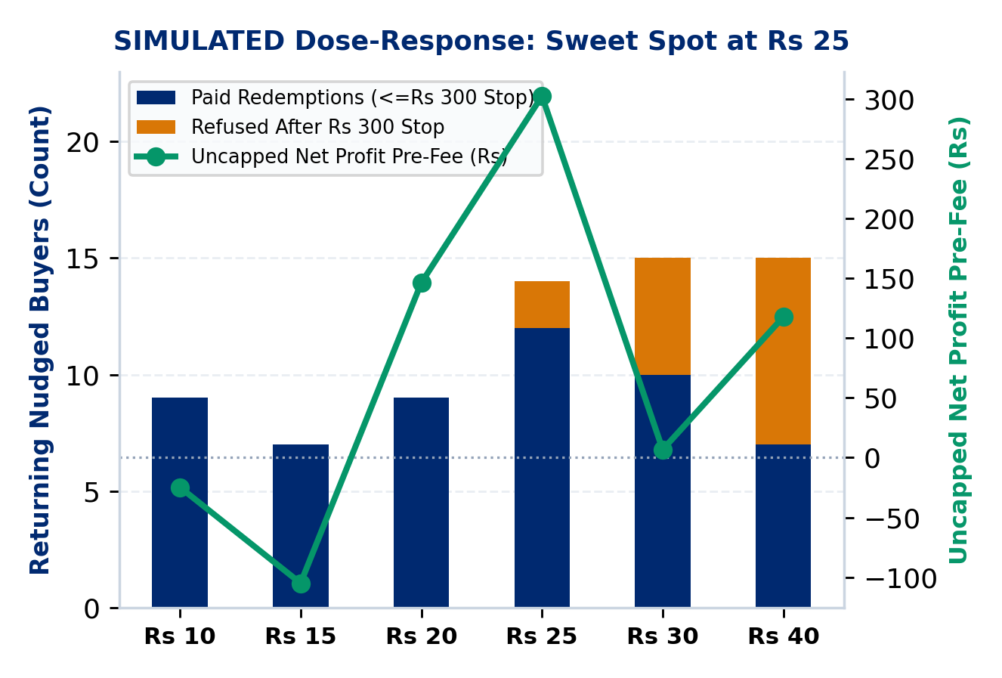
APPENDIX A11 : CAP LEDGERS & DOSE-RESPONSE
PaytmAI VyaparVoice | Team SemiTechnical (Kevin Joseph)
Merchant Spend Stop, Sarvam Credit Cap & Dose-Response Curve
Merchant Cashback Stop: Issues passes ('valid while budget lasts') to all 32 nudged buyers; SQLite lock stops spend at Rs 300 (12 paid) and logs declines.
Dose-Response Sweet Spot: In simulation, Rs 25 peaks uncapped profit: offers of Rs 30 to 40 erode uncapped net profit via organic subsidy AND trigger 5 to 8 cap refusals under a Rs 300 stop.
Margin & Lift Break-Even: At +25 pp simulated lift, shop breaks even at 17.2% margin pre-fee (24.7% post-fee); at 30% margin, break-even lift is +7.8 pp pre-fee (+15.3 pp post-fee).
Sarvam 30% Credit Ledger: Separate JSON ledger caps TTS <=15% and STT <=15% (30% total of 500 sponsor credits = 150 max) and halts fail-closed on HTTP 402/429/5xx.
Public Cloud Lock: PUBLIC_DEPLOY=true (auto-enabled on Render) hard-blocks live paid calls while SHA-256 audio cache replays at 0 credits.
DUAL CAP SUMMARY (SIMULATED & BUILT)
1. Merchant Cap: Protects shopkeeper pocket (Rs 300 stop; >10% overrun warning & 80% top-up prompt).
2. Sponsor API Cap: Protects hackathon credits (<=15% TTS, <=15% STT, fail-closed).
Paytm Build for India AI Hackathon (Bengaluru Track 1) | Traced to results/slide_numbers.md & unit_economics.md (Deck v3)
Appendix A11 (Slide 16 / 18)
Notes:
Appendix A11 shows how our simulated dose-response curve interacts with the Rs 300 spend stop and contrasts the merchant rupee cap against our separate 30 percent Sarvam credit ledger.

Slide 17
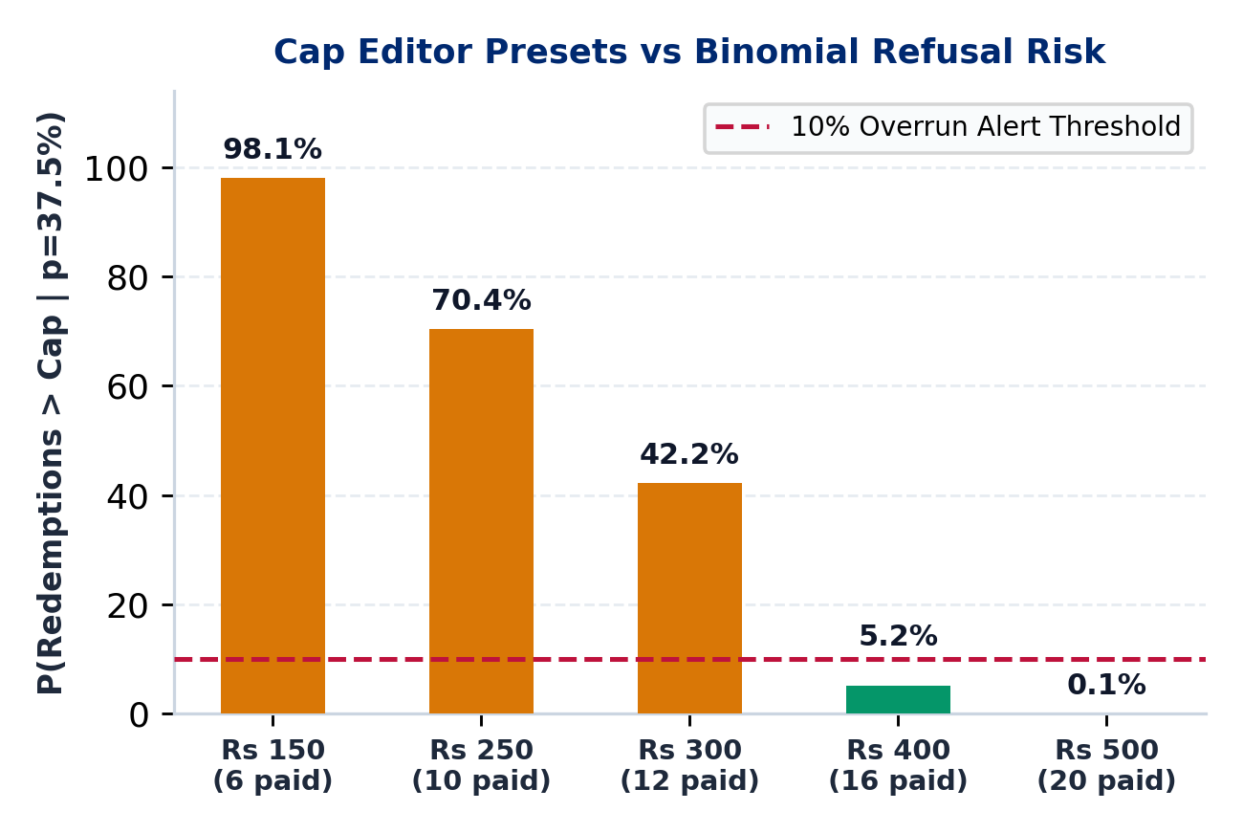
APPENDIX A12 : CAP EDITOR & LIVE STOP-LOSS [BUILT]
PaytmAI VyaparVoice | Team SemiTechnical (Kevin Joseph)
Bounded Cap Editor, Two-Step Voice Confirm & Live Interim Stop-Loss
Bounded Cap Editor [BUILT]: Enforces hard bounds [Rs 50, Rs 2,500] (>=1 pass of Rs 25) with 1-tap presets: Rs 150, Rs 250, Rs 300 (base), Rs 400 (<=10% overrun), Rs 500.
Two-Step Voice Confirmation [BUILT]: Saying 'Set my limit to 400 rupees' stages CAP_CONFIRMATION_PENDING without mutating SQLite until merchant says 'Confirm limit' or taps Confirm.
Live Interim Wave Monitor [BUILT]: Stepping live scans displays an explicit INTERIM DIRECTIONAL READOUT banner so shopkeepers never stop a wave early on noise.
Atomic 1-Tap Stop-Loss [BUILT]: Triggering Stop-Loss sets PAUSED_STOP_LOSS and blocks pass redemptions inside BEGIN IMMEDIATE (BLOCKED_STOP_LOSS).
Immutable Audit Trail [BUILT]: Every preset click, rejected out-of-bounds value, voice request/confirm, and Stop-Loss toggle writes to audit_logs.
CAP PRESETS VS BINOMIAL REFUSAL RISK (p = 37.5%, 32 PASSES)
Rs 150 (6 paid): 98.1% overrun | Rs 250 (10 paid): 70.4%
Rs 300 (12 paid): 42.2% (>10% alert) | Rs 400 (16 paid): 5.2% (SAFE)
Rs 500 (20 paid): 0.1% overrun.
Paytm Build for India AI Hackathon (Bengaluru Track 1) | Traced to results/slide_numbers.md & unit_economics.md (Deck v3)
Appendix A12 (Slide 17 / 18)
Notes:
Appendix A12 documents our Stage 2 Task 9 Cap Editor, two-step voice cap confirmation, live interim readout banner, and atomic SQLite Stop-Loss guard.

Slide 18
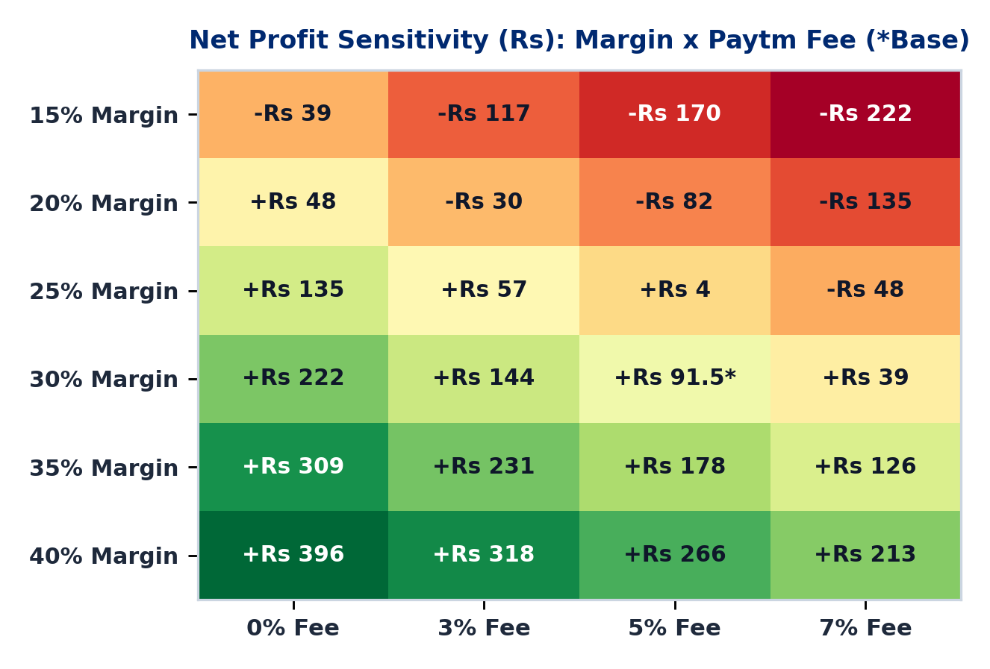
APPENDIX A13 : BAYESIAN SCORECARD & SENSITIVITY [BUILT]
PaytmAI VyaparVoice | Team SemiTechnical (Kevin Joseph)
Beta(1,1) Profit Posterior, Evidence Meter & 6x4 Margin-Fee Matrix
Plain-Language Verdict [BUILT]: Merchant View translates single-wave output into plain rupee terms with zero statistical jargon, backed by Grade A/B/C badges.
Bayesian Profit Posterior [BUILT]: Conjugate Beta(1,1) prior (10k draws, seed 20261025) without clamping negative draws: 88.8% P(lift>0), 67.0% P(pre-fee>0), 52.1% P(post-fee>0).
Why Single Wave Cannot Auto-Scale: Single-wave 95% CrI is [-Rs 19.97, +Rs 14.73] per nudged buyer (due to n=8 control uncertainty), failing A9 scale gate until 50 shops are pooled.
4-Stage Visual Evidence Meter [BUILT]: Tracks progress from n=40 (1 shop) -> n=155 (+25pp power) -> n=600 (15 shops) -> n=2,000 (50-shop stratified pilot, 83.3% power at +6 pp).
Kirana Margin Sensitivity [BUILT]: At 5% fee, Rs 25 pass profits at >=25% margin (+Rs 4.50 at 25%, +Rs 91.50 at 30%) and loses at 15%-20% (-Rs 82.50 at 20%), guiding smaller kirana offers.
HONEST SCORECARD TAKEAWAY (TRACED TO unit_economics.md)
Base [30% Margin, 5% Fee] = +Rs 91.50 (+Rs 222 pre-fee).
Low-margin grocery [15%-20% Margin] requires lowering pass to Rs 10-15 on Rs 250+ bills (4%-6% discount).
Paytm Build for India AI Hackathon (Bengaluru Track 1) | Traced to results/slide_numbers.md & unit_economics.md (Deck v3)
Appendix A13 (Slide 18 / 18)
Notes:
Appendix A13 shows our built Stage 2 Task 11 Merchant Scorecard: the Beta(1,1) profit posterior, 4-stage Evidence Meter, and 6 by 4 Shop Gross Margin times Paytm Fee sensitivity matrix.

