Slide 1
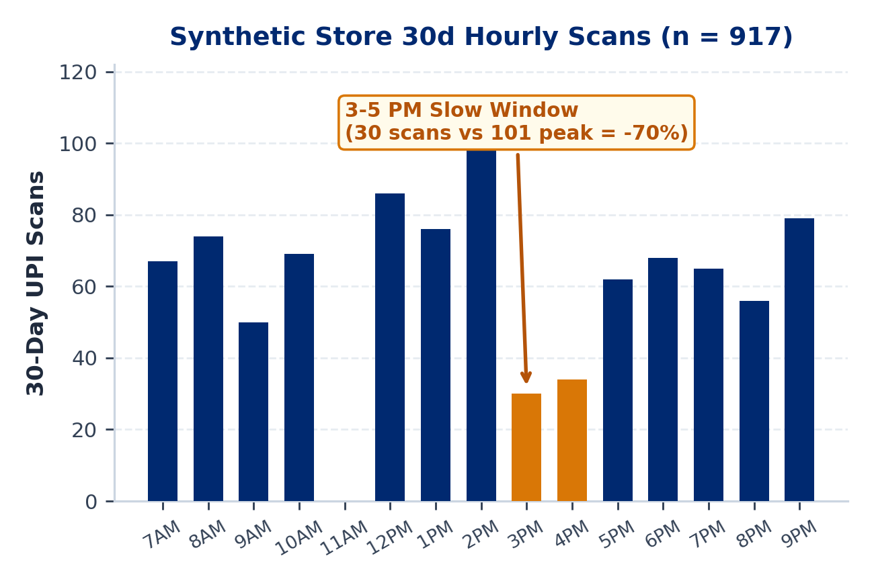
MAIN 1 / 5 : PROBLEM & OPPORTUNITY
PaytmAI VyaparVoice | Team SemiTechnical (Kevin Joseph)
1.64 Cr Merchants Pay for Subscriptions; Retention Stays Manual
Reported Paytm Scale: 1.64 Cr subscription merchants (+27L YoY), Rs 7.1L Cr GMV, Rs 2,648 Cr revenue (Reported: Paytm Q2 FY27 release, 26 Oct 2026).
Silent Repeat Churn: Small shops lose an estimated 25% to 35% of repeat buyers yearly without customer-level alerts (Assumption).
Dashboard Friction: Single-counter operators work 12+ hr shifts; SMB BI dashboards see <8% weekly usage (Assumption).
Slow Hours & Rush Prep: In our synthetic Bengaluru ledger, 3 to 5 PM scans fall 70% below peak while weekend rushes risk stockouts.
PaytmAI VyaparVoice (Track 1)
8:30 PM closing-time voice retention & ops copilot for Soundbox + Paytm for Business.
Team SemiTechnical | Kevin Joseph
Paytm Build for India AI Hackathon (Bengaluru Track 1) | Traced to results/slide_numbers.md (Deck v2.1)
Main 1 / 5 (Slide 1 / 16)
Notes:
Good morning. I am Kevin Joseph from Team SemiTechnical, presenting PaytmAI VyaparVoice for Track 1, Merchant Growth AI. In its Q2 FY27 earnings release on 26 October 2026, Paytm reported 1.64 crore subscription-paying merchants, Rs 7.1 lakh crore in merchant GMV, and Rs 2,648 crore in operating revenue. Yet once a QR payment clears, Soundbox goes quiet: counter shopkeepers lack customer-level retention alerts and rarely open analytics dashboards. In our synthetic Bengaluru darshini ledger, afternoon scans between 3 and 5 PM also drop 70 percent below peak.

Slide 2

MAIN 2 / 5 : SOLUTION & LIVE DEMO
PaytmAI VyaparVoice | Team SemiTechnical (Kevin Joseph)
One 8:30 PM Voice Action, Governed by Deterministic SQL Rules
Plain Voice Brief: EN author-checked, native review pending; KN/HI draft; zero jargon.
Synthetic Store Slice: Sri Krishna Darshini (240 payers, 1,613 scans); flags 48 regulars silent 16 to 38d.
Policy & 80/20 Split: Filters to 40 DPDP & 14d-cooldown clear buyers: 32 nudged vs 8 silent control.
Passes vs Spend Stop: All 32 nudged get Rs 25 pass (valid while budget lasts); hard stop at Rs 300 (>10% alert).
Zero LLM Math: SQLite computes every rupee and cap; per-visitor cloud sandboxes block paid calls.
TRY LIVE SANDBOX DEMO
https://paytmai-vyaparvoice
.onrender.com
Cloud Safeguards Active:
Isolated SQLite per visitor (30m TTL,
64-session LRU, 2MB/32MB disk caps).
Zero paid API calls on public URL.
Paytm Build for India AI Hackathon (Bengaluru Track 1) | Traced to results/slide_numbers.md (Deck v2.1)
Main 2 / 5 (Slide 2 / 16)
Notes:
At 8:30 PM closing time, VyaparVoice delivers a plain-language brief with zero statistical jargon; English copy is author-checked with native review pending, while Kannada and Hindi are marked unreviewed drafts. On our seeded synthetic ledger of 240 payers and 1,613 scans, SQL filters 48 lapsed regulars down to 40 eligible buyers, holding 8 in silent control and issuing Rs 25 passes to all 32 nudged buyers with terms valid while the shop's offer budget lasts, backed by an atomic Rs 300 hard spend stop and an upfront warning when cap-overrun risk exceeds 10 percent.

Slide 3
MAIN 3 / 5 : ARCHITECTURE (BUILT VS PLANNED)
PaytmAI VyaparVoice | Team SemiTechnical (Kevin Joseph)
Deterministic Core & Keyless Caps Built; Rail Hooks Scoped
[BUILT] ITT Stats & Atomic Cap Engine: Fisher exact p, Wilson 95% CIs, pooled/unequal power math, atomic BEGIN IMMEDIATE spend stop, 25-thread concurrency test.
[BUILT] Merchant Copy & Cloud Sandboxes: Merchant vs Technical View, banned-jargon lint, Evidence Grades A/B/C, TTL/LRU/byte-bounded visitor SQLite sessions.
[BUILT KEYLESS / PENDING LIVE] Sarvam & Caps: Keyless Bulbul TTS + Saaras STT adapter, mock-server selftest, SHA-256 audio cache, 15%/15% (30% max) fail-closed credit ledger.
[PRODUCTION PLAN] Paytm Ecosystem Hooks: Paytm QR dynamic coupon settlement, 4G Soundbox push audio, WhatsApp Cloud supplier POs, Postgres/Redis.
Automated Release Guards
Atomic Spend-Stop Lock
Bounded Visitor Sandboxes
Pre-release checks scan for secret keys, banned merchant jargon, and 21 QA assertions.
SQLite write locking stops simultaneous QR scans at the exact merchant rupee cap.
Per-visitor SQLite files enforce 30-min TTL, 64-session LRU eviction, and 32 MB disk cap.
Paytm Build for India AI Hackathon (Bengaluru Track 1) | Traced to results/slide_numbers.md (Deck v2.1)
Main 3 / 5 (Slide 3 / 16)
Notes:
Slide 3 separates verified code running in our repository today from pending live sponsor keys and production integrations. Built modules include exact Fisher and Wilson statistics, pooled and unequal-allocation power calculators, atomic thread-safe spend stopping, banned-jargon copy linting, bounded per-visitor SQLite sandboxes, and a mock-tested keyless Sarvam adapter capped at 30 percent of credits.

Slide 4
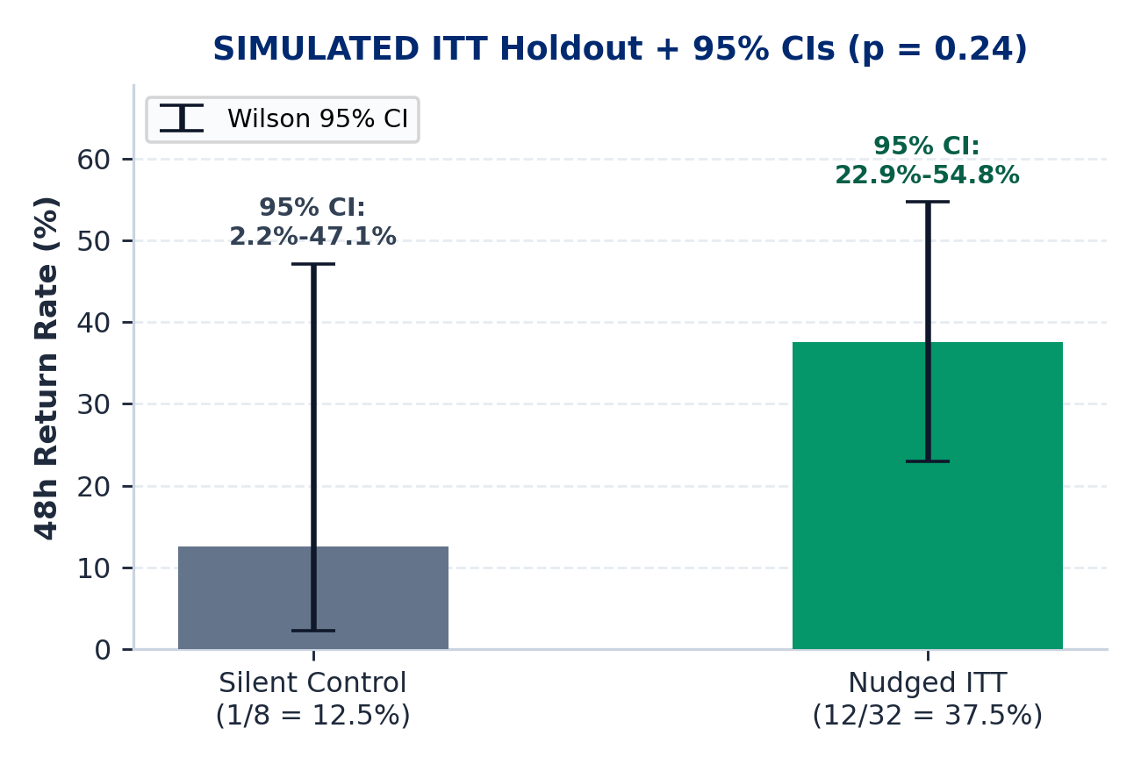
MAIN 4 / 5 : SIMULATED ITT PROOF & PROFIT MATH
PaytmAI VyaparVoice | Team SemiTechnical (Kevin Joseph)
Intention-to-Treat Holdout, Power & Merchant Net Profit
Simulated ITT Return: 12/32 nudged (37.5%) vs 1/8 control (12.5%); Fisher p = 0.24; simulated 12 equals the Rs 300 cap (0 refused).
Sample Requirement: Single wave (N=40) is directional; 25 pp lift needs 31C + 124T = 155 (~4 store-waves) or 46/arm at 50/50.
Sales vs Subsidy: 8 net visits = Rs 1,740 sales (5.8x sales/promo); 4 organic returners absorb Rs 100 cashback.
Merchant Net Profit: At 30% margin: Rs 522 GP (1.74x); +Rs 222 pre-fee (+74%), +Rs 91.50 after Rs 130.50 fee.
5% Fee Base: Rs 130.50 = 5% of all Rs 2,610 redeemed bills (12 bills, including organic returners).
CAP & BREAK-EVEN DISCLOSURE (SIMULATED)
Simulated 12 returners = 12 x Rs 25 = Rs 300 hard spend stop (42.2% overrun risk at p=37.5% triggers >10% alert; suggests Rs 400 cap).
Break-even margin: 17.2% pre-fee | 24.7% post-fee.
Break-even lift (30% margin): +7.8 pp pre | +15.3 pp post.
Intention-to-Treat (ITT) Definition: Compares all 32 assigned nudged buyers vs all 8 assigned silent controls regardless of redemption or cap stops, preventing selection bias and keeping lift invariant if the cap binds.
Paytm Build for India AI Hackathon (Bengaluru Track 1) | Traced to results/slide_numbers.md (Deck v2.1)
Main 4 / 5 (Slide 4 / 16)
Notes:
Slide 4 defines Intention-to-Treat: we compare every buyer assigned to receive an offer against every buyer assigned to silent control regardless of whether they redeem or hit the spend stop. In our simulated wave, 12 of 32 nudged buyers return versus 1 of 8 in control, with Fisher exact p equals 0.24, where the simulated 12 returning buyers equals the 12-redemption Rs 300 cap. At a 30 percent store margin, Rs 522 gross profit minus Rs 300 cashback leaves Rs 222 pre-fee, and Rs 91.50 after Paytm's Rs 130.50 5 percent fee levied on all Rs 2,610 redeemed bills including organic returners; post-fee break-even lift is plus 15.3 percentage points.

Slide 5
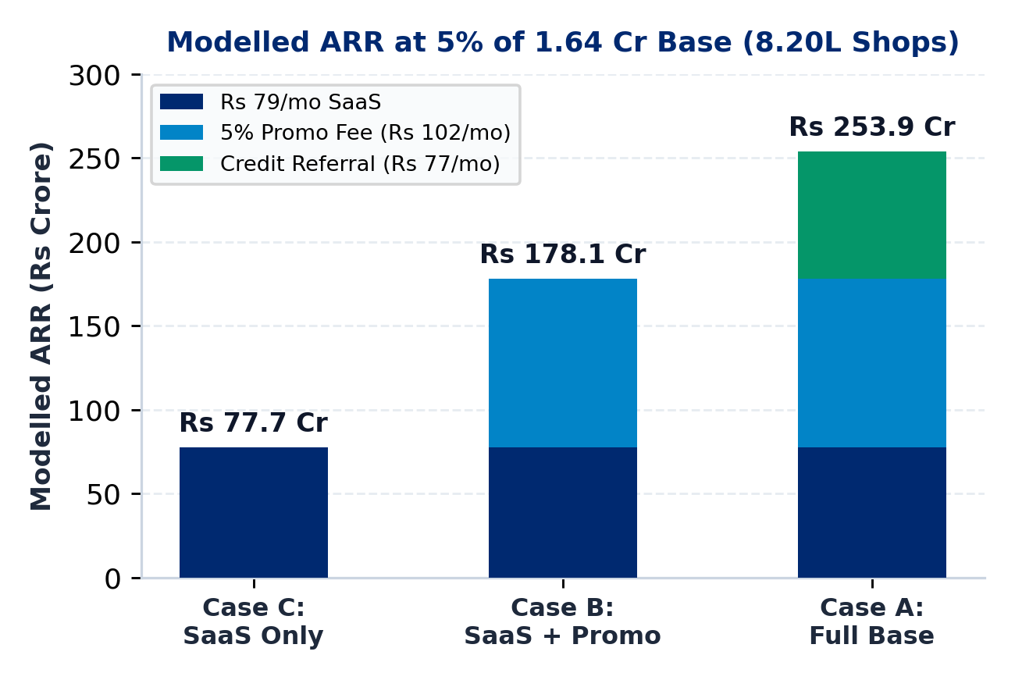
MAIN 5 / 5 : BUSINESS MODEL & POOLED PILOT
PaytmAI VyaparVoice | Team SemiTechnical (Kevin Joseph)
Three Revenue Cases (8.20L Shops) & 50-Shop Pooled Pilot
Case C (SaaS Only): Rs 79/mo Soundbox add-on x 8.20L shops = Rs 77.7 Cr ARR (zero promo/credit fees).
Case B (Core Excl. Credit): +Rs 102/mo steady promo fee (~0.78 waves/mo, Rs 2,040 redeemed bills) = Rs 178.1 Cr ARR.
Case A (Full Base): +Rs 77/mo credit referral (~7% loan pen. Assumption) = Rs 253.9 Cr ARR.
Unit COGS & Margin: Rs 48/mo cached (Rs 5 AI + Rs 43 msg; 81.4% margin) vs Rs 71.80 uncached TTS (72.2%).
Pooled 50-Shop Pilot: 50 shops x 1 wave (~400C + ~1,600T, stratified by shop): 83.3% power at +6 pp, 97.2% at +8 pp.
Q2 FY27 BASE & FEE RECONCILIATION
5% of 1.64 Cr subscription merchants (Reported: Paytm Q2 FY27, 26 Oct 2026) = 8.20L shops.
1 backlog wave = Rs 130.50 fee; steady state (~0.78 waves/mo) = Rs 102/mo.
Why Pool 50 Shops (Not 4 Waves/Shop): 14d cooldown & ~0.78 waves/mo replenishment preclude 4 weekly waves in 1 shop; pooling 50x1 gives 50.3%/68.8%/83.3%/92.5%/97.2%/99.8% power at +4/+5/+6/+7/+8/+10 pp.
Paytm Build for India AI Hackathon (Bengaluru Track 1) | Traced to results/slide_numbers.md (Deck v2.1)
Main 5 / 5 (Slide 5 / 16)
Notes:
Slide 5 updates our scale model to Paytm's Q2 FY27 base of 1.64 crore subscription-paying merchants: 5 percent adoption equals 8.20 lakh shops, yielding Rs 77.7 crore ARR on SaaS alone, Rs 178.1 crore adding steady-state promo fees of Rs 102 per month at 0.78 waves per month, and Rs 253.9 crore in our full base case. Rather than claiming a single store runs four full waves in four weeks, which would conflict with our 14-day cooldown and 0.78 waves per month replenishment rate, our pilot pools one wave across 50 shops for roughly 400 control and 1,600 nudged customers stratified by shop, achieving 83.3 percent power at a 6-point lift and 97.2 percent at an 8-point lift.

Slide 6
APPENDIX A1 | TRACK 1: MERCHANT GROWTH AI (UPDATED TO PAYTM Q2 FY27)
PaytmAI VyaparVoice
Closing-Time Voice Growth, Operations & Retention Copilot
Built for Paytm's 1.64 Cr subscription-paying merchant deployments (Reported: Paytm Q2 FY27 release, 26 Oct 2026). Combines deterministic SQL segmentation, ITT spend-cap accounting, and plain-language voice briefings.
01 : Plain Voice + Button
02 : ITT Cap-vs-Holdout
03 : 50-Shop Pooled Pilot
EN author-checked, native review pending; KN/HI draft
All 32 nudged get passes; Rs 300 hard spend stop & >10% risk alert
+Rs 91.50 post-fee; 400C+1,600T gives 83.3% power at +6 pp lift
TEAM: SemiTechnical | Member: Kevin Joseph | Live: paytmai-vyaparvoice.onrender.com
Deck v2.1 Status: Stage 1 verified (stage1-ok); pooled 50-shop power, ITT definition, and copy disclosures applied.
Notes:
Appendix A1 summarizes our Q2 FY27 attribution, copy review status, Intention-to-Treat cap accounting, and pooled 50-shop pilot design.

Slide 7
APPENDIX A2 : PROBLEM & Q2 FY27 SOURCES
PaytmAI VyaparVoice | Team SemiTechnical (Kevin Joseph)
Problem Details, Primary Paytm Q2 FY27 Sources & Synthetic Persona
1. Silent Repeat Churn (25% to 35% Yearly - ASSUMPTION)
Merchants hear isolated payment alerts without customer-level retention tracking, losing repeat buyers before cashflow drops are noticed.
2. Dashboard Friction (<8% WAU - ASSUMPTION)
Counter-operated kirana, darshini, and pharmacy shops lack time to write prompts, export CSVs, or configure CRM rules.
3. Slow Hours & Rush Prep (SYNTHETIC STORE)
Reported (Paytm Q2 FY27, 26 Oct 2026): 1.64 Cr subscription-paying merchants, Rs 7.1L Cr merchant GMV, Rs 2,648 Cr operating revenue.
Assumptions vs Synthetic: ~7% merchant loan pen. & Rs 90-100/mo Soundbox fee (Assumptions); Ramesh Rao store is synthetic (917 scans/30d).
In our 60-day synthetic Indiranagar ledger, 3 to 5 PM scans fall 70% below peak while weekend morning rushes risk staple stockouts.
Paytm Build for India AI Hackathon (Bengaluru Track 1) | Traced to results/slide_numbers.md (Deck v2.1)
Appendix A2 (Slide 7 / 16)
Notes:
Appendix A2 cites Paytm's 26 October 2026 Q2 FY27 earnings release for merchant subscriptions, GMV, and operating revenue, while tagging ~7 percent merchant loan penetration and Rs 90 to 100 monthly Soundbox rental as assumptions.

Slide 8
APPENDIX A3 : 3-PILLAR MAPPING
PaytmAI VyaparVoice | Team SemiTechnical (Kevin Joseph)
Track 1 Coverage: Growth, Operations, and Customer Recovery
PILLAR 1 : GROW BUSINESS
PILLAR 2 : MANAGE OPERATIONS
PILLAR 3 : SERVE CUSTOMERS
Retention & Slow-Hour Copilot
Rush Prep & Credit Signals
Privacy-Safe Service Recovery
Churn Detection (Built): SQL flags regulars silent 16+ days (16-38d in synthetic DB).
Slow-Hour Group (Built): Identifies 3-5 PM snack buyers (55 detected, 34 eligible).
ITT Spend Stop (Built): Issues passes to all nudged buyers; atomic cap stops spend.
QR Coupon Hook (Planned): Production hook into Paytm QR redemption rail.
Rush Alert (Simulated): Flags weekend morning demand spikes from scan history.
Supplier PO (Simulated): Dispatches pre-filled WhatsApp restock (+18L milk, +12kg batter).
Dual Ledgers (Built): Separates merchant cashback stop from 30% Sarvam credit cap.
Credit Signal (Planned): Feeds verified cashflow stability to partner NBFC funnel.
Delay Tagging (Simulated): Flags peak-hour queue delays and 3-star feedback tags.
Goodwill Pass (Simulated): 1-tap bilingual apology + Rs 30 next-scan coffee voucher.
Zero PII Leakage (Built): No raw phone numbers or payer IDs ever leave SQLite.
DPDP & Cooldown (Built): Hard opt-in filter and 14-day per-payer anti-spam cooldown.
Paytm Build for India AI Hackathon (Bengaluru Track 1) | Traced to results/slide_numbers.md (Deck v2.1)
Appendix A3 (Slide 8 / 16)
Notes:
Appendix A3 maps built modules, simulated MVP flows, and planned Paytm production hooks across Track 1's three pillars.

Slide 9
APPENDIX A4 : ITT WORKFLOW & SPEND STOP
PaytmAI VyaparVoice | Team SemiTechnical (Kevin Joseph)
Intention-to-Treat Cap-vs-Holdout & Late-Arrival Handling
STEP 1 : PASS ISSUANCE
STEP 2 : >10% & 80% ALERTS
STEP 3 : INDEPENDENT DRAW
STEP 4 : ITT & DECLINE LOG
Filter 48 -> 40 eligible (80/20: 32 nudged, 8 control). Issue Rs 25 passes ('valid while shop offer budget lasts') to ALL 32 nudged buyers (Rs 800 face).
At approval, P(Binomial(32, 0.375) > 12) = 42.2% (>10% alert -> suggests Rs 400 cap). Live at 80% cap (10/12 paid), prompt merchant 1-tap top-up.
48h simulator draws customer return visits independently of max_budget first, then applies atomic BEGIN IMMEDIATE stop at Rs 300 (12 paid).
After cap, normal UPI clears, cashback withholds, refused_redemptions + audit_log increment (brand risk tracked). ITT (32 vs 8) stays unchanged.
DISCLOSED BRAND RISK & VERIFIED INVARIANCE TESTS
Post-Cap Customer Experience & Brand Risk: Pass terms state 'valid while shop offer budget lasts'; declining a 13th regular still risks counter disappointment, so overrun alerts, 80%-cap top-up prompts, and logged declines are mandatory.
Automated Concurrency & ITT Tests: 25-thread simultaneous scan test verifies budget_spent == Rs 300 (12 paid, 13 refused); multi-seed test proves ITT holdout comparison is identical whether cap is Rs 800 or Rs 100.
Paytm Build for India AI Hackathon (Bengaluru Track 1) | Traced to results/slide_numbers.md (Deck v2.1)
Appendix A4 (Slide 9 / 16)
Notes:
Appendix A4 details customer pass terms, proactive top-up prompts, decline logging, counter brand risk, and our verified concurrency and ITT invariance tests.

Slide 10
APPENDIX A5 : SYSTEM ARCHITECTURE
PaytmAI VyaparVoice | Team SemiTechnical (Kevin Joseph)
Component Status: Built vs Pending vs Production Plan
TOUCHPOINTS
[BUILT] Merchant & Technical View UI
[BUILT] 1-Tap & Voice Chip Fallback
[PLANNED] Soundbox 4G Push & WhatsApp Cloud
VOICE & LLM
[BUILT] Browser Speech + SHA-256 Cache
[PENDING LIVE] Keyless Sarvam (30% Cap)
[STAGE 2] Keyless Groq Grounded English Q&A
CORE ENGINE
[BUILT] FastAPI + TTL/LRU/Byte Sessions
[BUILT] 5-Rule Guardrails + Jargon Lint
[BUILT] ITT Fisher/Wilson/Power + Profit ROI
DATA & OPS
[BUILT] Atomic SQLite Spend-Stop Ledger
[BUILT] Automated Preflight + Stress Suite
[PLANNED] PostgreSQL & Redis Cluster
Paytm Build for India AI Hackathon (Bengaluru Track 1) | Traced to results/slide_numbers.md (Deck v2.1)
Appendix A5 (Slide 10 / 16)
Notes:
Appendix A5 maps built modules, pending live sponsor keys, and planned production infrastructure.

Slide 11
APPENDIX A6 : POSITIONING (USP)
PaytmAI VyaparVoice | Team SemiTechnical (Kevin Joseph)
Differentiation vs Manual Khata Apps and Generic Chatbots
Dimension | Manual BI / Khata Apps | Generic LLM Chatbots | PaytmAI VyaparVoice
Merchant UX | Charts & manual ledger entry | Requires typing business prompts | 8:30 PM plain voice brief + 1-tap button
Customer Graph | Incomplete manual phonebooks | No link to payment history | Paytm QR repeat-payer IDs (synthetic in MVP)
Financial Safety | Manual coupon rules | LLM can invent unsafe offers | Deterministic floor, atomic spend stop & >10% alert
Privacy (DPDP) | Raw phone lists exposed | Prompt data leakage risk | SQL opt-in filter; zero PII sent to voice/LLM
Causal Proof | Vanity message counts | No comparison group | 80/20 ITT holdout + 50-shop stratified pilot
Paytm Build for India AI Hackathon (Bengaluru Track 1) | Traced to results/slide_numbers.md (Deck v2.1)
Appendix A6 (Slide 11 / 16)
Notes:
Appendix A6 compares VyaparVoice against manual dashboards and unconstrained LLM chatbots.

Slide 12
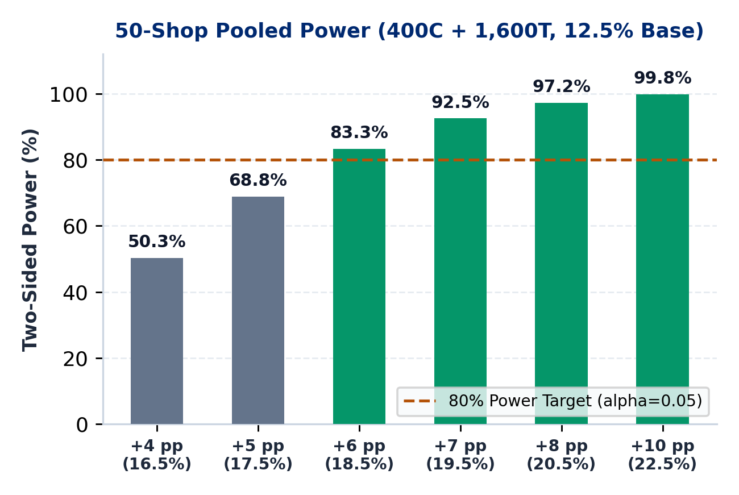
APPENDIX A7 : POOLED POWER & TARGETS
PaytmAI VyaparVoice | Team SemiTechnical (Kevin Joseph)
50-Shop Stratified Power (400C + 1,600T) & Pilot Targets
POOLED 50-SHOP X 1-WAVE POWER (12.5% BASELINE, ALPHA=0.05)
Why Pool Stores: 50 shops x 1 wave (~400C + ~1,600T, stratified by shop); avoids claiming 1 shop runs 4 waves in 4w under a 14d cooldown (~0.78 waves/mo).
Exact Power Curve: +4 pp: 50.3% | +5 pp: 68.8% | +6 pp: 83.3% | +7 pp: 92.5% | +8 pp: 97.2% | +10 pp: 99.8%.
Break-Even Lift: +7.8 pp pre-fee (20.3%) and +15.3 pp post-5%-fee (27.8% at 30% shop margin; >99.9% power).
ECOSYSTEM HYPOTHESES (UNVALIDATED PILOT TARGETS)
Repeat & Waste Targets: +14% to +22% repeat visits; -18% afternoon perishable loss (PILOT TARGETS).
Device & QR Share: -35% Soundbox churn; +12% to +15% store Paytm QR GMV lift (PILOT TARGETS).
Credit Funnel: Expand ~7% merchant loan pen. (ASSUMPTION) toward 15% (LONG-TERM TARGET).
83.3%
+15.3 pp
Rs 5.00
Power at +6 pp Lift
(400C + 1,600T)
Post-Fee Break-Even
(+7.8 pp Pre-Fee)
Cached AI Cost/Mo
(Rs 28.80 Uncached)
Paytm Build for India AI Hackathon (Bengaluru Track 1) | Traced to results/slide_numbers.md (Deck v2.1)
Appendix A7 (Slide 12 / 16)
Notes:
Appendix A7 presents the exact power curve for pooling 50 shops times one wave, yielding 400 control and 1,600 nudged buyers stratified by shop: 50.3, 68.8, 83.3, 92.5, 97.2, and 99.8 percent power for 4, 5, 6, 7, 8, and 10 point lifts above a 12.5 percent baseline.

Slide 13
APPENDIX A8 : UNIT ECONOMICS & FEE MATH
PaytmAI VyaparVoice | Team SemiTechnical (Kevin Joseph)
Q2 FY27 ARR Cases, Fee Reconciliation & TTS Cache Sensitivity
Stream 1 (SaaS - Rs 79/mo): Add-on to Soundbox (~Rs 90-100/mo rental ASSUMPTION) x 8.20L shops (5% of 1.64 Cr Q2 FY27 base) = Rs 77.7 Cr ARR.
Stream 2 (Promo Fee - Rs 102/mo): 5% fee on ALL redeemed bills incl. organic returners: 1 wave = Rs 130.50 (Rs 2,610 bills); steady state assumes ~0.78 waves/mo (Rs 2,040/mo bills) = Rs 102/mo (+Rs 100.4 Cr -> Rs 178.1 Cr ARR).
Stream 3 (Credit - Rs 77/mo): Amortized 1.5%-2.5% partner origination uplift (~7% loan pen. ASSUMPTION) -> +Rs 75.8 Cr (Rs 253.9 Cr ARR).
Cached COGS (Rs 48.00/mo): Rs 1.80 SLM + Rs 3.20 TTS (~88% phrase cache hit on Bulbul v3) + Rs 43 msg = 81.4% gross margin.
Uncached COGS (Rs 71.80/mo): Uncached Bulbul v3 (9k chars at Rs 30/10k = Rs 27 TTS) = 72.2% margin (39.2% cached margin on SaaS-only).
FEE & BASE RECONCILIATION
1. Fee Base: 5% applies to gross QR-redeemed promo bills including organic returners.
2. Cadence: Initial backlog wave yields Rs 130.50; steady replenishment (~0.78 waves/mo) yields Rs 102/mo.
3. Q2 FY27 Base: 5% x 1.64 Cr = 8.20L shops.
Paytm Build for India AI Hackathon (Bengaluru Track 1) | Traced to results/slide_numbers.md (Deck v2.1)
Appendix A8 (Slide 13 / 16)
Notes:
Appendix A8 reconciles the Rs 130.50 single-campaign fee on Slide 4 with the Rs 102 per month steady-state promo fee assumption and updates ARR to Paytm's 1.64 crore Q2 FY27 merchant base.

Slide 14
APPENDIX A9 : VALIDATION & GO / NO-GO DECISION RULE
From Verified Synthetic MVP to Pooled 50-Shop Stratified Pilot
STAGE A : BUILT & VERIFIED
STAGE B : POOLED 50-SHOP PILOT
STAGE C : PRODUCTION SCALE
Deterministic Core & Safeguards
Stratified Single-Wave Validation
Paytm Ecosystem Integration
FastAPI + TTL/LRU/byte-bounded SQLite sessions (204 KB/visitor)
ITT cap-vs-holdout, >10% alert, 25-thread concurrency & preflight
Keyless Sarvam mock selftest (30% cap) + banned-jargon lint
3-merchant counter teach-back across EN (author-checked), KN & HI (draft)
50 shops x 1 wave (~400C + ~1,600T, stratified by shop; 83.3% power at +6 pp)
Advance only if lower 95% bound of post-5%-fee net profit/nudged > 0 AND lift > break-even (+15.3 pp)
Bind Paytm QR dynamic coupon settlement & 4G Soundbox push
Enforce live 80%-cap merchant top-up prompt to protect counter goodwill
Scale across 8.20L target stores (Rs 77.7 Cr to Rs 253.9 Cr ARR)
PaytmAI VyaparVoice | Team SemiTechnical (Kevin Joseph)
Appendix A9 (Slide 14 / 16) | Go/No-Go: Lower 95% CI of Post-5%-Fee Net Profit/Nudged > Rs 0 AND Observed Lift > Break-Even Lift
Notes:
Appendix A9 states our exact pooled 50-shop stratified pilot design and go/no-go advancement rule: advance only if the lower 95 percent bound of net profit per nudged customer after the 5 percent fee is above zero and the observed lift exceeds the break-even lift.

Slide 15
APPENDIX A10 : DUAL SCORECARD & COPY LINT
PaytmAI VyaparVoice | Team SemiTechnical (Kevin Joseph)
Merchant Plain-Language View vs Technical Audit View
MERCHANT VIEW (ZERO JARGON - LINT VERIFIED)
TECHNICAL & AUDIT VIEW (ANALYST / JUDGE)
Plain Outcome Copy: Early check on one store wave (pool multiple shops to be sure): 12 of 32 with offer came back vs 1 of 8 without.
Clear Spend Stop: Your 300 rupee limit was reached after 12 paid redemptions (0 extra declined in base run).
Estimated Shop Profit: At 30% shop margin, estimated profit is Rs 222 before Paytm fee (Rs 91.50 after 5% fee).
Honest Copy Status: EN author-checked, native review pending; KN & HI carry visible [DRAFT - UNREVIEWED] badges.
ITT & Wilson 95% CIs: 37.5% [22.9%, 54.8%] vs 12.5% [2.2%, 47.1%]; two-sided Fisher exact p = 0.24.
Pooled Pilot Power: 50 shops x 1 wave (400C + 1,600T): 50.3%, 68.8%, 83.3%, 92.5%, 97.2%, 99.8% at +4..+10 pp.
Cap Risk & Refusals: Face exposure Rs 800; P(X > 12 | p=0.375) = 42.2% (>10% alert -> suggests Rs 400 cap).
Banned Merchant Terms: Automated regex blocks cohort, holdout, p-value, Fisher, Wilson, ROI, DPDP, RFM, ITT.
GRADE A : OBSERVED LEDGER
GRADE B : SIMULATED ITT
GRADE C : ASSUMPTIONS
SQLite store counts (240 payers, 1,613 scans, 48 silent -> 40 eligible; synthetic seed 20261025).
Randomized 32 vs 8 split, independent outcome draw, Fisher p & Wilson CIs (simulated).
30% shop gross margin, 5% fee on redeemed bills, ~0.78 waves/mo steady cadence.
Paytm Build for India AI Hackathon (Bengaluru Track 1) | Traced to results/slide_numbers.md (Deck v2.1)
Appendix A10 (Slide 15 / 16)
Notes:
Appendix A10 contrasts our jargon-free merchant scorecard with Technical View and reports honest copy review status across all three languages.

Slide 16
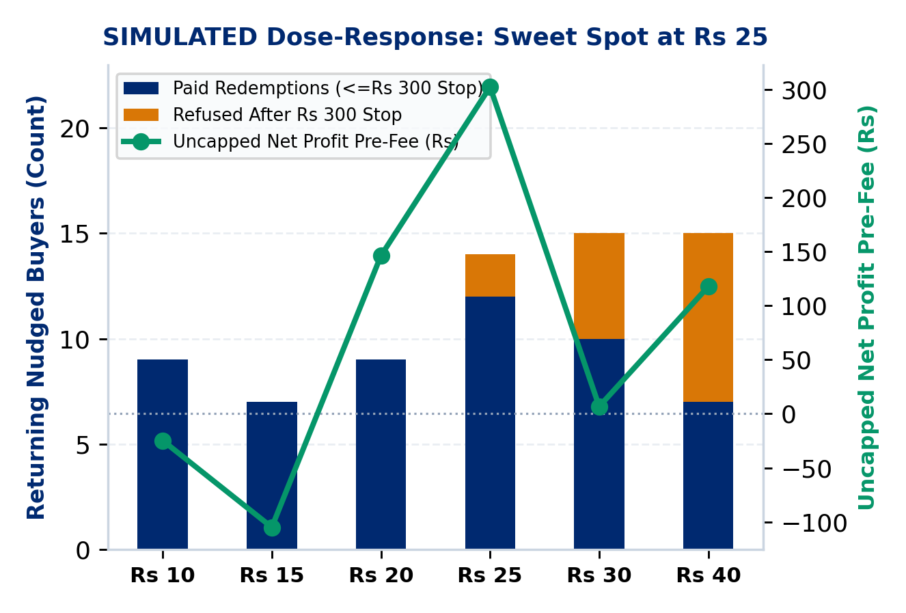
APPENDIX A11 : CAP LEDGERS & DOSE-RESPONSE
PaytmAI VyaparVoice | Team SemiTechnical (Kevin Joseph)
Merchant Spend Stop, Sarvam Credit Cap & Dose-Response Curve
Merchant Cashback Stop: Issues passes ('valid while budget lasts') to all 32 nudged buyers; SQLite lock stops spend at Rs 300 (12 paid) and logs declines.
Dose-Response Sweet Spot: In simulation, Rs 25 peaks uncapped profit: offers of Rs 30 to 40 erode uncapped net profit via organic subsidy AND trigger 5 to 8 cap refusals under a Rs 300 stop.
Margin & Lift Break-Even: At +25 pp simulated lift, shop breaks even at 17.2% margin pre-fee (24.7% post-fee); at 30% margin, break-even lift is +7.8 pp pre-fee (+15.3 pp post-fee).
Sarvam 30% Credit Ledger: Separate JSON ledger caps TTS <=15% and STT <=15% (30% total of 500 sponsor credits = 150 max) and halts fail-closed on HTTP 402/429/5xx.
Public Cloud Lock: PUBLIC_DEPLOY=true (auto-enabled on Render) hard-blocks live paid calls while SHA-256 audio cache replays at 0 credits.
DUAL CAP SUMMARY (SIMULATED & BUILT)
1. Merchant Cap: Protects shopkeeper pocket (Rs 300 stop; >10% overrun warning & 80% top-up prompt).
2. Sponsor API Cap: Protects hackathon credits (<=15% TTS, <=15% STT, fail-closed).
Paytm Build for India AI Hackathon (Bengaluru Track 1) | Traced to results/slide_numbers.md (Deck v2.1)
Appendix A11 (Slide 16 / 16)
Notes:
Appendix A11 shows how our simulated dose-response curve interacts with the Rs 300 spend stop and contrasts the merchant rupee cap against our separate 30 percent Sarvam API credit ledger.

