Slide 1

Multithread c# .net
Tornike Kikacheishvili

Slide 2
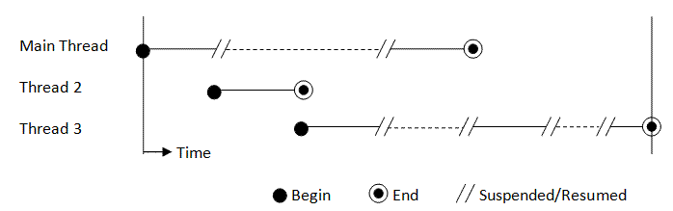
Structure

Slide 3

Priority
AvodeNormal 3
BelowNormal 1
Highest 4
Lowest 0
Normal 2
Example: thread.Priority = ThreadPriority.BelowNormal

Slide 4
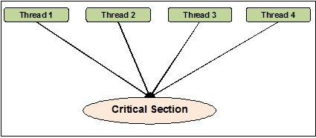
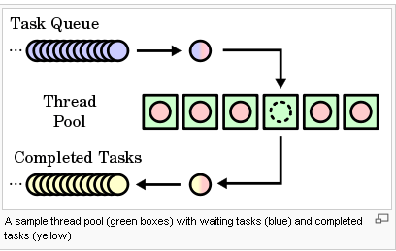
Sync
LOCK
MONITOR
MANUAL RESET EVENT
AUTO RESET EVENT
MUTEX
SEMAPHORE

