Slide 1

TailwindCSS
Tornike Kikacheishvili

Slide 2
Initial Release
v0.7.4
v1.9.6
v2.2.19
v3.0.24
May 2019

Slide 3
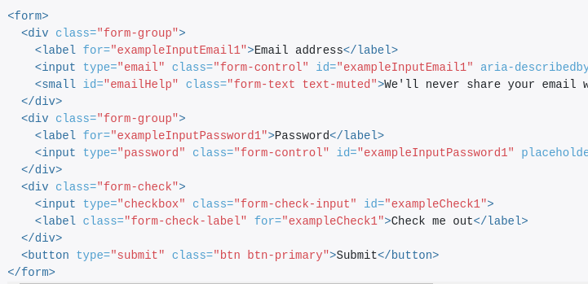
Old

Slide 4
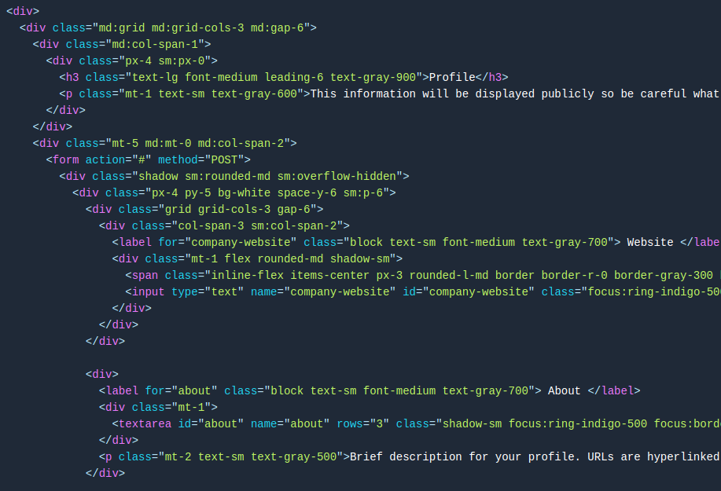

Slide 5
Example Time…

