Slide 1

Time Series-based Weather Forecasting
Mircea Meche
BIOSINF – IA2

Slide 2
Contents
Introduction
Dataset and methods
Architectures
Ablation studies
Results
Conclusions

Slide 3
Introduction
A time series is a sequence of data points recorded at various points in time
Predictions can be made using statistical analysis over a time series
The process can be automated with the help of neural networks

Slide 4
Dataset and methods
Multiple datasets for weather forecast available: Jena Climate, Weather5K, multiple community-made datasets (ex: Kaggle Time Series dataset)
Dataset was analyzed for seasonality/periodicity
Several features were extracted and used
Split: ~70% for training, only training and testing
Data is normalized before use

Slide 5
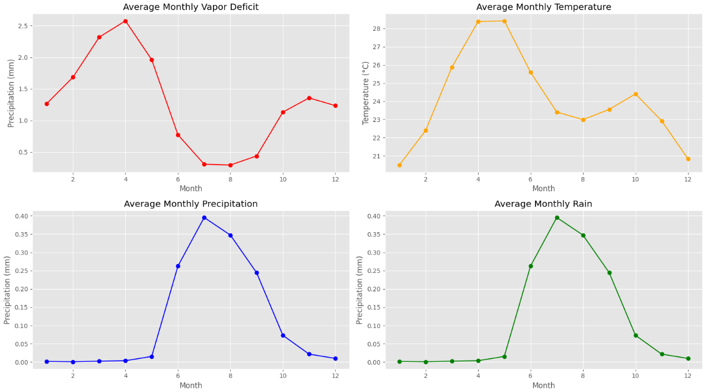
Monthly data vizualization

Slide 6
Architectures and ablation studies
Architectures: LSTM, GRU, CNN
Architectures were chosen due to their prevalence in consulted sources
Ablation study #1: data augmentation / depravation
Ablation study #2: architecture augmentation
Ablation study #3: hybrid architecture LSTM-CNN

Slide 7
Results
Across the 3 ablation studies, LSTM obtained best overall results
In theory, LSTM-CNN should be the best architecture
GRU should offer better portability (lower inference time)

Slide 8
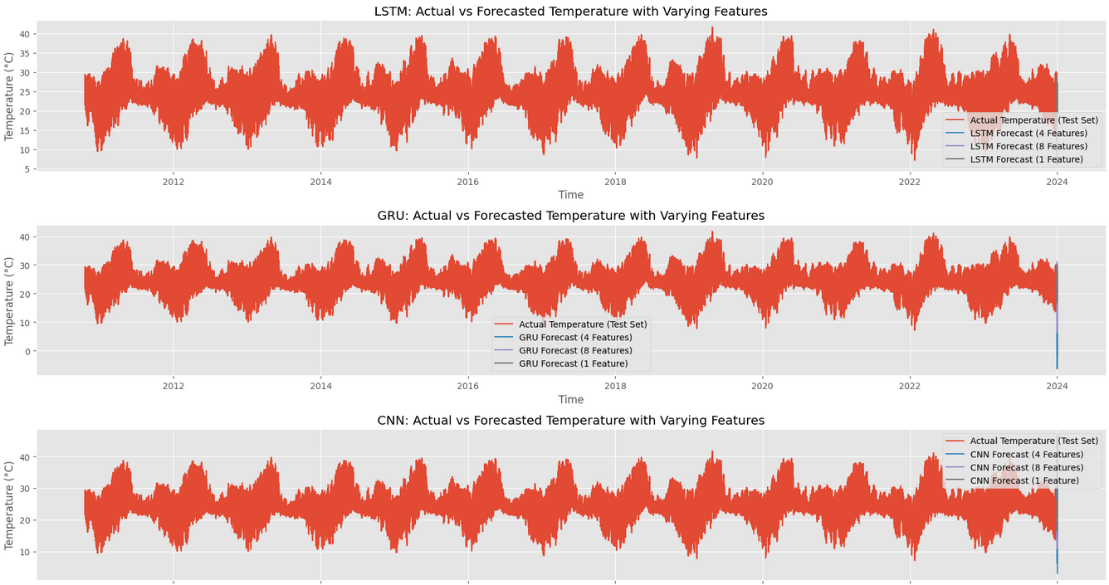
Prediction results (Study #1)

Slide 9
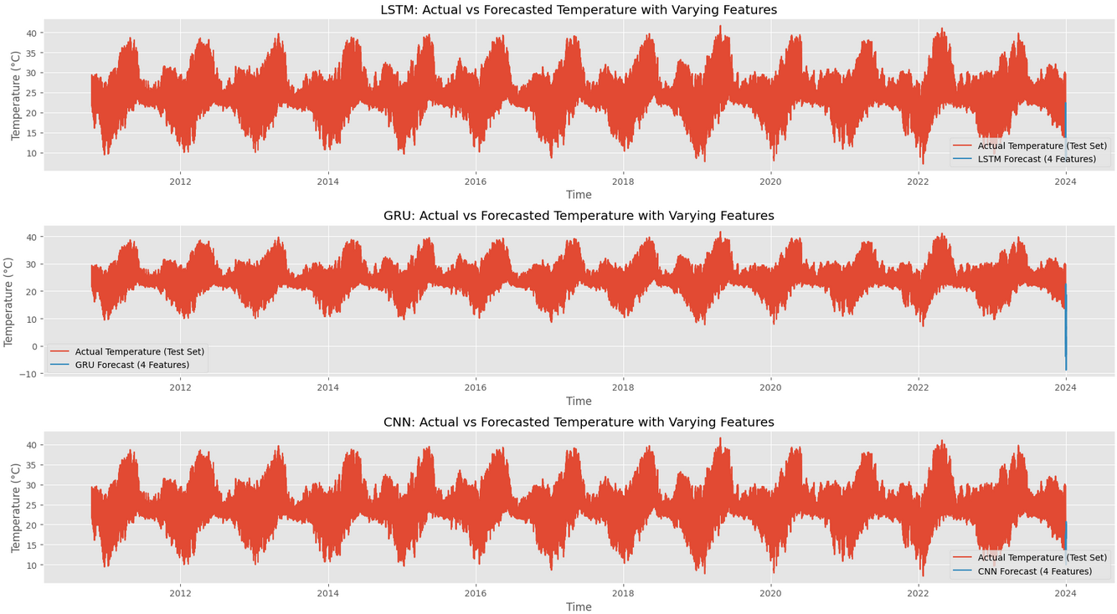
Prediction results (Study #2)

Slide 10
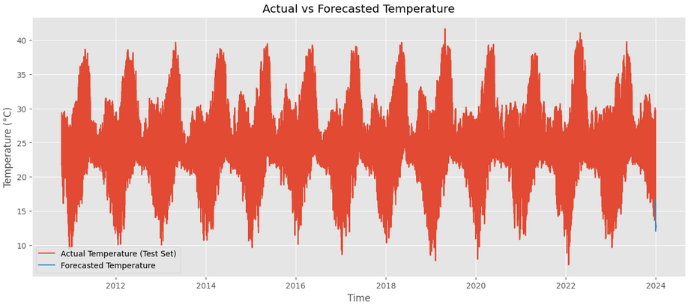
Prediction results (Study #3)

Slide 11
Conclusions
Future plans: apply methods and fixes to testing procedure, better ablation studies, implementation on real task
Overall results show that the LSTM/GRU is the best system when both dimensionality and performance is concerned
Mistakes and limitations:
1. Normalization applied across the entire dataset, not just on the training dataset
2. Predictions only done for one parameter while training on 1 or more parameters

