Slide 1

IA3 – Adversarial Neural Networks Project
Voicu Eduard-Andrei Meche Mircea-Ionut
BIOSINF 2025

Slide 2
Table of contents
Introduction
Network Architecture
Attacks
Defenses
Results

Slide 3
Introduction
Task: object recognition
Defenses: Adversarial Training, Jacobian Regularization
Attacks: PGD, DeepFool

Slide 4
Neural Architecture
CNN architecture:
  Convolution, 32 neurons, 3x3 kernel
  Batch Normalization
  LeakyReLU activation
  Max Pooling, 3x3 kernel
  Convolution, 64 neurons, 3x3 kernel
  Batch Normalization
  LeakyReLU activation
  Max Pooling, 3x3 kernel
  Flatten
  Dropout 0.5
  Dense, 10 neurons
MNIST classification, split into training, validation and testing
K-Fold training

Slide 5

Attacks
Projected Gradient Descent
DeepFool

Slide 6
Projected Gradient Descent
(PGD)
Iterative attack that repeatedly applies Fast Gradient Sign method and projects the result back into the epsilon-ball around the attack
The algorithm:
  Take image and compute gradient loss with respect to input
  Increase loss in steps and project result back into a valid range, perturbation remains bounded
  Repeat
The maximum allowed perturbation dictates how far the loss should be decreased

Slide 7
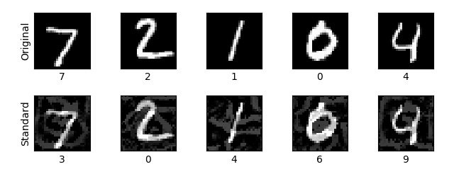
PGD

Slide 8
DeepFool
Iterative attack that find the minimal perturbation necessary to change the classification by linearizing the decision boundary and moving towards it:
The algorithm:
  Calculate the distance to each decision boundary and find the closest one
  Take a step towards said boundary, repeat until misclassification occurs
PGD minimizes confusion, DeepFool finds minimal perturbation for misclassification

Slide 9
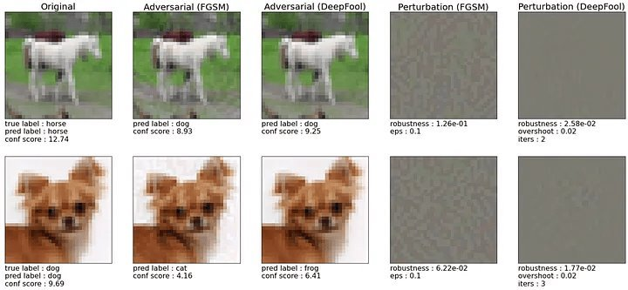
DeepFool

Slide 10
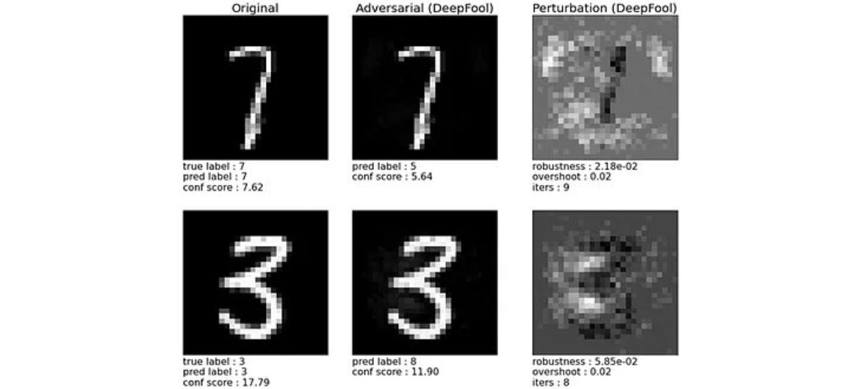
DeepFool

Slide 11
PDG vs DeepFool

Slide 12
Aspect | PGD | DeepFool
Working Principle | Maximizes misclassification probability – maximization of loss | Approximates and crosses decision boundary with minimal "effort"
Result | Strong but possibly larger perturbations | Minimal and often imperceptible perturbations.
Computation per step | Low | High
Iterations | Many (small steps) | Few (larger adaptive steps)
Outcome | Strong adversarial examples | Minimal perturbations

Slide 13
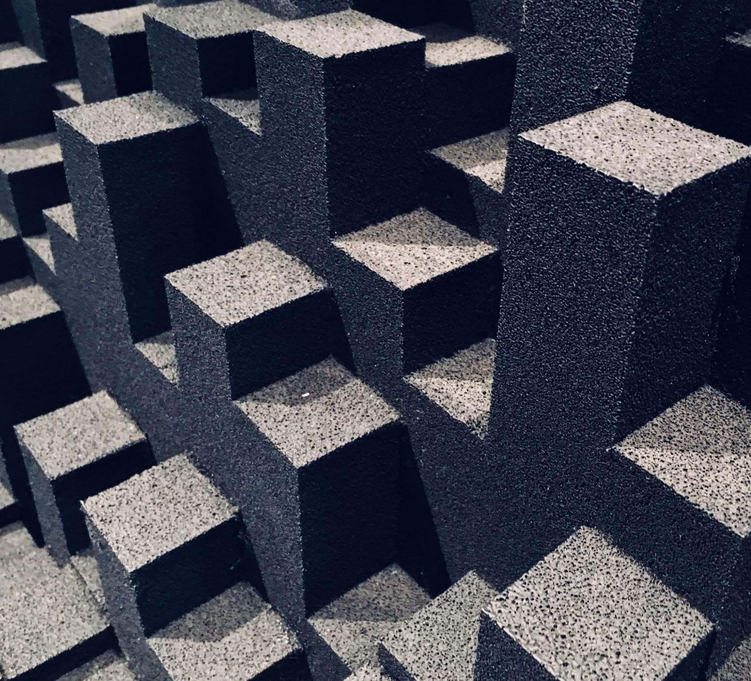
Defenses

Slide 14
Adversarial Training
Algorithm:
  Generate adversarial example based on current batch
  Combine both clean and adversarial examples
  Train on both types of data
A very common attack type used for adversarial examples is Fast Gradient Sign Method (single-iteration PGD)

Slide 15
Jacobian Regularization
The Jacobian matrix contains all partial derivatives of the network outputs with respect to the input
The idea of Jacobian regularization is to add a penalty term in the formula to discourage large gradients with respect to the input, thus resulting in a more robust model
Algorithm:
  Compute classification loss as usual
  Compute regularization term based on input gradient magnitude
  Combine and update the model
A higher penalty term increases robustness; however, this comes at the cost of accuracy

Slide 16

Results

Slide 17
Final architectural experiments
After several iterations (MNIST classification, CIFAR10 classification, YOLO on VisDrone2019), we ultimately decided on a CNN for CIFAR10 classification, motivated by time and performance constraints
After making custom implementations of the chosen attacks and defenses, they were compared to the implementations from IBM Research Adversarial Robustness Toolbox (ART)
Jacobian Regularization did not have enough widespread adoption in popular libraries, and such wasn't considered for benchmarking

Slide 18
Custom implementations (5 folds) accuracy
Attacks | Normal training | Adversarial training | Jacobian regularization
Clean | 79.2% | 48.3% | 10%
PGD | 0.01% | 30.7% | 10%
DeepFool | 11.45% | 21.2% | ?%

Slide 19
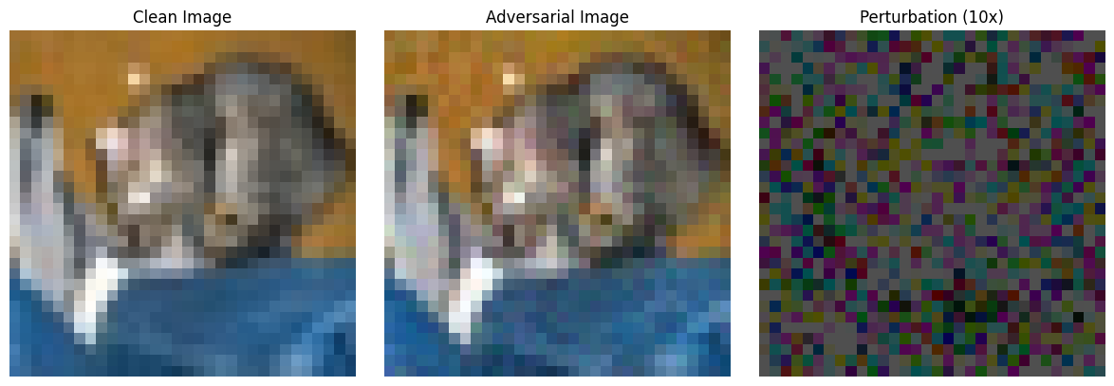
Clean vs Adversarial images

Slide 20
Custom implementations vs state-of-the-art (3 epochs), base acc = 61.79%
Attacks | Statistics | Custom | SotA
PGD | Accuracy | 2.9% | 13.4%
 | Avg. t / Batch [s] | 0.03 | 0.208
DeepFool | Accuracy | 14% | 20.5%
 | Avg. t / Batch [s] | 0.124 | 30.77

Slide 21
Questions?

